Slide 1
Generative AI and Large Language Models
S. Visa, 2024

Slide 2
Example of an LLM run via replicate for Python [let’s run it in DataSpell]
A Beginner's Guide to LLMs – What's a Large-Language Model and How Does it Work? by Bhavishya Pandit
https://www.freecodecamp.org/news/a-beginners-guide-to-large-language-models/
import os
import replicate # pip install replicate
# Get your token from -> https://replicate.com/account/api-tokens os.environ["REPLICATE_API_TOKEN"] = "TOKEN"
api = replicate.Client(api_token=os.environ["REPLICATE_API_TOKEN"])
# Running llama3 model using replicate
output = api.run( "meta/meta-llama-3-70b-instruct", input={"prompt": 'Hey how are you?'} )
# Printing llama3's response
for item in output:
print(item, end="")

Slide 3
[Some] Resources – Understand transformers in LLMs
How large language models work, a visual intro to transformers | Chapter 5, Deep Learning, by 3Blue1Brown [class video] (27min)
https://www.youtube.com/watch?v=wjZofJX0v4M
Attention in transformers, visually explained | Chapter 6, Deep Learning
https://www.youtube.com/watch?v=eMlx5fFNoYc (26min)
The moment we stopped understanding AI [AlexNet] by Welch Labs
https://www.youtube.com/watch?v=UZDiGooFs54
[Very nice video explaining that AI means scale in computing, see LeNet(1989) to AlexNet(2012) to ChatGPT(2022)]

Slide 4
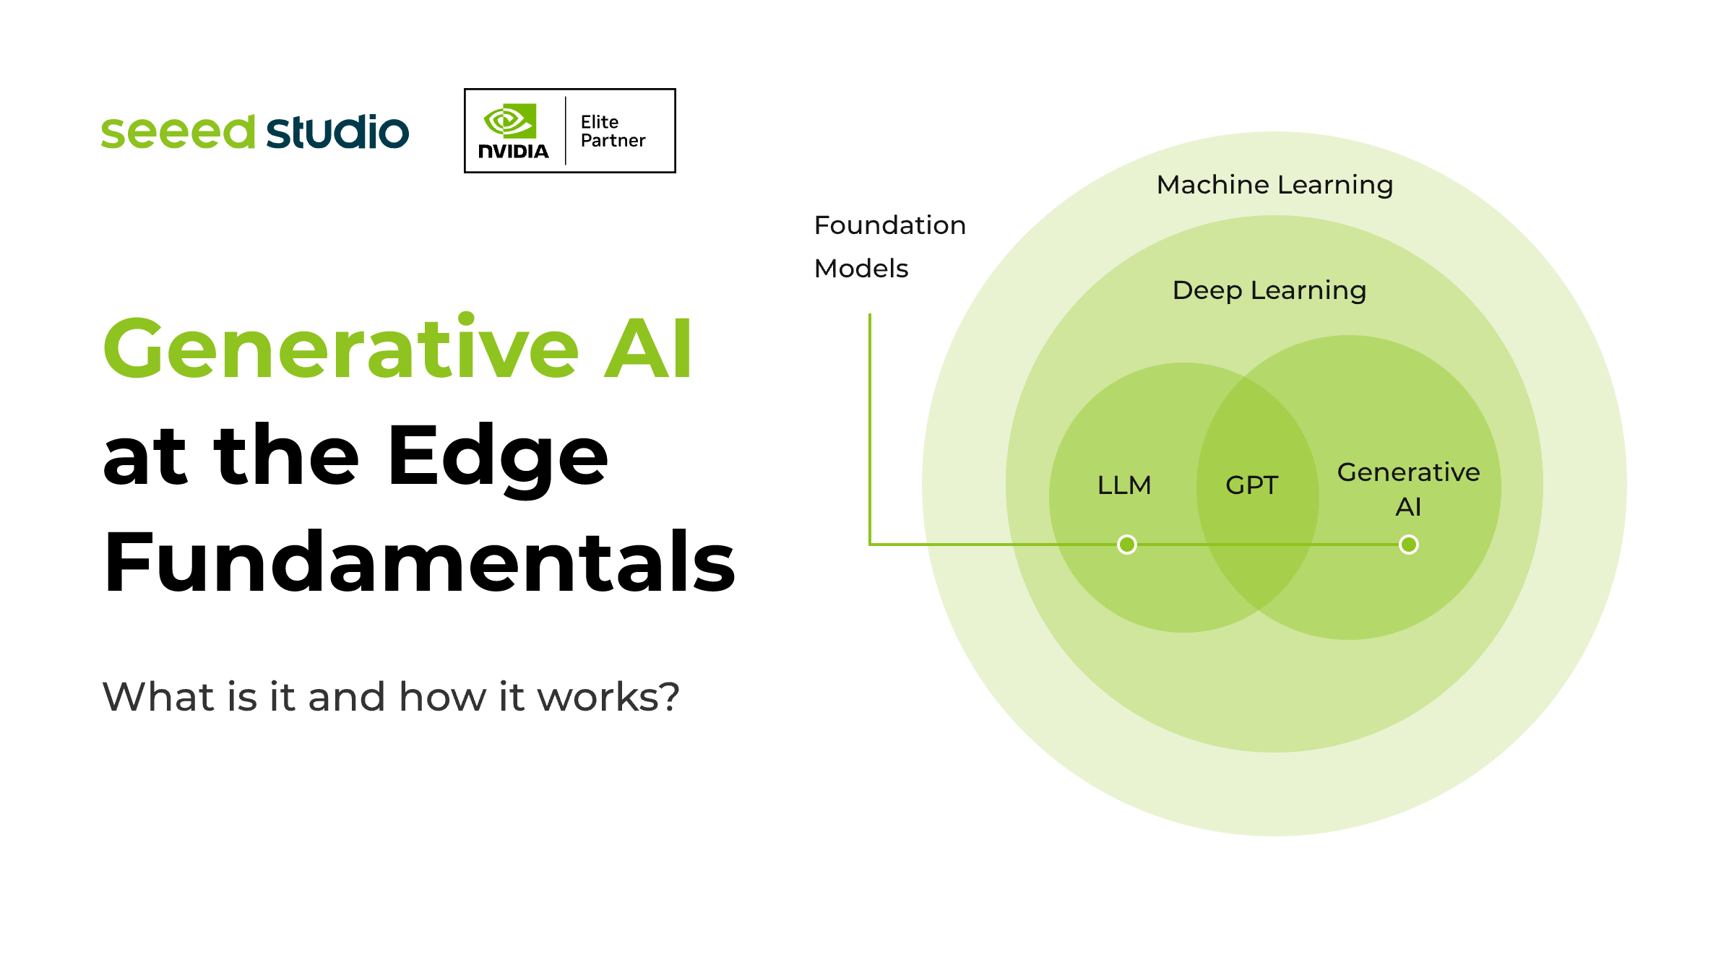
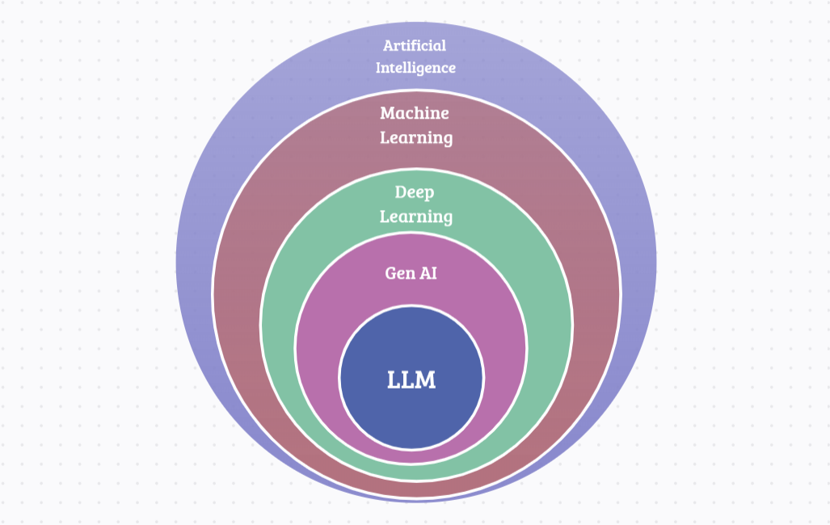
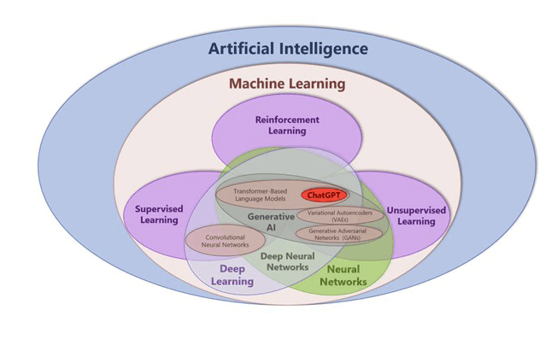
(1) Gen AI vs LLMs vs others

Slide 5
Top 11 Gen AI tools in 2024
https://www.turing.com/resources/generative-ai-tools

Slide 6
A historic moment
What is an LLM? A Guide on Large Language Models and How They Work, by Javier Canales Luna
https://www.datacamp.com/blog/what-is-an-llm-a-guide-on-large-language-models

Slide 7
Steps in learning this new tech
Where to get started with GenAI, by Priyanka Vergadia and Alex Xu
https://blog.bytebytego.com/p/where-to-get-started-with-genai

Slide 8
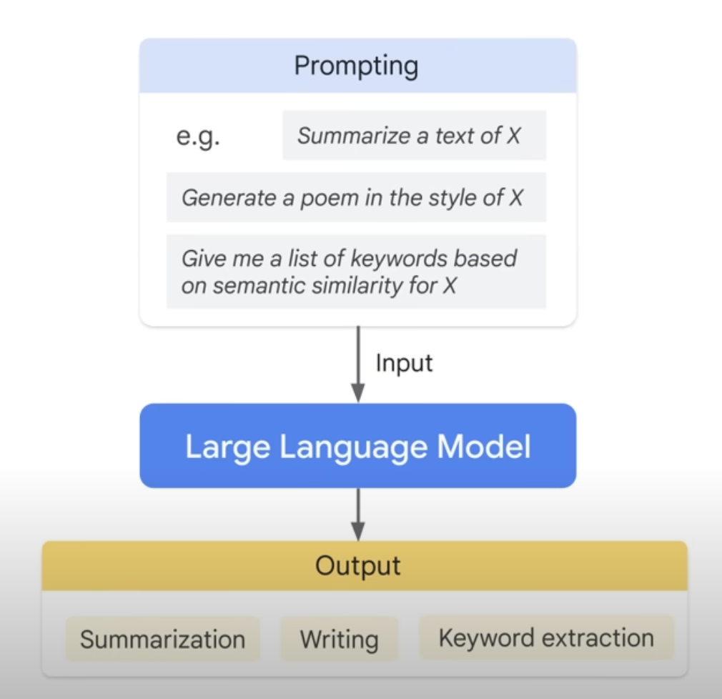
(2) What can LLM do?
Predict next most likely word (generative); context matters!
Prompt1: I am a child. Complete this sentence: The cat on the...
Sure! How about this: “The cat on the mat was taking a cozy nap.” 🐱
Prompt2: I am an adult. Complete this sentence: The cat on the...
Alright! How about this: “The cat on the windowsill watched the world go by with curious eyes.”
Prompt3: I am a child who likes books from Dr. Seuss. Complete this sentence: The cat on the...
How fun! Here’s a Seuss-inspired twist: “The cat on the hat sat flat and that was that!”
Take instructions
Dialog (special step 2)

Slide 9
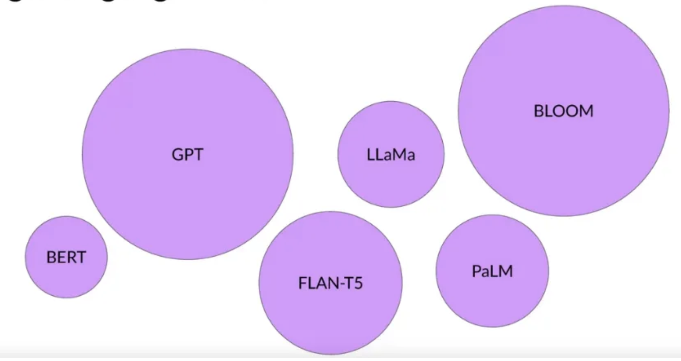
LLMs
Introduction to LLMs and the generative AI : Part 1 — LLM Architecture, Prompt Engineering and LLM Configuration, by Yash Bhaskar https://medium.com/@yash9439/introduction-to-llms-and-the-generative-ai-part-1-a946350936fd
What is an LLM? A Guide on Large Language Models and How They Work, by Javier Canales Luna
https://www.datacamp.com/blog/what-is-an-llm-a-guide-on-large-language-models
Use transformers = special NN architecture
First LLMs:
BERT (2018; Google; open source)
GPT-1 (OpenAI)
LLaMa2 (Meta)
Come pre-trained; GPT-4 has 1.8 trillion params
Fine tuning with human reviewers via reinforcement learning
Applications: ChatGPT powered by GPT-3.5

Slide 10
(3) What can Generative AI do
Text to text
Text to images
Image to image
Text+image to image
To generate images
DALL-E 2 by OpenAI – not free
Midjourney – not free
Stable Diffusion – free available to use; they offer the trained weights and everyone can build from it; see next example from Deeplizard

Slide 11
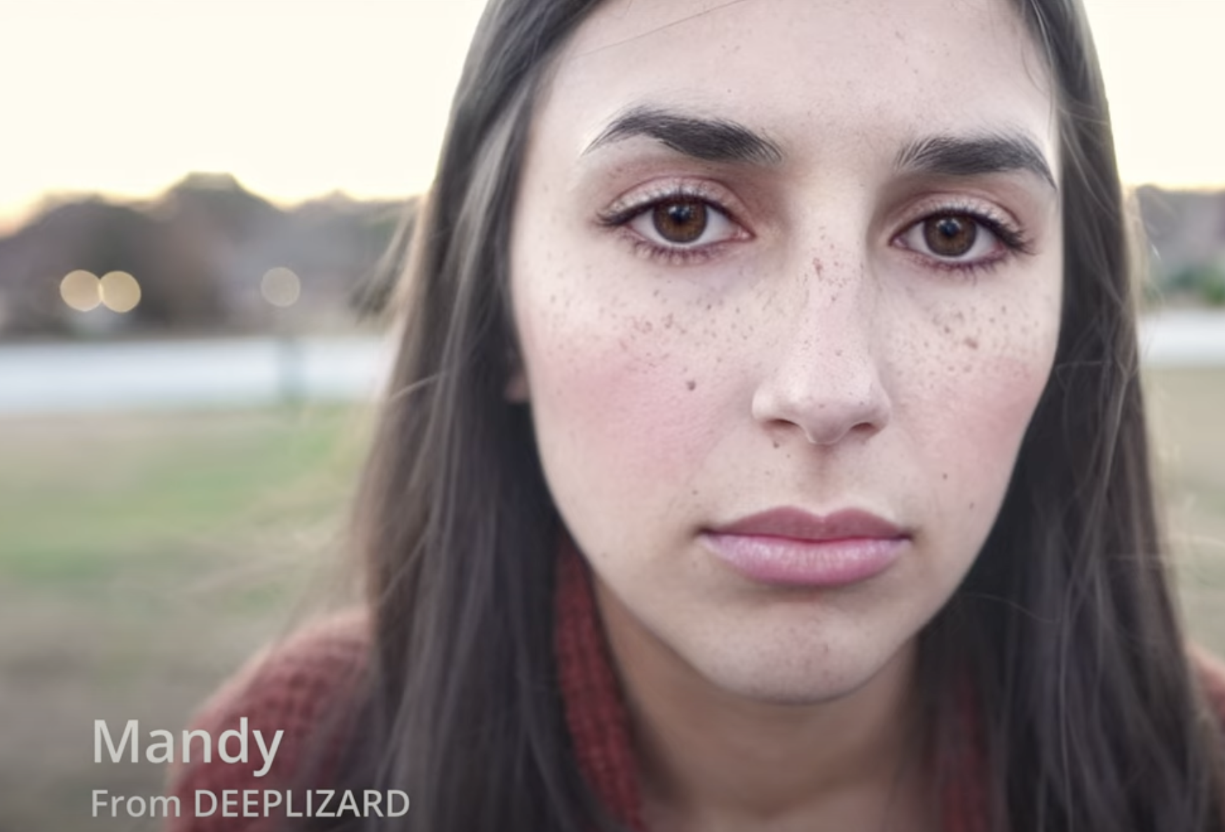
Ex: Women of the World Project by Deeplizard
Text to images: give a cool headshot of a beautiful dog, cat, lizard, llama, alpaca, moon, man, woman
Image to image: generates 2,000+ photos generated in the likeness of Mandy
https://www.youtube.com/watch?v=0ToXPFepgx4

Slide 12
(4) Vocabulary 1) Ex. Embeddings in PyTorch: nn.Embedding vector for “cat”→ [0.2, 0.8] “apple”→ [0.6, 0.3] 2) Context or meaning is encapsulated in the vector: “model” has different embeddings ML “model” → [1.3 8.3 …] Photo “model” → [2.6 5.8 …]

Slide 13
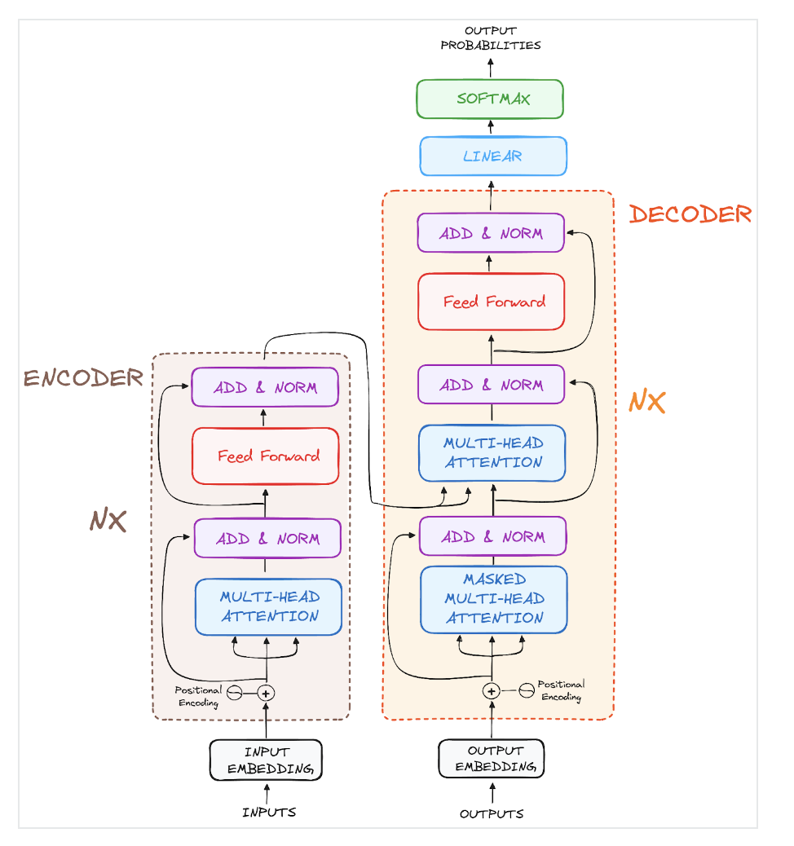
(5) Transformer Architecture
How Transformers Work: A Detailed Exploration of Transformer Architecture, by Josep Ferrer https://www.datacamp.com/tutorial/how-transformers-work

Slide 14
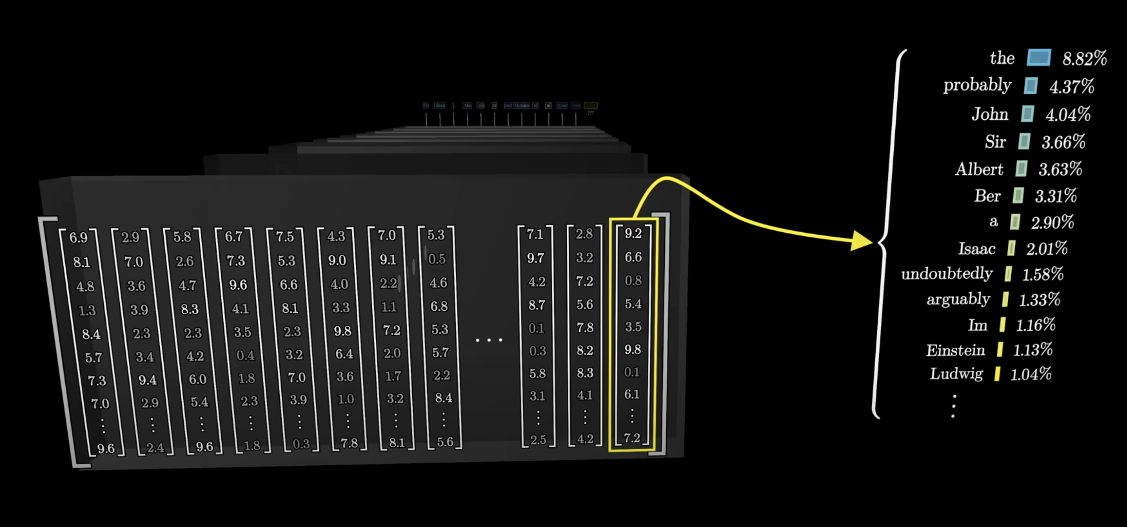
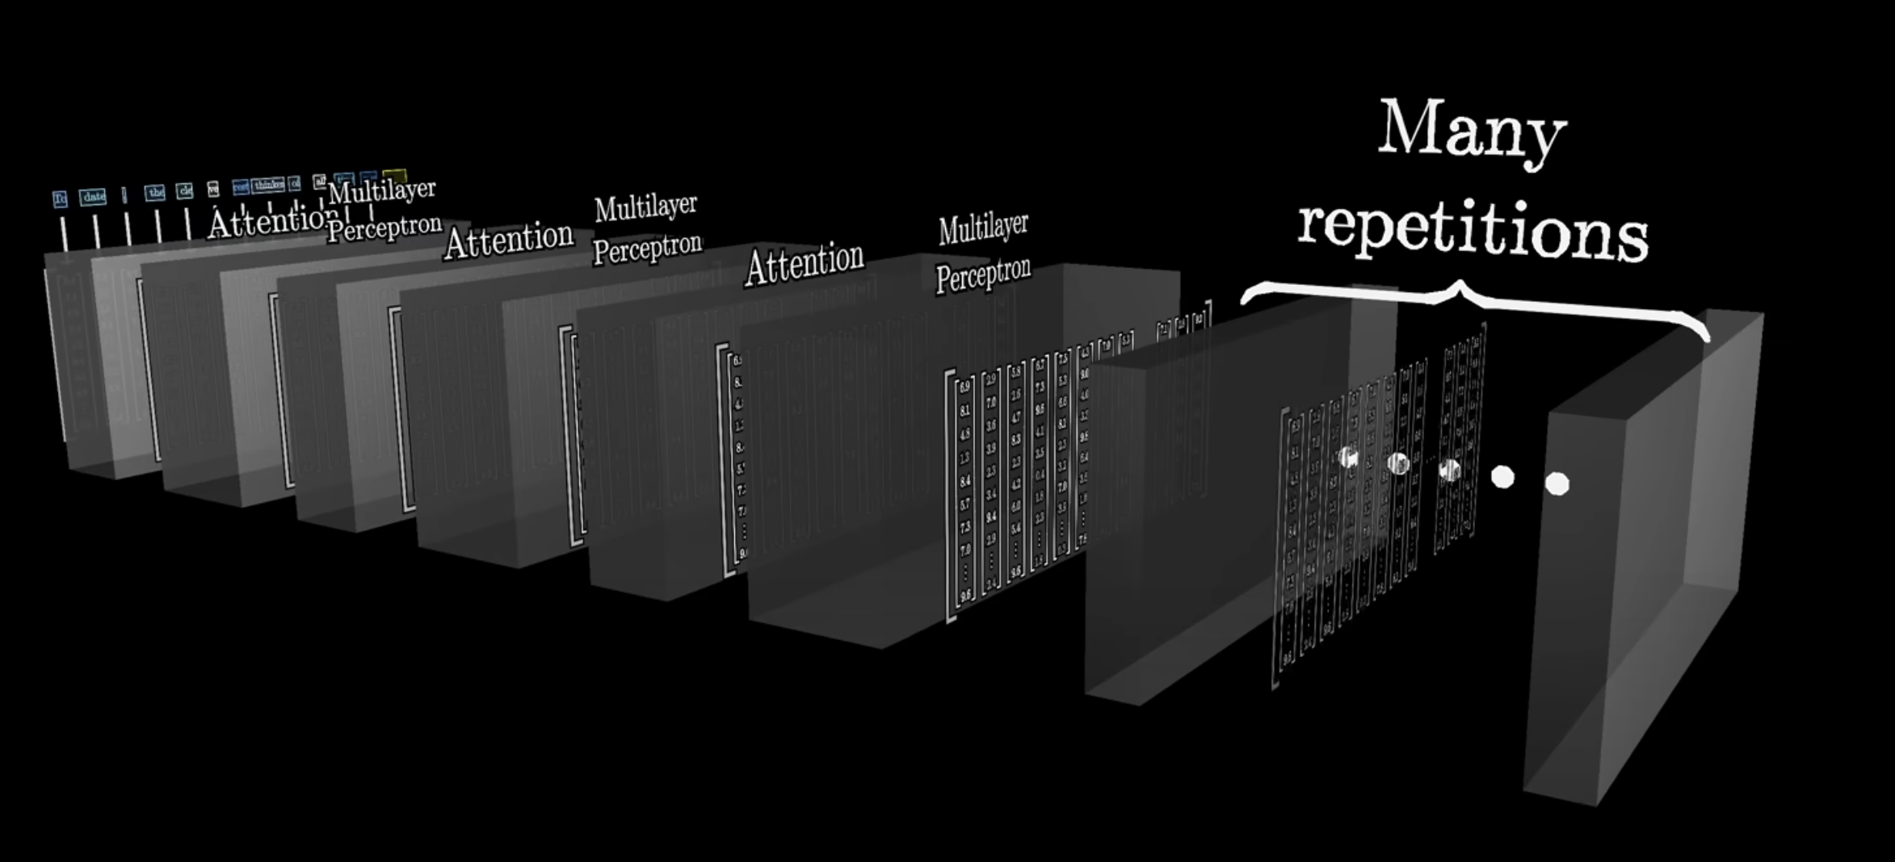
(6) ChatGPT3 (Generative Pre-trained Transformer 3) architecture; 170 billion params
Is a stack of 96 decoders with 96 attention heads
Vocabulary Size: 50,257 tokens (cat, seven, ab, mom, entum, $, etc.)
Embedding space is 12,288-dimensions; ➔ Embedding matrix is 617 million weights
each token (word) is embedded in a vector of size 12,288
each embedding incorporates info on position of the word in sentence and context
Context size – 2,048 vectors or tokens (limits how much text can incorporate when predicting one word)
Unembedding matrix is 617 million weights
Has a transformer architecture
Encoding and Embedding
96 Multi-heads Attention layers
96 Add&Normalize Feed Forward layer (one after each Attention)
Decoding (+softmax)
See more here: https://digital-garden.jonghoon.blog/gpt3%20architecture

Slide 15
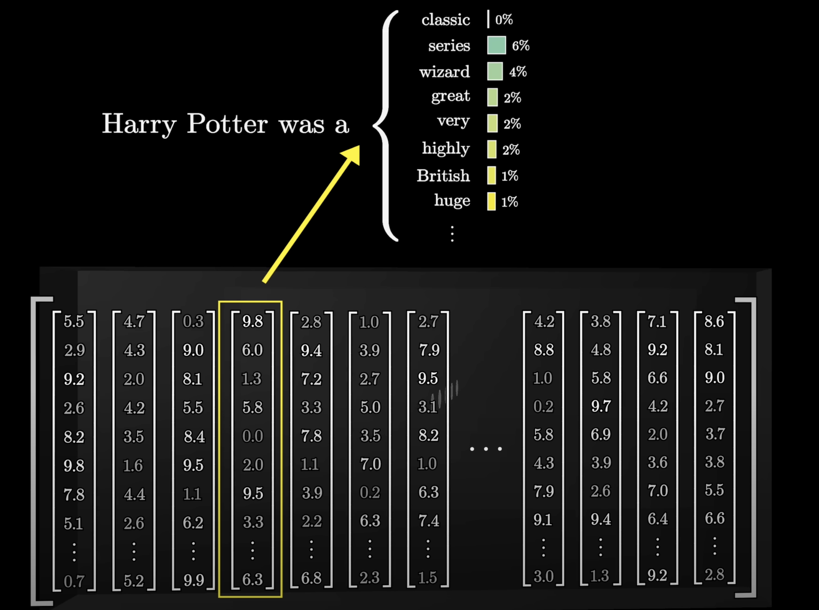
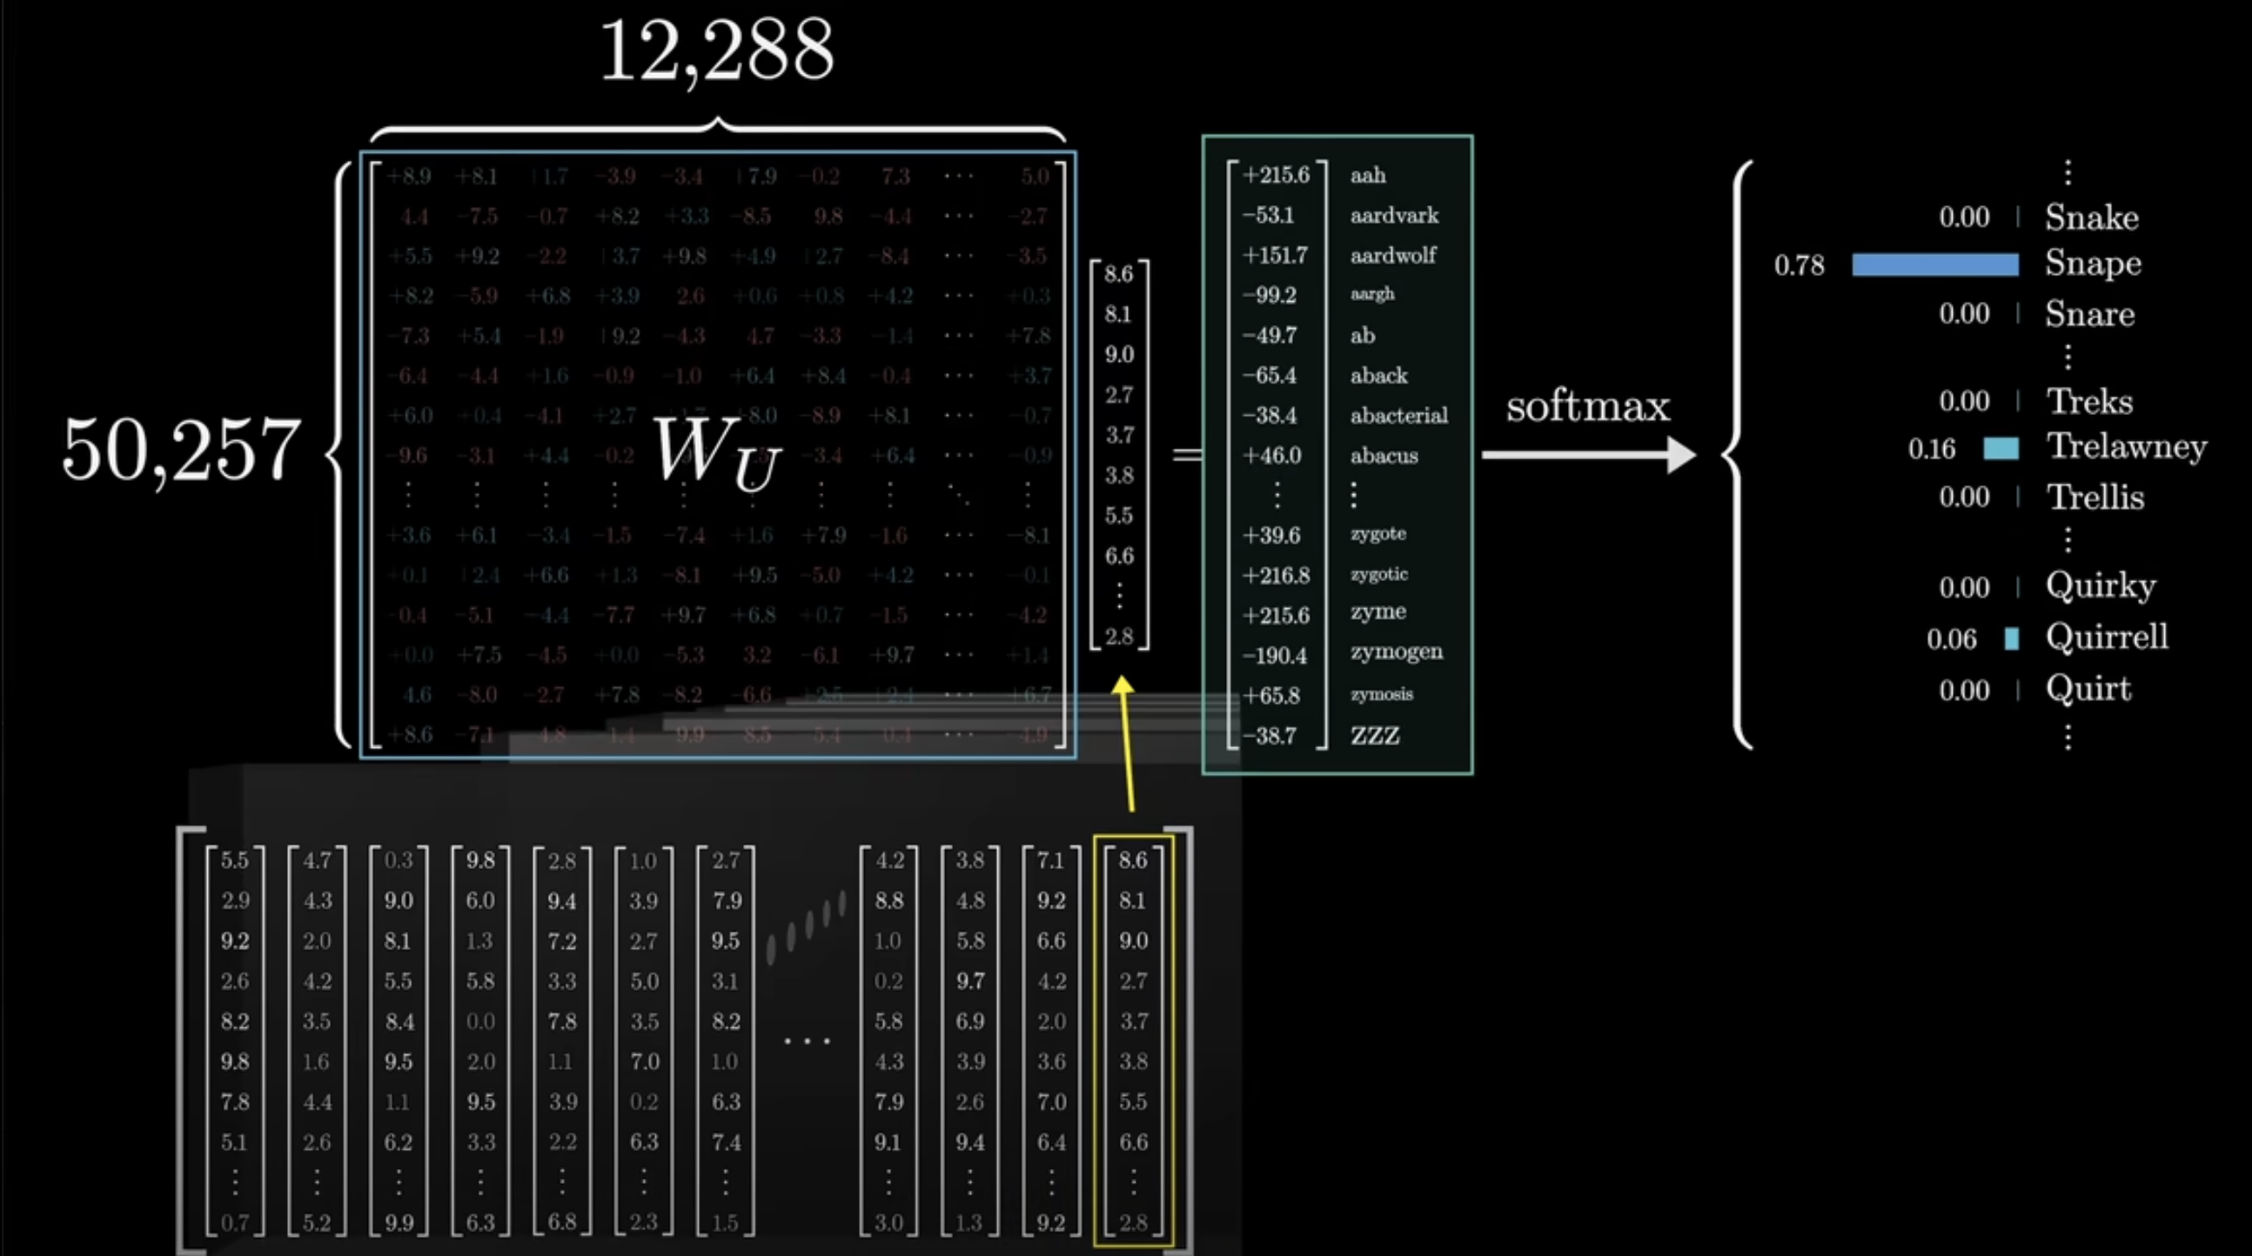
Predicting next word: “Harry Potter was an highly unusual boy … least favorite teacher, Professor ???? ”
Decoding
Each vector encodes the existing words in input
The “pink” vectors are the learned context
The yellow vector is the probability for the next word; has 50,257 probab., one for each possible tokens
From How large language models work, a visual intro to transformers | Chapter 5, Deep Learning, by 3Blue1Brown [class video]
https://www.youtube.com/watch?v=wjZofJX0v4M

Slide 16
Attention (context) layer
Attention in transformers: when predicting a word at the end of 5 pages, we compute its embedding/value by using the context from all 5 pages (context window)
Ex: learn the “attention” that adjectives attends (or precedes) nouns
One-Head of attention computes 3 matrices:
Query - 1.5mill params
Key - 1.5mill params
Value - 12,288 params
Ex: A fluffy blue creature
Embeddings of “fluffy” and “blue” attend to embeddings of “creature” = how relevant is a word to the meaning of another word
Multiply keys with query vectors and get the max values; uses SoftMax layer to get 0-1 prob. Distrib.
Multi-Head attention: do this for many attentions (=associations/patterns)
➔ Layers learn: sentiment; tone; is a poem?; is an animal?; etc.

Slide 17
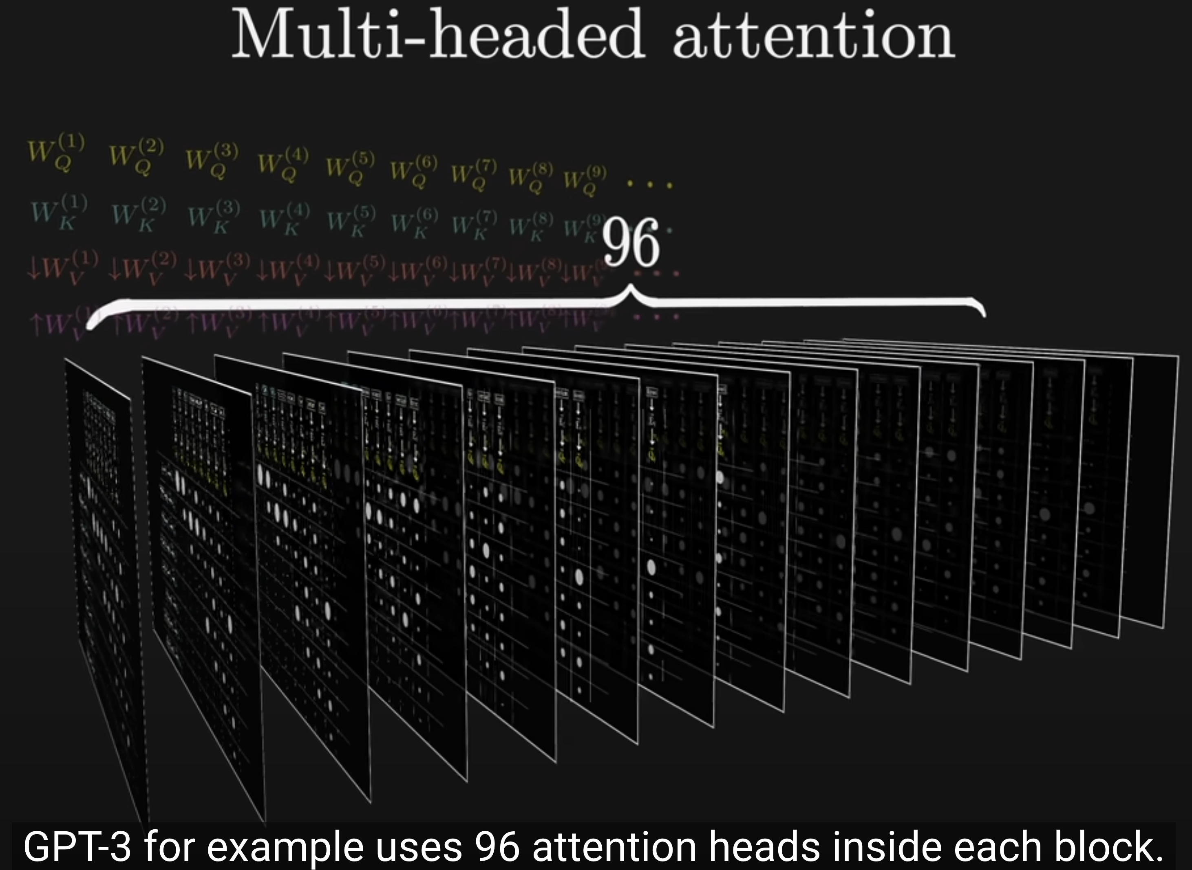
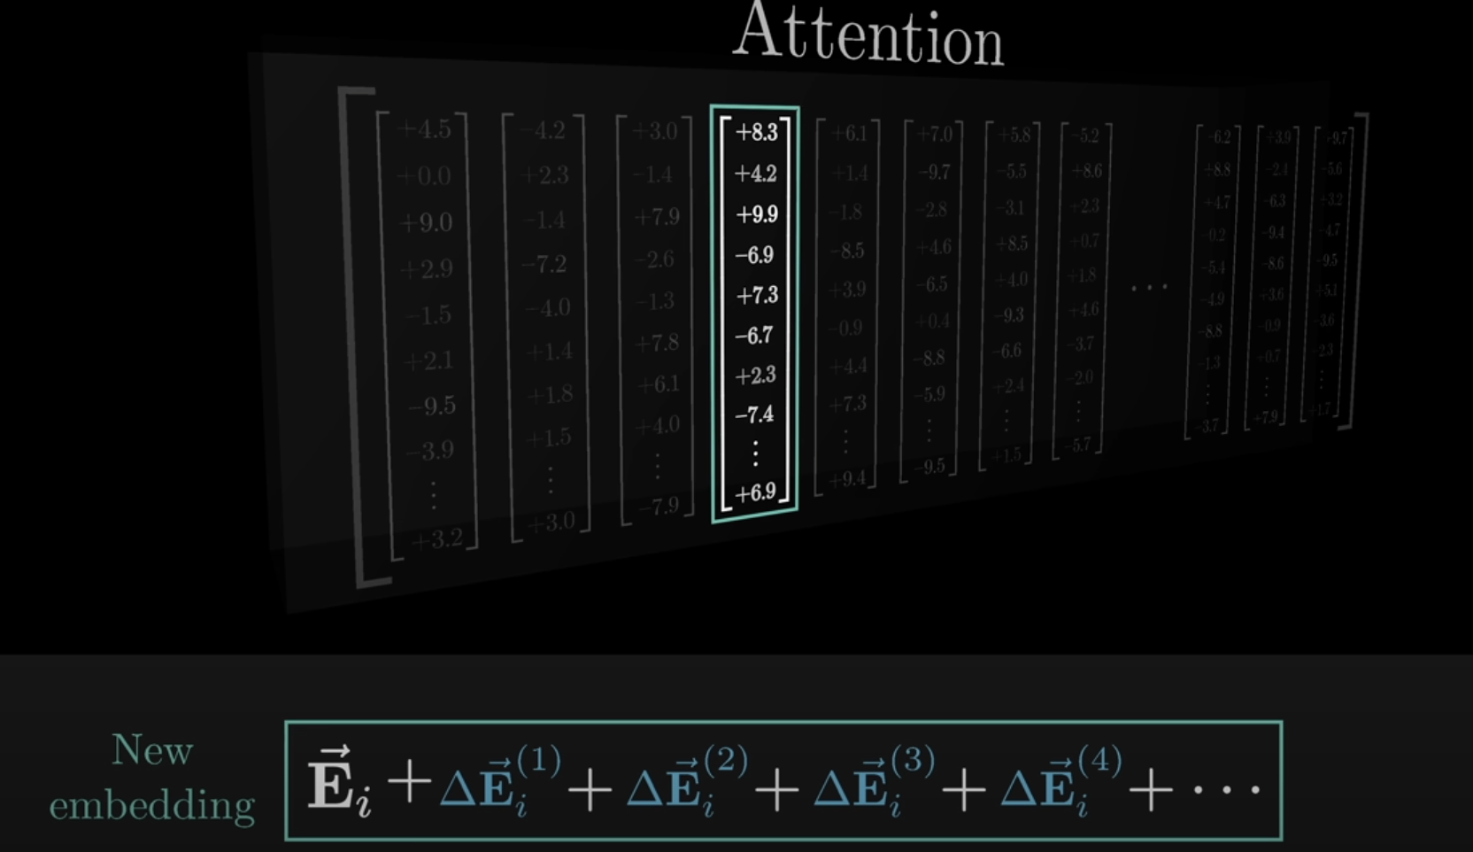
Multi-head attention
Each of the 96 attention heads create an update; all 96 updates are added to the original embedding of that position i.
One column in the attention matrix addresses the word in that position
What you accomplish here is 96 distinct way to capture the meaning of a word i, and you sum of all those ways, and you do that for all words in your sentence
e
Ex. Embeddings in PyTorch: nn.Embedding vector for “cat”→ [0.2, 0.8] “apple”→ [0.6, 0.3]

Slide 18
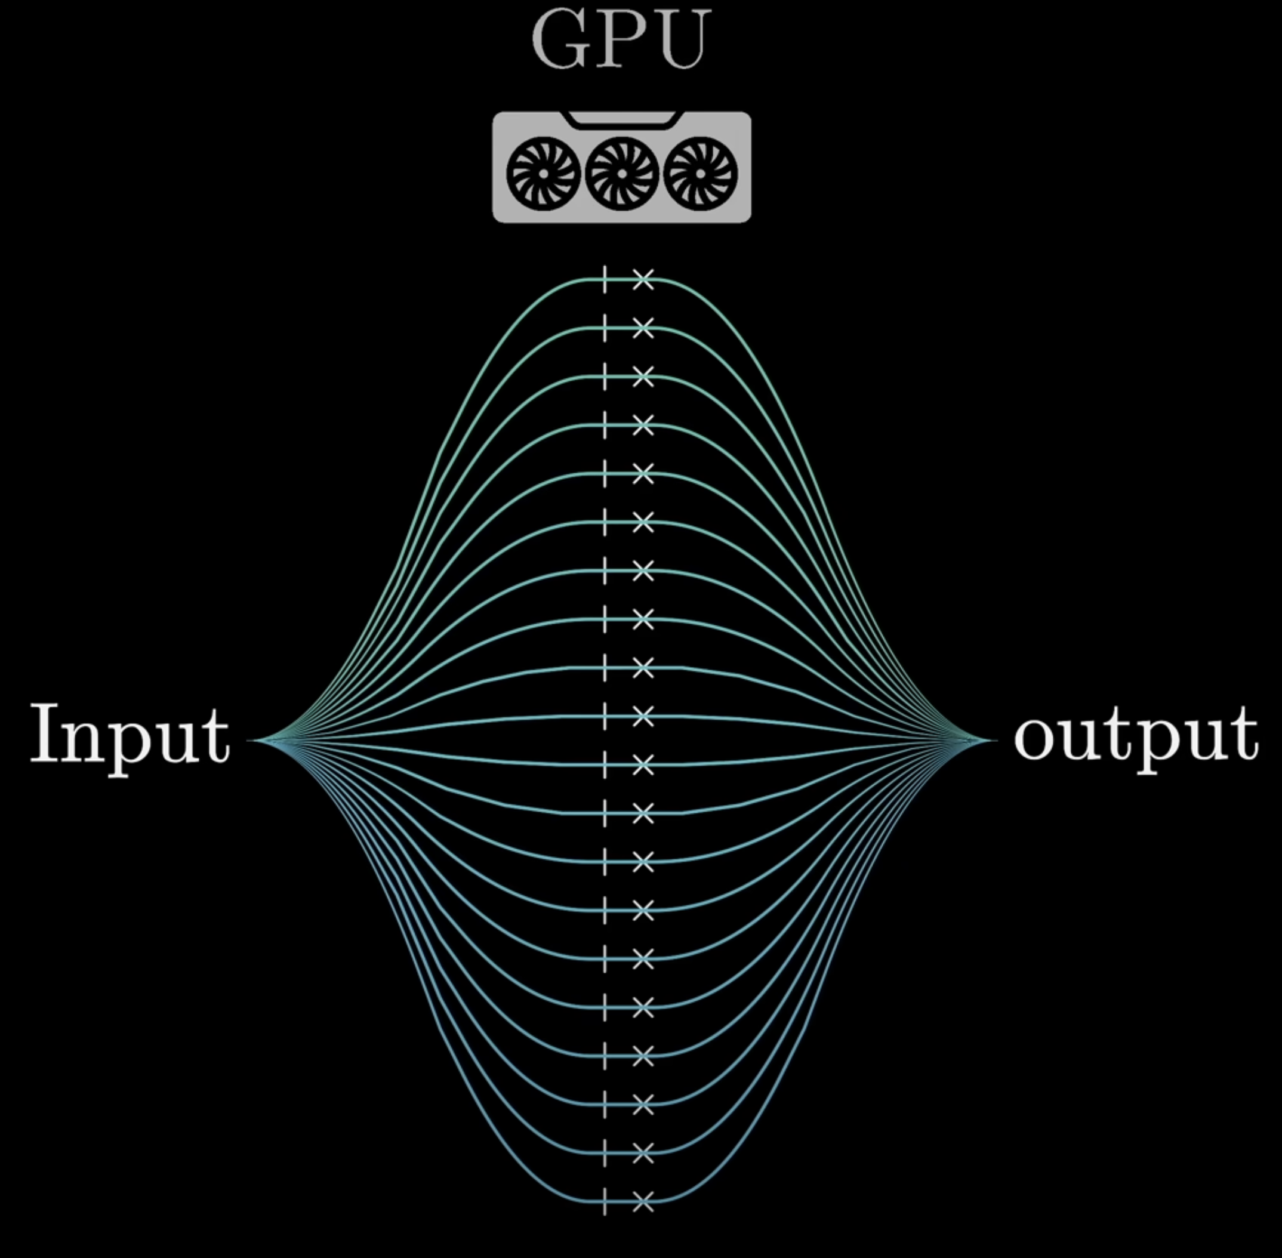
Attention is so successful because parallel computing trying to capture “things”, not because the “things” are designed in a specific way – SCALE alone does most of the “intelligence” here

Slide 26
[More ] Resources
Generative AI in a Nutshell - how to survive and thrive in the age of AI (17min) by Henrik Kniberg https://www.youtube.com/watch?v=2IK3DFHRFfw
Introduction to large language models (15min) by Google Cloud Tech https://www.youtube.com/watch?v=zizonToFXDs
11 Best Generative AI Tools and Platforms https://www.turing.com/resources/generative-ai-tools
An Introduction to Using Transformers and Hugging Face by Zoumana Keita https://www.datacamp.com/tutorial/an-introduction-to-using-transformers-and-hugging-face
Create a Large Language Model from Scratch with Python – Tutorial (5.4h) by FreeCodeCamp
https://www.youtube.com/watch?v=UU1WVnMk4E8

