Slide 1
Deep Learning
S. Visa, 2023

Slide 2
Convolutional NN resources
First proposed by LeCun in 1995
Convolutional Neural Networks (best 8min explanation!) https://www.youtube.com/watch?v=YRhxdVk_sIs
Convolutional Neural Networks - Ep. 8 (Deep Learning SIMPLIFIED), 8min https://www.youtube.com/watch?v=JiN9p5vWHDY
But what is a convolution? by 3Blue1brown, 23 min, https://www.youtube.com/watch?v=KuXjwB4LzSA
How Convolutional Neural Networks work, 26min (see min 2-17)
https://www.youtube.com/watch?v=FmpDIaiMIeA (see next slide, Ex. Classify images of “X” and “O”)

Slide 3
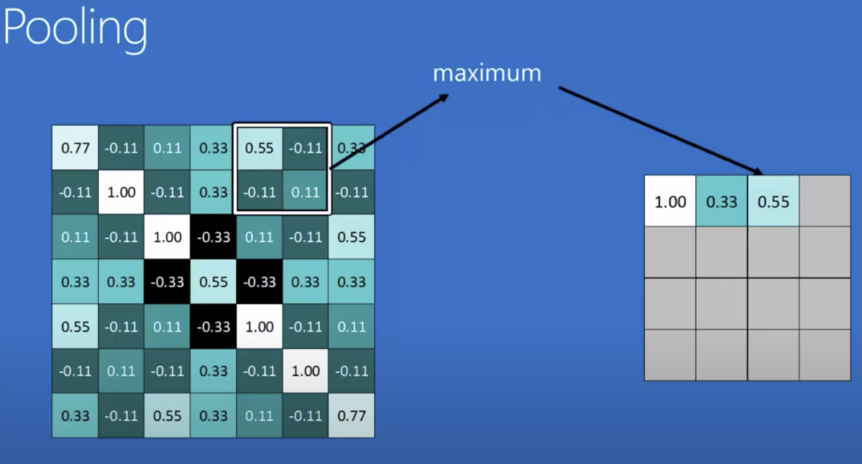
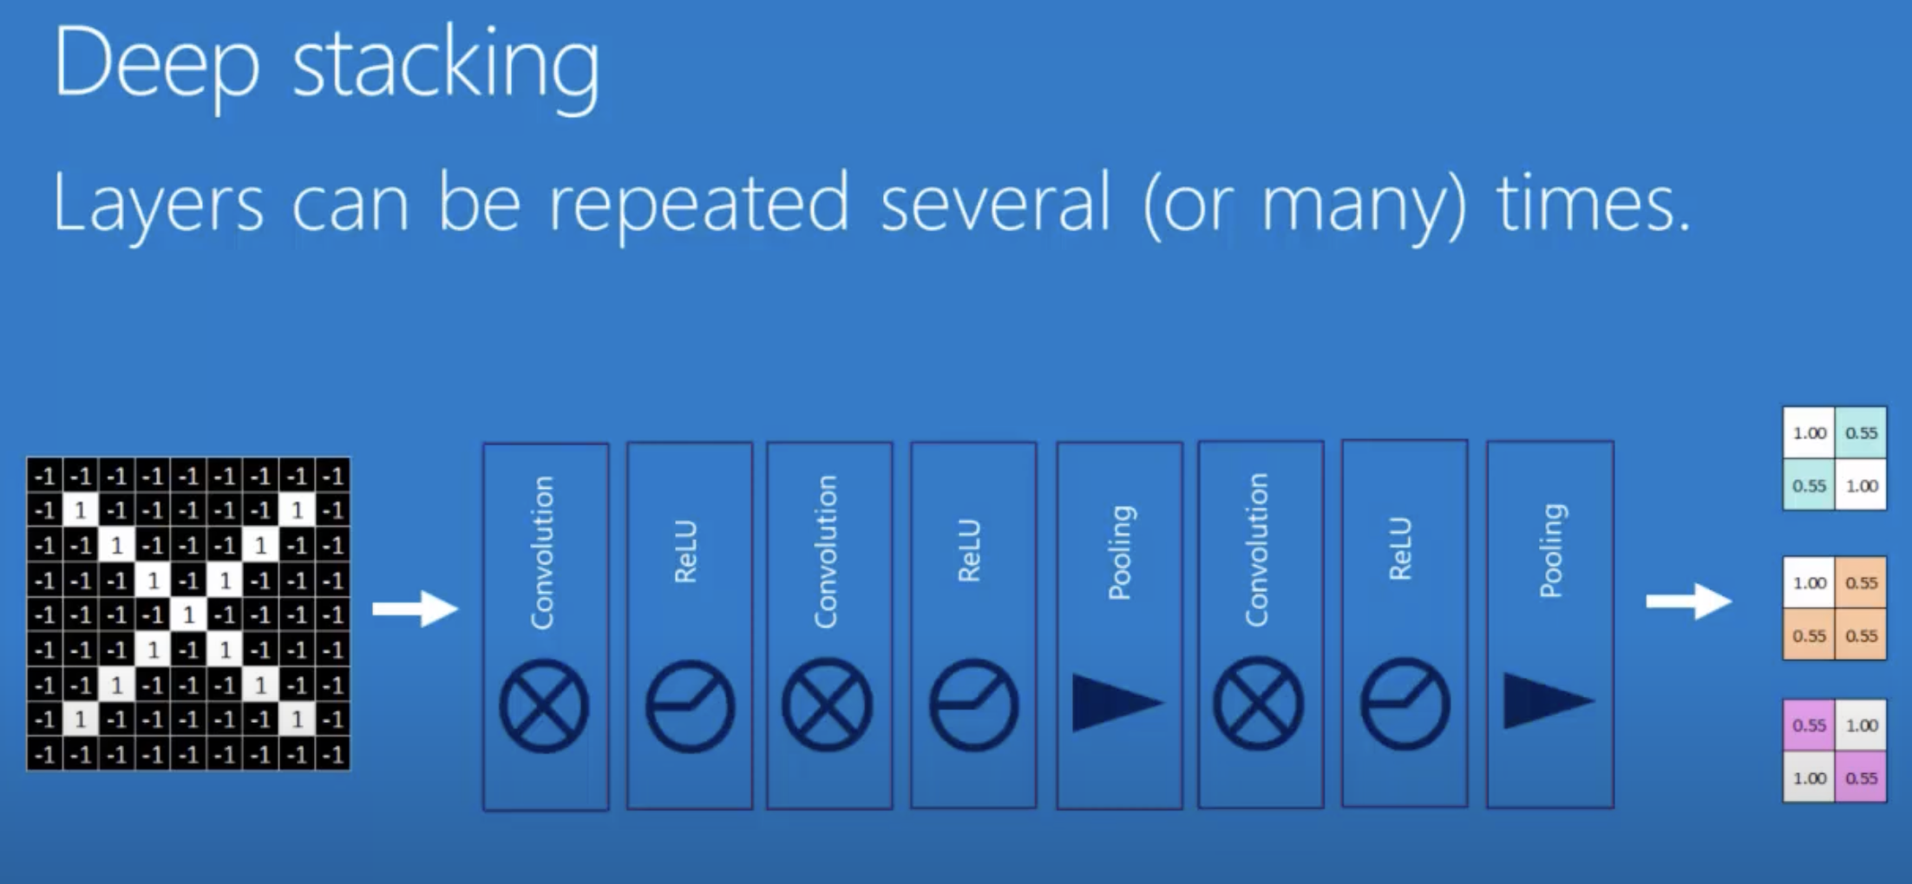
Convolutional NN has 3 layers Ex. Classify images of “X” and “O”
Convolution (apply filters to det. where in img the features occur; see 2 diagonals and “x” kernels ex.)
+ ReLU (set to zero any negative value; helps with math)
+Maxpooling layers (shrinks img; keeps similar patterns but smaller features; ex. 7x7→4x4)
2. Fully connected layers (FFNN)
3. Output layer
See “How Convolutional Neural Networks work” by Brandon Roher min. 2-26
After each layer [Convol+ReLU+Pooling], the img gets more filtered and smaller!

Slide 4
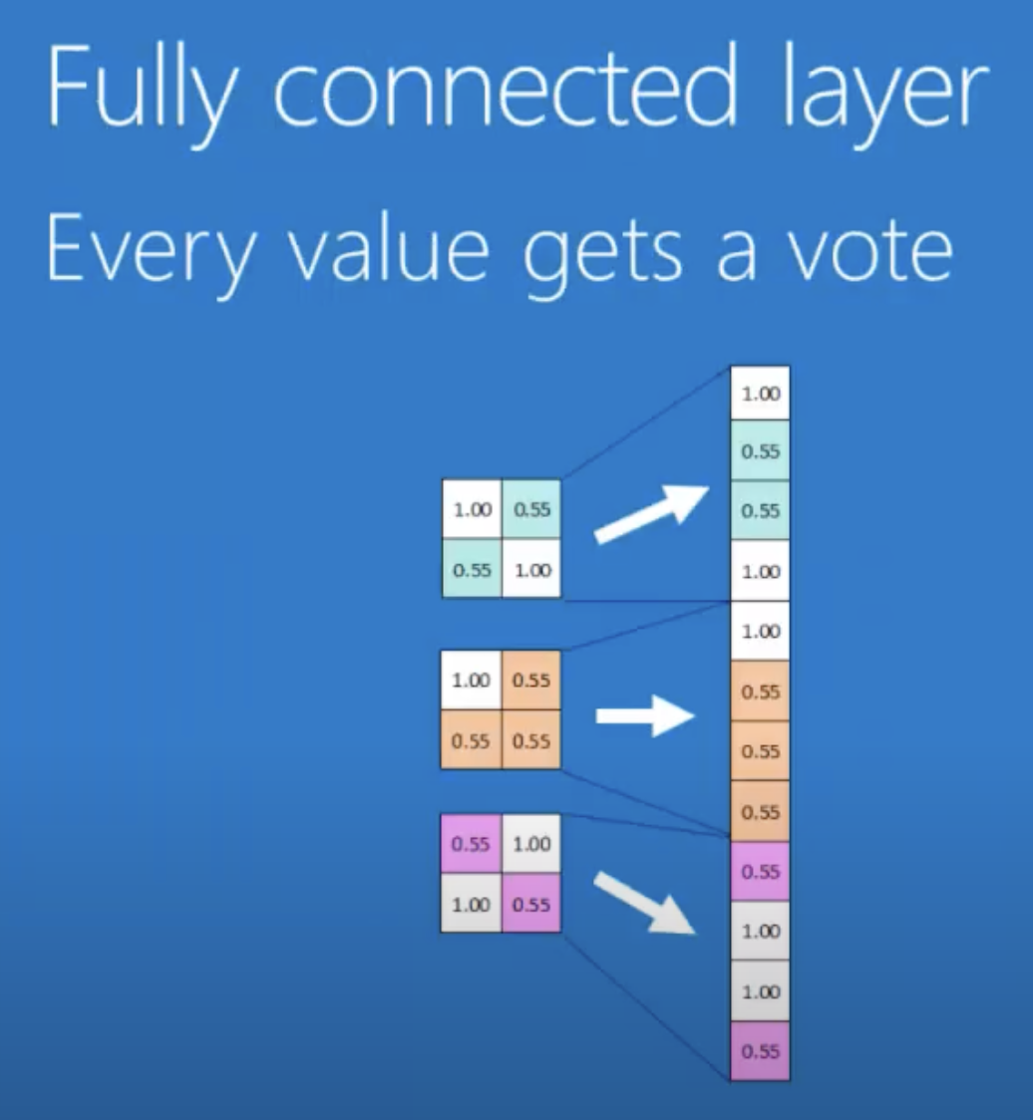
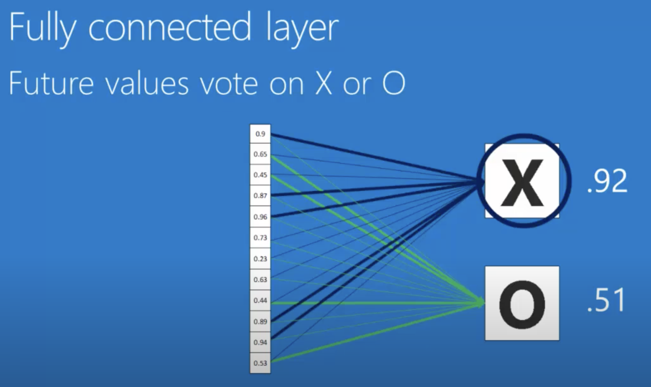
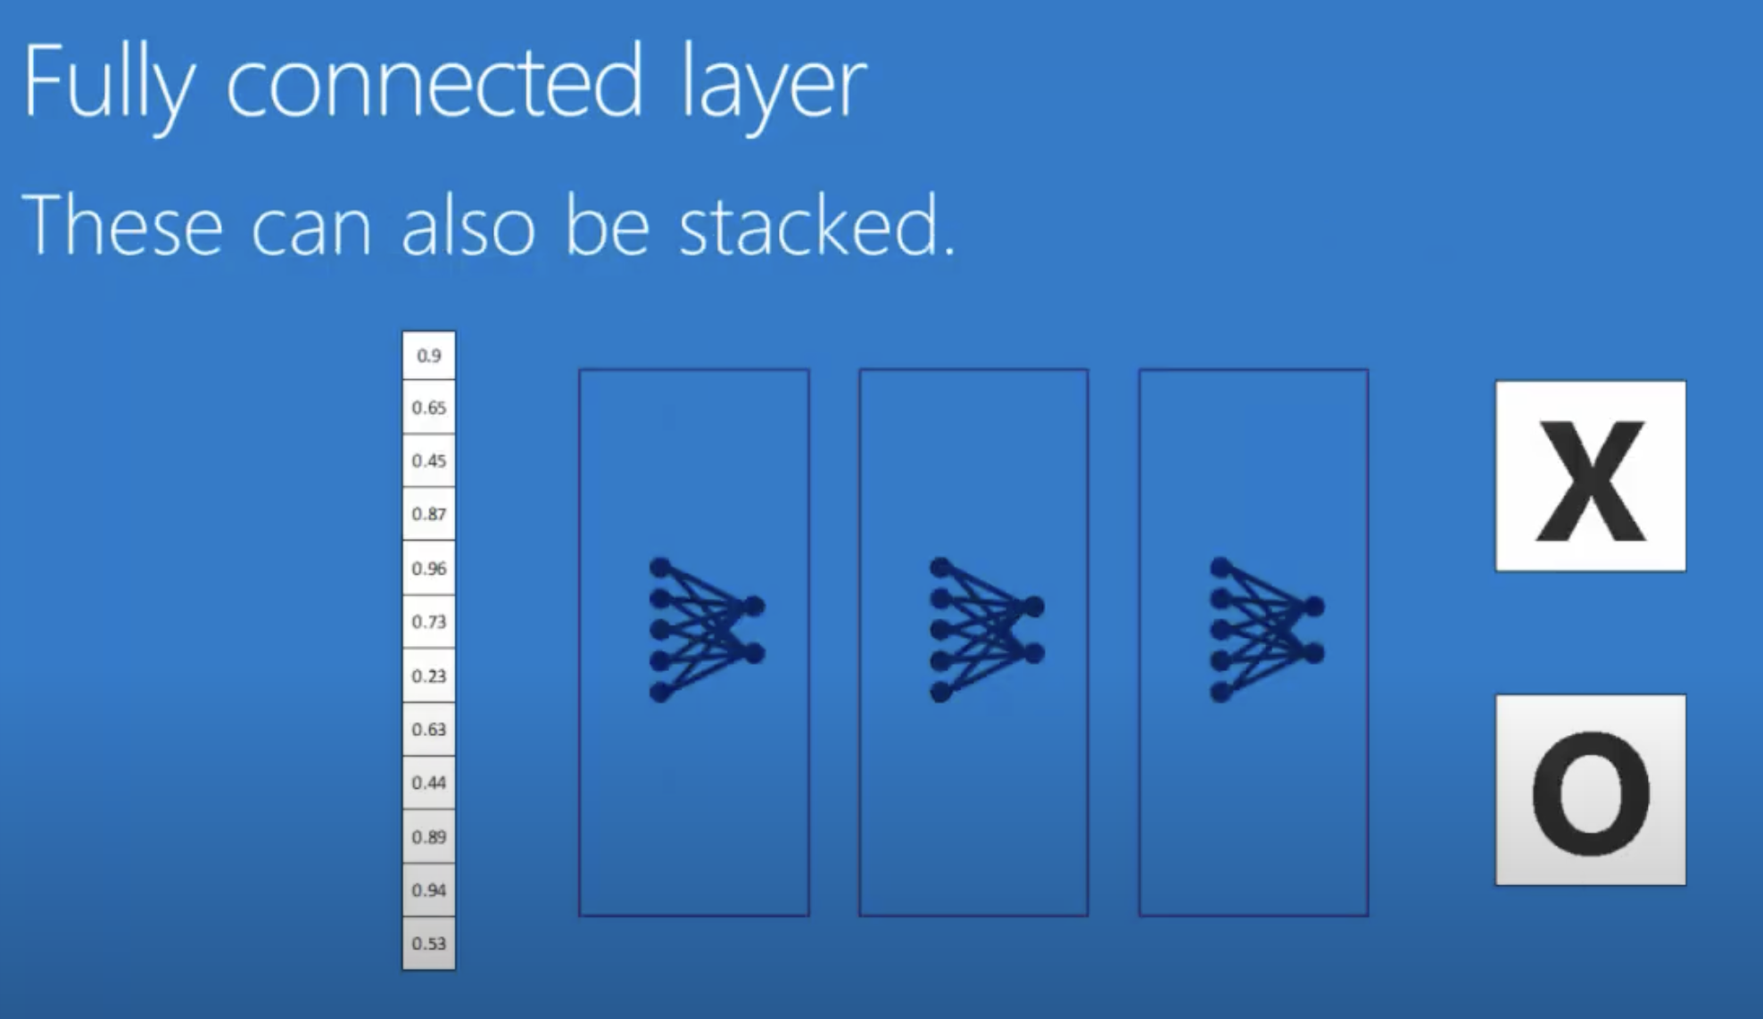
Convolutional NN has 3 layers (cont’d) Ex. Classify images of “X” and “O”
2. Fully connected layers (FFNN) (flatten out into a vector all the image “representations” produced by the convolution step)
3. Output layer

Slide 5
Ex.1: AlexNet trained on ImageNet dataset
ImageNet dataset: over 1 million images from 1,000 categories
https://www.image-net.org/
AlexNet: The Architecture that Challenged CNNs (article)
https://towardsdatascience.com/alexnet-the-architecture-that-challenged-cnns-e406d5297951

Slide 6
AlexNet – pre-trained CNN network
Created for the 2012 Image Recognition Challenge
Used deep learning first time for this challenge -> err = 15% (when human err is 25%)
2017 err -> 5%
Must train on GPU
Has 8 layers
C1: 96 filters (96 “representations” of same img)
C2: 256 filters
C3: 384 filters
Etc.
Trained in ImageNet dataset
Output layer: 1000 neurons corresponding to 1000 categories like car, bird, boat, airplane, etc.

Slide 7
Ex.2: VGC16 architecture ResNET (2015)
152 layers
1million parameters
Ex. 224x224x64
224x224 pixels/numbers in an image
Use 64 filters (to detect patterns; one filter finds all vertical lines; another finds all horizontal ones; etc.)

Slide 8
Ex.3: GoogLeNet - Another pre-trained CNN
https://www.geeksforgeeks.org/understanding-googlenet-model-cnn-architecture/
Architecture takes image of size 224 x 224 with RGB color channels
Has 22 layers
Err -> 6.7%
A Review of Popular Deep Learning Architectures: AlexNet, VGG16, and GoogleNet
https://blog.paperspace.com/popular-deep-learning-architectures-alexnet-vgg-googlenet/

Slide 9
Tutorials with good visualizations
But what is a convolution? - https://www.youtube.com/watch?v=KuXjwB4LzSA
But what is a neural network? | Chapter 1, Deep learning
https://www.youtube.com/watch?v=aircAruvnKk
Restricted Boltzmann Machines
https://www.youtube.com/watch?v=puux7KZQfsE
A friendly introduction to Convolutional Neural Networks and Image Recognition, Luis Serano
https://www.youtube.com/watch?v=2-Ol7ZB0MmU
How Convolutional Neural Networks work, 26min
https://www.youtube.com/watch?v=FmpDIaiMIeA
Deep Learning Demystified by Brandon Rohrer
https://www.youtube.com/watch?v=Q9Z20HCPnww
Brief demo of Deep Learning in Python (recognizing hand-written digits)
https://pyimagesearch.com/2014/09/22/getting-started-deep-learning-python/

Slide 10
Other Resources
Neural Networks and Deep Learning, free book by Michael Nielsen http://neuralnetworksanddeeplearning.com/
Gradient descent, how neural networks learn | Chapter 2, Deep learning https://www.youtube.com/watch?v=IHZwWFHWa-w

