Slide 1
Chapter 5
Large and Fast: Exploiting Memory Hierarchy

Slide 2
5.6 Virtual Machines
Host computer emulates guest operating system and machine resources
Improved isolation of multiple guests
Avoids security and reliability problems
Aids sharing of resources
Virtualization has some performance impact
Feasible with modern high-performance computers
Examples
IBM VM/370 (1970s technology!)
VMWare
Microsoft Virtual PC

Slide 3
Virtual Machine Monitor
Maps virtual resources to physical resources
Memory, I/O devices, CPUs
Guest code runs on native machine in user mode
Traps to VMM on privileged instructions and access to protected resources
Guest OS may be different from host OS
VMM handles real I/O devices
Emulates generic virtual I/O devices for guest

Slide 4
Example: Timer Virtualization
In native machine, on timer interrupt
OS suspends current process, handles interrupt, selects and resumes next process
With Virtual Machine Monitor
VMM suspends current VM, handles interrupt, selects and resumes next VM
If a VM requires timer interrupts
VMM emulates a virtual timer
Emulates interrupt for VM when physical timer interrupt occurs

Slide 5
Instruction Set Support
User and System modes
Privileged instructions only available in system mode
Trap to system if executed in user mode
All physical resources only accessible using privileged instructions
Including page tables, interrupt controls, I/O registers
Renaissance of virtualization support
Current ISAs (e.g., x86) adapting

Slide 6
5.7 Virtual Memory
§5.7 Virtual Memory
Use main memory as a “cache” for secondary (disk) storage
Managed jointly by CPU hardware and the operating system (OS)
Programs share main memory
Each gets a private virtual address space holding its frequently used code and data
Protected from other programs
CPU and OS translate virtual addresses to physical addresses
VM “block” is called a page
VM translation “miss” is called a page fault

Slide 7
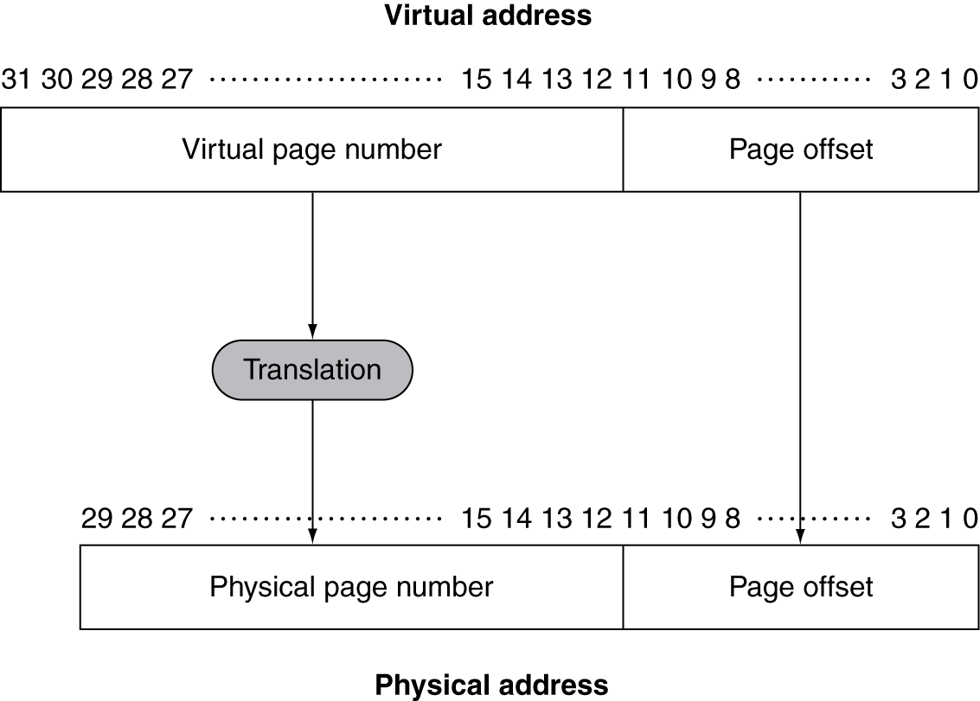
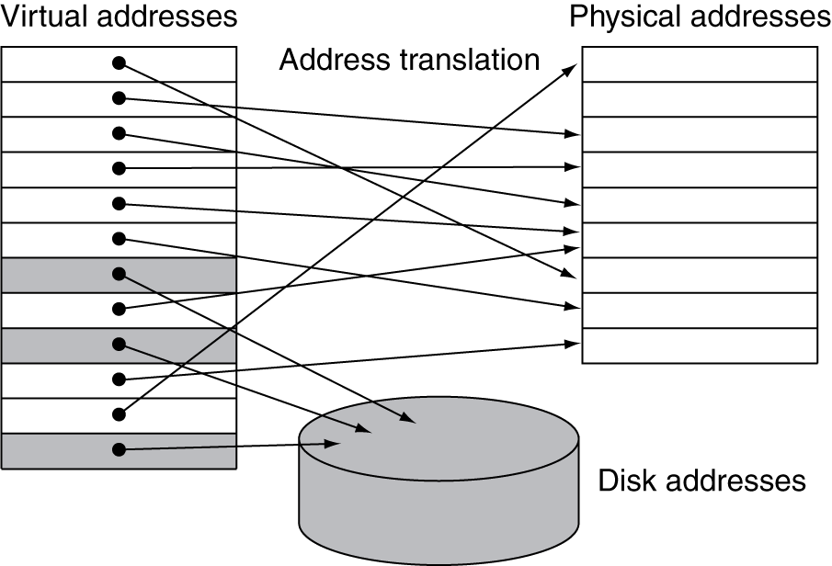
Address Translation
Fixed-size pages (e.g., 4K)

Slide 8
Page Fault Penalty
On page fault, the page must be fetched from disk
Takes millions of clock cycles
Handled by OS code
Try to minimize page fault rate
Fully associative placement
Smart replacement algorithms

Slide 9
Page Tables
Stores placement information
Array of page table entries, indexed by virtual page number
Page table register in CPU points to page table in physical memory
If page is present in memory
PTE stores the physical page number
Plus other status bits (referenced, dirty, …)
If page is not present
PTE can refer to location in swap space on disk

Slide 10
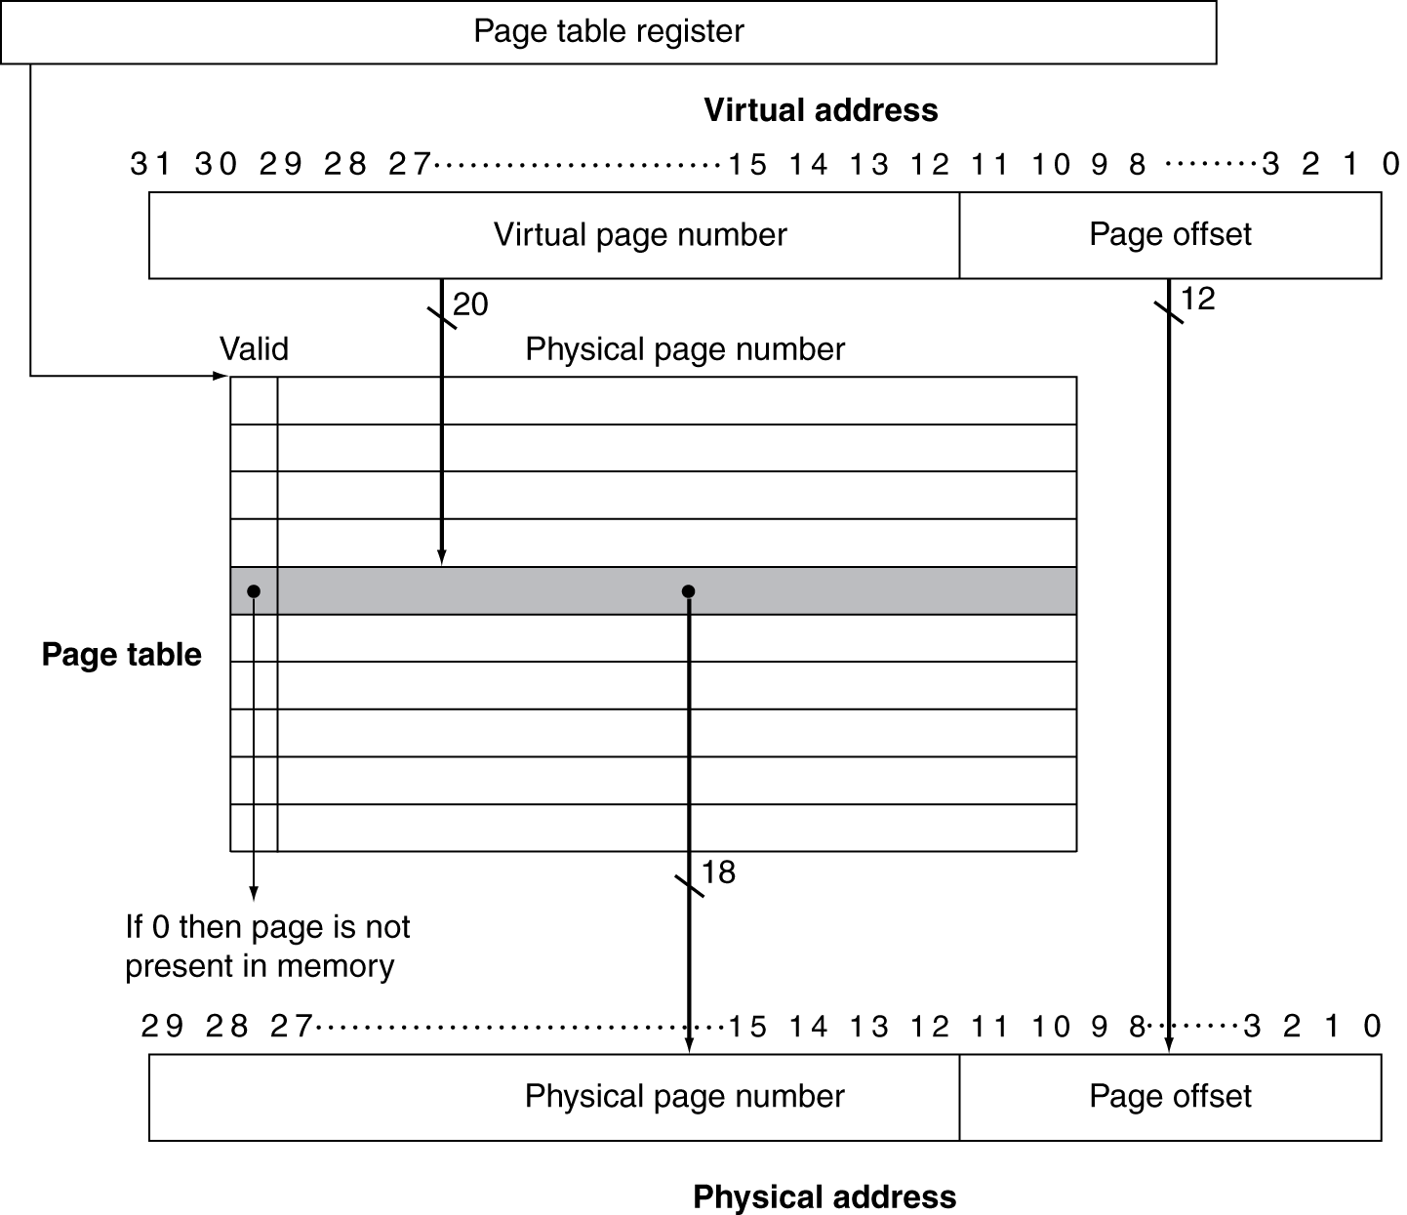
Translation Using a Page Table

Slide 11
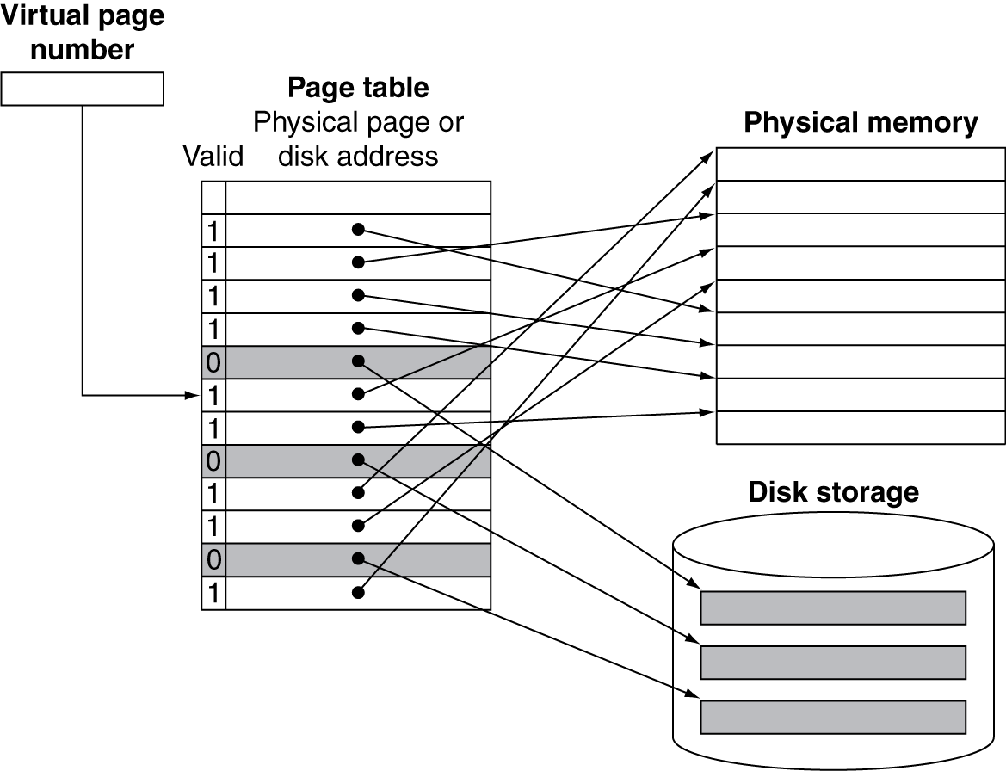
Mapping Pages to Storage

Slide 12
Replacement and Writes
To reduce page fault rate, prefer least-recently used (LRU) replacement
Reference bit (aka use bit) in PTE set to 1 on access to page
Periodically cleared to 0 by OS
A page with reference bit = 0 has not been used recently
Disk writes take millions of cycles
Block at once, not individual locations
Write through is impractical
Use write-back
Dirty bit in PTE set when page is written

Slide 13
Fast Translation Using a TLB
Address translation would appear to require extra memory references
One to access the PTE
Then the actual memory access
But access to page tables has good locality
So use a fast cache of PTEs within the CPU
Called a Translation Look-aside Buffer (TLB)
Typical: 16–512 PTEs, 0.5–1 cycle for hit, 10–100 cycles for miss, 0.01%–1% miss rate
Misses could be handled by hardware or software

Slide 14
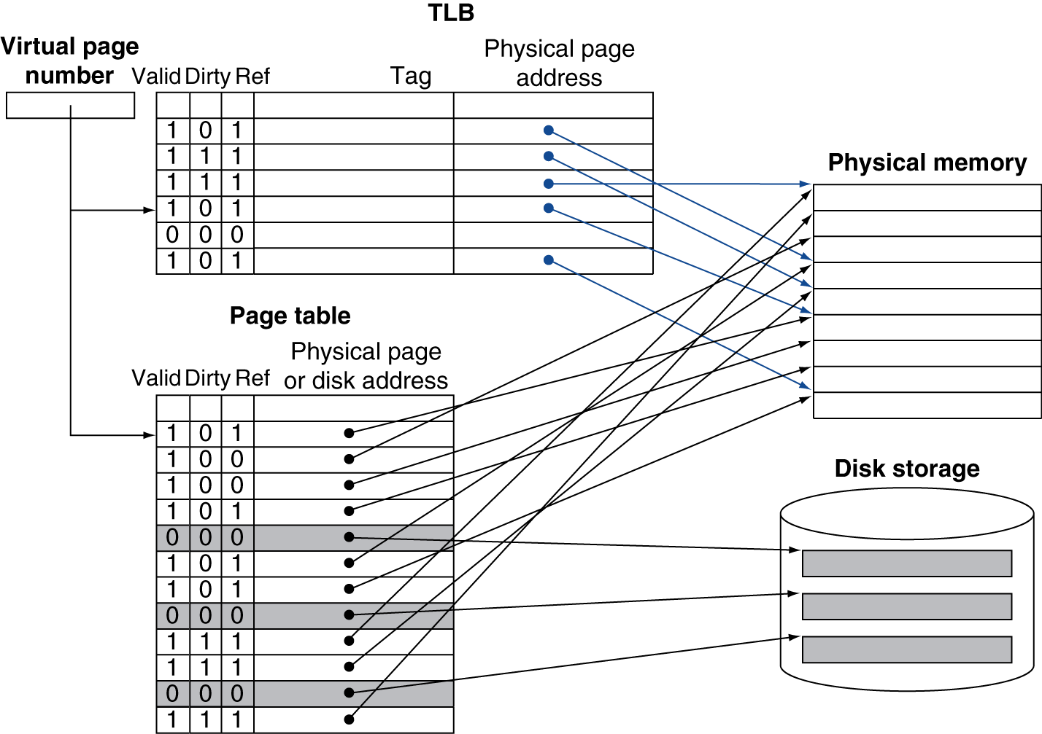
Fast Translation Using a TLB

Slide 15
TLB Misses
If page is in memory
Load the PTE from memory and retry
Could be handled in hardware
Can get complex for more complicated page table structures
Or in software
Raise a special exception, with optimized handler
If page is not in memory (page fault)
OS handles fetching the page and updating the page table
Then restart the faulting instruction

Slide 16
TLB Miss Handler
TLB miss indicates
Page present, but PTE not in TLB
Page not preset
Must recognize TLB miss before destination register overwritten
Raise exception
Handler copies PTE from memory to TLB
Then restarts instruction
If page not present, page fault will occur

Slide 17
Page Fault Handler
Use faulting virtual address to find PTE
Locate page on disk
Choose page to replace
If dirty, write to disk first
Read page into memory and update page table
Make process runnable again
Restart from faulting instruction

Slide 18
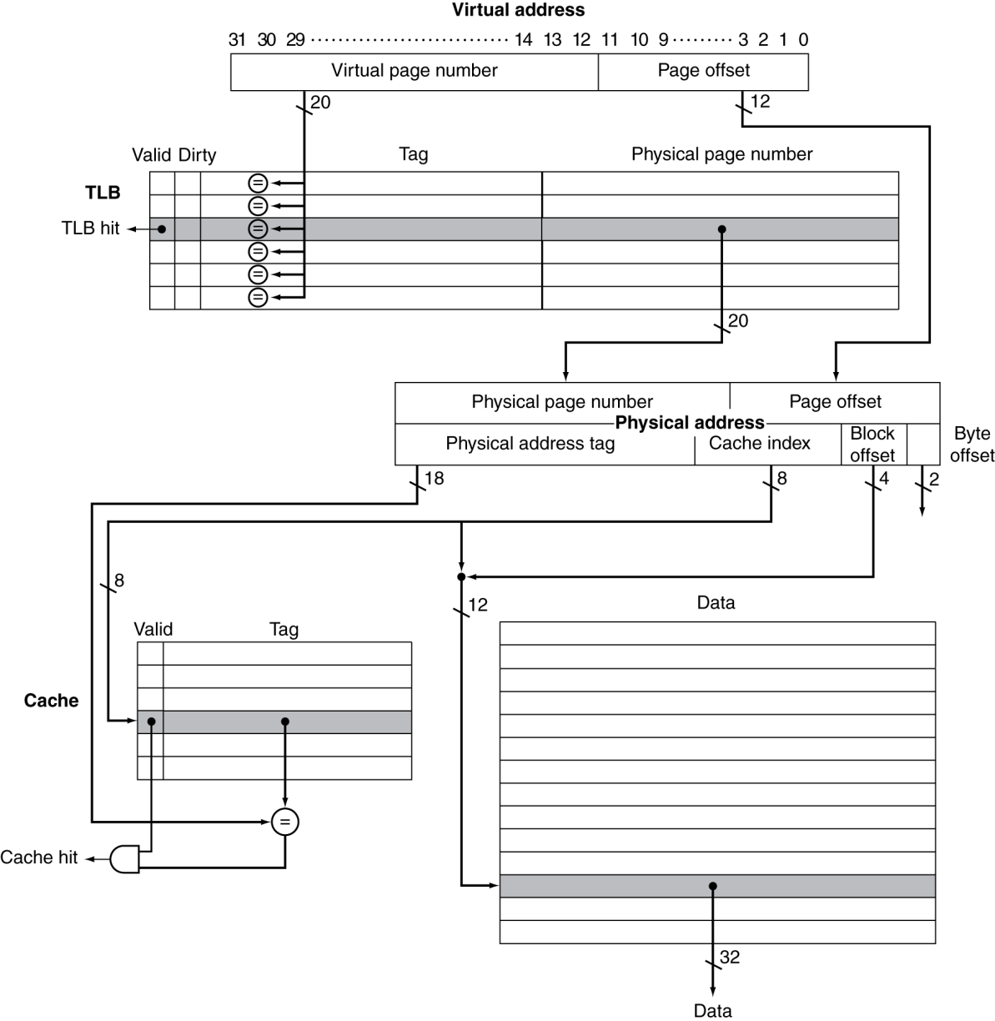
TLB and Cache Interaction
If cache tag uses physical address
Need to translate before cache lookup
Alternative: use virtual address tag
Complications due to aliasing
Different virtual addresses for shared physical address

Slide 19
Memory Protection
Different tasks can share parts of their virtual address spaces
But need to protect against errant access
Requires OS assistance
Hardware support for OS protection
Privileged supervisor mode (aka kernel mode)
Privileged instructions
Page tables and other state information only accessible in supervisor mode
System call exception (e.g., syscall in MIPS)

Slide 20
Concluding Remarks
Fast memories are small, large memories are slow
We really want fast, large memories ☹
Caching gives this illusion ☺
Principle of locality
Programs use a small part of their memory space frequently
Memory hierarchy
L1 cache ↔ L2 cache ↔ … ↔ DRAM memory ↔ disk
Memory system design is critical for multiprocessors

