Slide 1
5.4 Measuring Cache Performance
Components of CPU time
Program execution cycles
Includes cache hit time
Memory stall cycles
Mainly from cache misses
With simplifying assumptions:

Slide 2
Cache Performance Example
Given
I-cache miss rate = 2%
D-cache miss rate = 4%
Miss penalty = 100 cycles
Base CPI (ideal cache) = 2
Load & stores are 36% of instructions
Miss cycles per instruction
I-cache: 0.02 × 100 = 2
D-cache: 0.36 × 0.04 × 100 = 1.44
Actual CPI = 2 + 2 + 1.44 = 5.44
Ideal CPU is 5.44/2 =2.72 times faster
What happens if the processor is faster?

Slide 3
Average Access Time
Hit time is also important for performance
Average memory access time (AMAT)
AMAT = Hit time + Miss rate × Miss penalty
Example
CPU with 1ns clock, hit time = 1 cycle, miss penalty = 20 cycles, I-cache miss rate = 5%
AMAT = 1 + 0.05 × 20 = 2ns
2 cycles per instruction

Slide 4
Performance Summary
When CPU performance increased
Miss penalty becomes more significant
Decreasing base CPI
Greater proportion of time spent on memory stalls
Increasing clock rate
Memory stalls account for more CPU cycles
Can’t neglect cache behavior when evaluating system performance

Slide 5
Associative Caches
Fully associative
Allow a given block to go in any cache entry
Requires all entries to be searched at once
Comparator per entry (expensive)
n-way set associative
Each set contains n entries
Block number determines which set
(Block number) modulo (#Sets in cache)
Search all entries in a given set at once
n comparators (less expensive)

Slide 6
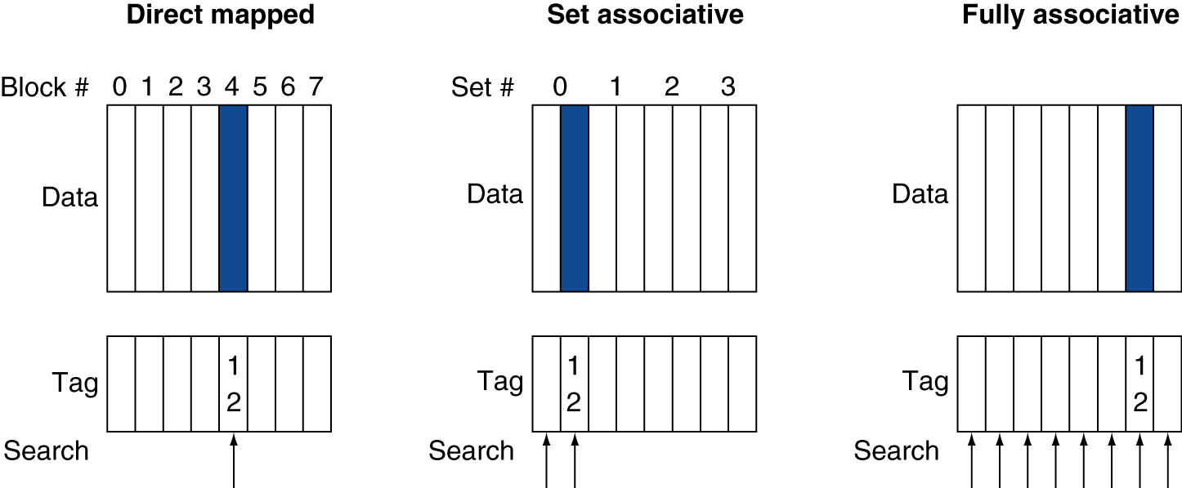
Associative Cache Example

Slide 7
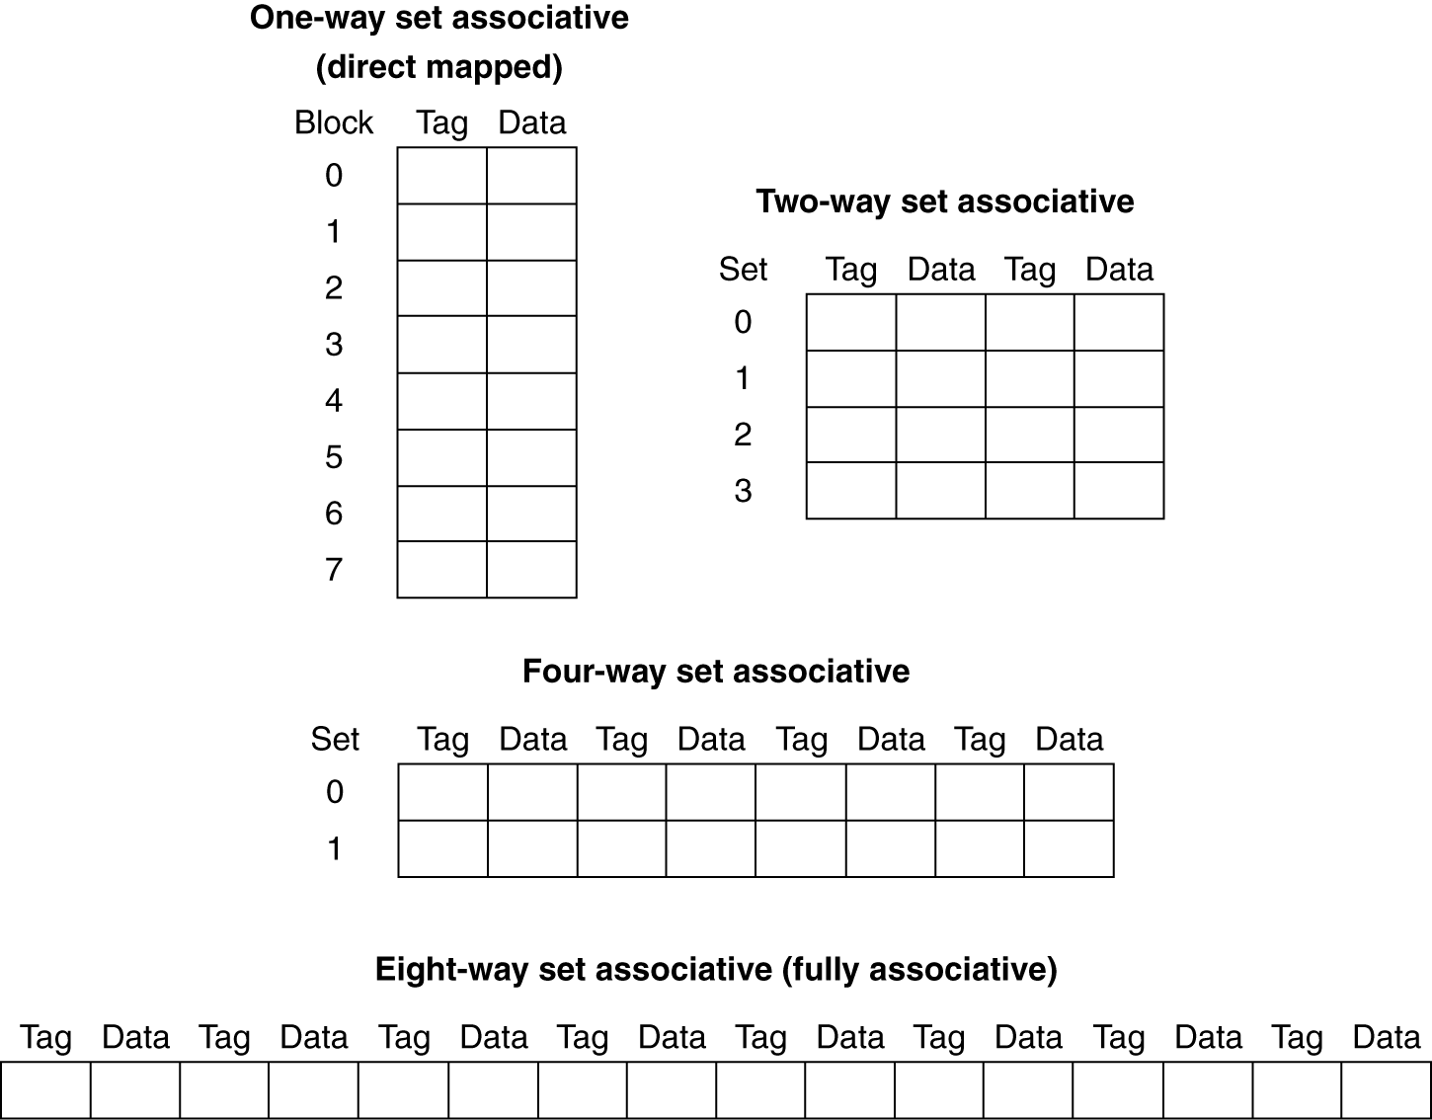
Spectrum of Associativity
For a cache with 8 entries

Slide 8
Associativity Example
Compare 4-block caches
Direct mapped, 2-way set associative, fully associative
Block access sequence: 0, 8, 0, 6, 8
Direct mapped
Block address | Cache index | Hit/miss | Cache content after access
 |  |  | 0 | 1 | 2 | 3
0 | 0 | miss | Mem[0]
8 | 0 | miss | Mem[8]
0 | 0 | miss | Mem[0]
6 | 2 | miss | Mem[0] |  | Mem[6]
8 | 0 | miss | Mem[8] |  | Mem[6]

Slide 9
Associativity Example
2-way set associative
Block address | Cache index | Hit/miss | Cache content after access
 |  |  | Set 0 |  | Set 1
0 | 0 | miss | Mem[0]
8 | 0 | miss | Mem[0] | Mem[8]
0 | 0 | hit | Mem[0] | Mem[8]
6 | 0 | miss | Mem[0] | Mem[6]
8 | 0 | miss | Mem[8] | Mem[6]
Fully associative
Block address |  | Hit/miss | Cache content after access
0 |  | miss | Mem[0]
8 |  | miss | Mem[0] | Mem[8]
0 |  | hit | Mem[0] | Mem[8]
6 |  | miss | Mem[0] | Mem[8] | Mem[6]
8 |  | hit | Mem[0] | Mem[8] | Mem[6]

Slide 10
How Much Associativity
Increased associativity decreases miss rate
But with diminishing returns
Simulation of a system with 64KB D-cache, 16-word blocks, SPEC2000
1-way: 10.3%
2-way: 8.6%
4-way: 8.3%
8-way: 8.1%

Slide 11
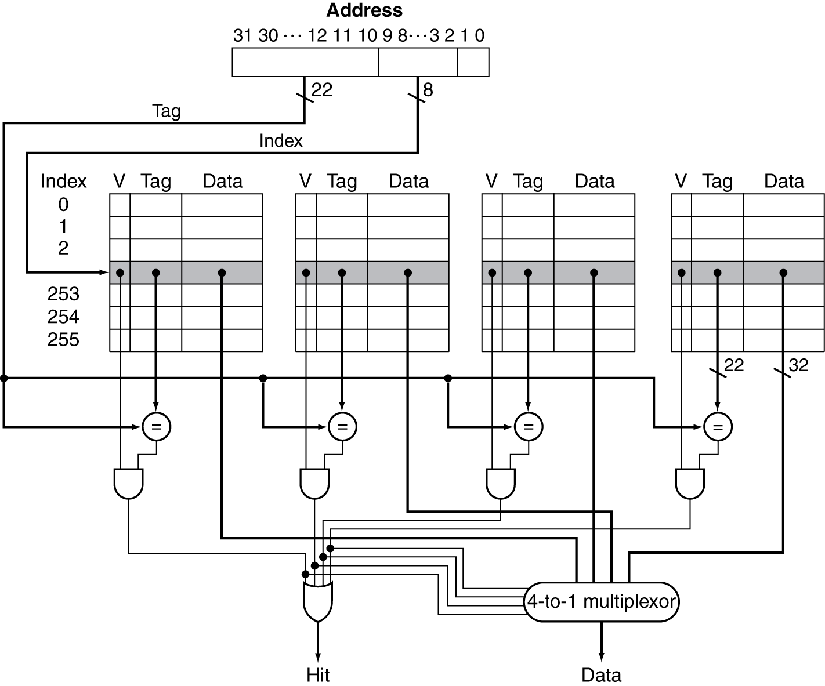
Set Associative Cache Organization

Slide 12
Replacement Policy
Direct mapped: no choice
Set associative
Prefer non-valid entry, if there is one
Otherwise, choose among entries in the set
Least-recently used (LRU)
Choose the one unused for the longest time
Simple for 2-way, manageable for 4-way, too hard beyond that
Random
Gives approximately the same performance as LRU for high associativity

Slide 13
Multilevel Caches
Primary cache attached to CPU
Small, but fast
Level-2 cache services misses from primary cache
Larger, slower, but still faster than main memory
Main memory services L-2 cache misses
Some high-end systems include L-3 cache

Slide 14
Multilevel Cache Example
Given
CPU base CPI = 1, clock rate = 4GHz
Miss rate/instruction = 2%
Main memory access time = 100ns
With just primary cache
Miss penalty = 100ns/0.25ns = 400 cycles
Effective CPI = 1 + 0.02 × 400 = 9

Slide 15
Example (cont.)
Now add L-2 cache
Access time = 5ns
Global miss rate to main memory = 0.5%
Primary miss with L-2 hit
Penalty = 5ns/0.25ns = 20 cycles
Primary miss with L-2 miss
Extra penalty = 500 cycles
CPI = 1 + 0.02 × 20 + 0.005 × 400 = 3.4
Performance ratio = 9/3.4 = 2.6

Slide 16
Multilevel Cache Considerations
Primary cache
Focus on minimal hit time
L-2 cache
Focus on low miss rate to avoid main memory access
Hit time has less overall impact
Results
L-1 cache usually smaller than a single cache
L-1 block size smaller than L-2 block size

Slide 17
Interactions with Advanced CPUs
Out-of-order CPUs can execute instructions during cache miss
Pending store stays in load/store unit
Dependent instructions wait in reservation stations
Independent instructions continue
Effect of miss depends on program data flow
Much harder to analyse
Use system simulation

Slide 18
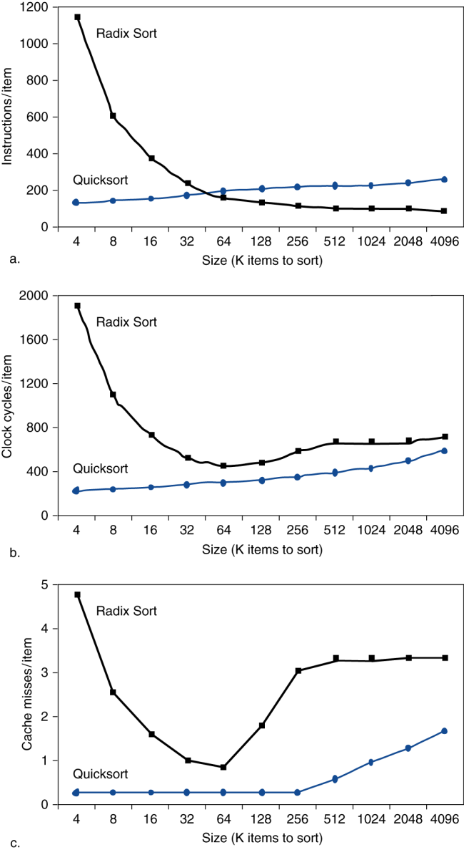
Interactions with Software
Misses depend on memory access patterns
Algorithm behavior
Compiler optimization for memory access

Slide 19
Software Optimization via Blocking
Goal: maximize accesses to data before it is replaced
Consider inner loops of DGEMM:
for (int j = 0; j < n; ++j)
{
double cij = C[i+j*n];
for( int k = 0; k < n; k++ )
cij += A[i+k*n] * B[k+j*n];
C[i+j*n] = cij;
}

Slide 20
DGEMM Access Pattern
C, A, and B arrays
older accesses
new accesses

Slide 21
Cache Blocked DGEMM
1 #define BLOCKSIZE 32
2 void do_block (int n, int si, int sj, int sk, double *A, double
3 *B, double *C)
4 {
5 for (int i = si; i < si+BLOCKSIZE; ++i)
6 for (int j = sj; j < sj+BLOCKSIZE; ++j)
7 {
8 double cij = C[i+j*n];/* cij = C[i][j] */
9 for( int k = sk; k < sk+BLOCKSIZE; k++ )
10 cij += A[i+k*n] * B[k+j*n];/* cij+=A[i][k]*B[k][j] */
11 C[i+j*n] = cij;/* C[i][j] = cij */
12 }
13 }
14 void dgemm (int n, double* A, double* B, double* C)
15 {
16 for ( int sj = 0; sj < n; sj += BLOCKSIZE )
17 for ( int si = 0; si < n; si += BLOCKSIZE )
18 for ( int sk = 0; sk < n; sk += BLOCKSIZE )
19 do_block(n, si, sj, sk, A, B, C);
20 }

Slide 22
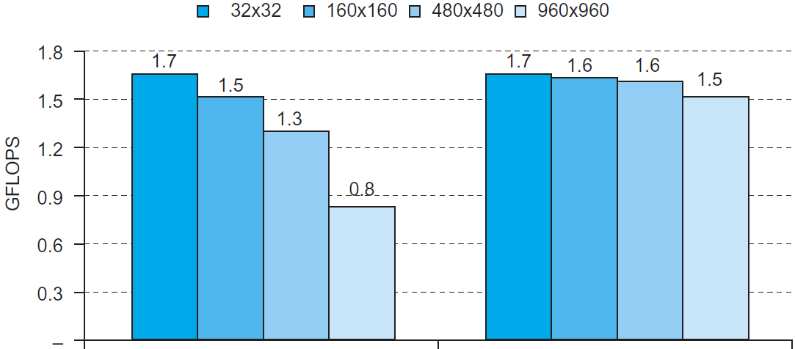
Blocked DGEMM Access Pattern
Unoptimized
Blocked

