Slide 1
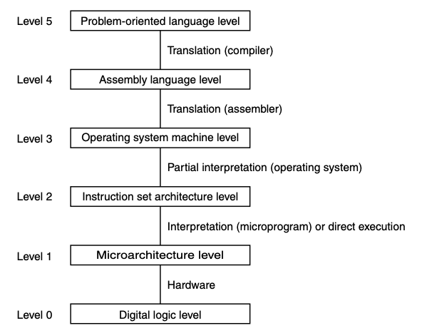
Operating System Machine Level

Slide 2
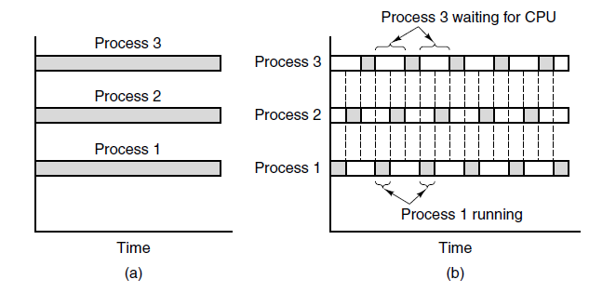
Parallel Processing
Some computations can be programmed for two or more operating processes running in parallel (i.e., simultaneously, on different processors) rather than in a single process
Processes may communicate through a shared resource
An area of memory
A file
(a) True parallel processing with multiple CPUs; (b) Parallel processing simulated by switching one CPU among three processes

Slide 3
Process Creation
Programs run as part of a process, which contains
State (program counter, stack pointer, general registers, etc.)
Address space
Processes can be created and terminated dynamically
Create a new process: fork() system call in POSIX systems
Child process is a copy of the parent process and begins executing directly after the fork() call
All segments are copied: stack, heap, etc.
fork() returns 0 for the child, returns the PID of the child to the parent
Code examples
Creating a process: processes.c
Using shared memory: shared_memory.c

Slide 4
Race Conditions
Two or more processes are reading and/or writing shared data and the result depends on the precise order of events
Example: output = A and NOT A
Example: Unlimited Starbucks Credits
Discovered by Egor Homakov in 2015
Occurs when multiple requests are made to transfer points from card A to card B in a short time frame
Steps:
Check that card A has enough credits
Transfer (add) credits to card B
Deduct credits from card A

Slide 5
Preventing race conditions through synchronization
To avoid race conditions, any operation on a shared resource must be executed atomically.
An action is atomic if it can be carried out in its entirety without interruption, and appears to be a single action to the rest of the system even if it involves multiple instructions
A critical section is a section of code in which a process accesses shared resources.
The execution of critical sections must be mutually exclusive (i.e., at most one process can be in its critical section at any time)
Can be accomplished through the use of a semaphore
Variable that stores an integer
Two operations: down (wait) and up (post)
Down waits until semaphore is non-zero, then decrements it in atomic action
Up increments semaphore
Code examples
Using shared memory: shared_memory_semaphore.c

