Slide 1
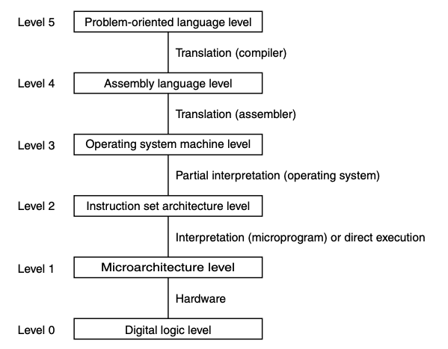
Operating System Machine Level
POSIX

Slide 2
Portable Operating System Interface (POSIX)
A family of IEEE standards (IEEE 1003) for maintaining compatibility among operating systems
Based on the design of UNIX
Defines
System calls
Command line utility
Filesystem structure
OSes that try to conform to POSIX
Linux
macOS
FreeBSD
….

Slide 3
File Systems
Used for long-term storage of information
Essential requirements
Store a large amount of information
Info must survive when processes die and the computer is off
Multiple processes must be able to access the info at once
Basic model of a disk
Linear sequence of fixed-size blocks
Supports 2 operations: read block k, write block k
OS provides abstractions to:
Locate information
Protect information
Manage free space
File – a logical unit of persistent information created by a process
File system – the part of the OS that manages files

Slide 4
File Naming
Restrictions are system dependent
Limit on length
Limit on character set
Case sensitivity
Extensions
Last part of file name following a period
Convention in a UNIX system – used by applications
Registered to applications in Windows at a lower level

Slide 5
Directory tree & path names
Directory tree
Filesystems are organized in a tree starting at a root directory
Leaves are files and empty directories
Path names
Absolute path - /home/guarnera/test.txt
Relative path
Does not start with the root directory
Relative to the working directory
Working directory - /home/guarnera/
Each process has a working directory
. – working directory
.. – parent of working directory

Slide 6
More on Files
File structure: In modern OSes, files are simply byte sequences
File types:
In POSIX systems
Regular files – contain user info
Directories – system files for maintaining file system structure
Character special files – used for I/O
Block special files – used to access disks
Text files
Encoded with ASCII, UTF-8, ISO-8859-1, etc.
Binary files
Not text files – executables, archives, non-text media
Executables must be in a system-specific format to be executed
File access:
Sequential – read all the bytes in a file in order
Random – can seek to a position in the file

Slide 7
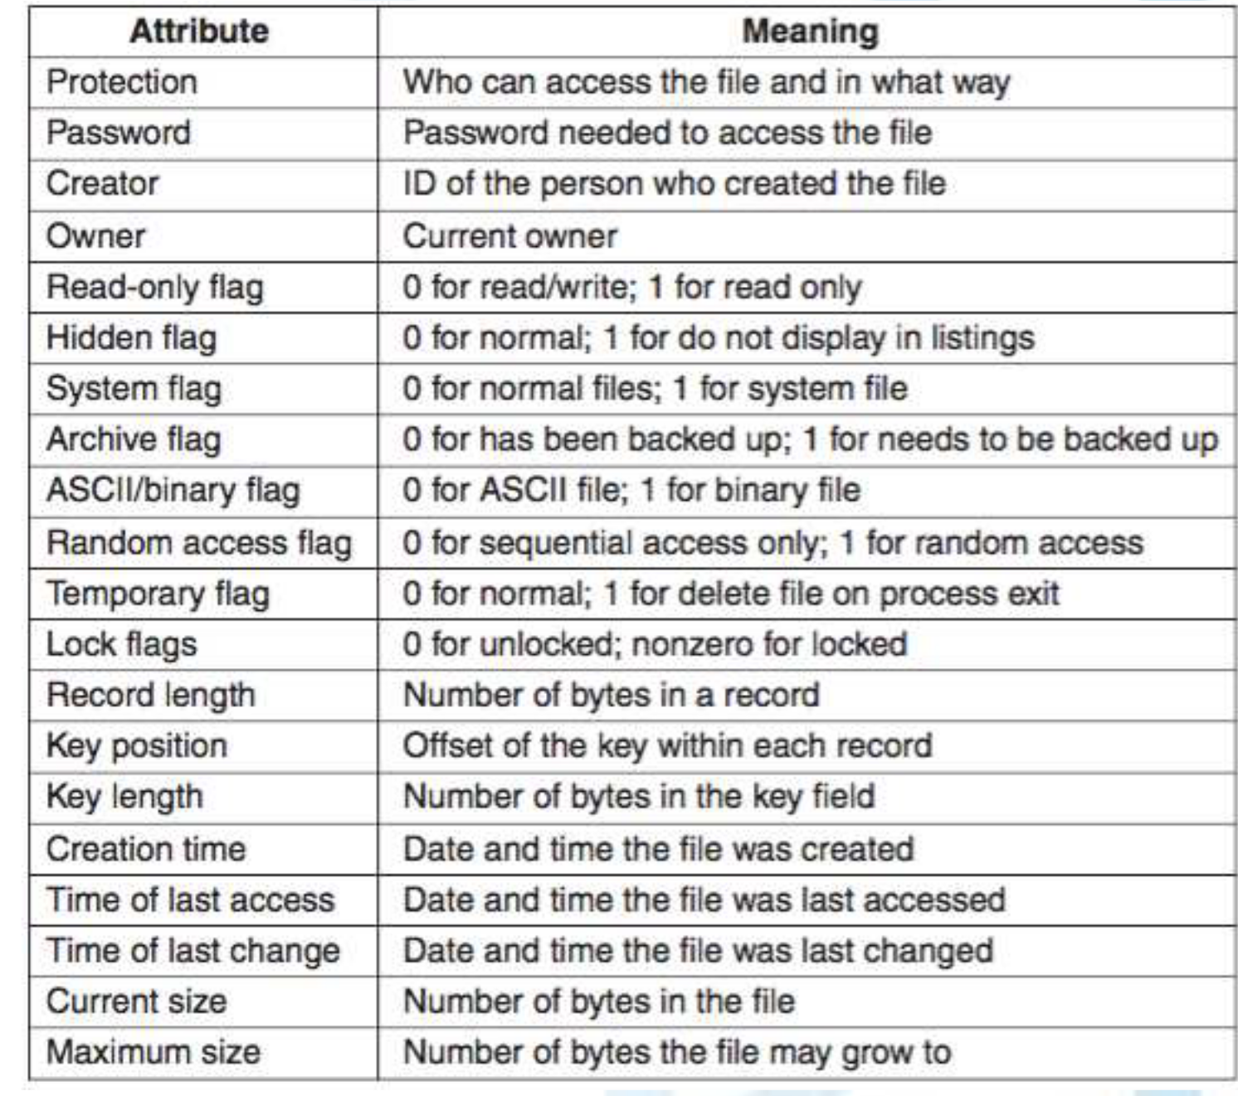
What kind of attributes are associated with a file?
Figure: Some possible file attributes (Source: [Tanenbaum and Bos, 2015])

Slide 8
Keeping track of free blocks
Linked List
Store lists of free blocks in free blocks themselves
End of each block points to next block in the list
Bitmap
Store 1 bit for every block on disk
Bit is 1 if free, 0 if used
More space efficient unless disk is very full

Slide 9
Most common system calls relating to files
Create: file is created with no data
Delete: when file is no longer needed, delete to free up space
Open: before using a file, fetch the attributes and list of disk addresses into main memory for rapid access on later calls
Close: when all accesses are finished, attributes and disk addresses are no longer needed; free up internal table space
Read: byte comes from current position; caller specifies how many bytes to read and buffer to place data
Seek: reposition file pointer to a specific place in the file
Write: if current position is the end of the file, file size increases; if current position is the middle of the file, overwrite existing data

Slide 10
File System Layout
File systems are stored on disks
Most disks can be divided up into one or more partitions
Partitions have independent file systems
Sector 0 of the disk is called the Master Boot Record (MBR)
Used to boot the computer
End of MBR contains the partition table
Partition table contains
Starting and ending address of each partition
One of the partitions is marked as active
When computer is booted
BIOS (basic input/output system) reads in and executes MBR program
Active partition is located
Active partition boot block is read and executed
Boot block program loads OS

Slide 11
Information associated with a partition
Superblock: contains key parameters about the file system (type identification, number of blocks, etc.)
Free space management: info about file system free blocks
inodes (POSIX systems): blocks that store attributes and disk block locations of filesystem objects
Root directory: contains top of the file-system tree
Files and directories:
containing all the real information
directories map names to inodes; often use a hash table
Files can be shared with symbolic links (shortcuts in windows)
Turns directory into DAG (directed acyclic graph)

Slide 12
Practice navigating a file system….

