Slide 1
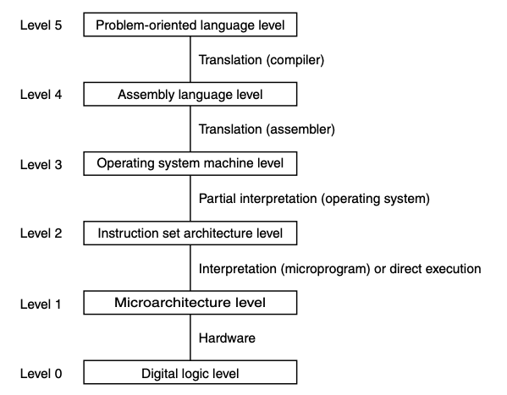
Instruction Set Architecture Level
Ch 5.1, 5.2, 5.3

Slide 2
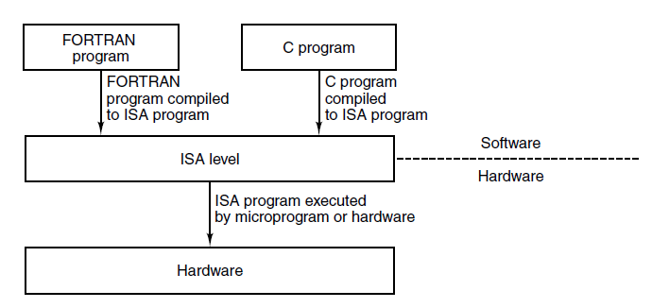
Instruction Set Architecture (ISA) level
Interface: a shared boundary across which two or more components of a computing system exchange information (Wikipedia)
Defined separately from implementation
Not necessary to know implementation details to use the interface (abstraction)
Instruction Set Architecture (ISA)
Interface between hardware and software
Compilers target the ISA level and do not need to worry about the microarchitecture level

Slide 3
What makes a good ISA?
In an ideal world: perfectly optimized for intended programming languages
(Sometimes conflicting) reality: it is backwards compatible
The new machine must be able to run old programs without changes
New machine can have new instructions and other features that can only be exploited by new software
Defines a set of instructions that can be implemented efficiently in current and future technologies
Leads to cost-effective designs over several generations
Makes hardware designers happy
Provides a clean target for compiled code
Regularity and completeness of a range of choices
Makes software designers happy

Slide 4
Characteristics of ISA level
ISA-level code is what a compiler outputs (ignoring OS calls and symbolic assembly language for the moment).
Compiler writer needs to know the characteristics of ISA level to do so
Separation of levels can be a little murky
ISA level can be specified by a formal defining document
Memory model
Registers
Data types
Instructions
Often at least two execution modes
Kernel mode: enabled for the operating system, allows all instructions
User mode: enabled for applications, does not allow certain instructions

Slide 5
Memory Models
Memory is divided into cells, each of which has an address
Modern computers use 8-bit cells (bytes)
Address space
Most machines have a single linear address space at the ISA level, extending from address 0 up to some maximum, often $2^{32}−1$ or $2^{64}−1$
A few have separate address space for instructions and data
$2^{32}$ bytes of program
$2^{32}$ bytes of data
More complex
Only need 32-bit address
Impossible for program to accidently overwrite itself
ISA usually has instructions for operating on words rather than bytes
Alignment is often required because memories operator more efficiently that way
Machines often fetch words from memory, not bytes
With 8-byte (64 bit) words, addresses that are multiples of 8 are aligned to the words

Slide 6
Alignment: a couple examples
Consider a 4-byte word
If aligned, the word would reside at an address which is a multiple of 4
If not aligned, the word could reside at address 7. Reading the word requires memory operation to
get bytes 0 – 7 (disregarding bytes 0-6)
get bytes 8-15 (disregarding bytes 11-15)
Consider an 8-byte word

Slide 7
Registers
Provided by the microarchitecture, but some registers are visible to the ISA level
Special purpose registers
Specific uses related to execution
Example: stack pointer, program counter, etc.
IJVM registers were all special purpose
Some are only available in kernel mode
Flags register, or PSW (Program Status Word): miscellaneous bits needed by CPU. Includes condition codes set by ALU, typically
N - set when result was Negative
Z – set when result was Zero
V – set when result caused oVerflow
C – set when result caused a Carry out of the leftmost bit
P – set when the result had even Parity
General purpose registers
Available for the program to use for any purpose
Example: temporary arithmetic results, etc.
Often interchangeable, but typically adopt conventions about usage
Example: deciding which registers would be used for parameters / procedure calls vs. scratch registers

Slide 8
Categories of instructions
LOAD and STORE: Move data between memory and registers
MOVE: Copy data among registers
Arithmetic
Boolean
Compare and branch

Slide 9
Examples of ISAs
Intel’s IA-32, as embodied in the Core i7
Desktop machines and server farms
ARM v7 architecture, implemented in the OMAP4430 system on a chip
Phones, tablets, other mobile devices
AVR 8-bit architecture, used by the ATmega168 microcontroller
Low-end embedded systems such as traffic lights & clock radios

Slide 10
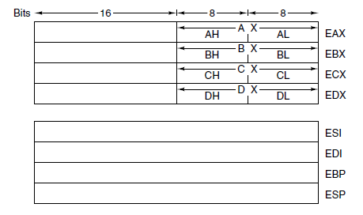
Overview of the Core i7 ISA Level: primary registers
arithmetic
holding pointers
looping
multiplication & division
source string
destination string
bottom of stack (like LV)
top of stack (like SP)
not used anymore…. kept just for backwards compatibility
program counter
PSW (program status word)

Slide 11
Overview of the OMAP4430 ARM ISA Level: general registers
Not shown: PSR (program status register) – effectively, PSW

Slide 12
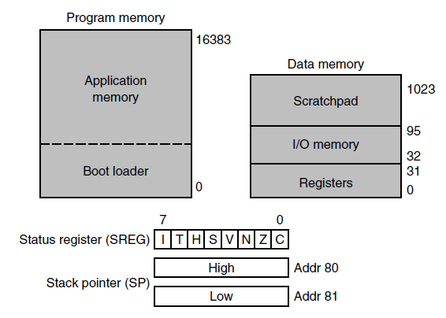
Overview of the ATmega168 AVR ISA Level: on-chip register and memory organization
16 KB of program memory and 1KB of data memory
application code
only this code can update flash memory
PSW

