Slide 1
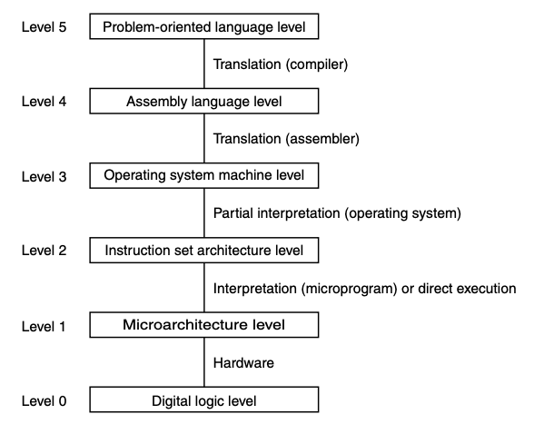
Microarchitecture Level
Ch 4.3
Example:
IJVM
macroarchitecture
Mic-1
microarchitecture

Slide 2
IJVM Memory Model
No memory addresses are used directly at the ISA level
All variable references are relative to some base address
Areas:
Constant Pool
Read-only
Stores constants and strings
Loaded when the program is brought into memory
CPP points to the beginning of the constant pool
Local Variable Frame & Operand Stack
Area of the call stack between LV and SP
Method Area (the code)
Contains the program itself
Often called “text segment” in UNIX processes
Treated as a byte array
PC stores the address of the instruction to be fetched out

Slide 3
IJVM Instruction Set
Op-code (Hex) | Assembly Language Mnemonic | Operands | Description
0x10 | BIPUSH | byte | Push a byte onto stack
0x59 | DUP | N/A | Copy top word on stack and push onto stack
0xA7 | GOTO | label name | Unconditional jump
0x60 | IADD | N/A | Pop two words from stack; push their sum
0x7E | IAND | N/A | Pop two words from stack; push Boolean AND
0x99 | IFEQ | label name | Pop word from stack and branch if it is zero
0x9B | IFLT | label name | Pop word from stack and branch if it is less than zero
0x9F | IF_ICMPEQ | label name | Pop two words from stack and branch if they are equal
0x84 | IINC | variable name, byte | Add a constant value to a local variable
0x15 | ILOAD | variable name | Push local variable onto stack
0xB6 | INVOKEVIRTUAL | method name | Invoke a method
0x80 | IOR | N/A | Pop two words from stack; push Boolean OR
0xAC | IRETURN | N/A | Return from method with integer value
0x36 | ISTORE | variable name | Pop word from stack and store in local variable
0x64 | ISUB | N/A | Pop two words from stack; push their difference
0x13 | LDC_W | constant name | Push constant from constant pool onto stack
0x00 | NOP | N/A | Do nothing
0x57 | POP | N/A | Delete word from top of stack
0x5F | SWAP | N/A | Swap the two top words on the stack
0xC4 | WIDE | N/A | Prefix instruction; next instruction has a 16-bit index

Slide 4
IJVM Instruction Set
Op-code (Hex) | Assembly Language Mnemonic | Operands | Description
0x10 | BIPUSH | byte | Push a byte onto stack
0x59 | DUP | N/A | Copy top word on stack and push onto stack
0xA7 | GOTO | label name | Unconditional jump
0x60 | IADD | N/A | Pop two words from stack; push their sum
0x7E | IAND | N/A | Pop two words from stack; push Boolean AND
0x99 | IFEQ | label name | Pop word from stack and branch if it is zero
0x9B | IFLT | label name | Pop word from stack and branch if it is less than zero
0x9F | IF_ICMPEQ | label name | Pop two words from stack and branch if they are equal
0x84 | IINC | variable name, byte | Add a constant value to a local variable
0x15 | ILOAD | variable name | Push local variable onto stack
0xB6 | INVOKEVIRTUAL | method name | Invoke a method
0x80 | IOR | N/A | Pop two words from stack; push Boolean OR
0xAC | IRETURN | N/A | Return from method with integer value
0x36 | ISTORE | variable name | Pop word from stack and store in local variable
0x64 | ISUB | N/A | Pop two words from stack; push their difference
0x13 | LDC_W | constant name | Push constant from constant pool onto stack
0x00 | NOP | N/A | Do nothing
0x57 | POP | N/A | Delete word from top of stack
0x5F | SWAP | N/A | Swap the two top words on the stack
0xC4 | WIDE | N/A | Prefix instruction; next instruction has a 16-bit index

Slide 5
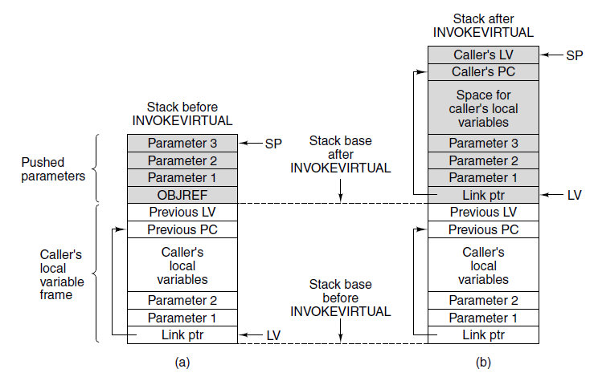
INVOKEVIRTUAL
IJVM instruction for calling a procedure
To call a procedure
Push OBJREF onto the stack (for consistency with JVM)
Push the procedure arguments onto the stack
Issue INVOKEVIRTUAL
Memory before executing INVOKEVIRTUAL. After executing it.

Slide 6
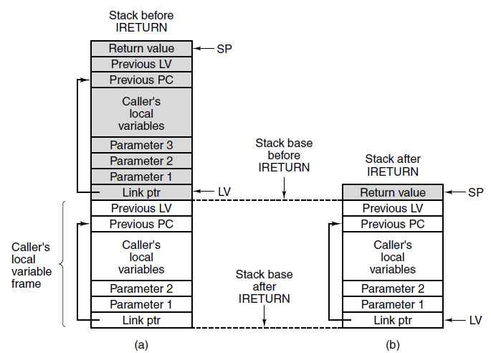
IRETURN
IJVM instruction for returning from a procedure
Memory before executing IRETURN. After executing it.

Slide 7
IJVM Instruction Set
Op-code (Hex) | Assembly Language Mnemonic | Operands | Description
0x10 | BIPUSH | byte | Push a byte onto stack
0x59 | DUP | N/A | Copy top word on stack and push onto stack
0xA7 | GOTO | label name | Unconditional jump
0x60 | IADD | N/A | Pop two words from stack; push their sum
0x7E | IAND | N/A | Pop two words from stack; push Boolean AND
0x99 | IFEQ | label name | Pop word from stack and branch if it is zero
0x9B | IFLT | label name | Pop word from stack and branch if it is less than zero
0x9F | IF_ICMPEQ | label name | Pop two words from stack and branch if they are equal
0x84 | IINC | variable name, byte | Add a constant value to a local variable
0x15 | ILOAD | variable name | Push local variable onto stack
0xB6 | INVOKEVIRTUAL | method name | Invoke a method
0x80 | IOR | N/A | Pop two words from stack; push Boolean OR
0xAC | IRETURN | N/A | Return from method with integer value
0x36 | ISTORE | variable name | Pop word from stack and store in local variable
0x64 | ISUB | N/A | Pop two words from stack; push their difference
0x13 | LDC_W | constant name | Push constant from constant pool onto stack
0x00 | NOP | N/A | Do nothing
0x57 | POP | N/A | Delete word from top of stack
0x5F | SWAP | N/A | Swap the two top words on the stack
0xC4 | WIDE | N/A | Prefix instruction; next instruction has a 16-bit index

Slide 8
IJVM Instruction Set
Op-code (Hex) | Assembly Language Mnemonic | Operands | Description
0x10 | BIPUSH | byte | Push a byte onto stack
0x59 | DUP | N/A | Copy top word on stack and push onto stack
0xA7 | GOTO | label name | Unconditional jump
0x60 | IADD | N/A | Pop two words from stack; push their sum
0x7E | IAND | N/A | Pop two words from stack; push Boolean AND
0x99 | IFEQ | label name | Pop word from stack and branch if it is zero
0x9B | IFLT | label name | Pop word from stack and branch if it is less than zero
0x9F | IF_ICMPEQ | label name | Pop two words from stack and branch if they are equal
0x84 | IINC | variable name, byte | Add a constant value to a local variable
0x15 | ILOAD | variable name | Push local variable onto stack
0xB6 | INVOKEVIRTUAL | method name | Invoke a method
0x80 | IOR | N/A | Pop two words from stack; push Boolean OR
0xAC | IRETURN | N/A | Return from method with integer value
0x36 | ISTORE | variable name | Pop word from stack and store in local variable
0x64 | ISUB | N/A | Pop two words from stack; push their difference
0x13 | LDC_W | constant name | Push constant from constant pool onto stack
0x00 | NOP | N/A | Do nothing
0x57 | POP | N/A | Delete word from top of stack
0x5F | SWAP | N/A | Swap the two top words on the stack
0xC4 | WIDE | N/A | Prefix instruction; next instruction has a 16-bit index

Slide 9
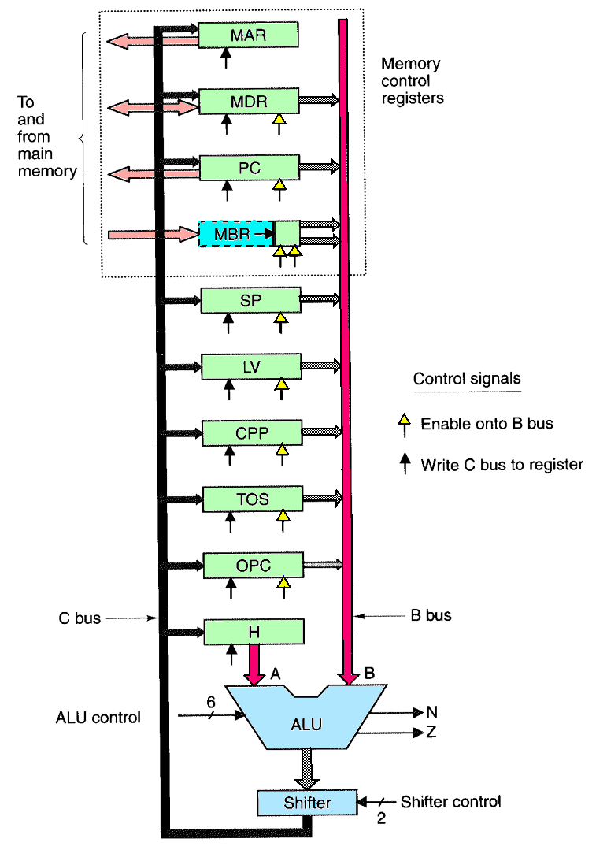
IADD
MAR = SP = SP – 1; rd
Read in next-to-top word of stack
H = TOS
H = top of stack
MDR = TOS = MDR + H; wr; goto Main1
Add top two words; write to top of stack

Slide 10
Example: add_procedure.jas
See Fig 4-17 for the mapping of all IJVM instructions to Mic-1 microinstructions

