Slide 1
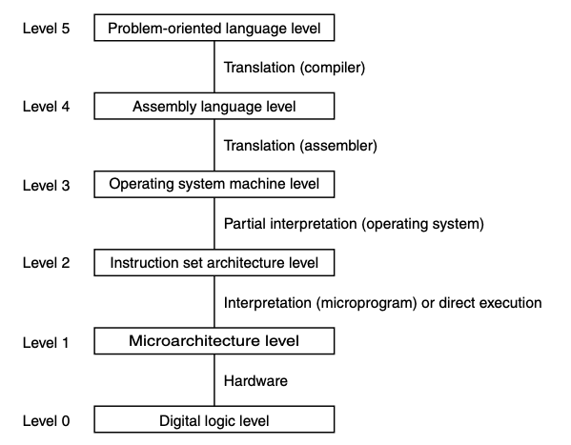
Microarchitecture Level
Ch 4.1
Example:
IJVM
Mic-1

Slide 2
JVM versus IJVM ISA
Java is a high-level object-oriented language; main goal is portability
Designers achieved this by defining JVM (Java Virtual Machine)
Machine could be implemented in hardware or software (common)
JVM is a low-level machine specification with a corresponding JVM ISA
An ISA specifies instructions that a CPU provides
Java programs are compiled into the ISA of this machine
Anywhere machine is implemented, you can run the code
You could compile other languages down into the JVM ISA code if you wanted (or write JVM ISA code directly)
IJVM: a subset of JVM which only has integer instructions
We look at a possible hardware implementation of IJVM
The hardware machine is called Mic-1

Slide 3
Mic-1 Microprogram
This Mic-1 machine will have a microprogram in ROM
Responsible for fetching, decoding, and executing the individual IJVM instructions
Think of each ISA instruction as a function implemented by the microprogramming
Main program is an infinite loop which figures out what to execute next and executes it
Has state consisting of variables (registers), which can be accessed by all functions (instructions)
Each IJVM instruction does one simple thing: e.g., add, load from a memory location, etc.
Each IJVM instruction consists of a few fields (usually one or two):
First field is opcode (operation code) which specifies what type of instruction, e.g., add, load, branch
Second field, if it exists, will be the operand, e.g., on memory load, the address to load from

Slide 4
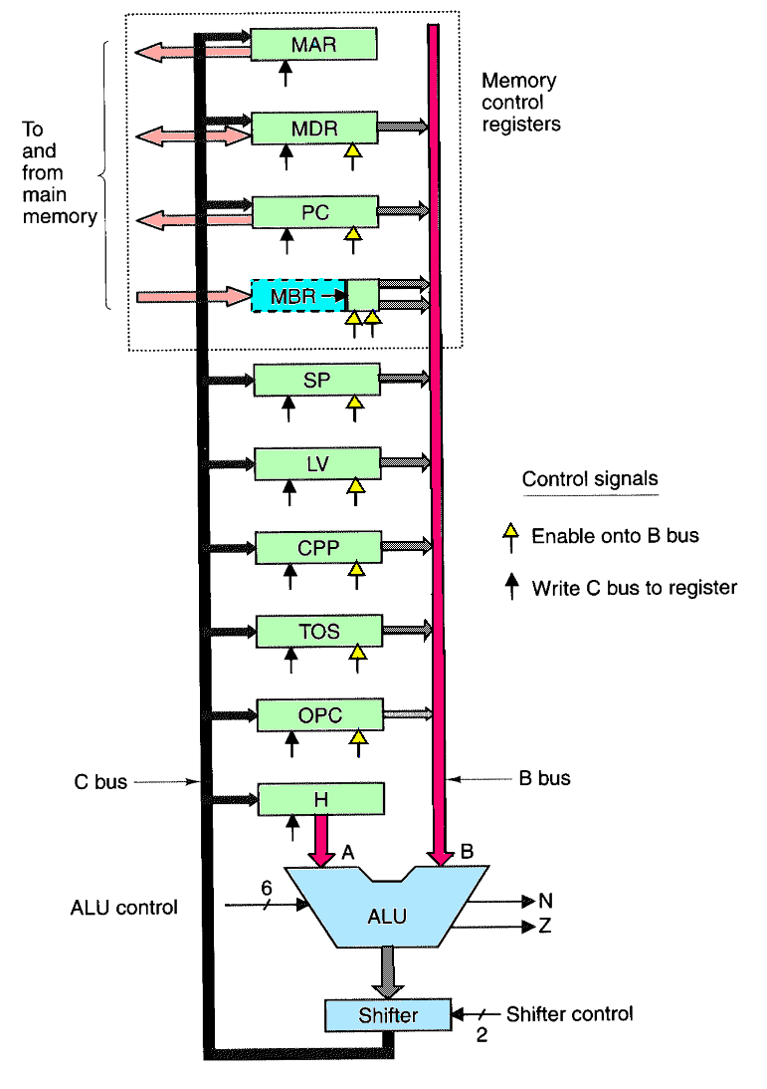
Data Path
The basic hardware that the microprogram will control
Contains the ALU, its inputs, and its outputs
Access to these hardware elements can only be done at the microprogram level; ISA cannot manipulate this directly
Register names correspond to variables of the same name at the ISA level
The data path of the example microarchitecture used in this chapter.

Slide 5
Data Path
Buses
A Bus - Only contents of register H can go on this bus and it serves as left input of ALU
B Bus - serves as right input to ALU; most registers can put their contents on this bus
C Bus - carries ALU output back into registers

Slide 6
Data Path
Registers
32 bit registers
each has one or two control inputs for outputting and loading the register
overview
MAR - Memory Address register
MDR - Memory Data Register
PC - Program Counter
MBR - Memory Buffer Register
SP - Stack Pointer
LV - Local Variable pointer
CPP - Constant Pool Pointer
TOS - Top of Stack register
OPC - OpCode register
H - Holding Register is the left ALU input

Slide 7
Data Path
Control Signals:
9 signals to control writing data from C bus into registers
9 signals to enable registers onto B bus for ALU input
8 signals to control ALU and shifter functions
3 memory control signals (not shown)
Total: 29 control signals in microarchitecture

Slide 8
ALU – identical to the one in Fig 3-18 & Fig 3-19
Recall:
Figure 3-19. ALU slices connected to make a 32-bit ALU.
6 bits of ALU control
F0 and F1 - selects the ALU function: AND, OR, NOT or ADD
INVA - complement A input (one's complement)
ENA - enable the A input (else zero)
ENB - enable the B input (else zero)
INC - lowest order carry in bit (allows adding 1)
Not all 64 combinations of the ALU input control do something useful.
2 ALU status output bits
N - negative flag
Z - zero flag

Slide 9
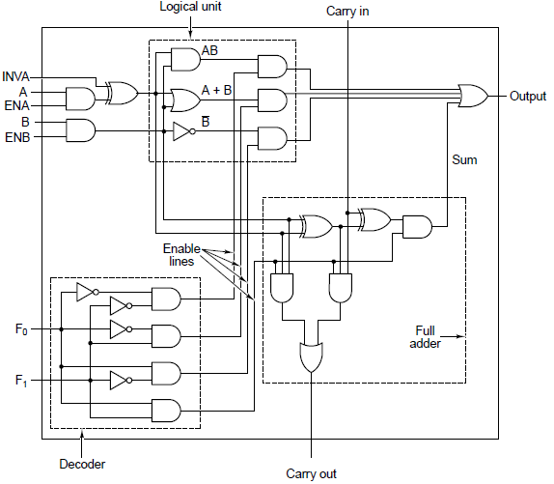
ALU – identical to the one in Fig 3-18 & Fig 3-19
Recall:
Figure 3-18. A 1-bit ALU.

Slide 10
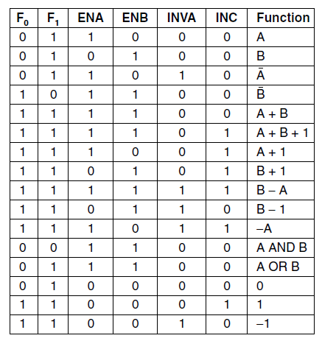
ALU
6 control lines
2 inputs – Buses A and B
A input is holding register H
B input can be from one of the 9 sources attached to the bus
Loading H
Pass the value to load through B
Use addition, except with ENA set to 0 which forces A to be 0
1 output – Bus C
Useful combinations of ALU signals and the function performed.

Slide 11
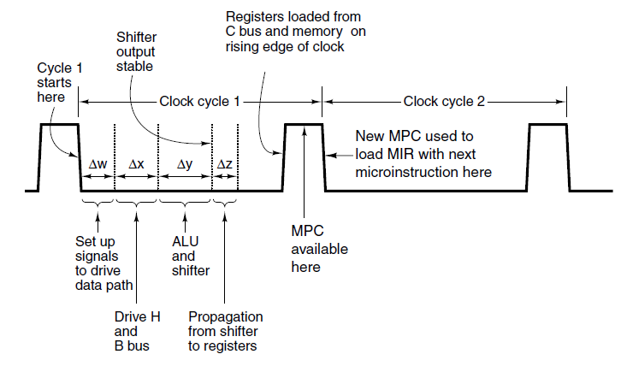
Data path timing – steps (with subcycle length)
Control signals are set up (Δw)
Registers are loaded onto the B bus (Δx)
The ALU and shifter operate (Δy)
Results propagate along the C bus back to the registers (Δz)
Timing of steps is implicit within 1 clock cycle, which is timed by propagation time. That is, no explicit clock pulse triggers the subcycles.
Timing diagram of one data path cycle.
Notes:
Implicit: no explicit clock pulses

Slide 12
Data Path
The basic hardware that the microprogram will control
Contains the ALU, its inputs, and its outputs
Access to these hardware elements can only be done at the microprogram level; ISA cannot manipulate this directly
Register names correspond to variables of the same name at the ISA level
The data path of the example microarchitecture used in this chapter.

Slide 13
Data Path
The basic hardware that the microprogram will control
Contains the ALU, its inputs, and its outputs
Access to these hardware elements can only be done at the microprogram level; ISA cannot manipulate this directly
Register names correspond to variables of the same name at the ISA level
The data path of the example microarchitecture used in this chapter.

Slide 14
Data Path
The basic hardware that the microprogram will control
Contains the ALU, its inputs, and its outputs
Access to these hardware elements can only be done at the microprogram level; ISA cannot manipulate this directly
Register names correspond to variables of the same name at the ISA level
The data path of the example microarchitecture used in this chapter.

Slide 15
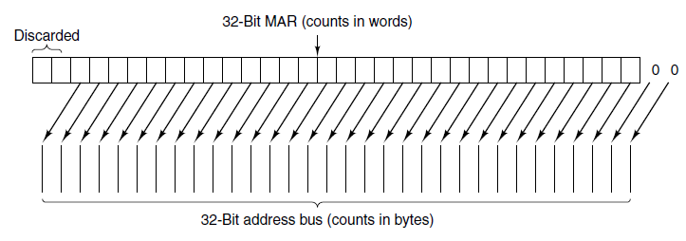
Memory operations
Memory takes time; reading on cycle k means data won’t be available until cycle k+2
32-bit word-addressable memory port (data cache interface)
Controlled by MAR (Memory Address Register) and MDR (Memory Data Register)
8-bit byte-addressable memory port (instruction cache interface)
Controlled by PC register, which reads 1 byte into the lower-order byte of MBR
MAR contains word address; PC contains byte addresses
Putting a 2 in PC and starting a memory read will read byte 2 from memory and put it in the low-order 8 bits of MBR
Putting a 2 in MAR and starting a memory read will read bytes 8-11 (i.e., word 2) from memory and put them in MDR
Mapping of the bits in MAR to the address bus.

Slide 16
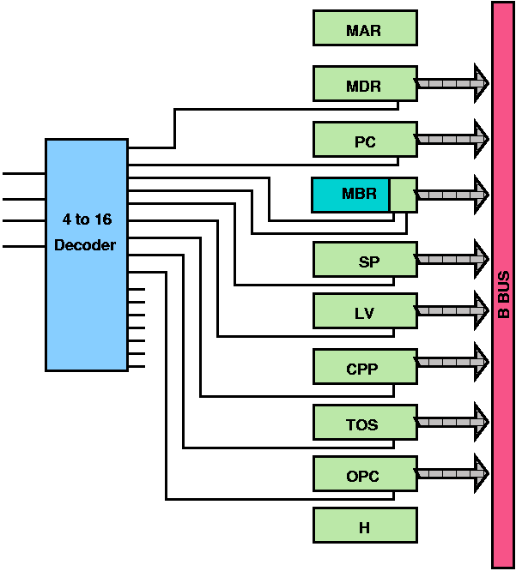
Microinstruction
Recall the control signals:
9 signals to control writing data from C bus into registers
9 signals to enable registers onto B bus for ALU input
8 signals to control ALU and shifter functions
3 memory control signals (not shown)
Total: 29 control signals in microarchitecture
We can only put one register onto the B bus at the same time.
With a decoder, we can control the data path with just 24 control signals (29 – 9 + 4)
Binary Value | Register Enabled
0 | MDR
1 | PC
2 | MBR
3 | MBRU
4 | SP
5 | LV
6 | CPP
7 | TOS
8 | OPC
9 - 15 | none

Slide 17
Microinstruction
36 bits: all necessary to carry out an instruction
Can be grouped into 6 categories
Determine next microinstruction
Addr – address (in control store) of potential next microinstruction
JAM – determines how the next microinstruction is selected
Operate the data path
ALU – ALU and shifter functions
C – selects which registers are written from the C bus
Mem – memory functions
B – select the B bus source

Slide 18
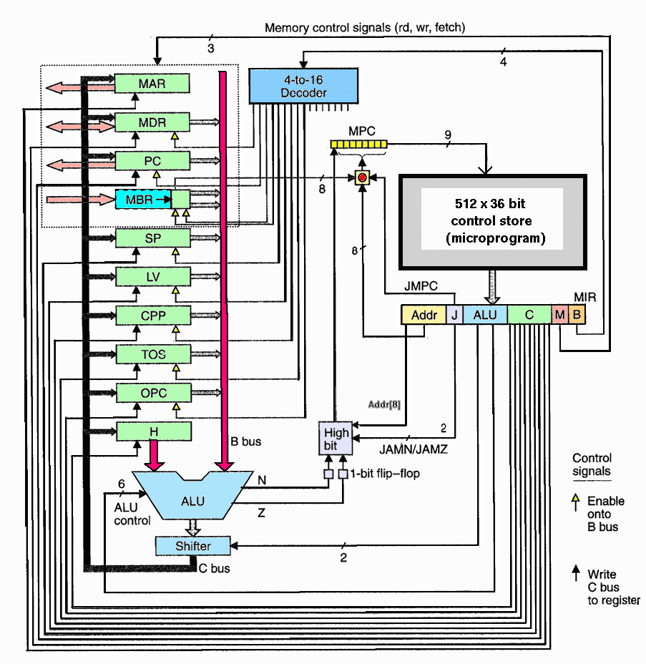
Complete Mic-1 Microarchitecture
Notes:
Left: data path
Right: Control section
Some things haven’t yet been explained (e.g., MPC, MIR, high-bit, JMPC, … )
By the end, all of this should be understood

Slide 19
Microinstruction control
The sequencer must produce two kinds of information each cycle:
The state of every control signal in the system
The address of the microinstruction that is to be executed next

Slide 20
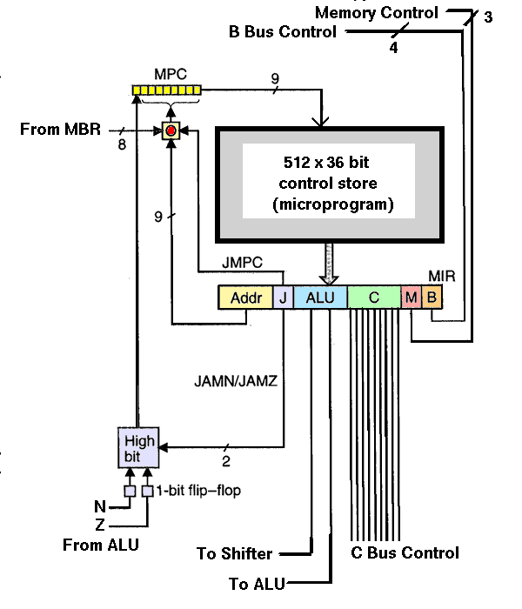
Mic-1 Control Store
Abstractly, it contains the complete microprogram (all microinstructions needed to implement the entire IJVM ISA)
Contains 512 words (why we needed 9 address bits) each consisting of 36-bit instructions
Very different from main memory:
Instructions in main memory are executed in address order (except for branches)
Microinstructions are not
Registers to execute the microprogram
MPC (MicroProgram Counter): holds the 9-bit address of the next instruction
MIR (MicroInstruction Register): holds currently executing microinstruction
To support branching instructions that are conditional based on the result of a computation, the three bits of the JAM field are used (JAMN, JAMZ, JMPC)

Slide 21
Complete Mic-1 Microarchitecture
Notes:
Left: data path
Right: Control section

