Slide 1
Memory
Ch 3.3
Circuits to “remember” previous input values

Slide 2
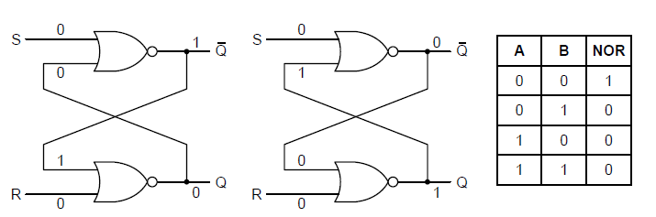
Latches
Unlike a combinatorial circuit, the outputs of a latch are not uniquely determined by the current inputs.
SR latch
Two inputs: $S$for setting the latch, and $R$ for resetting/clearing the latch
Two outputs: $Q$and $\overline{Q}$
To see how this works, let’s assume S and R are both 0 (as they are most of the time). We obtain two consistent states based on the value of Q.
(a) NOR latch in state 0. (b) NOR latch in state 1. (c) Truth table for NOR.
Q: If the latch is in state 0 (or 1), what happens when S or R are set to 1?

Slide 3
Latches: SR Latch
(a) NOR latch in state 0. (b) NOR latch in state 1. (c) Truth table for NOR.
Assuming we are in state 0:
S is set to 1:
R is set to 1:
Assuming we are in state 1:
S is set to 1:
R is set to 1:

Slide 4
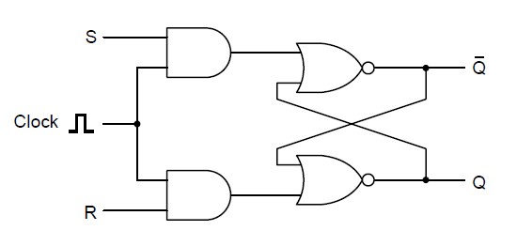
Latches: Clocked SR Latch
Goal: Prevent a latch from changing state except at certain specified times.
Inputs:
$S$for setting the latch,
$R$ for resetting/clearing the latch
Clock, which is normally 0, and on enable/strobe becomes 1
Two outputs: $Q$and $\overline{Q}$

Slide 5
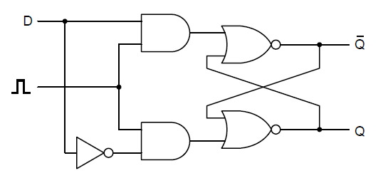
Latches: Clocked D Latch
Goal: Prevent a nondeterministic state (the instability of SR latches)
Inputs:
$D$the value to be stored
Clock, which is normally 0, and on enable/strobe becomes 1
Two outputs: $Q$and $\overline{Q}$
Note: latch is level-triggered, meaning state changes when the clock is 1

Slide 6
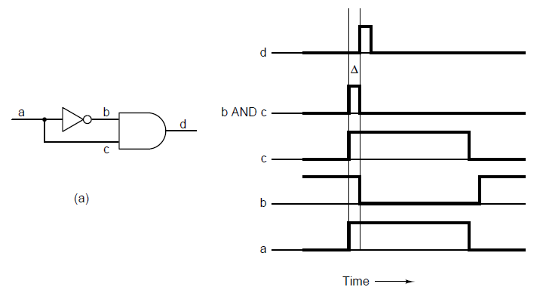
Flip-flops
A flip-flop is edge-triggered, meaning state changes when the clock transitions
One approach to design is to generate a very short pulse on the rising edge of the clock cycle
(a) A pulse generator (b) Timing at four points in the circuit.

Slide 7
Flip-flops: D flip-flop
Note: flip-flop is edge-triggered, meaning state changes when the clock transitions

Slide 8
Symbols for latches and flip-flops
D latch
is 1
D latch
is 0
D flip-flop
is on rising edge
D flip-flop
is on falling edge
Changes state when clock…

Slide 9
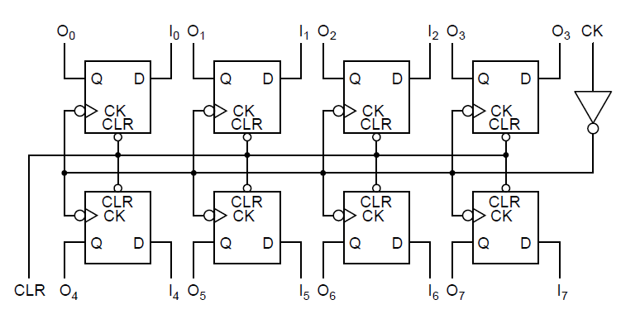
Registers
Hold data types larger than 1 bit in length by combining flip-flops in groups
An 8-bit register constructed from single-bit flip-flops
Clear signal CLR forces all flip-flops to their 0 state
Clock CK is inverted at input and again at each flip-flop

Slide 10
Memory Organization
One output for every bit stored is not feasible
8 GB of RAM is 68,719,476,736 bits
Only need as many output pins as the largest number of bits to read at once
Input
An address to read from or write to
Data bits that will be written to memory
Control bits (to indicate reading or writing, etc)
To cut down on inputs, sometimes the address is presented in 2 phases: the first to select a row, the second for the column
Use the address bits and digital logic (such as decoders) to route the signal to the correct place

Slide 11
RAM (Random Access Memory) Types
1. Static RAMs (SRAMs)
Built from flip-flops
Contents are retained as long as power is on
2. Dynamic RAMs (DRAMs)
Use a single transistor and a capacitor to store a bit
Capacitor is either charged or not, to represent 1 and 0
Since each bit is physically small, DRAM has a higher density than SRAM
Electric charge leaks out, so each bit must be refreshed every few milliseconds
Slower than SRAM
3. Synchronous DRAM (SDRAM)
Not actually directly controlled by the CPU
Once it is told what to do, it uses the system clock to conduct its own instructions
CPU is free to do other things while memory is working
4. Double Data Rate RAM (DDR SDRAM)
Chip produces output on the rising and falling edges of the clock

Slide 12
Non-volatile memory
Keeps its state even with no power
Read-only memory (ROM)
Cannot be changed or erased
Contents are “burned in” to the chip during manufacturing
Cheap, but inflexible
Electrically Erasable Programmable ROM (EEPROM)
Erasable and writable
Slower than RAM, smaller in capacity, more expensive
Recent kind: flash memory
Used by USB sticks, SD cards, SSDs

