Slide 1
Basic Digital Logic Circuits
Ch 3.2

Slide 2
Integrated Circuits (ICs or chips)
Normally made from silicon
Contains circuits with gates to carry out computations
Input and output is through pins
ICs can be very simple (compute a single Boolean function) or very complicated (CPU)
For complicated ICs, certain input pins are control points which specify which circuitry to use for the computation
Common types of integrated-circuit packages, including (a) a dual-inline package (DIP), (b) pin grid array (PGA), and (c) land grid array (LGA).
Combinatorial circuit: circuit whose output only depends on the input, and not stored values

Slide 3
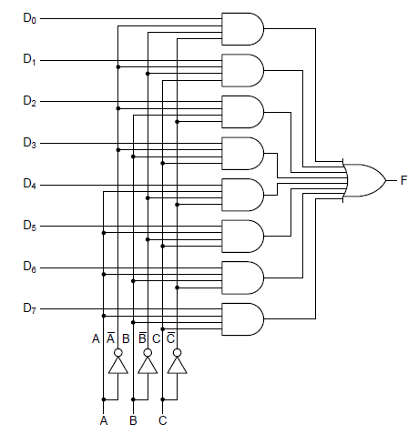
Multiplexer
Circuit with $2^{n}$ data inputs, n control inputs, and one output
Control input pattern selects one of the data inputs
Uses:
1. Parallel to series conversion Apply the data inputs and then cycle through all control input combinations to send each of the data inputs to the output one at a time
2. Compute arbitrary Boolean function Example – Boolean function of 3 variables
3 control bits, 8 data bits
Each data bit represents one row’s output from the truth table
Each control bit represents one variable
Ex: An eight-input multiplexer circuit.

Slide 4
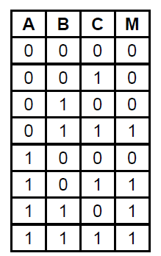
Multiplexer Example: Compute Majority Function
The same 8-input multiplexer wired to compute the majority function of 3 variables.
Truth table for the majority function
The wired eight-input multiplexer

Slide 5
Other circuits
Multiplexer
Demultiplexer
Inverse of a multiplexer
A single input is routed to one of the $2^{n}$ outputs, depending on the values of the n control lines
Decoder
Comparator
Shifter
Adder
ALU
Clock

Slide 6
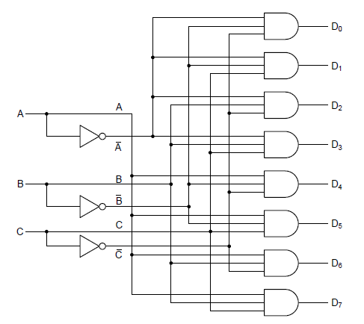
Decoder (Fig 3-13)
n input bits, $2^{n}$ output bits
Exactly 1 of the outputs is 1, the rest 0
Which output is 1 is determined by the input bits
A 3-to-8 decoder circuit

Slide 7
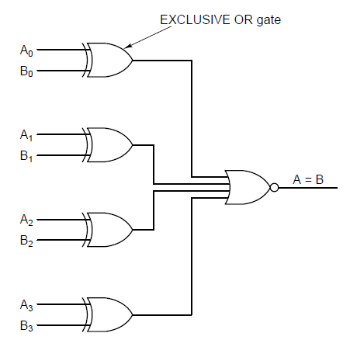
Comparator (Fig 3-14)
Compares two input words, producing a 1 if they are equal and a 0 otherwise
A simple 4-bit comparator

Slide 8
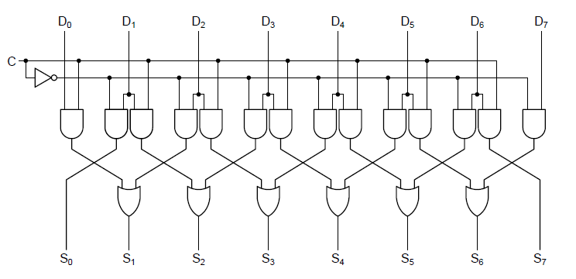
Shifter (Fig 3-15)
C determines direction (0 for left, 1 for right)
When C = 0, a 0 is inserted into bit 7 (S7) & the left pair of AND gates are activated
When C = 1, a 0 is inserted into bit 0 (S0) & the right pair of AND gates are activated
A 1-bit left/right shifter.

Slide 9
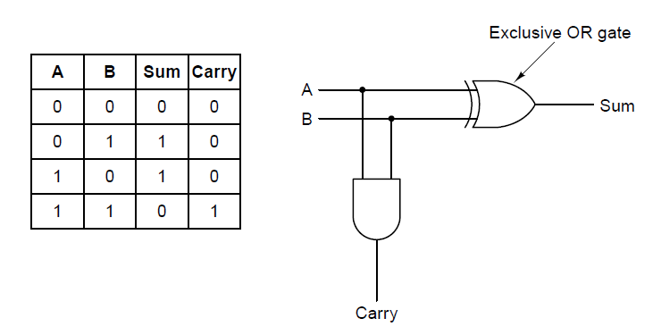
Half-Adder (Fig 3-16)
Goal: Add A+B
Output: Sum and Carry
A circuit for a half adder.
Truth table for 1-bit addition.
Adequate for summing low-order bits of two multi-bit input words, but not for a bit position in the middle of the word because it doesn’t handle the carry into the position from the right.

Slide 10
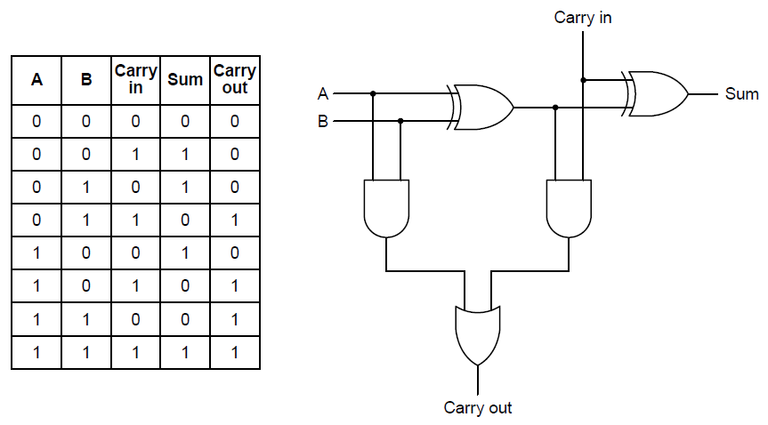
Full-Adder (Fig 3-17)
Goal: Add A+B, taking into consideration an input carry
Output: Sum and Carry
Truth table for a full adder.
A circuit for a full adder.

Slide 11
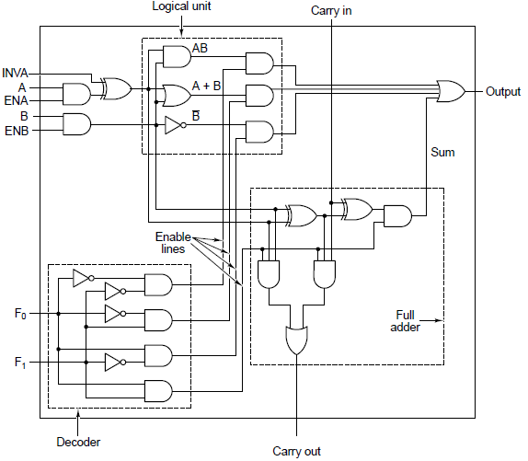
ALU – Arithmetic Logic Unit (Fig 3-18)
Goal: Add A+B, taking into consideration an input carry
Output: Sum and Carry
A 1 bit ALU

Slide 12
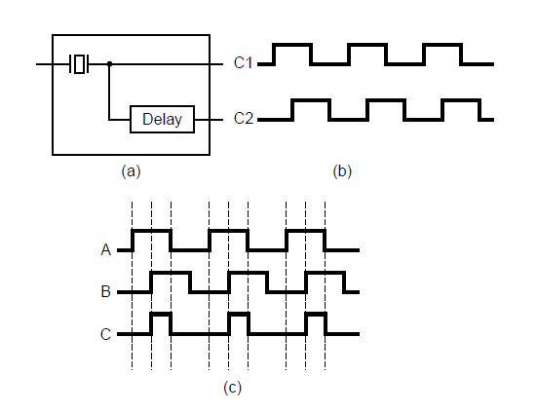
Clock (Fig 3-20)
Provides synchronization.
The time interval between corresponding edges of two connective pulses is known as the clock cycle time
Clocks are symmetric (equal time high & equal time low)
(a) A clock. (b) The timing diagram for the clock.
(c) Generation of an asymmetric clock by combining clock signals from A and B

Slide 13
In-class
The ALU of figure 3-19 is capable of doing 8-bit 2's complement additions. Is it also capable of doing 2's complement subtractions? If so, explain how. If not, how would you modify it to be able to do subtractions?
A common chip is a 4-bit adder. Four of these chips can be hooked up to form a 16-bit adder. How many pins would you expect the 4-bit adder chip to have? Why?
Fig 3-19: Eight 1-bit ALU slices connected to make an 8-bit ALU. The enables and invert signals are not shown for simplicity. The INC signal is useful only for addition operations. When present, it increments (i.e., adds 1 to) the result, making it possible to compute sums like A+1 and A+B+1

