Slide 1
Gates and Boolean Algebra
Ch 3.1

Slide 2
Gates
Digital circuit is one in which only two logical values are present
Different values represented by varying signals
Signal between 0 and 0.5 volts (often binary/logical 0)
Signal between 1 and 1.5 volts (often binary/logical 1)
Voltages outside those ranges not permitted
Gates: tiny electronic devices that compute various functions of these two-valued signals
Form the hardwire basis on which all digital computers are built
Details of how gates work inside is the device level: beyond our scope (below our level 0)

Slide 3
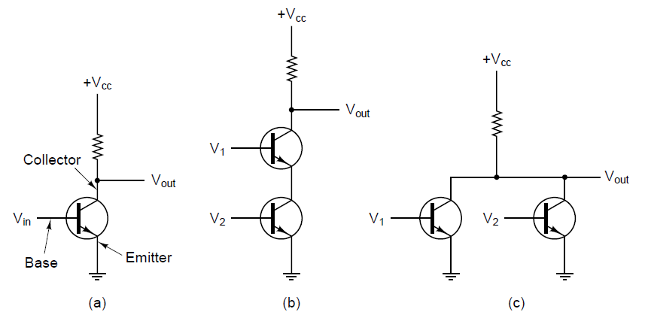
Gates at the device level … very briefly
Input (Vin, or V1, V2) & output voltage (Vout)
When input voltage is low (below a certain critical value)
transistor turns off and acts like an infinite resistance
Vout is high: takes on value close to Vcc (typically +1.5 volts -- logical 1)
When input voltage is high (exceeds critical value)
transistor switches on and acts like a wire
Vout is low: pulled down to ground (0 volts -- logical 0)
Output is 0 iff both inputs are 1
Converts logical 0 into logical 1, and vice versa
Output is 1 iff both inputs are 0
(a) A transistor inverter. (b) A NAND gate. (c) A NOR gate.

Slide 4
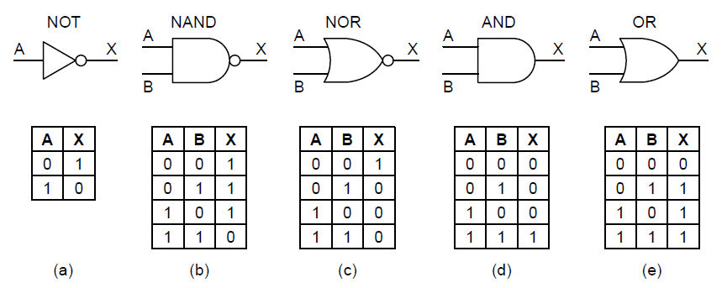
The three simplest gates: NOT, NAND, NOR
We will represent gates as symbols
Small circles in the gate are called inversion bubbles
Gate symbols:
Boolean function: (described by a truth table)

Slide 5
Two additional gates: AND, OR
We will represent gates as symbols
Small circles in the gate are called inversion bubbles
Gate symbols (top)
Boolean function (bottom - described by a truth table)

Slide 6
Two additional gates: AND, OR
We will represent gates as symbols
Small circles in the gate are called inversion bubbles
Gate symbols (top)
Boolean function (bottom - described by a truth table)
Q: How many transistors does each gate require?

Slide 7
Boolean algebra
Variables and functions can take on only the values 0 and 1
Ex: Boolean function f is defined as f(A) = 1 if A is 0, and f(A) = 0 if A is 1.
NOT function
How many possible combinations of input values are possible in a Boolean function of n variables?

Slide 8
Boolean algebra
Variables and functions can take on only the values 0 and 1
Ex: Boolean function f is defined as f(A) = 1 if A is 0, and f(A) = 0 if A is 1.
NOT function
How many possible combinations of input values are possible in a Boolean function of n variables? $2^{n}$
Truth table: A way of completely describing a Boolean function by giving a table with $2^{n}$ rows, each row telling the value of the function for a different combination of input values.
List rows in ascending numerical order (base 2)
First row: all 0s
Last row: all 1s
We can describe a function by reading the result column of the truth table vertically.
Ex: NAND is 1110

Slide 9
Boolean function notation
Suppose there is one inputs to a function f, which we will call A.
The NOT function can be described as $f=\overline{A}$
Suppose there are two inputs to a function f, which we will call A and B.
The OR function can be described as $f=A+B$
The AND function can be described as $f=AB$

Slide 10
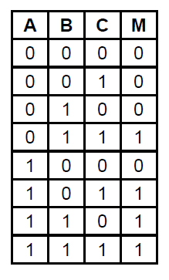
Boolean function notation
Suppose there is one inputs to a function f, which we will call A.
The NOT function can be described as $f=\overline{A}$
Suppose there are two inputs to a function f, which we will call A and B.
The OR function can be described as $f=A+B$
The AND function can be described as $f=AB$
Here, we have a function f with three inputs A,B,C.
This is the majority logic function, i.e.,
it is 0 if a majority of its inputs are 0, and
It is 1 if a majority of its inputs are 1
We could describe this function by: 1) its truth table, or
2) the following compact representation:
$$f=\overline{A}BC+A\overline{B}C+AB\overline{C}+ABC$$

Slide 11
Constructing a circuit for a function
Input: a Boolean function (majority function of 3 variables) as described in the following truth table.
Goal: Draw a circuit that accomplishes this using only AND, OR, and NOT gates.
$$f=\overline{A}BC+A\overline{B}C+AB\overline{C}+ABC$$

Slide 12
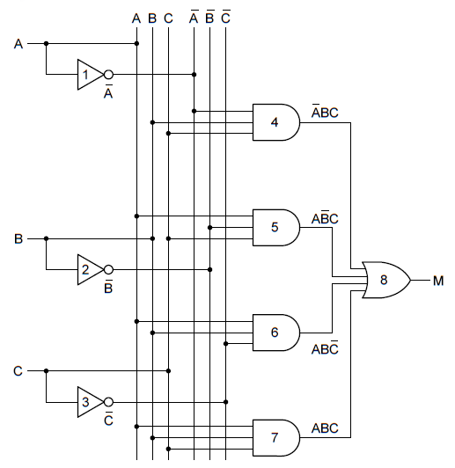
Constructing a circuit for a function
Input: a Boolean function (majority function of 3 variables) as described in the following truth table.
Goal: Draw a circuit that accomplishes this using only AND, OR, and NOT gates.
$$f=\overline{A}BC+A\overline{B}C+AB\overline{C}+ABC$$

Slide 13
Circuit implementation
We have a general method to implement a circuit for any Boolean function:
Write truth table for function
Provide inverters to generate complement of each input
Draw AND gate for each term with 1 in result column
Wire AND gates to appropriate inputs
Feed output of all AND gates into an OR gate
Example: Implement a circuit for Boolean function f which takes three inputs, A, B, C, and outputs a 1 iff no more than one of the inputs is a 1.

Slide 14
Ex: Circuit implementation
Example: Implement a circuit for Boolean function f which takes three inputs, A, B, C, and outputs a 1 iff no more than one of the inputs is a 1.

Slide 15
Working towards a better circuit implementation
New goal: Construct a circuit with less gates
Reduce chip area needed to implement them
Minimize power consumption
Increase speed
Our previous approach guarantees we CAN construct a circuit
Solution is feasible
Doesn’t necessarily construct one using only a few gates
A functionally complete set of gates is one which can be used to express all possible truth tables by combining members of the set into a Boolean expression.
{NOT, AND, OR} is functionally complete.
{NAND} is functionally complete.
{NOR} is functionally complete.
It’s often convenient to implement circuits using only a single type of gate
Ex: any Boolean function can be computed using just NAND gates! (or just NOR gates!)

Slide 16
Circuit equivalence: NOT, AND, and OR using only NAND gates
Which one is which?

Slide 17
Circuit equivalence: NOT, AND, and OR using only NOR gates
Which one is which?

Slide 18
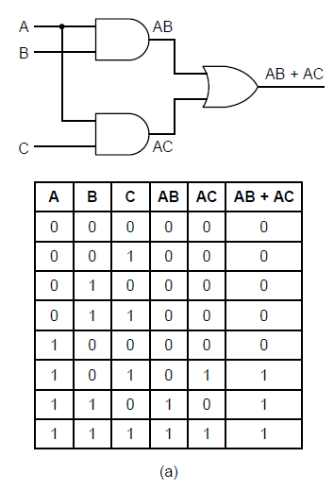
Circuit Equivalence
Two circuits/functions are equivalent if and only if they have the same output for every possible input.
Goal: Design a circuit using a small number of gates
Reduces chip area needed
Minimizes power consumption
Increases speed
Example: Can you find a circuit which uses less gates but is equivalent to the circuit on the right? Note: Use a truth table to prove equivalence.

Slide 19
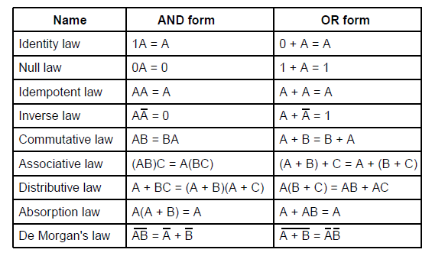
Identities of Boolean Algebra

Slide 20
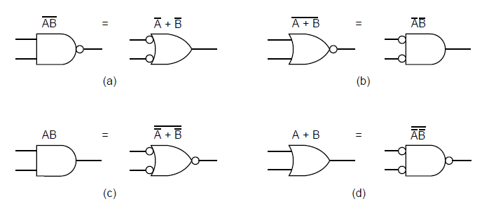
Gate Equivalence of De Morgan’s law

Slide 21
Examples
Build a circuit for XOR. Can you build it in more than one way?
Use a truth table to show that X = (X AND Y) OR (X AND NOT Y)

Slide 22
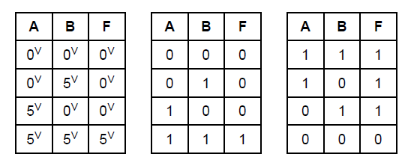
Note on equivalence: Positive vs. Negative logic
The same physical gate can compute different functions, depending on the convention used.
Positive logic: (we assume this)
low voltage = logical 0 / false
high voltage = logical 1 / true
Negative logic:
low voltage = logical 1 / true
high voltage = logical 0 / false
Electrical Positive logic Negative logic characteristics of a device

Slide 23
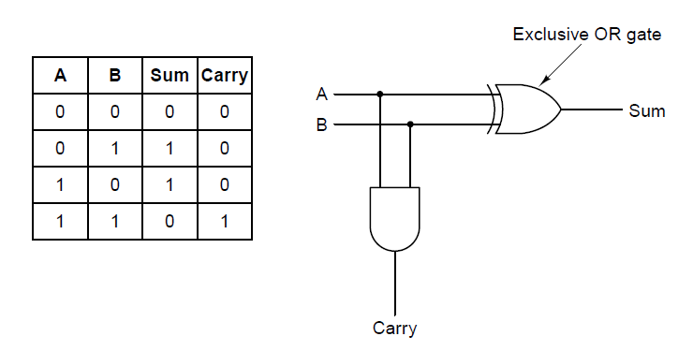
Example circuit: Half-Adder (Fig 3-16)
Goal: Add A+B
Output: Sum and Carry
Truth table for 1-bit addition.
A circuit for a half adder.

