Slide 1
Input/Output (I/O)
Ch 2.4

Slide 2
A computer system has three major components:
CPU
Memories (primary and secondary)
I/O equipment
Input devices
Take data from external sources and place them on a bus
Keyboards, mice, network cards, etc.
Output devices
Take data from a bus and use it externally
Monitors, printers, network cards, etc.
Some devices (like network cards) are both input and output devices

Slide 3
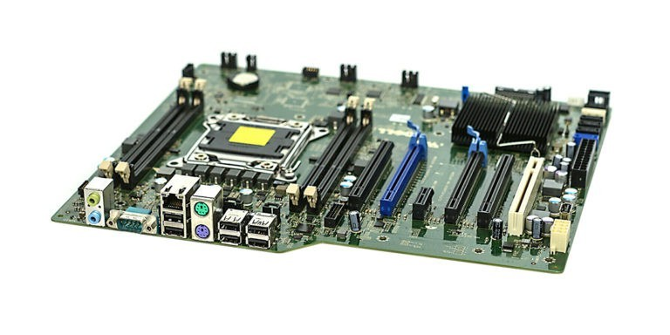
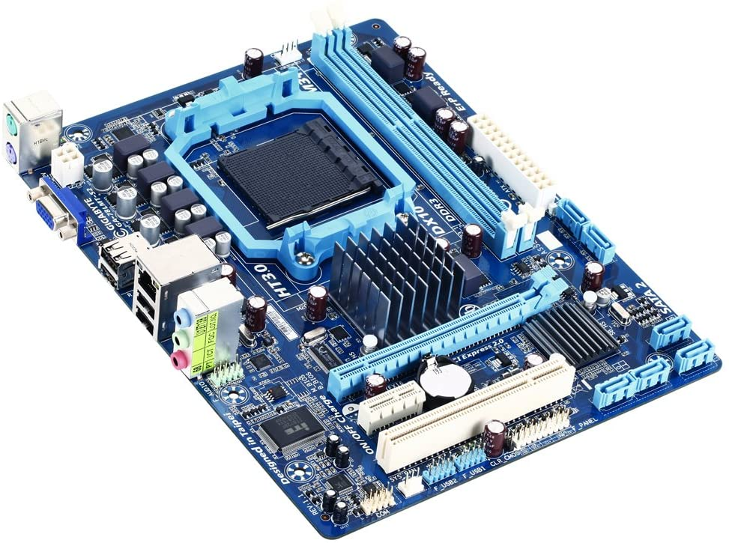
Motherboard
Motherboard: printed circuit board (PCB) which contains the buses that connect the CPU, memory, and other devices
Components are plugged into a motherboard’s slots and sockets

Slide 4
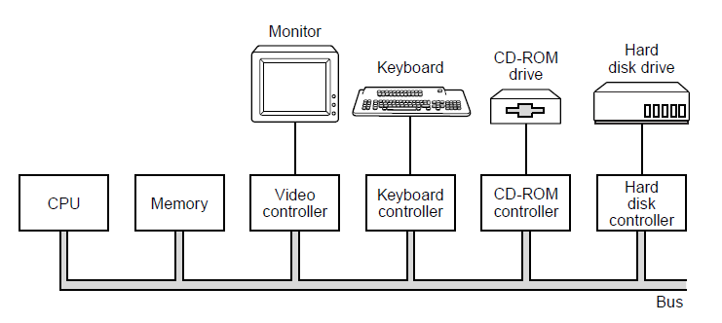
I/O Device
Consists of two parts: controller and IO device itself
Controller: controls the device itself and translates data to and from bus formats
Direct Memory Access (DMA)
Allows data from controllers to be placed directly into main memory
When the transfer is completed, the CPU is notified with an interrupt

Slide 5
Interrupts
A notification that the CPU needs to do something else
CPU performs a context switch
The currently running process is suspended
Contents of registers are written to main memory
An interrupt handler (provided by the OS) starts running to figure out what to do with the interrupt
Check for errors
Take any special action needed
Inform OS that I/O is finished

Slide 6
Buses
Used by I/O controllers and CPU for fetching instructions and data
Bus arbiter decides who goes next
Preference given to I/O
I/O is requested and granted the bus when needed in a process called cycle stealing, which slows down computer
Faster I/O & CPU components? Need faster buses!
ISA (Industry Standard Architecture) bus – IBM
EISA (Extended ISA) bus – backwards compatible with ISA bus
PCI (Peripheral Component Interconnect) bus -- Intel (public domain)

Slide 7
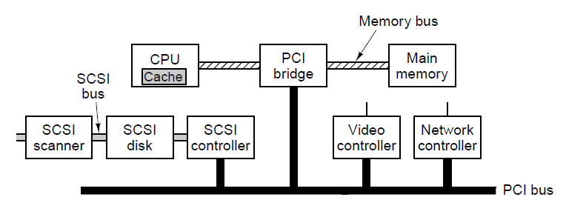
PCI Bus
CPU-memory traffic does not go over PCI bus directly
Peripherals connect to PCI bus directly
Capability for plug and play (PnP)
A typical PC built around the PCI bus. The SCSI (“SKUZ-ee”) controller is a PCI device.

Slide 8
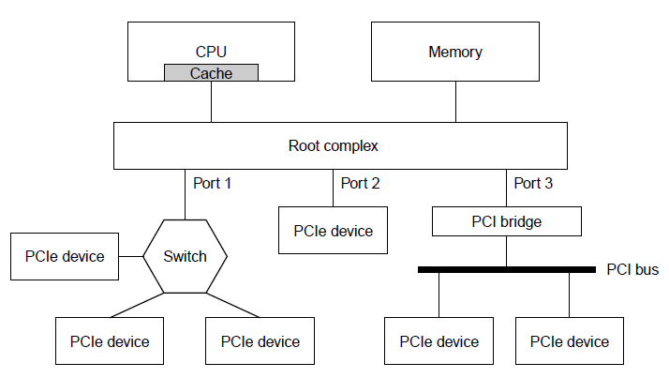
PCIe (PCI Express) Bus
Connections between devices are serial (1-bit) → faster speeds
Device can have multiple (asynchronous) wire pairs, called lanes, to communicate with root complex or switch
All communication is point to point
Sample architecture of a PCIe system with three PCIe ports.

Slide 9
Terminals
Computer terminals consist of keyboard + monitor
Keyboard
One way to detect: dome under each key which buckles when pressed far enough, conductive material inside closes the circuit
Keyboard interrupt handler (OS)
Key depressed: interrupt
Key released: interrupt
Handle key combos
Monitors
(Multi) Touch Screens
Flat Panel Displays… a long way from cathode ray tubes (CRTs)
Refreshed ~60-100 times/second from video RAM on display controller
Memory intensive
Full-motion video: total data rate ~155 MB/sec

Slide 10
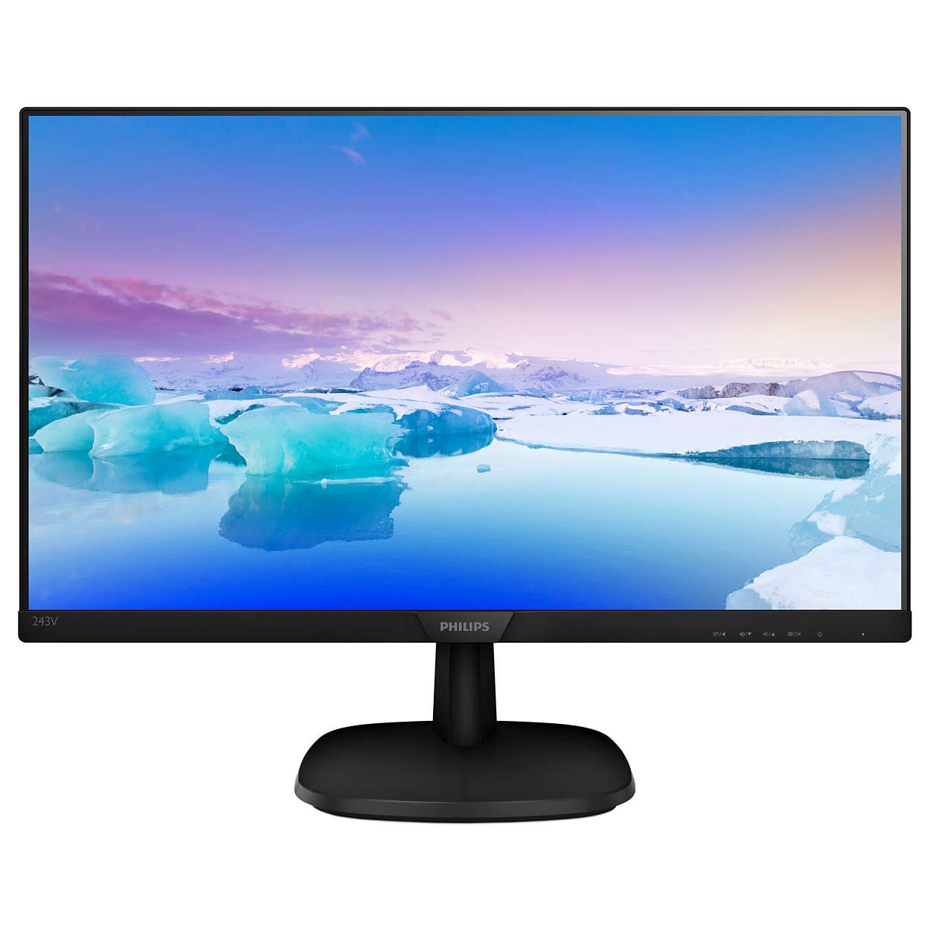
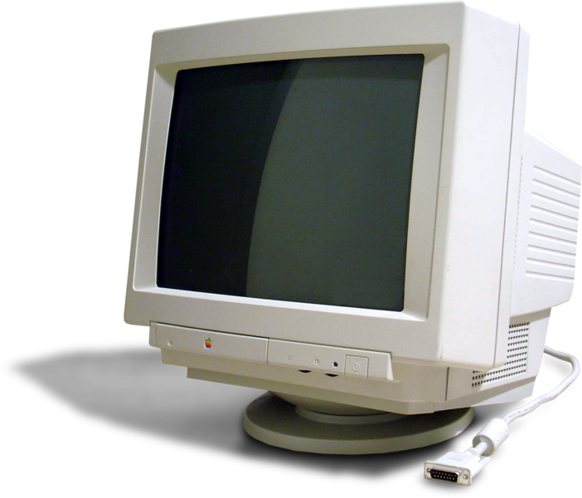
Monitors
Cathode Ray Tube (CRT)
Flat Panel Displays
Liquid Crystal Display (LCD)
Organic Light Emitting Diode (OLED)
Touch Screens:
Major types: Infrared, resistive, and capacitive
Latter supports multi-touch

