Slide 1
Secondary Memory
Ch 2.3

Slide 2
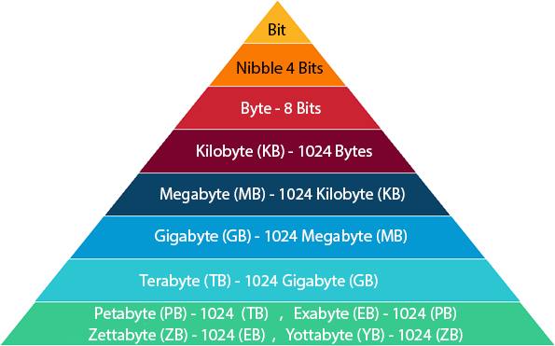
Storage
Notes:
1e+9 nanoseconds in a second

Slide 3
Secondary Memory
Main memory (RAM) is too small to store everything
Media – images, audio, video
Databases
Etc.
Main memory does not persist when the computer is powered off
Secondary memory is cheaper, larger, slower, and persists even without power.
Notes:
Human hair: ~70 microns

Slide 4
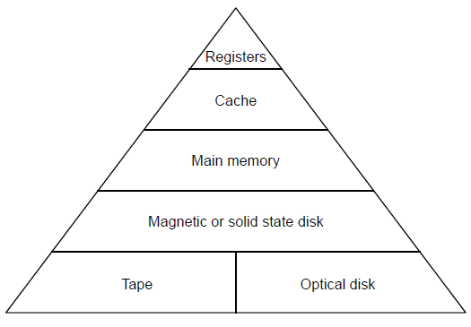
5-level Memory Hierarchy: Storage
Small storage
~128 bytes
~ megabytes
~ gigabytes
~ terabytes or gigabytes
Large storage
Notes:
A kilobyte (KB) is 1,024 bytes.
A megabyte (MB) is 1,024 kilobytes.
A gigabyte (GB) is 1,024 megabytes.
A terabyte (TB) is 1,024 gigabytes.

Slide 5
5-level Memory Hierarchy: Access Time
Quick access time
< nanosecond
~ 10 nanoseconds
~ 100 nanoseconds
~ seconds
Slow access time
Notes:
1e+9 nanoseconds in a second

Slide 6
5-level Memory Hierarchy: Cost
Expensive (less bits per dollar)
~ dollars / megabyte
Cheaper (more bits per dollar)
~ pennies / gigabyte
Notes:
1e+9 nanoseconds in a second

Slide 7
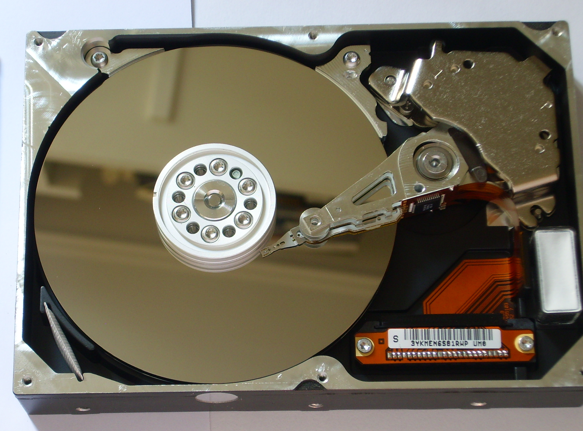
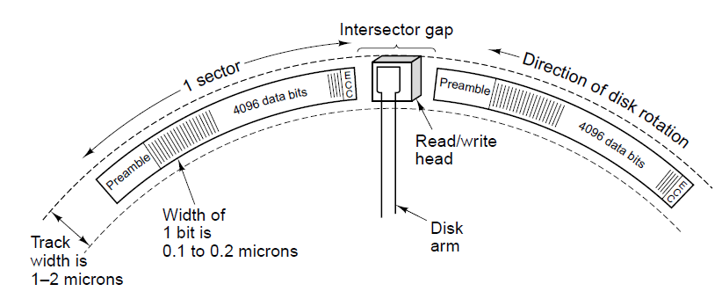
Magnetic Disks
Data is stored on spinning plates
Disk head containing induction coil floats over the surface
Write: +/- current passes through the head, which magnetizes the surface beneath the head
Magnetic particles face left or right depending on polarity of drive current
Read: when head passes over magnetized area, +/- current is induced in the head
As the platter rotates under the head, stream of bits can be written and later read back.
Notes:
Human hair: ~70 microns

Slide 8
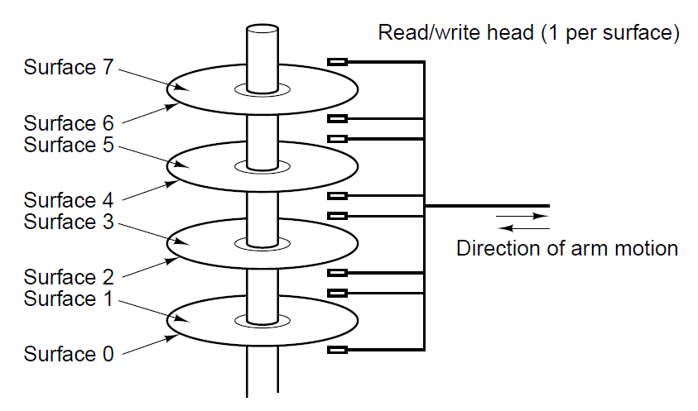
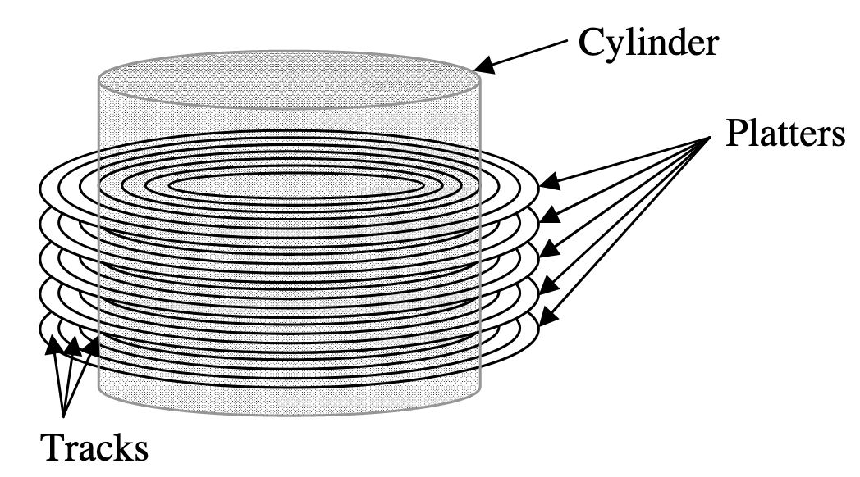
Magnetic Disks
A disk with four platters.
Action of the head during read/write
1. Seek (find correct radial position)
2. Find desired sector (preambles help)
Q: What’s the difference between read/write on the track farthest from the center and the track closest to the center?
Illustration of hard-drive cylinder
Notes:
Human hair: ~70 microns

Slide 9
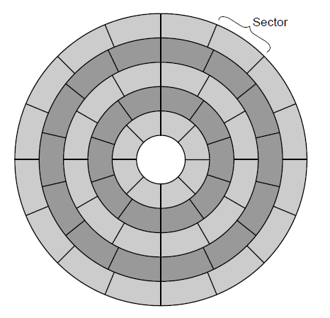
Magnetic Disks
A disk with five zones. Each zone has many tracks (the circular sequences of bits written as the disk makes a complete rotation).
Notes:
Human hair: ~70 microns

Slide 10
Flash Cells
Transistors wear out with use
One way a transistor can fail is with a “hot carrier injection”, a failure mechanism in which an electron charge gets embedded inside a once-working transistor, leaving it in a state where it is permanently stuck on/off
Fujio Masuoka used this concept to invent the first flash memory.
Idea:
Program flash cell with hot carrier injection.
Embedded negative charge increases voltage necessary to turn on flash transistor
Test whether the channel turns on with a high/low voltage → 0/1 value
Embedded charge remains even if power is turned off
Notes:
Human hair: ~70 microns

Slide 11
Solid State Drives (SSDs)
SSDs are non-volatile flash memory, made up of many solid-state flash memory cells
No moving parts
Faster and more energy efficient than magnetic disks
Magnetic disk: ~100 MB/sec
SSD: ~300 MB/sec
Still more expensive than magnetic disks
Magnetic disk: ~pennies/GB
SSD: ~dollars/GB
Notable failure rate: a flash cell can be written ~100K times before it stops functioning
Notes:
Human hair: ~70 microns

