Slide 1
Computer Systems Organization
Chapter 1 Intro
Chapter 2.1 Processors

Slide 2
Introduction
Digital computer: a machine to carry out instructions (i.e., execute a program)
Instructions are simple
Add numbers
Check if a number is zero
Copy data between memory locations
Primitive instructions in machine language

Slide 3
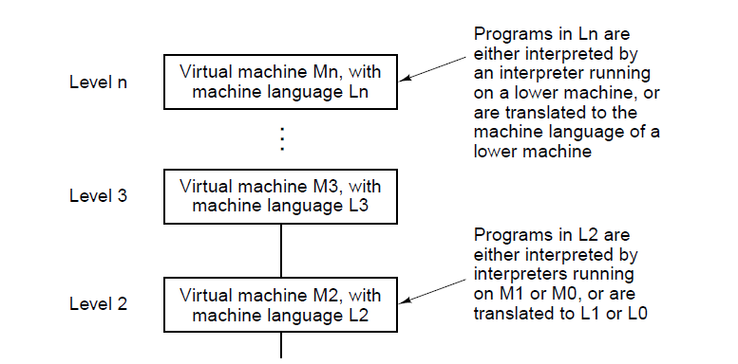
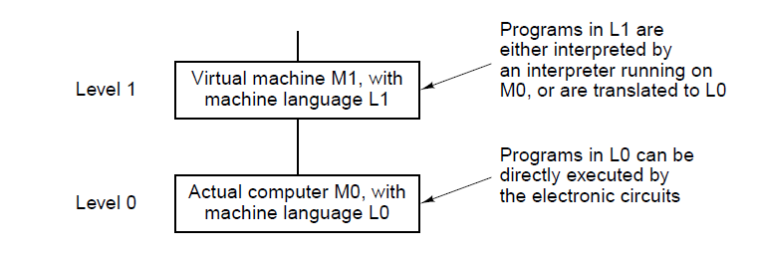
Languages, Levels, and Virtual Machines
|
. . .

Slide 4
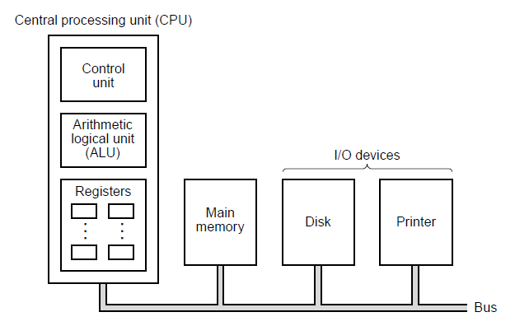
Processors
The organization of a simple computer with one CPU and two I/O devices.

Slide 5
Processors
Bus
Collection of parallel wires for transmitting address, data, and control signals
Multiple wires allow multiple bits to be transmitted at once in parallel
The organization of a simple computer with one CPU and two I/O devices.

Slide 6
Processors
Central Processing Unit (CPU)
Executes program instructions
The organization of a simple computer with one CPU and two I/O devices.

Slide 7
Processors
CPU → Control Unit
Fetches instructions from memory and determines their types
The organization of a simple computer with one CPU and two I/O devices.

Slide 8
Processors
CPU → Arithmetic Logic Unit (ALU)
Performs the operations (addition, logical operations, etc.) needed to carry out instructions
Modern computers have multiple ALUs specialized for different functions
The organization of a simple computer with one CPU and two I/O devices.

Slide 9
Processors
CPU → Registers
Special high-speed memory
General purpose registers:
Generally, 64-bits on 64-bit machine
Can store
Variables that will soon be used in arithmetic
Result of computation
Special purpose registers
Program counter (PC) – points to the next instruction to be fetched for execution
Instruction register (IR) – holds the instruction currently being executed
The organization of a simple computer with one CPU and two I/O devices.

Slide 10
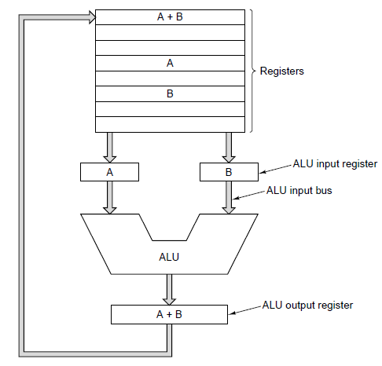
Data path (registers, ALU, busses)
Data path cycle
process of running two operands through the ALU and storing the result
“heart” of most CPUs
The data path of a typical von Neumann machine

Slide 11
Fetch-decode-execute cycle
The CPU executes each instruction in a series of small steps:
Fetch next instruction from memory
Change program counter to point to next instruction
Determine type of instruction just fetched
If instruction uses a word in memory, locate it
Fetch word, if needed, into a CPU register.
Execute instruction.
Go to step 1 to begin executing following instruction

Slide 12
Instruction execution
It’s possible to implement the fetch-decode-execute cycle in a program. A program that fetches, examines, and executes the instructions of another program is called an interpreter.
Benefits of a machines with interpreted instructions
Ability to fix incorrectly implemented instructions in field
Make up for design deficiencies in basic hardware
Opportunity to add new instructions at minimal cost (even after delivery of machine)

Slide 13
CPU architecture
Initially, more complex instructions often led to faster program execution
Hardware support for optimization
Different CPUs can support the same instructions
x86-64 is currently the most popular desktop and laptop architecture
Programs are compiled for a specific architecture
Provides a layer of abstraction
Same instructions can be made more efficient in future CPUs

Slide 14
Pipelining
Often fetching, decoding, and executing can be done in parallel
While an instruction is executing, the next can be decoded, and yet another fetched
Modern CPUs have very complex pipelines
Multiprocessors
A system with more than one CPU sharing a common memory
Multicomputers
Multiple interconnected systems, each with its own memory

Slide 15
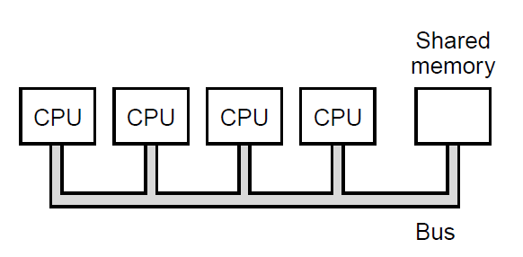
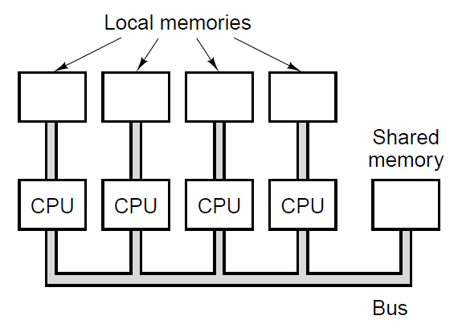
Multiprocessors & Multicomputers
Multiprocessors: A system with more than one CPU sharing a common memory
Multicomputers: Multiple interconnected systems, each with its own memory

