Slide 1
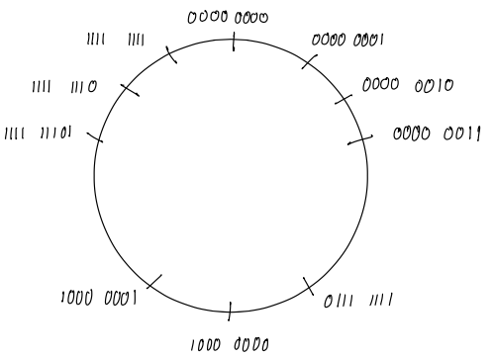
Negative Numbers
Appendix A
Signed magnitude
One’s complement
Two’s complement
Excess $2^{m−1}$

Slide 2
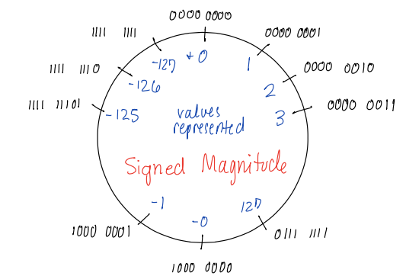
Signed Magnitude
Leftmost bit is the sign bit (0=+, 1=-)
Remaining bits hold absolute magnitude
Negate: swap sign bit
Examples of negation in signed magnitude:
+5 is 0000 0101 -5 is
+65 is 0100 0001 -65 is

Slide 3
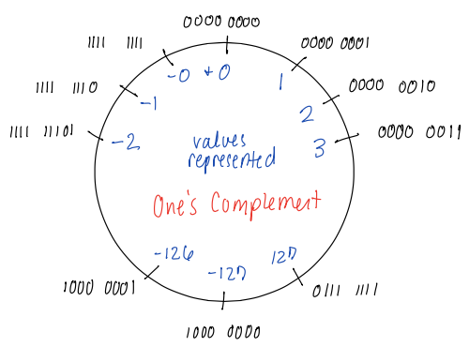
One’s Complement
Leftmost bit is the sign bit (0=+, 1=-)
Negate: swap all bits
Examples of negation in one’s complement:
+5 is 0000 0101 -5 is
+65 is 0100 0001 -65 is

Slide 4
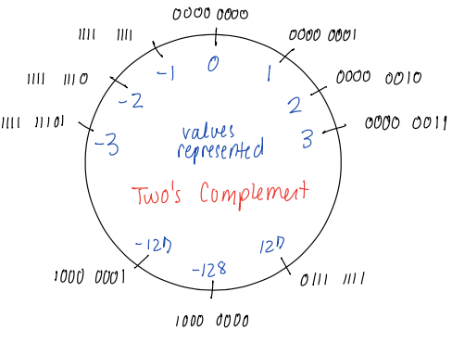
Two’s Complement
Leftmost bit is the sign bit (0=+, 1=-)
Negate: swap all bits THEN add one to result
Examples of negation in two’s complement:
+5 is 0000 0101 -5 is
+65 is 0100 0001 -65 is

Slide 5
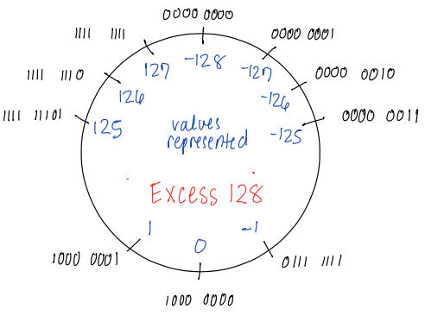
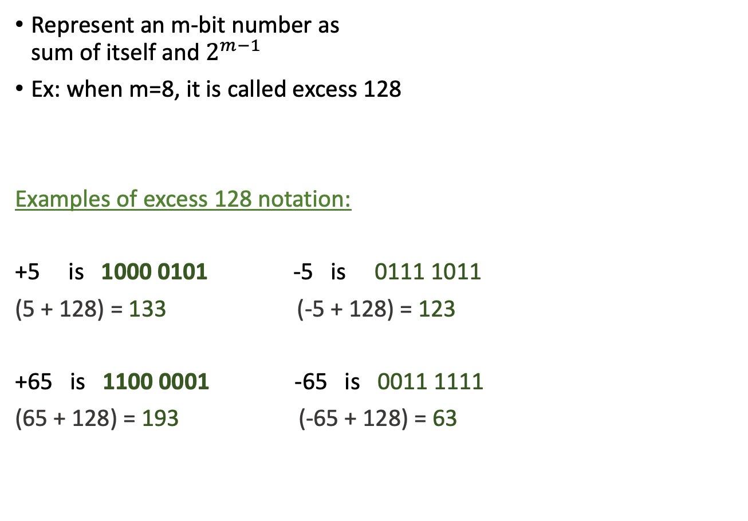
Excess $2^{m−1}$
Represent an m-bit number as sum of itself and $2^{m−1}$
Ex: when m=8, it is called excess 128
Examples of excess 128 notation:
+5 is 1000 0101 -5 is 0111 1011
(5 + 128) = 133 (-5 + 128) = 123
+65 is 1100 0001 -65 is 0011 1111
(65 + 128) = 193 (-65 + 128) = 63

Slide 6
Excess $2^{m−1}$
Represent an m-bit number as sum of itself and $2^{m−1}$
Ex: when m=8, it is called excess 128
Examples of excess 128 notation:
+5 is 1000 0101 -5 is 0111 1011
(5 + 128) = 133 (-5 + 128) = 123
+65 is 1100 0001 -65 is 0011 1111
(65 + 128) = 193 (-65 + 128) = 63
Question: How would we convert 123 to binary?

Slide 7
Example: Convert ${123}_{10}$ to binary
Approach
repeatedly divide by 2
store the remainder (0 if even, 1 if odd)
bit string is constructed by all remainders, where the bit remainder from the last division is the most significant bit

Slide 8
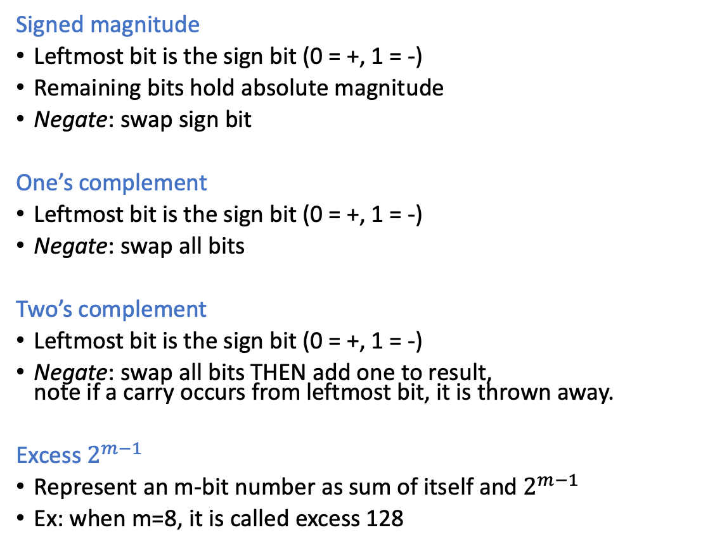
Systems to represent negative numbers Ex: $±$5
Signed magnitude
Leftmost bit is the sign bit (0 = +, 1 = -)
Remaining bits hold absolute magnitude
Negate: swap sign bit
One’s complement
Leftmost bit is the sign bit (0 = +, 1 = -)
Negate: swap all bits
Two’s complement
Leftmost bit is the sign bit (0 = +, 1 = -)
Negate: swap all bits THEN add one to result, note if a carry occurs from leftmost bit, it is thrown away.
Excess $2^{m−1}$
Represent an m-bit number as sum of itself and $2^{m−1}$
Ex: when m=8, it is called excess 128
-5: 1000 0101
+5: 0000 0101
-5: 1111 1010
-5: 1111 1011
-5: 0111 1011
+5: 1000 0101

Slide 9
Back to arithmetic: Subtracting = adding a negative number!
What to do with the carry?
Depends on the system…
With 2’s complement: discard it!
Overflow occurs if and only if the addend & augend have the same sign, but the output is of a different sign.

Slide 10
Examples
Perform the following calculations on 8-bit two’s complement numbers.
0010 1101
+ 0110 1111
1111 1111
+ 1111 1111
0000 0000
- 1111 1111

Slide 11
Group work
Convert the following to 8-bit two’s complement:
+80
- 40
Subtraction by two’s complement: To perform binary subtraction, we can convert the subtrahend (the number being subtracted) to its two’s complement and then add it to the minuend (the number being subtracted from). Perform the following subtraction by converting the numbers to 8-bit binary and then follow this method. Show all your steps to compute 80 - 40.

