Slide 1
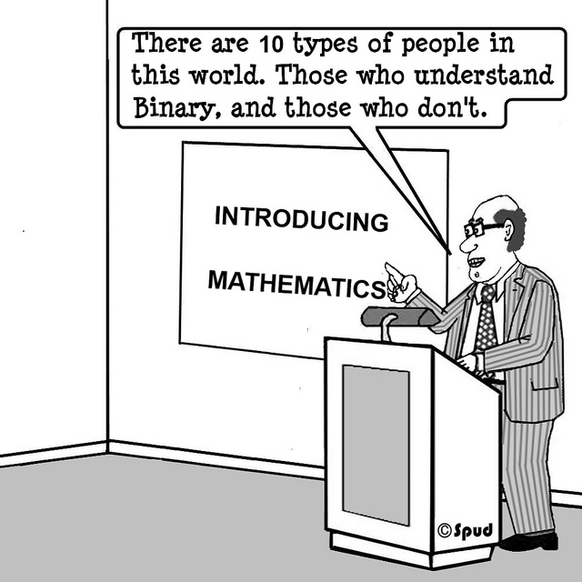
Binary Numbers
Appendix A

Slide 2
Binary
Bit (binary digit)
Most basic unit of information on a computer
Has one of two values: 0 or 1
Interpretation depends on context
Literal 0 / 1
True / False
Part of more complex piece of information (number, string, etc.)
Byte (almost always 8 bits)
Smallest addressable unit of memory
Can store
Single extended ASCII character
Unsigned values [0, 255]
Signed values [-128, 127]
Multi-byte values
int is typically 4 bytes (32 bits)

Slide 3
Finite-Precision Numbers
Consider representing numbers by three decimal digits [0, 999]
There are some problems:
Numbers larger than 999
Negative numbers
Fractions
Irrational numbers
Complex numbers
Important property on the set of integers is closure with respect to operations (e.g., add, subtract, multiply)
Finite precision numbers are not closed with respect to these operations
Ex: result is too large (overflow error) or too small (underflow error)

Slide 4
Radix System: Decimal and Binary
Decimal: 3 4 0 2
Binary: 1 0 1 1

Slide 5
Addition: note the overflow
Decimal
9
+ 1
1 0
Decimal
1 1
+ 1
1 2
Binary
1 1
+ 1
1 0 0

Slide 6
Conversion between systems
Example 1:
Binary: 1 0 1 1 1 1 0 1 1 0
Hexadecimal:
Decimal:
Example 2:
Hexadecimal: D B
Binary:
Decimal:
Decimal | Binary | Hex
0 | 0 | 0
1 | 1 | 1
2 | 10 | 2
3 | 11 | 3
4 | 100 | 4
5 | 101 | 5
6 | 110 | 6
7 | 111 | 7
8 | 1000 | 8
9 | 1001 | 9
10 | 1010 | A
11 | 1011 | B
12 | 1100 | C
13 | 1101 | D
14 | 1110 | E
15 | 1111 | F
16 | 10000 | 10

Slide 7
Group practice
Convert 10 0110 1001 (binary) to decimal and hexadecimal
Which of the following are valid hexadecimal numbers?
BED
CAB
DAB
DECADE
ACCEDED
BAG
DAD
How many different positive integers can be expressed in k digits using radix r numbers (note: radix 2 = binary; radix 10 = decimal; radix 16 = hexadecimal)

