Slide 1
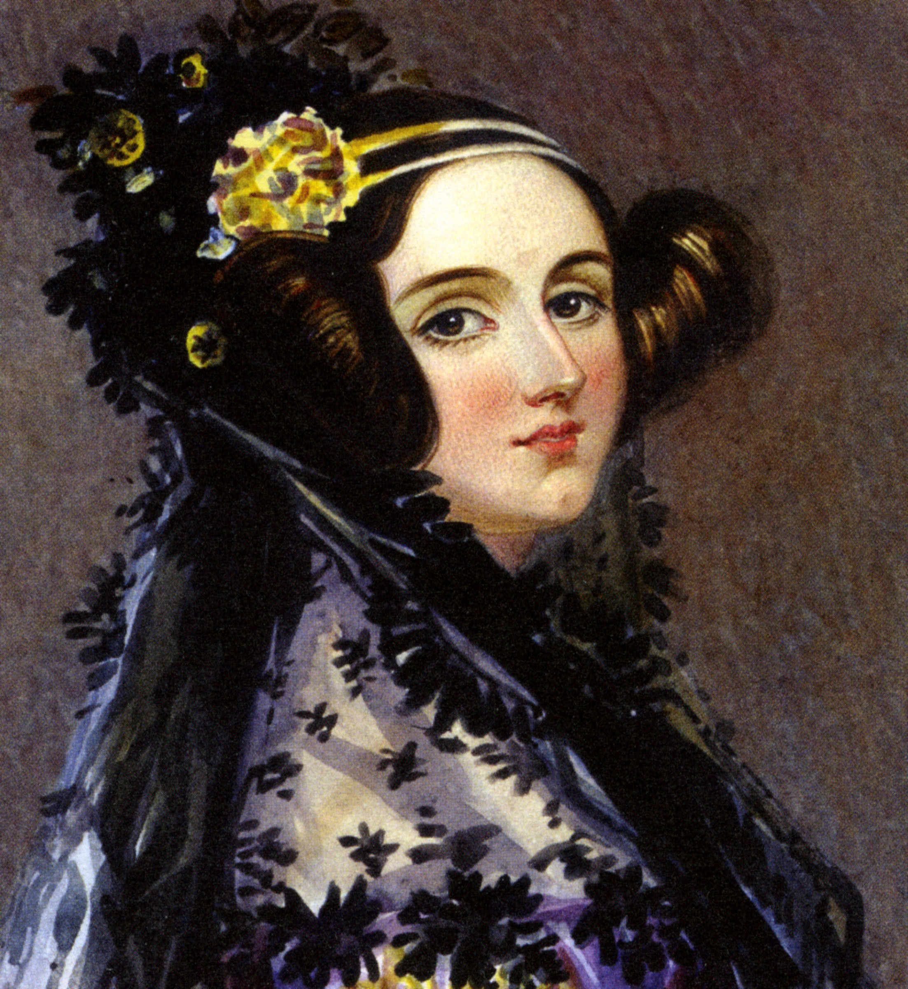
Ada Lovelace
Presented by Dr. Heather Guarnera

Slide 2
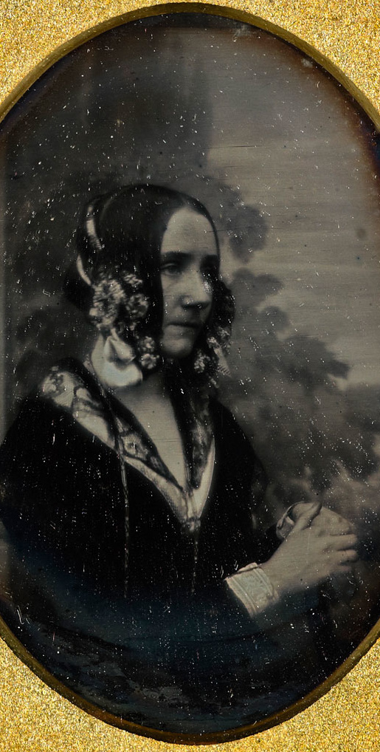
Background
Born: December 10th, 1815 Died: 1852
Only child of Lord Byron (famous poet) and Lady Byron
Parents separated shortly after she was born
Lady Byron (“Princess of Parallelograms”) spitefully promoted Ada’s interest in mathematics and logic
Married William King, Earl of Lovelace
Friends with: Charles Babbage, Michael Faraday, Charles Dickens, …

Slide 3
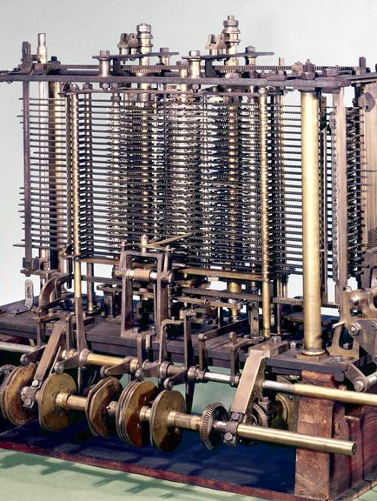
Contribution: First Programmer
Worked with Charles Babbage on his Analytic Engine (first computer)
1843: translated an article and added extensive notes of her own
First stepwise sequence of operations for solving mathematical problems
She thought the Engine “might act upon other things besides number... the Engine might compose elaborate and scientific pieces of music of any degree of complexity or extent.”

Slide 4
References
“Ada Lovelace”. URL: https://www.computerhistory.org/babbage/adalovelace/
“Ada Lovelace, the First Tech Visionary”. URL: https://www.newyorker.com/tech/annals-of-technology/ada-lovelace-the-first-tech-visionary

