Slide 1
Hello Web Design Ch. 1-2.4
Leah and Grace

Slide 2
2 steps to good design
Determine what success looks like: what is your design’s goal?
Get feedback from target users
May get conflicting feedback, prioritize users closer to your target audience

Slide 3
Quick Tips on Improving Design
Use a grid
Use only a few colors
Only use two different fonts
Simplify your text layout (no giant paragraphs)
Add whitespace
Bottom line:
Make sure your design works well, and
reduce as much clutter as possible

Slide 4
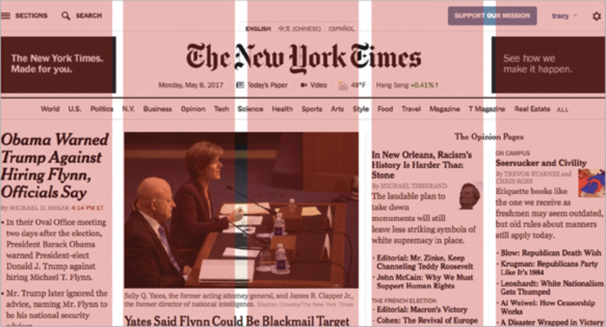
Grids
Line things up!
Uneven alignment makes everything look less cohesive
Using a grid as a starting point: you don’t have to start from a big empty canvas

Slide 5
Grids
Line things up!
Uneven alignment makes everything look less cohesive
Using a grid as a starting point: you don’t have to start from a big empty canvas

Slide 6
Colors
Color Moods:
Colors help attribute a ‘mood’ to a layout
Generally, warmer and brighter colors create a higher energy environment while darker, less saturated colors create a calmer environment.
Limited color use helps build cohesion
Choose two colors as a base and a third one to bring emphasis
Poor choices of conflicting colors can lead to illegibility and confusion
Passion, Anger
Friendly, Joyful
Natural, Successful
Comforting, Relaxed
Royal, Mysterious

Slide 7
Colors
Color Moods:
Colors help attribute a ‘mood’ to a layout
Generally, warmer and brighter colors create a higher energy environment while darker, less saturated colors create a calmer environment.
Limited color use helps build cohesion
Choose two colors as a base and a third one to bring emphasis
Poor choices of conflicting colors can lead to illegibility and confusion
Passion, Anger
Friendly, Joyful
Natural, Successful
Comforting, Relaxed
Royal, Mysterious

Slide 8
Typography (Fonts)
Different types of fonts can also attribute to the “feel” of a page.
Blocky fonts such as Arbutus Slab can give a feeling of of weight and stability to a page
Monospace fonts such as Geist Mono can feel technical and (for better or for worse) emphasize the spacing and grid layout of a page
Display fonts such as Qwigley or Pacifico don't aim for overt legibility but instead try to grab your attention and ✨look fancy✨
Making large chunks of text in display fonts will lead to readers just ignoring them outright
Notes:
SPEAK SLOWER 4HEAD

Slide 9
TYPOGRAPHY (FONTS)
DIFFERENT TYPES OF FONTS CAN ALSO ATTRIBUTE TO THE “FEEL” OF A PAGE.
BLOCKY FONTS SUCH AS Arbutus Slab CAN GIVE A FEELING OF WEIGHT AND STABILITY TO A PAGE
MONOSPACE FONTS SUCH AS Geist Mono CAN FEEL TECHNICAL AND (FOR BETTER OR FOR WORSE) EMPHASIZE THE SPACING AND GRID LAYOUT OF A PAGE
DISPLAY FONTS SUCH AS Qwigley OR Pacifico DON’T AIM FOR OVERT LEGIBILITY BUT INSTEAD TRY TO GRAB YOUR ATTENTION AND ✨LOOK FANCY✨
MAKING LARGE CHUNKS OF TEXT IN DISPLAY FONTS WILL LEAD TO READERS JUST IGNORING THEM OUTRIGHT

Slide 10
Typography (Kerning and Spacing)
Kerning is the measure of the space between individual letters in text.
A kerning value which is too low will bring a feeling of claustrophobia and clutter to a page
A kerning value which is too high will make the text feel like it's falling apart at the seams
Either way, it looks bad, its distracting, and it will take the reader’s attention away from the content of the page
The same goes for Spacing between lines.
Too little space between lines leads to crowding and clutter (and often poorly used white space)
Too much space between lines leads to a feeling of disconnect from one line to another and can make it actively difficult to read

Slide 11
Typography (Kerning and Spacing)
Kerning is the measure of the space between individual letters in text.
A kerning value which is too low will bring a feeling of claustrophobia and clutter to a page
A kerning value which is too high will make the text feel like it's falling apart at the seams
Either way, it looks bad, its distracting, and it will take the reader’s attention away from the content of the page
The same goes for Spacing between lines.
Too little space between lines leads to crowding and clutter (and often poorly used white space)
Too much space between lines leads to a feeling of disconnect from one line to another and can make it actively difficult to read

Slide 12
Whitespace
Definition: the empty space around and between elements in your design
Not necessarily white: just empty space
Improves comprehension
No information overload
Improves legibility
Kerning and line spacing falls into this
Provides contrast
Easier make things stand out
Sets a tone
Airy designs feel more professional than cluttered ones
Strategies: think about spacing between…
Letters and lines of text
Elements (think of the Gestalt principles of spacing!)
Groups of elements

Slide 13
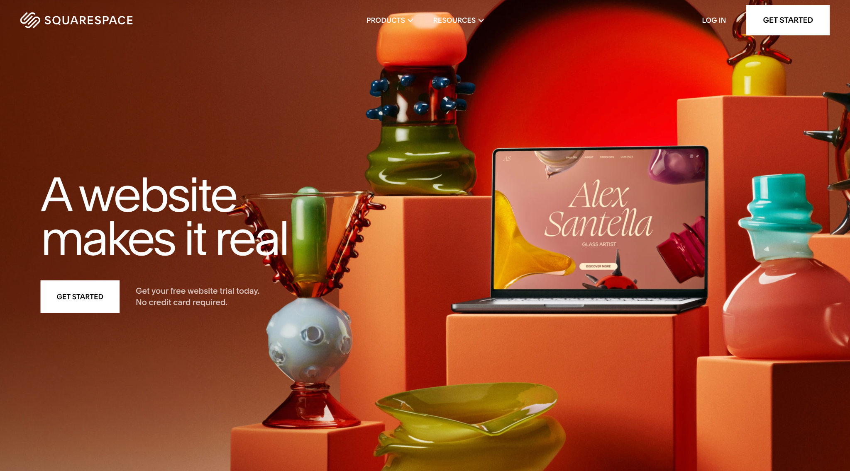
Whitespace: Good Example

Slide 14
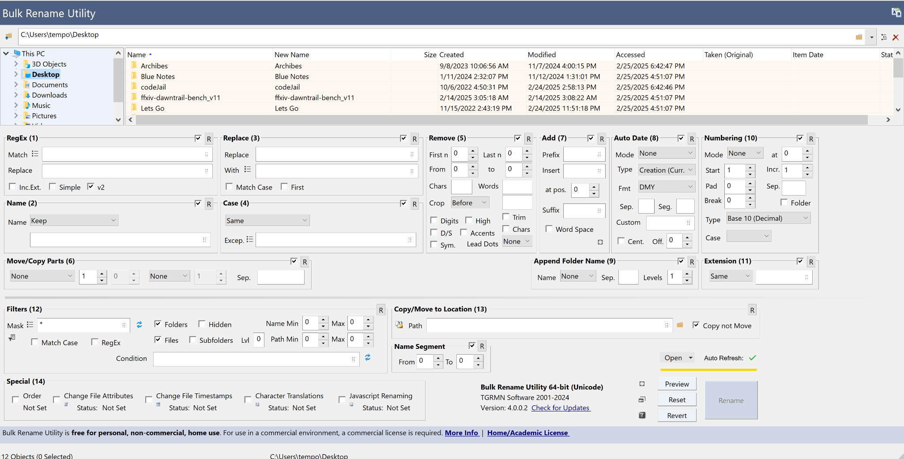
Notes:
Leah Note

Slide 15
Whitespace
Strategies: think about spacing between…
Letters and lines of text Elements (think of the Gestalt principles of spacing!) Groups of elements
Definition: the empty space around and between elements in your design
Not necessarily white: just empty space
Improves comprehension
No information overload
Improves legibility
Kerning and line spacing falls into this
Provides contrast
Easier make things stand out
Sets a tone
Airy designs feel more professional than cluttered ones

