Slide 1
Hello Web Design 2.5-2.9
By Tracy Osborn
Julian, Jungho

Slide 2
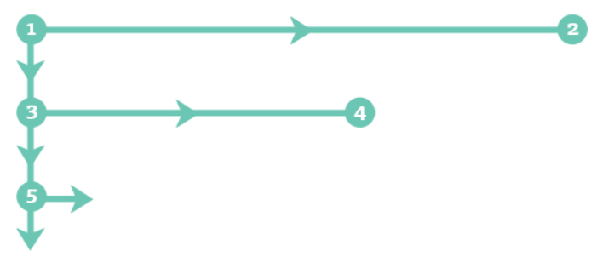
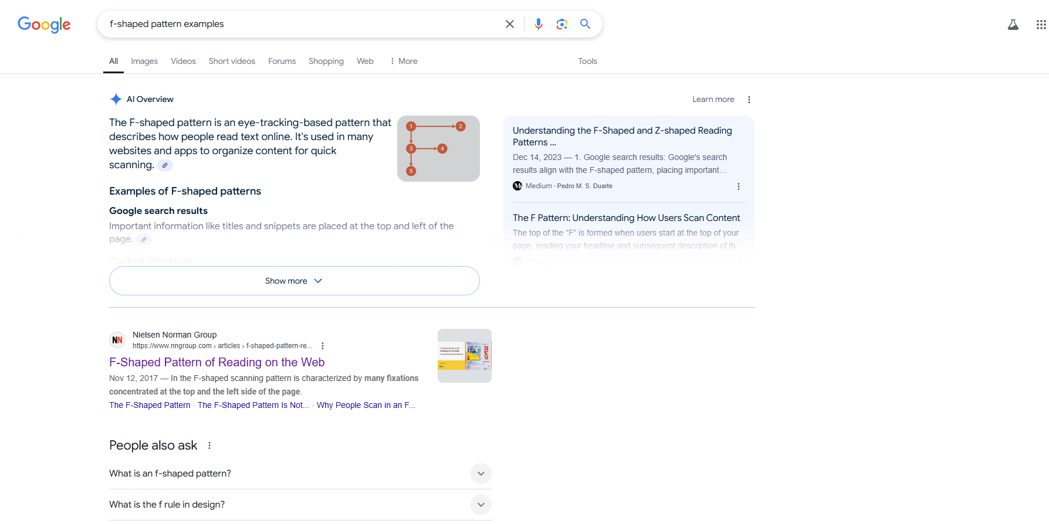
Layout
Layout: The way information is arranged and prioritized.
The F pattern

Slide 3
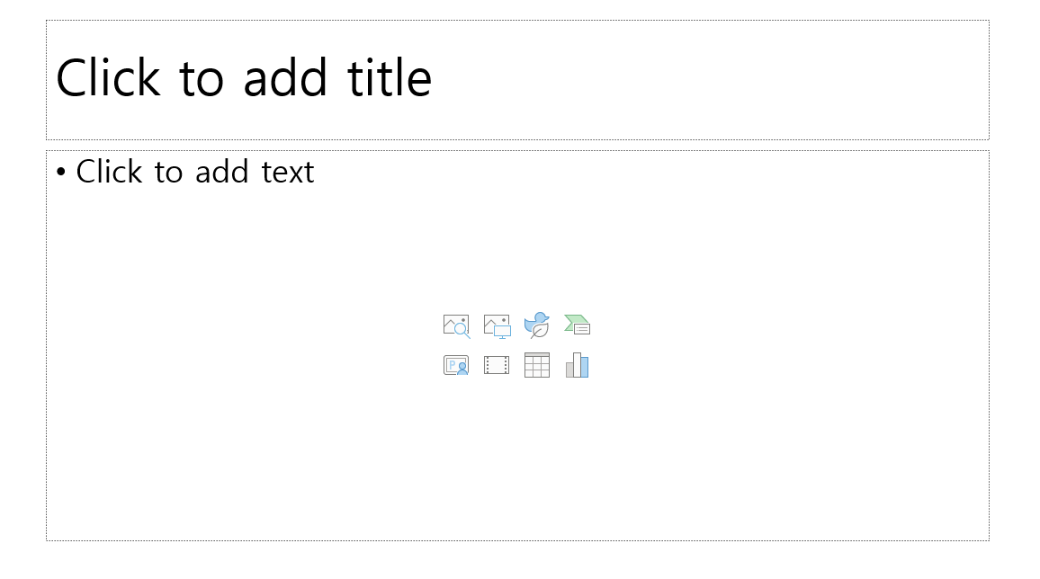
Hierarchy
Visual Hierarchy: Some elements are more important than others when designing. This guides the users where to look first.
Indicators of importance
Size: Larger items are more visible.
Color: More saturated colors, warmer colors are more visible.
Positioning: Items in upper left corner are more important.

Slide 4
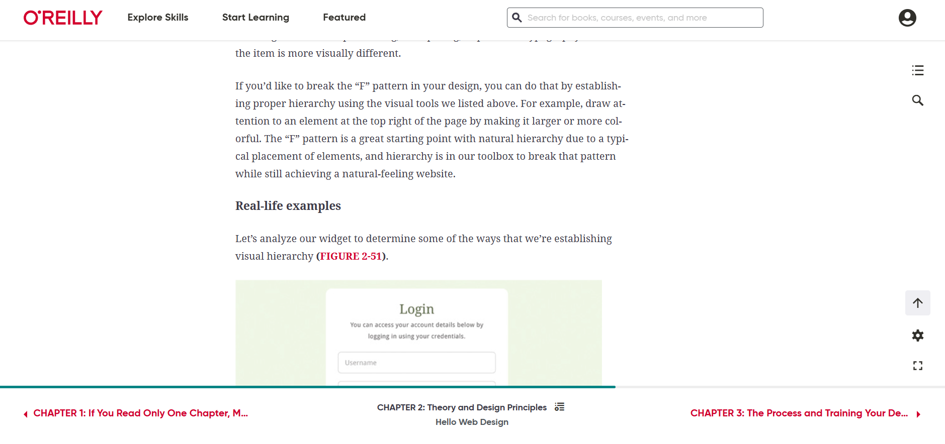
Hierarchy
Contrast: Items with more contrast are visible.
White space: More white space around appear more important.
Typography: Items with different fonts could indicate hierarchy.

Slide 5
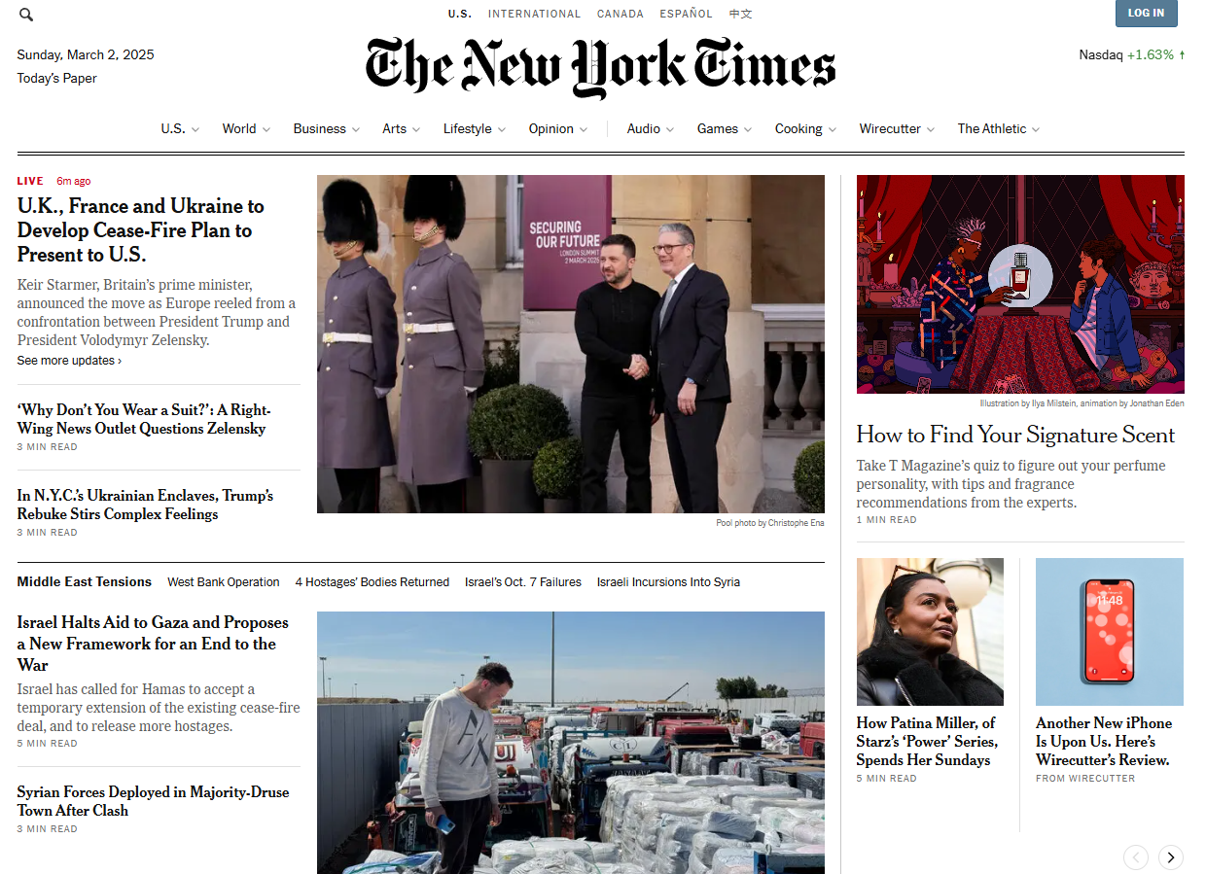
Content
People usually scan the page.
People won’t read paragraphs unless they are interested
The more content you present, the less control about what the reader actually consumes.
Tips:
2-3 sentences for a paragraph
Use bullet points
Use headlines

Slide 6
User Experience
Before Designing
Who is your ideal user?
What is their personal goal?
What are your business goals?
Competitive analysis: looking at competitors and analyze what they do well and not so well
Surveys and Interviews

Slide 7
User Experience
During the Design Process
Wireframes, prototypes, usability testing
After Launching your Design
More usability testing
Tips:
Make desired actions easy to find and use
Pay attention to website size
Run usability tests
Include analytics

Slide 8
Images and Imagery
#1 Thing to keep in mind: Royalties and Licensing
3 Main types of images
Rights-managed images: have particular terms and conditions to use
Royalty-free images: lesser terms or one-time fee and then free use
Creative commons: allowable to use with smaller requirements such as attribution, denying derivatives, etc.
Berne Convention widely implemented - anything unmarked is copyrighted by default

Slide 9
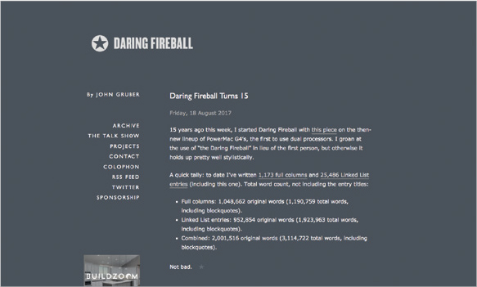
Images and Imagery
Fundamentals
In general not necessary - screenshots & flexible typography
A good use is faces that convey emotion
Keep file size in mind
Website size increases quickly with images
Make sure not to put big images in small containers
Provide retina and non-retina images
HTML and CSS have options to change based on retina screens or other types

Slide 10
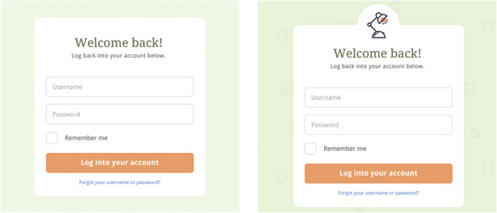
Images and Imagery
Fundamentals
Images are good for backgrounds or large features
Icons are good for helping out a feeling or concept
Beware of overly stocky stock photos

Slide 11
Extra Tidbits - Everything Else
General Tips
Start simple - it is nearly always better to start with something that is easy and add on later
Contrast highlights importance
Tips for designing for repeated workflows - when it’s super important to make it complex
Keyboard shortcuts
Everything all at once

Slide 12
Extra Tidbits - Everything Else
Visual related
Consider the “rule of thirds”
Often used in photography and filmmaking
More interesting than centered

Slide 13
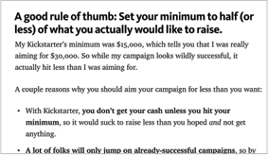
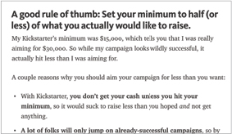
Extra Tidbits - Everything Else
Visual related
Avoid pure black - can look off-putting
Use a slightly off color instead
Headlines: #222222
Text: #444444
Not: #000000

Slide 14
Extra Tidbits - Everything Else
Visual related
Lighting should come from above
Seems more natural since it matches the sun

Slide 15
Extra Tidbits - Everything Else
Visual related
Colors look different depending on the environment
If you’re using a consistent color palette, it’s okay to alter a use of it slightly to make it look the same to the user

Slide 16
Extra Tidbits - Everything Else
Visual related
Beware of overlaying text on images
Overlay transparent color on image to background the text (transparent black is the same as darkening the image)
Add a solid block of color behind the text
Blur the image behind the text

