Slide 1
Gui Bloopers Ch.3 ~ Navigation Bloopers ~
Leah Goodall, Julian Grace-Martin & Noelynn Batalingaya

Slide 2
Navigation Bloopers
It is incredibly important for users to know where they are when using *any* software, be it a website, a local program, or whatever else.
Along with that, users should be able to intuit how to get from where they are to anywhere else easily and quickly.
This chapter covers three main blooper types
Not showing users where they are
Leading users astray
Poor search navigation

Slide 3
Not Showing Users Where They Are
Generally, users expect somewhere on the top bar to tell them where they are or what the current window is.
Without it, users who weren't paying MAXIMAL ATTENTION (or really anyone who has just developed muscle memory which relies on it) could struggle to use something.
Pages in isolation without labels are often confusing in isolation
Even most slides have titles!

Slide 4
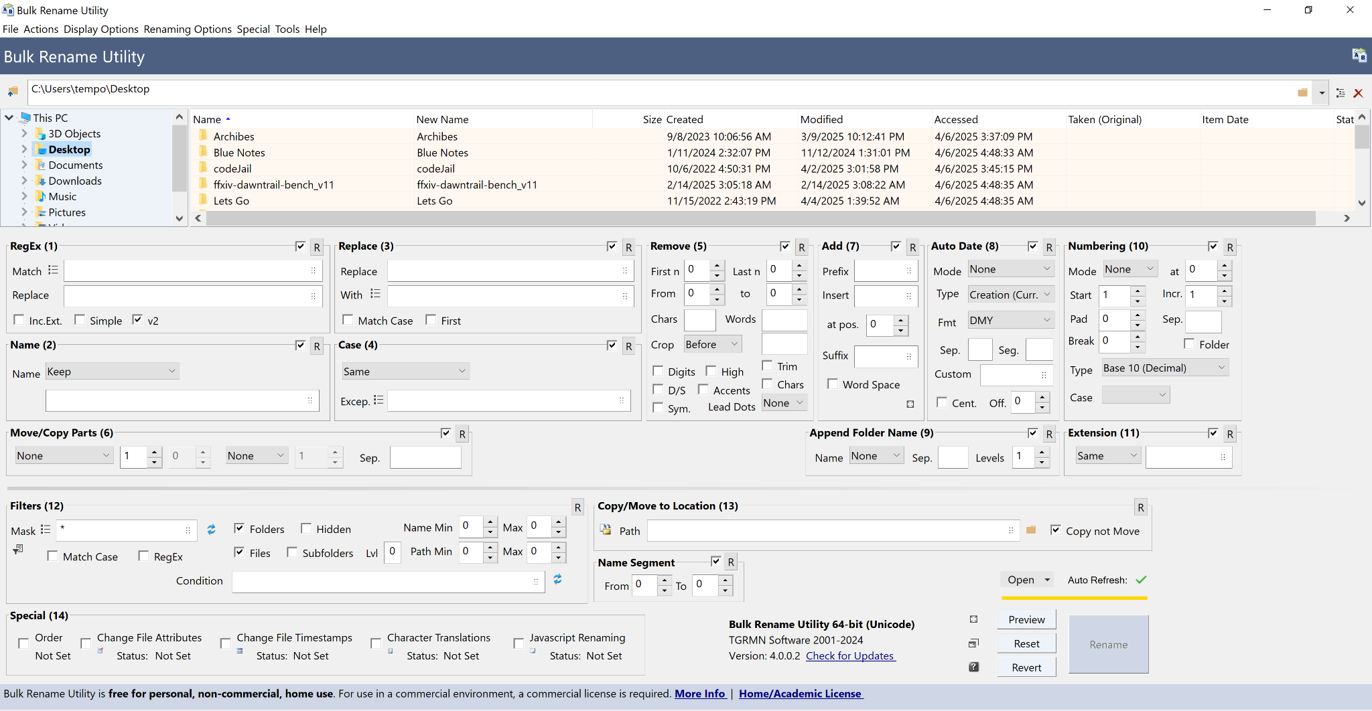

Slide 5
Not all labeling is created equal
Using the <title> tag on html can be useful but it is not a good way to label a website.
I don't even have that many tabs open yet all of their have titles cropped less than half way through.

Slide 6
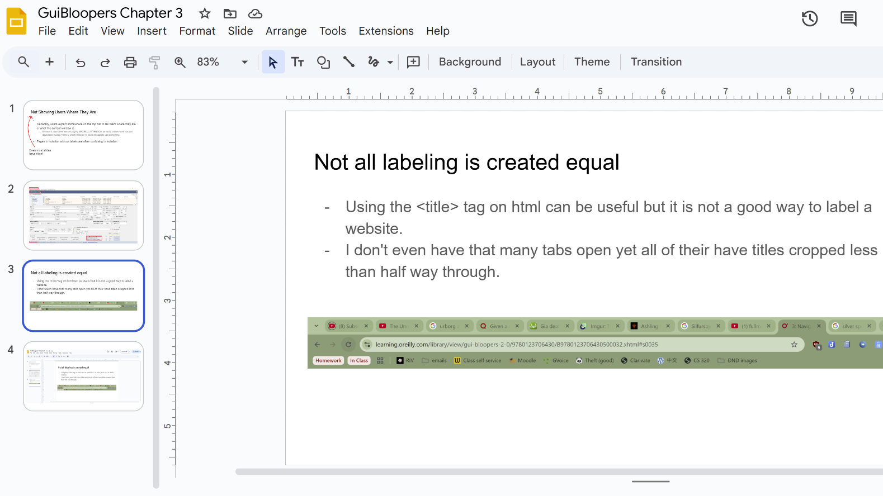

Slide 7
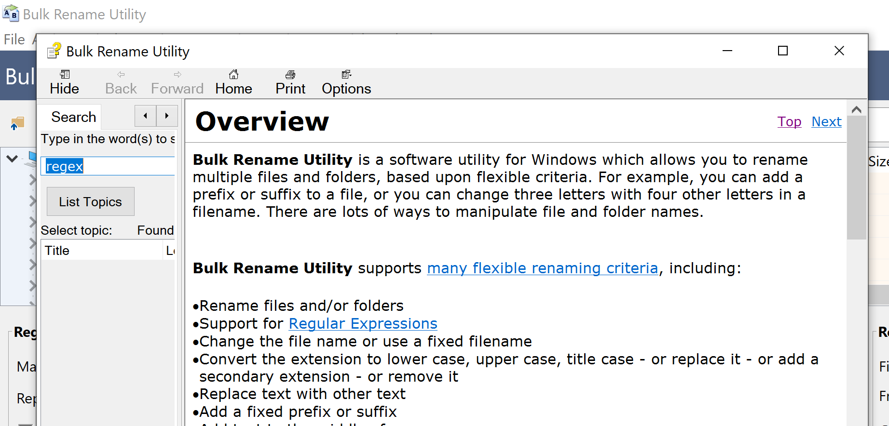
Multiple of the same label
Having multiple pages with the same label can lead to bad communication and overall confusion.
Imagine explaining how to perform a task on a page only to find out the person you were working with was on a completely different page with The same label
(also here is an Example of bad white Space usage)

Slide 8
Names not matching the button which opened them
If a button opens a new window, the window’s title should match the button pressed to open it, if not exactly than at least very closely.
This is somewhat a common sense problem, pressing a button should open the thing the button says it should but often there are weird complications because this is a fairly low priority fix

Slide 9
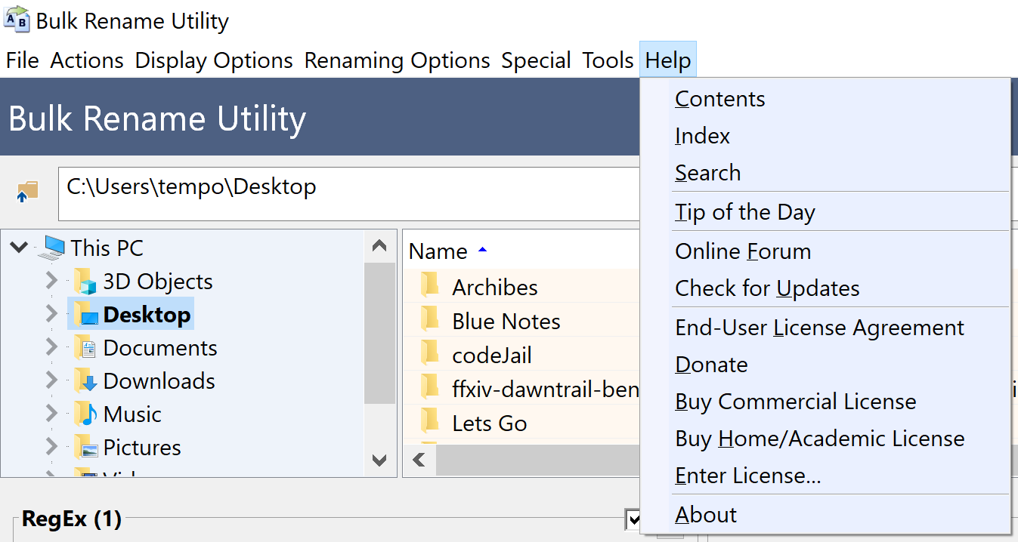
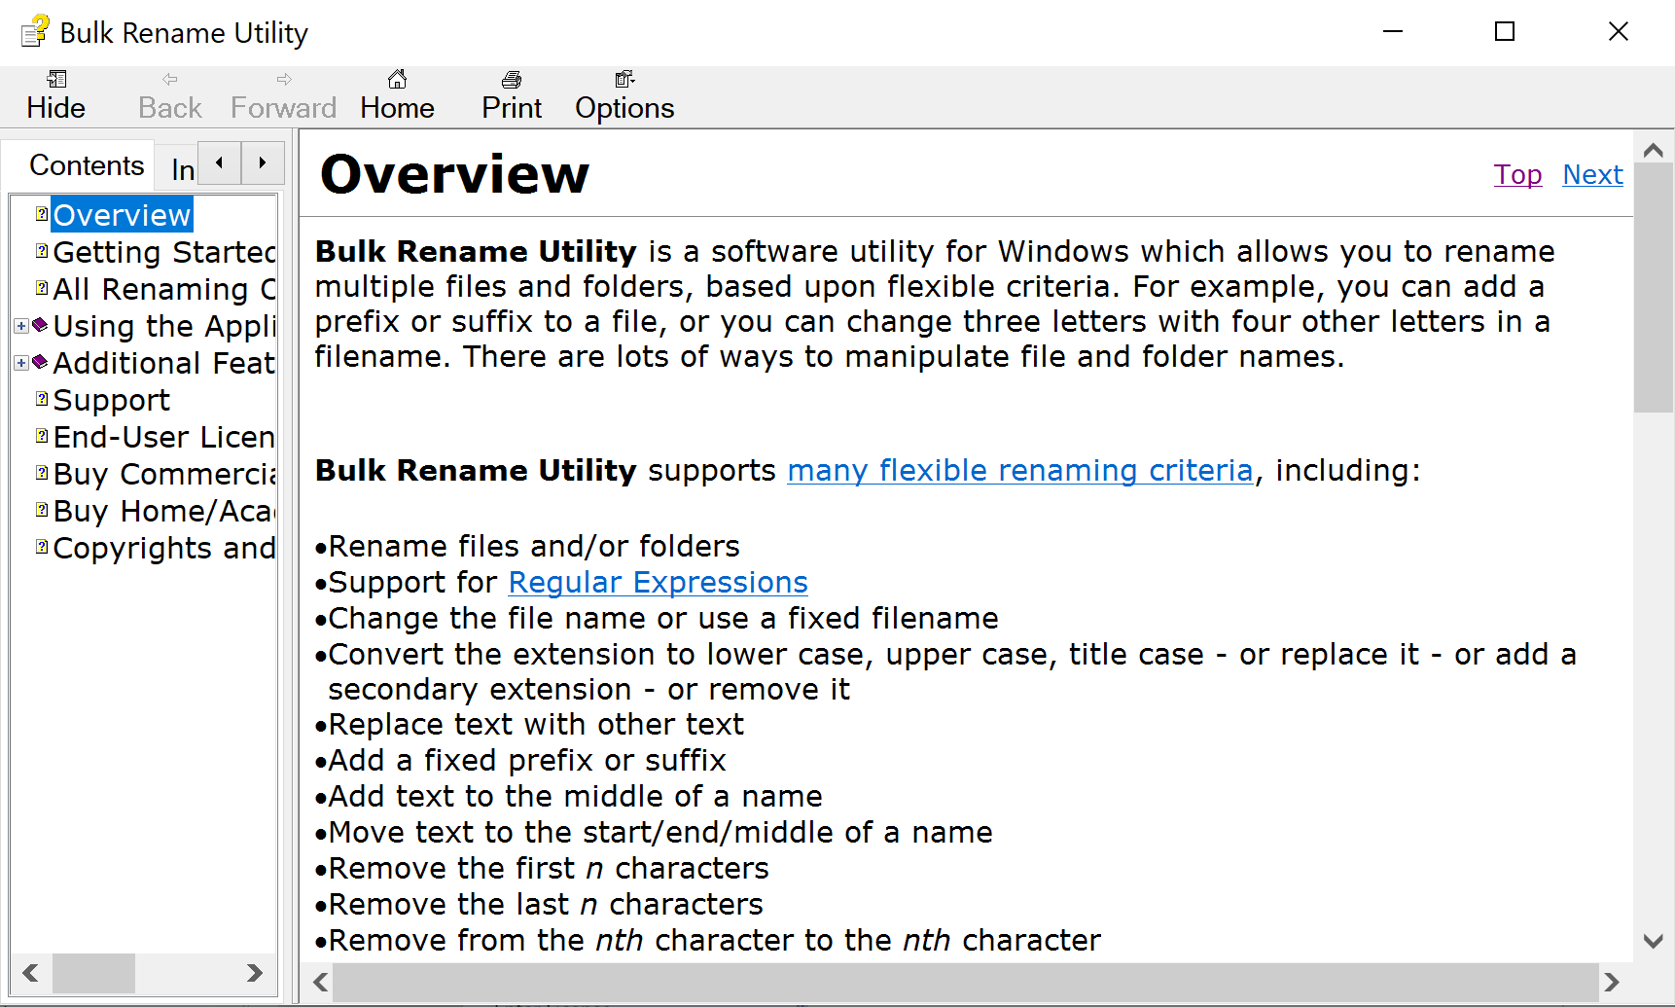
THIS NOT GOOD

Slide 10
Leading Users Astray and Not Showing the Way
Often users come to a website for a specific goal and want to get there quickly
Websites should be able to lead users to the thing they want to get to using clues at each step of the way
At any given place the clues leading from that place should show the user the direction to go for their goal and especially not lead them away from it

Slide 11
Blooper 16: Distracting off-path buttons and links
These fail leading the user to their destination by looking like what the user is trying to do without actually being that thing
Too many links all on the same page
User has to read a lot to figure out which is right or sees one that looks close and clicks before finding the exact match
Misleading ads
Ads appearing in weird spots and look like what the user is trying to click on
Worst when user can’t find way back after clicking off or entered info is lost

Slide 12
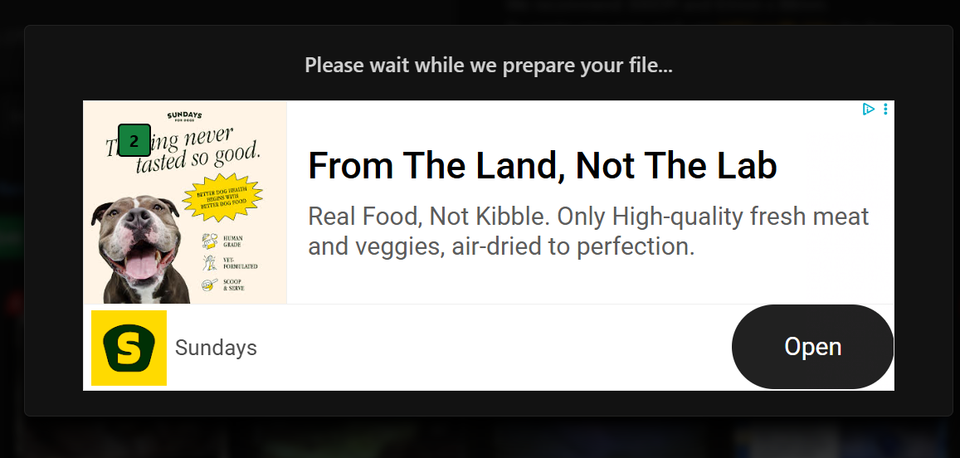

Slide 14
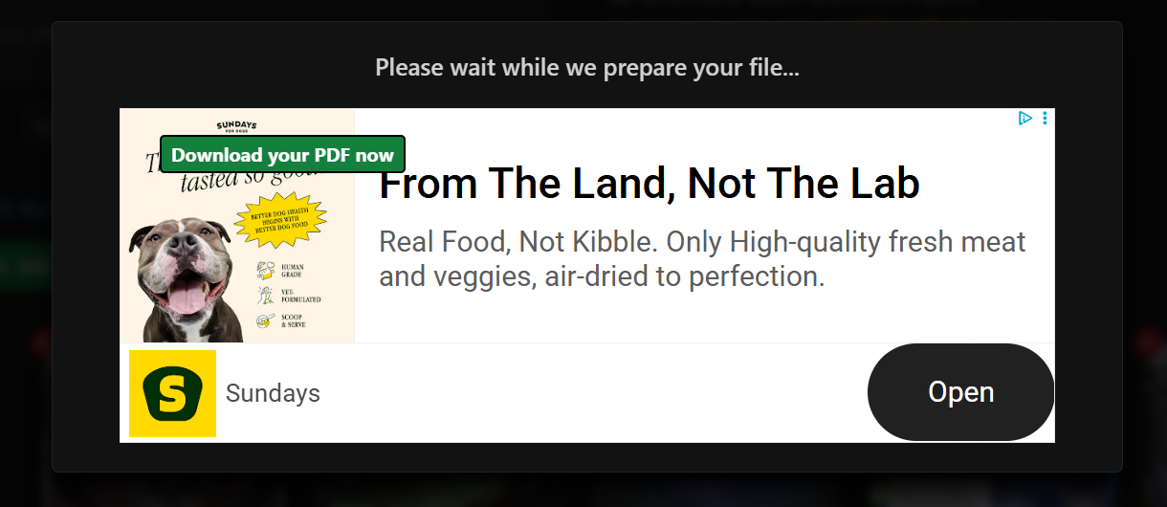

Slide 15
Blooper 16: Fixing it
Create a “process funnel” towards where the user wants to be for any given goal
Make it clear when a link is not going to continue down the path the user is taking
If extra information is important to include, use a pop-up or open another window for it so it’s easy to get back on track

Slide 16
Blooper 17: Self-links
Links that redirect the user back to the same page it was on
How a link reloading the page can be disorienting
User gets sent to new page not at the top through anchor link, clicks a link that redirects to that page, then doesn’t recognize the page now
Page has changing image displays and user thinks it’s a new page now
Animations might be loading on the page and make it appear differently

Slide 17
Disguised Self-Links
How self-links can look like something else
Usually navigation bar links appear off when user is on that page, but not always
Subsites can be confusing too - if there’s a link to the subsite on that subsite and it isn’t clearly labeled, the user might think the link goes somewhere else
Breadcrumb trails are helpful to show how you got here, but confusing when the current page is a clickable link

Slide 18
Fixing Blooper 17
Simple solution: never have an active link to the same page of any kind other than an anchor link (“back to top ^”)
The navigation page issue is most common by copying the same code onto each page, but the programmer can go back and edit that for each page to fix this issue with a simple solution

Slide 19
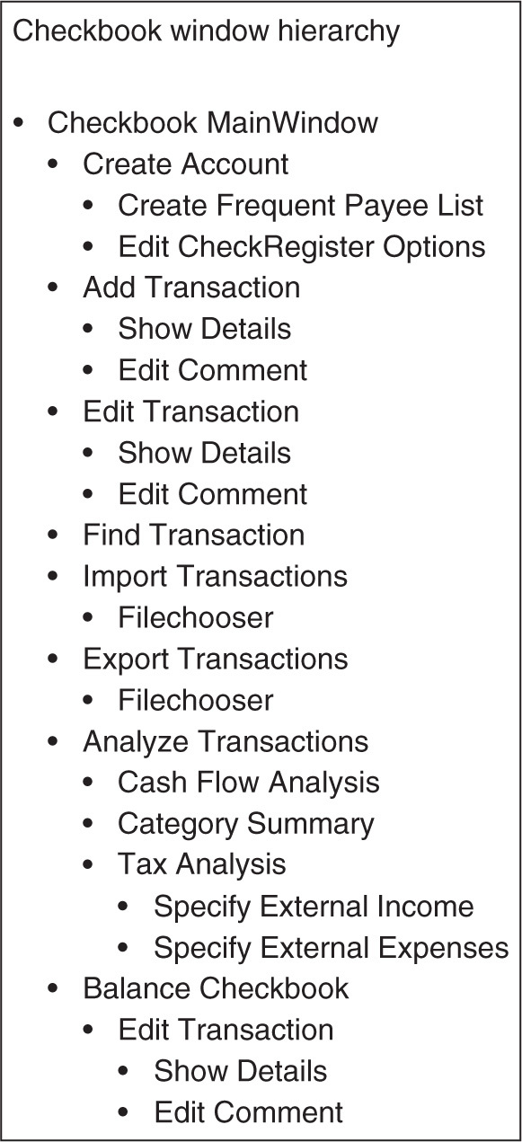
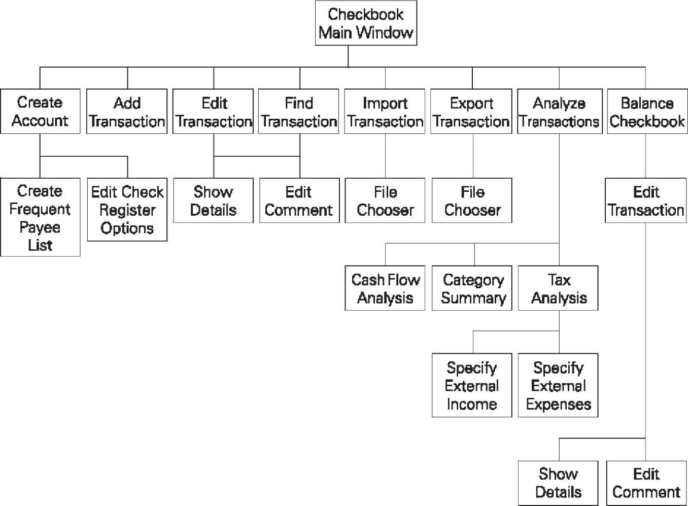
Blooper 18: Too many levels of dialog boxes
When the user clicks on a button to bring them to a location, then that one has a button to a new location, then another, and another…
It’s important to have a chart or map when developing a website to see where these chains are
They should never go past 2 levels of dialog boxes

Slide 20
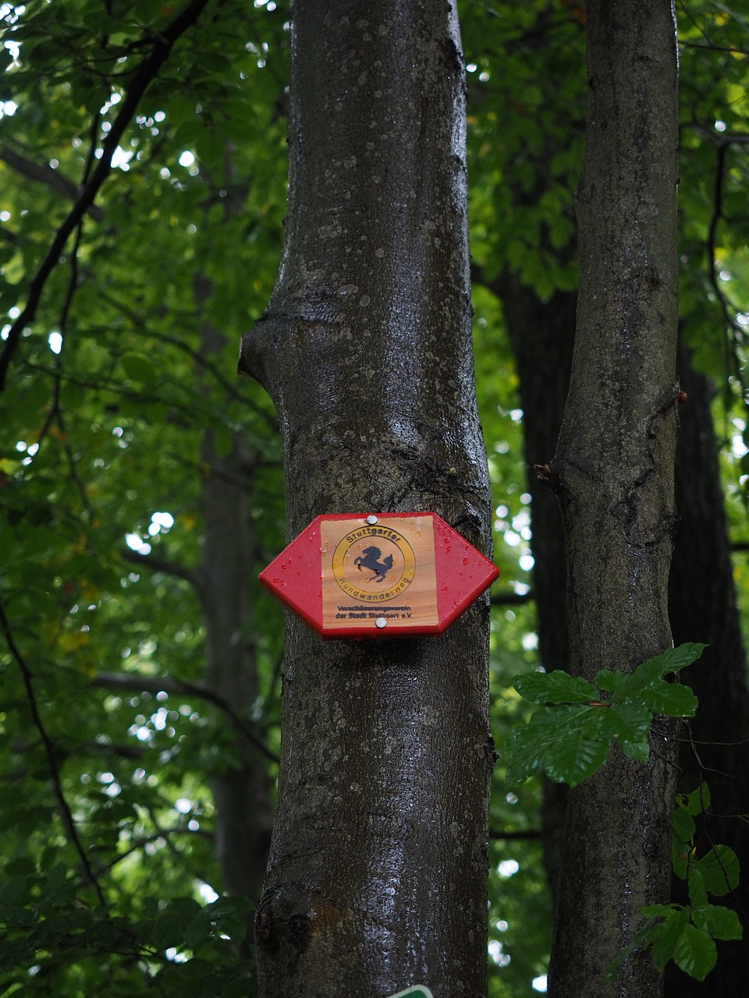
Dialog Boxes Specifically (and exceptions)
What counts as a dialog box?
True dialog boxes: separate from browser window - error, file chooser, etc.
Opened browser windows: quick window that only involves simple actions
Actual pages acting as dialog boxes: going to a new page that only has a small amount of information or small number of options then continues
Exceptions - don’t lead to more d-boxes or are quick flashes
File choosers, color pickers, & date pickers
Errors with only 1 option to acknowledge
These don’t feel like separate locations due to familiarity and/or simplicity

Slide 21
Fixing Blooper 18
Must have a layout of the system
How to cut excess levels
If trying to hide info until needed, have a details panel to the side that changes based on what is being highlighted/hovered
Similarly use a cascading menu to extend the visual more and more as the user hovers over options rather than relocate to a new window

Slide 22
Poor Search Engines
-Search functions are essential for users to navigate interactive systems.
-Not all search functions are effective. Some are easy to use, while others complicate the process.
-Problems often arise in the input stage (too many options without guidance) and the output stage (irrelevant results).
-Easy Search Function( Microsoft Copilot) vs. Complicated Search Function(Google)

Slide 23
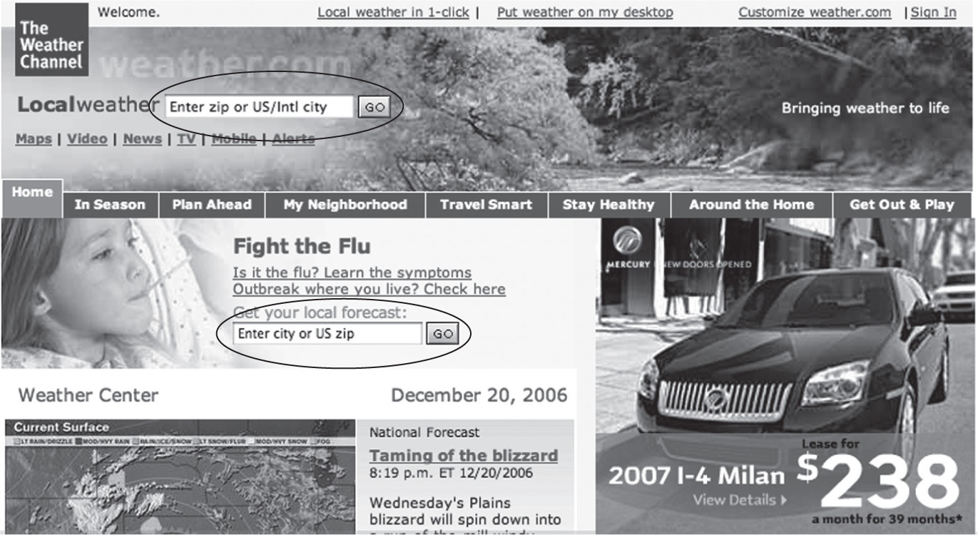
Competing Search Boxes
Problem: Multiple search boxes on the same page can confuse users.
-Variation 1(Oops! Wrong Search!): The University of Canterbury website has two search boxes, one for courses and one for the entire site , but users often use the wrong one.
-Variation 2(Two identical search boxes. How to choose?): Weather.com has two identical search boxes , leading users to make arbitrary choices.

Slide 24
Avoiding Blooper 19- Clear Search Boxes
-Problem: Multiple search boxes on the same page can confuse users
-Solution: Minimize the number of search boxes.
-Tip; Only use one prominent search box for general search. Place it in standard locations ( e.g top left , top right).
If multiple search functions are needed, differentiate them clearly( e.g label them distinctly).
Use different designs for different search functions (eg.stock quote lookup vs. general search)

Slide 25
Blooper 20 & 21: Browsing and Noisy Results
Blooper 20: Poor navigation through search results (e.g., only : “Next” and “Back” buttons).
—Example: IBM.com limits navigation options, forcing users to click through pages repeatedly.
Blooper 21: Noisy search results (irrelevant details, repetitive information).
—Example: Federal Reserve Bank of Minneapolis shows irrelevant data like URLs repeatedly, making it hard to scan results.

Slide 26
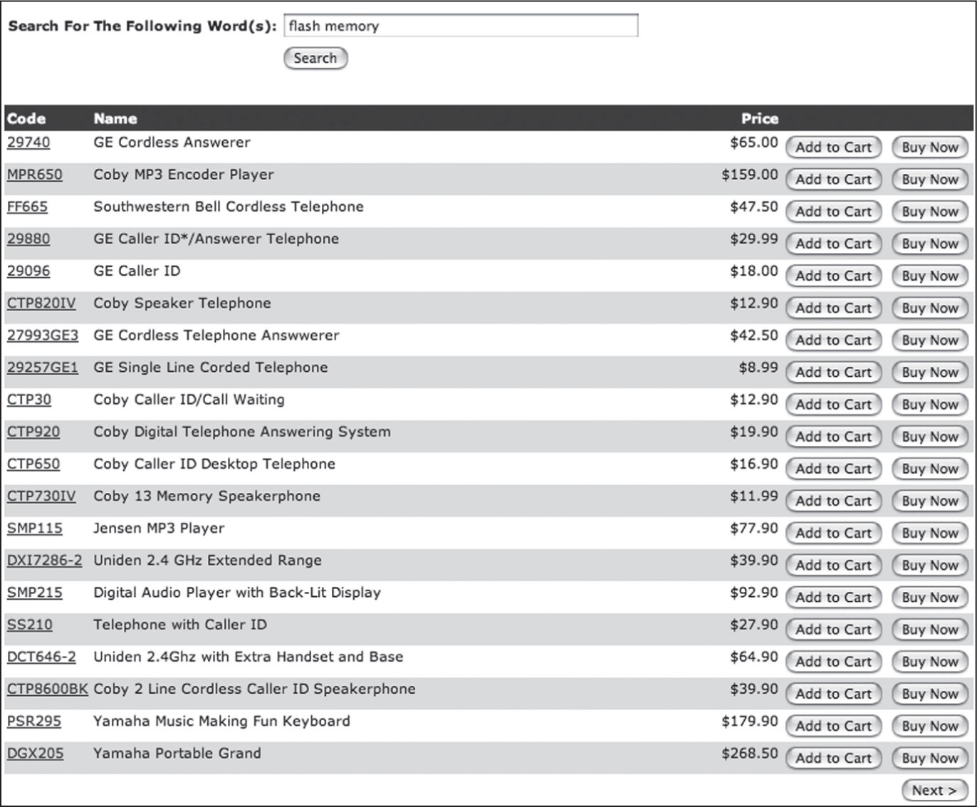
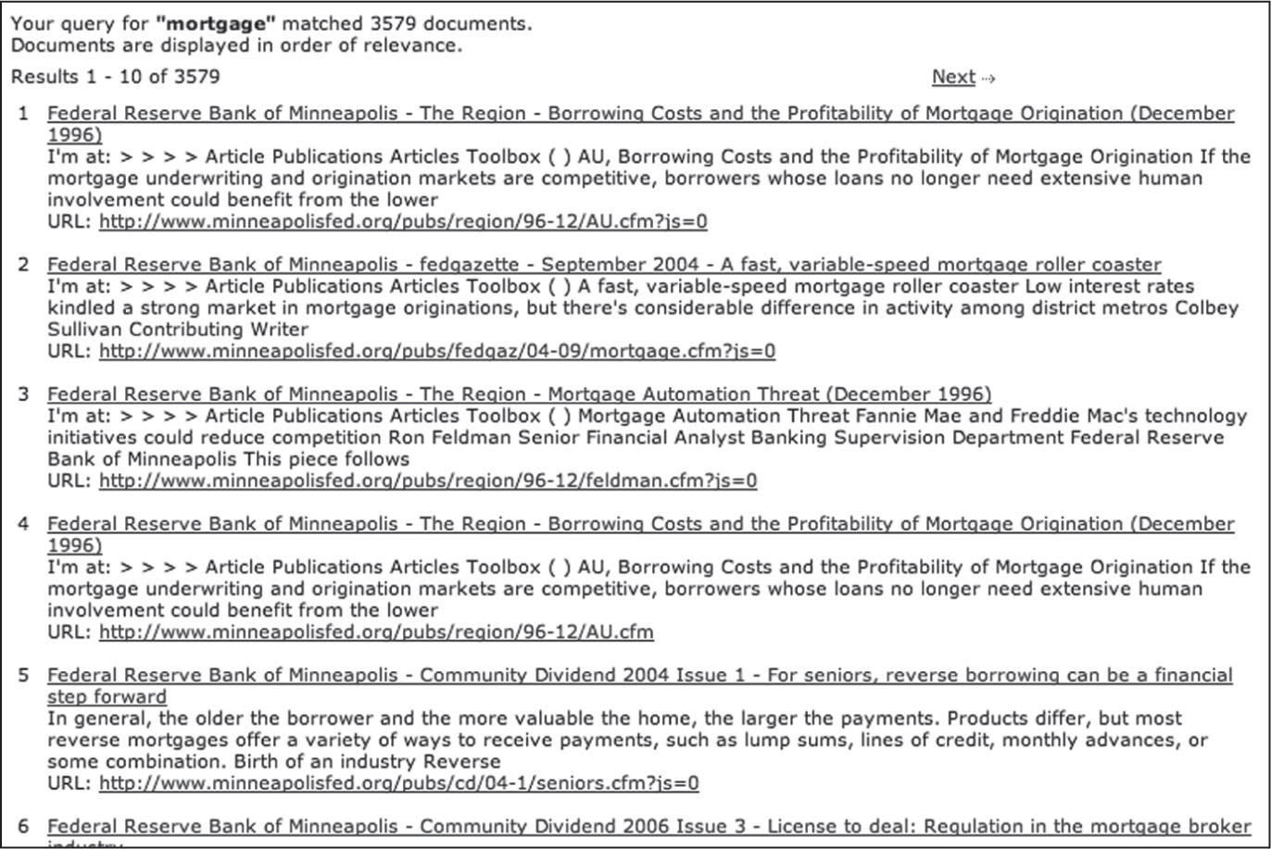
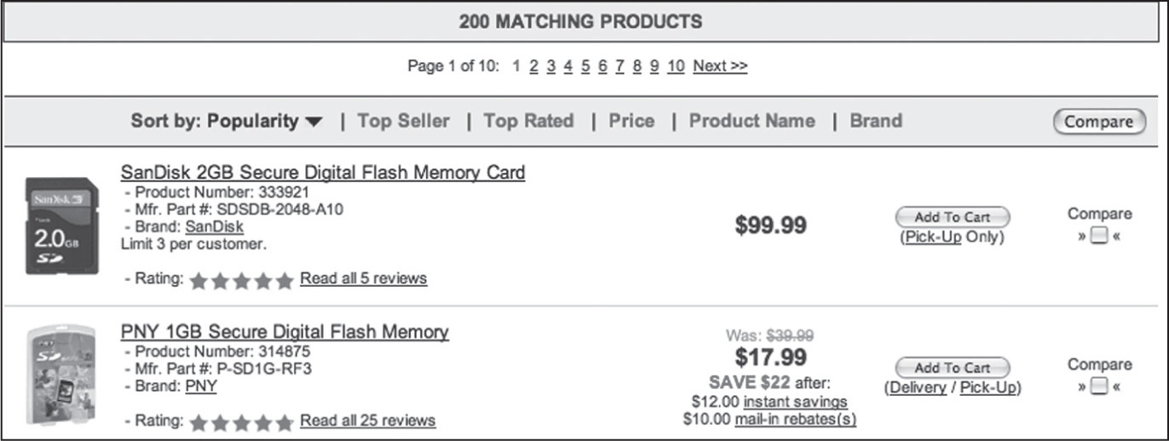
Examples from the previous slides

