Slide 1
DWTMIM Chapters 9-10 (Jeff Johnson)
RM, Grace, Jungho

Slide 2
Recognition is Easy
Neural Patterns: Memories are represented by patterns of neural activity that can be reactivated.
Perceptual Input: Recognition occurs when incoming sensory information closely matches a stored neural pattern.
Examples
Facial Recognition:
Humans recognize faces in a fraction of a second.
The brain reactivates the neural pattern from a previous encounter without “searching” memory.
Everyday Recognition:
Recognizing familiar objects, maps of US, all of which depend on repeated exposure and context.
Recognition is Fast

Slide 3
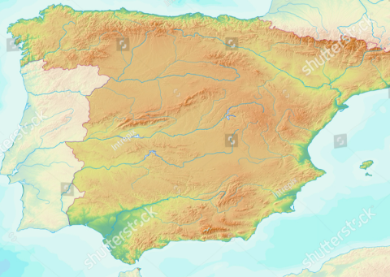
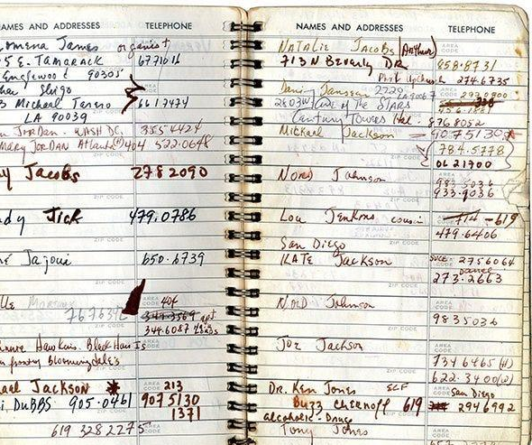
Recall is HARD
Recall
The process of reactivating a memory without direct perceptual support.
Why It’s Hard:
Without cues, the brain must “search” for the correct neural pattern, often leading to partial or incorrect recall.
Examples
Everyday Memory Struggles:
People often have difficulty recalling specific facts or ways of doing things. Eg. Recalling syntax while Programming
Map of a place you are not familiar with.
Memorization Techniques:
Historical methods such as the method of loci, reciting long poetry etc. Storing them in mental spaces
Phone books

Slide 4
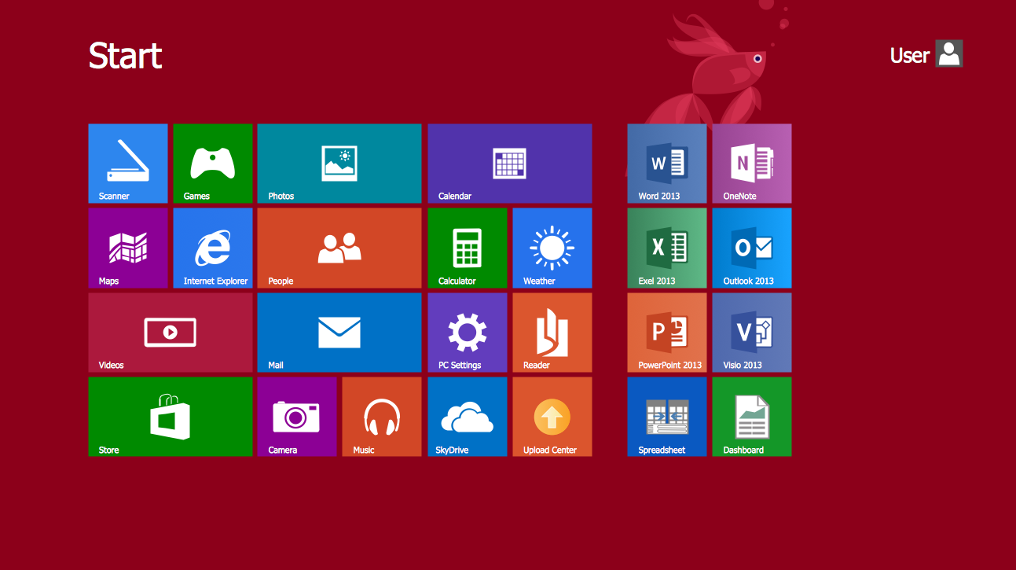
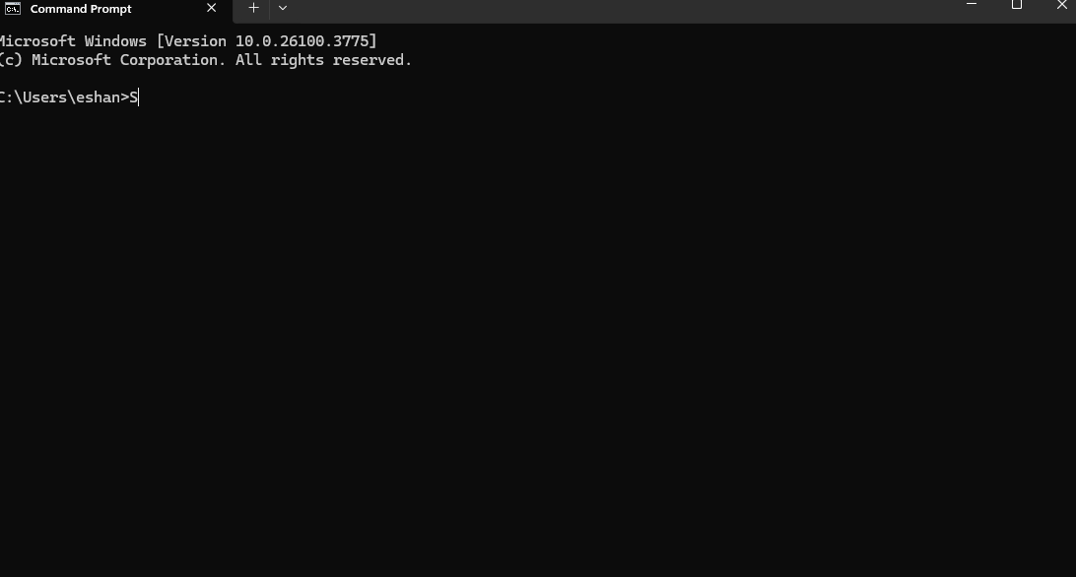
Recognition vs Recall
Design Principle: Favor recognition over recall in interfaces.
Strategies:
Use menus and icons instead of requiring users to remember commands.​
Provide visual cues and consistent layouts.
Graphical User Interface (GUI): Relies on recognition (e.g., icons, menus).​
Command-Line Interface (CLI): Relies on recall (e.g., typing commands).
Authentication Ease:
Recognizing the difficulty of recalling complex passwords, systems should offer password hints, allow user-created passwords, or use biometric methods.
Contextual Cues:
Use visual elements (like personal account logos on secure sites, see Fig. 9.10) to reassure users and prevent errors such as phishing.

Slide 5
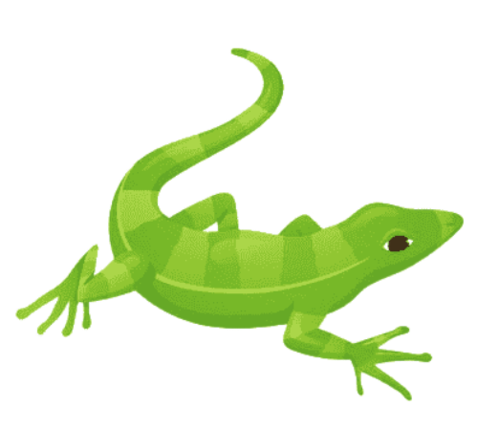
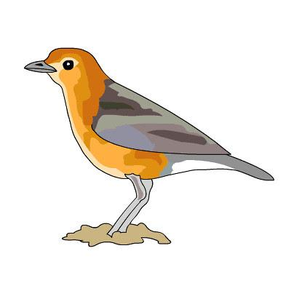
We Have 3 Brains
Old brain: takes care of automatic bodily functions (breathing, digestion, reflexes)
Classifies things as edible, dangerous, or sexy
Lives in the brain stem
Midbrain: controls emotions
Lives in the middle section of your brain
New brain: controls purposeful, intentional, planned actions and problem solving
The conscious part of your brain
Lives in the cerebral cortex

Slide 6
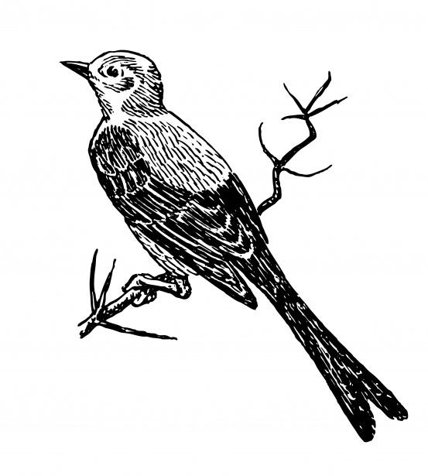
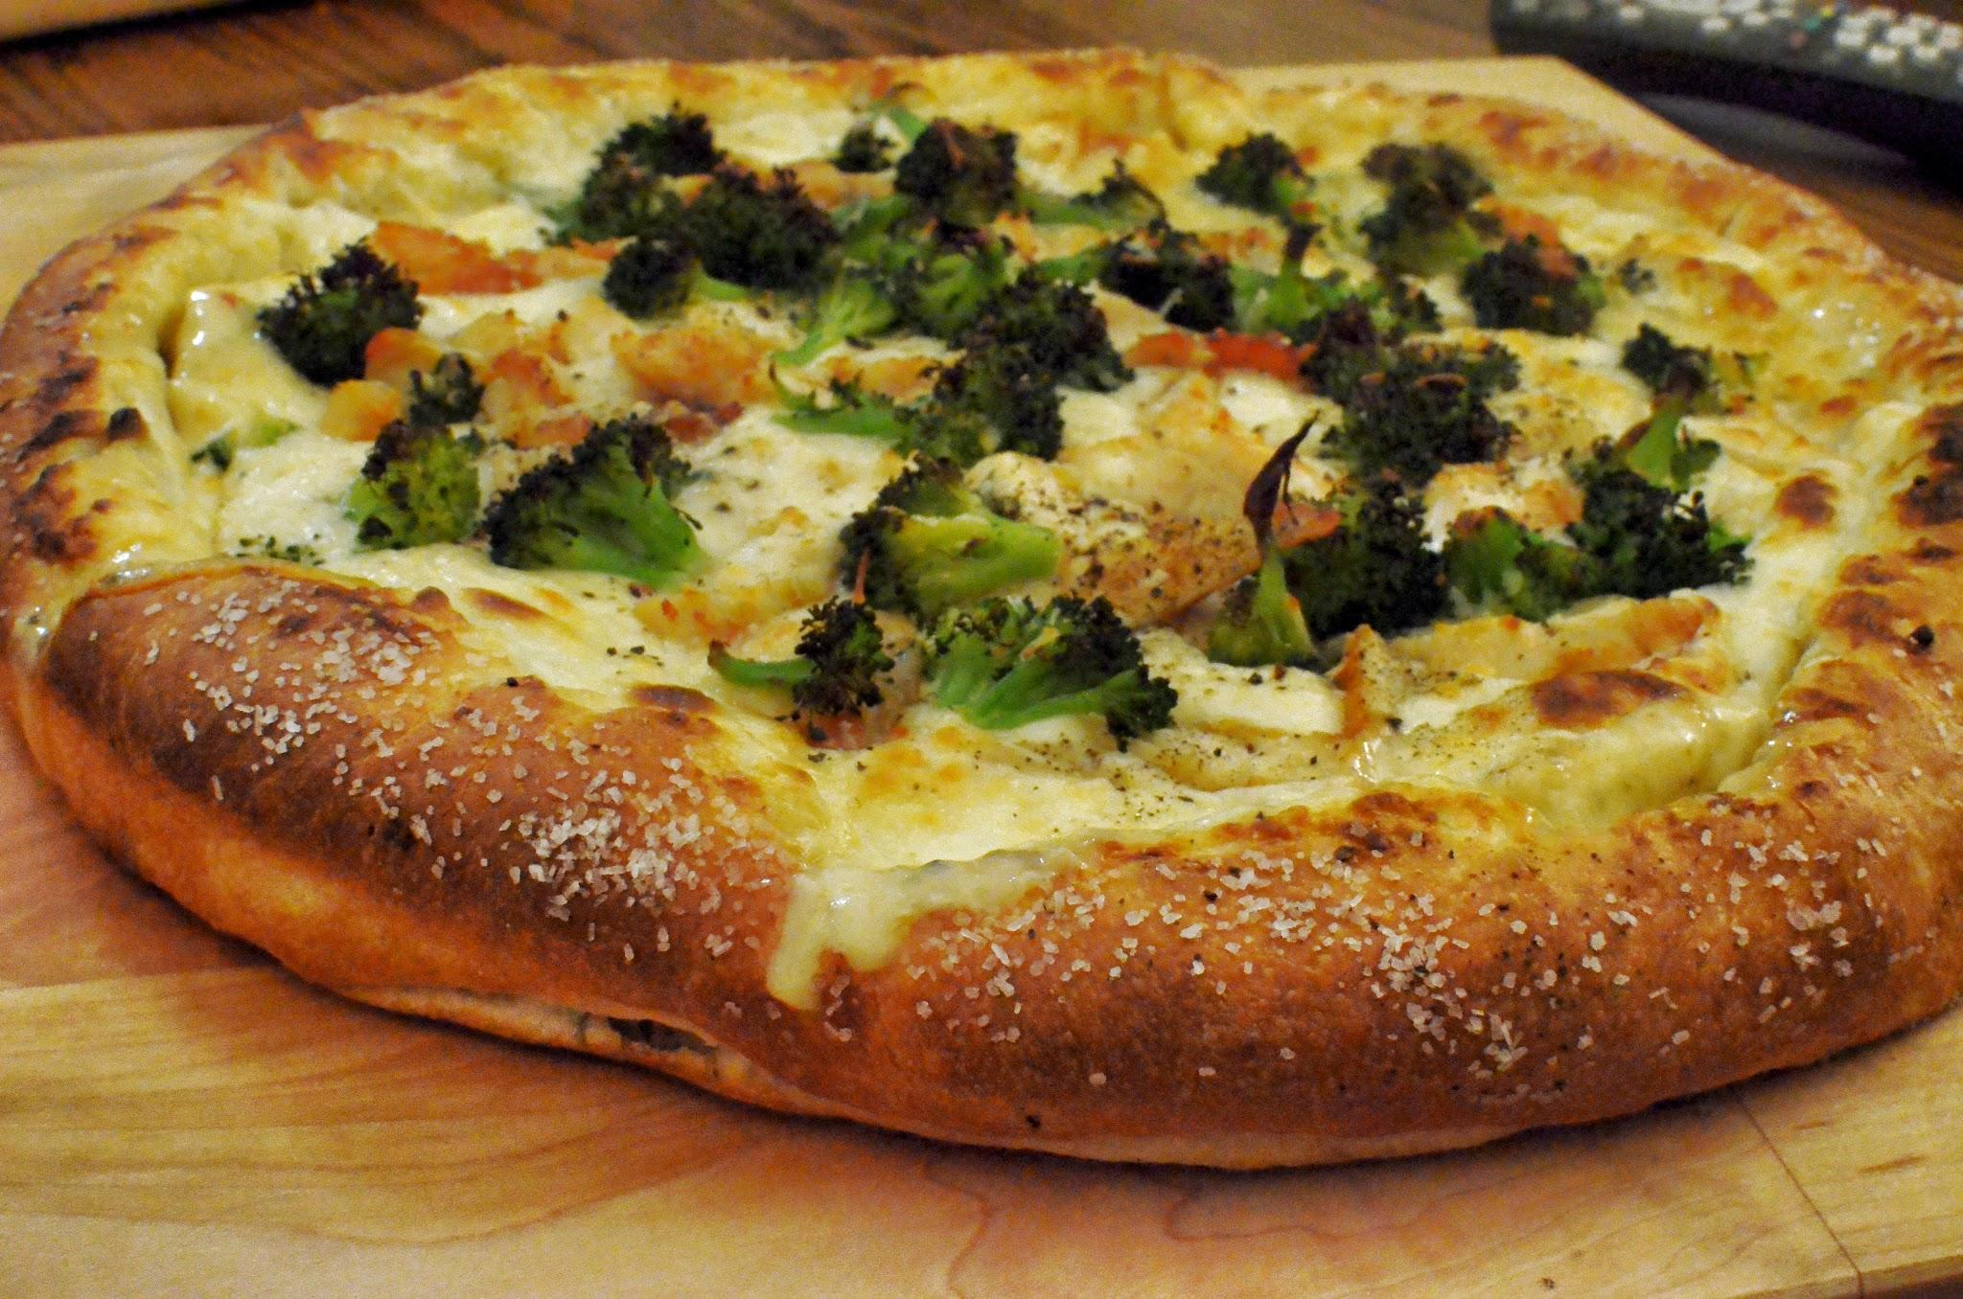
We Have 2 Minds
System 1: automatic, unconscious, the emotional mind
Old brain + midbrain
Main controller of perception and behavior
Operates very quickly using assumptions, shortcuts, and guesses
Judgements based only on perception
Optical illusions
Filters perception based on goals and beliefs
Selective attention
Will substitute an easier problem to solve a hard one
Ex: is broccoli good on pizza?

Slide 7
We Have 2 Minds
System 2: monitored, conscious, the rational mind
New brain
Rarely in charge
Ex: walking to class
Generally accepts answers provided by System 1
Takes effort to check
Takes over when System 1 isn’t enough:
We need to be exactly right
Totally new situation (with no automatic response)
Multiple conflicting responses and no easy way to solve them

Slide 8
Learning from Experience is (Usually) Easy
We generalize based on (sometimes few) specific experiences and observations
System 1 learns from experience and automatically adjusts behavior
Ex: Don’t step in anthills
Limitations
Complex situations with lots of variables are hard to learn from since we can’t reliably predict them (ex: the weather)
Our own experiences and family and friends’ experiences override others (ex: rate my professor)
Hard to pinpoint mistake and learn from it if the result becomes obvious much later than when the mistake was made
We overgeneralize easily

Slide 9
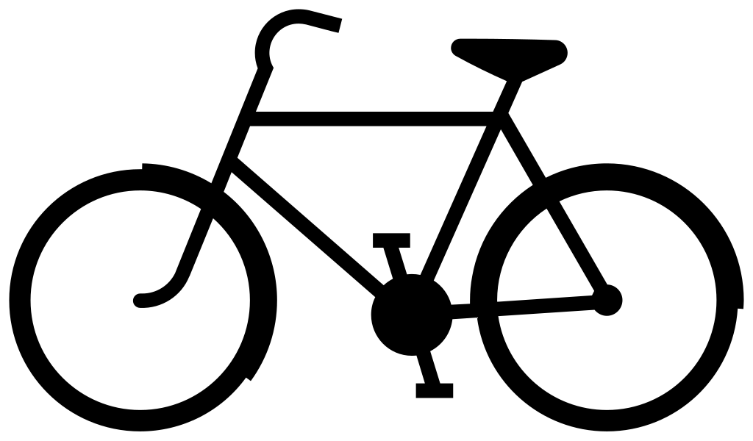
Performing Learned Actions is Easy
Learned actions = System 1 is in charge
Not limited by short-term memory or attention since conscious effort is not needed
Ex:
Riding a bicycle
Typing on a computer or phone
Talking
What else?

Slide 10
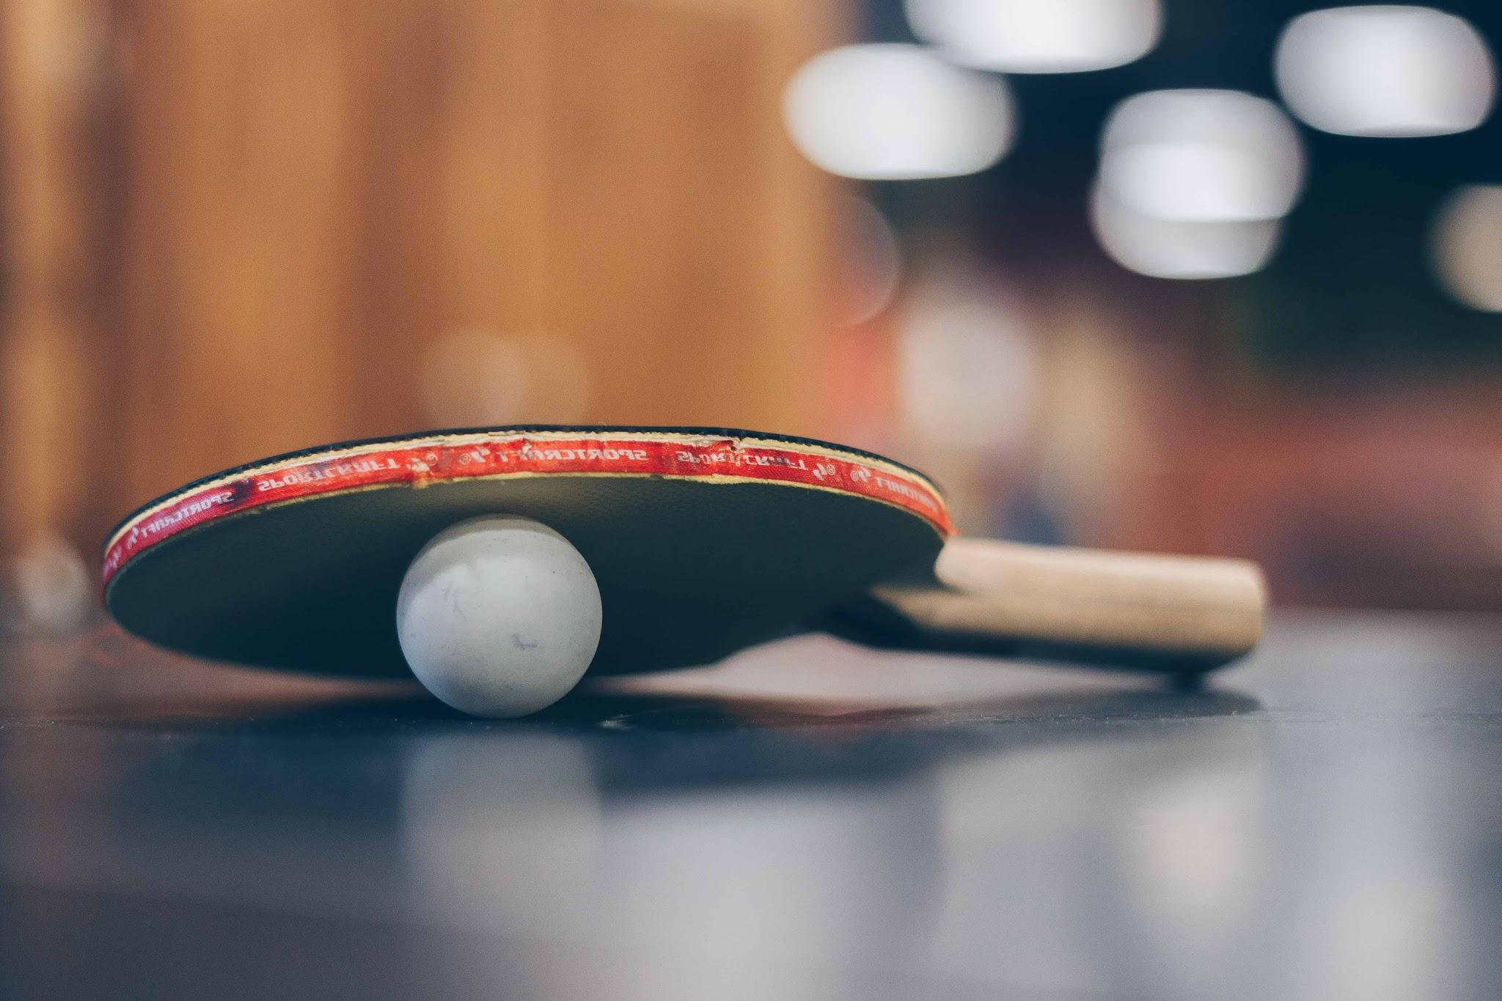
Performing Novel Actions is Hard
Most real-world tasks have a mixture of automatic and controlled components
System 2 is used
Application to UI design: design interactive systems to use system 1 as fast as possible

Slide 11
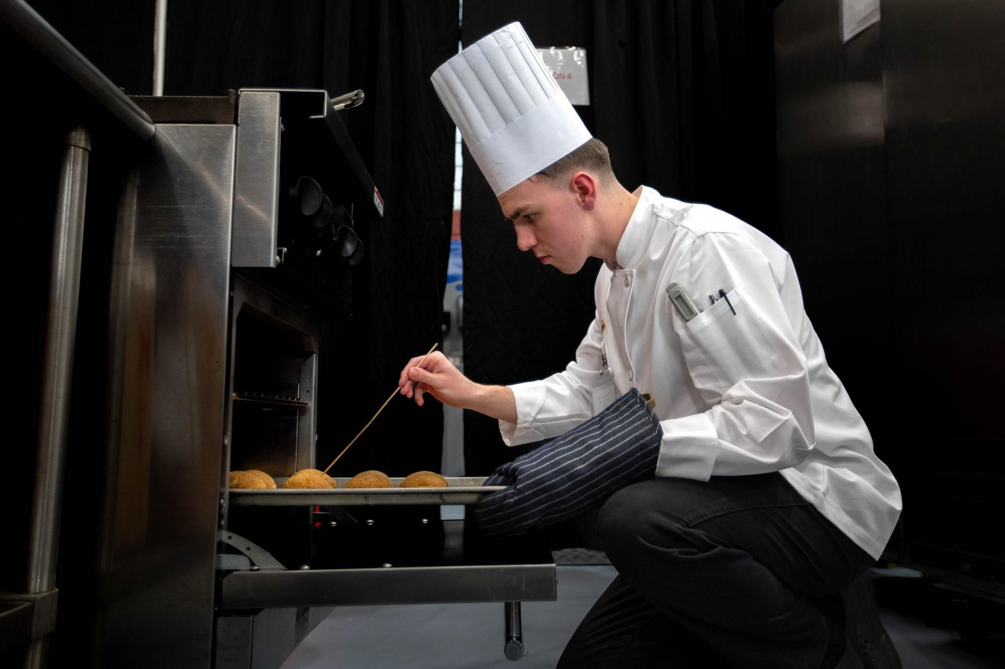
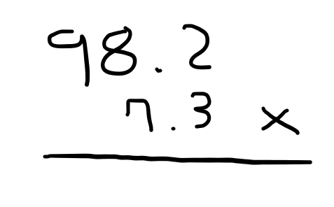
Problem Solving and Calculation are Hard
All happens in the cortex, where conscious reasoning take place
System 2 is used
Requires more cost compared to learning from experience
focused attention, constant conscious monitoring
Executes relatively slow and serially
Limit on short term memory - multiple chunks of information required

Slide 12
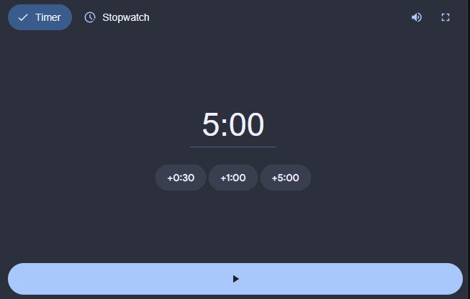
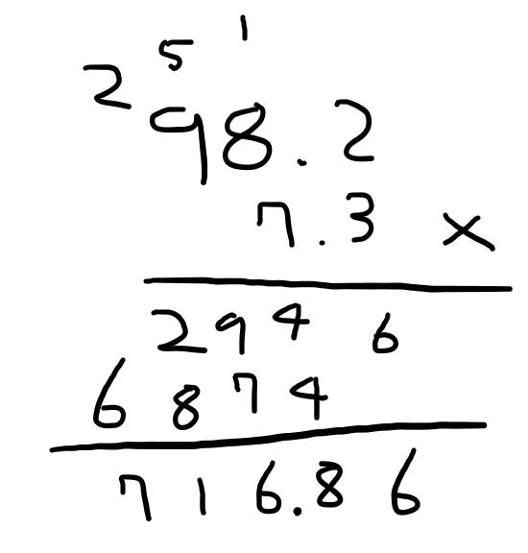
Problem Solving and Calculation are Hard
External aids are used
Invention of calculators and computers

Slide 13
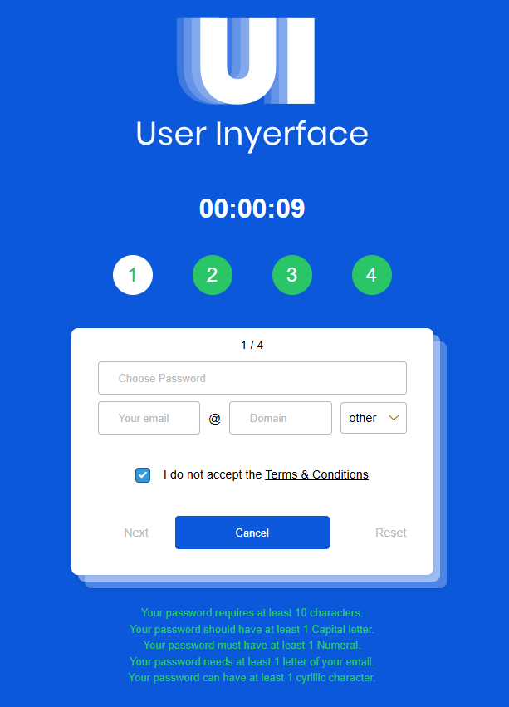
Implications for User-Interface Design
People have their own goals of using the program
UI designers should respect this and help people focus attention on their goal.

Slide 14
Design Rules
Prominently indicate system status and users’ progress toward their goal
Guide users toward their goals
Tell users explicitly and exactly what they need to know
Don’t make users diagnose system problems
Minimize the number and complexity of settings
Let people use perception rather than calculation
Make the system familiar
Let the computer do the math

