Slide 1
Designing with the Mind in Mind Chapters 7 & 8
Lina Boughton, Minh Phan, Pem Gurung

Slide 2
Our Attention is Limited; Our Memory is Imperfect
Chapter 7

Slide 3
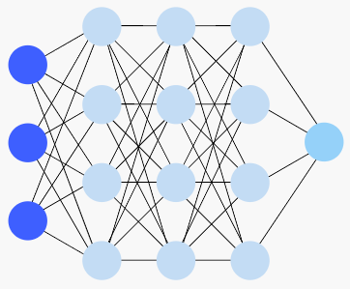
How Long-Term Memory Works
Formation of long-term memories = activating & changing a pattern of neuron activity
The more often a neural pattern is used, the easier it is to reactivate!
Stores information from all 5 senses in different parts of the brain
Facts & relationships (semantic)
Past events (episodic)
Action sequences (procedural)

Slide 4
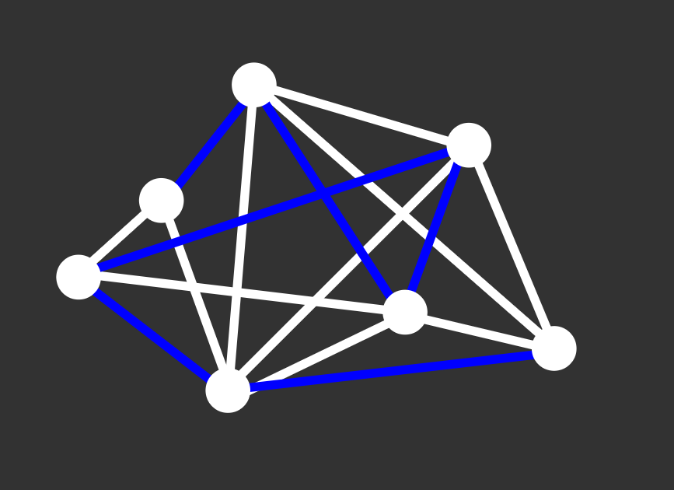
Recognition vs Recall
2 ways to activate long-term memories:
Recognition: perceptions → similarity to old/original perceptions → activates the same pattern of neurons
Recall: activity in other parts of the brain → activates the same pattern of neurons
CAT

Slide 5
Characteristics of Long-Term Memory
Lasts for hours to years :)
Error-prone :(
Forgets details
Perceives incorrect information
Low resolution
Easily influenced by emotions :3
Can change retroactively :0

Slide 6
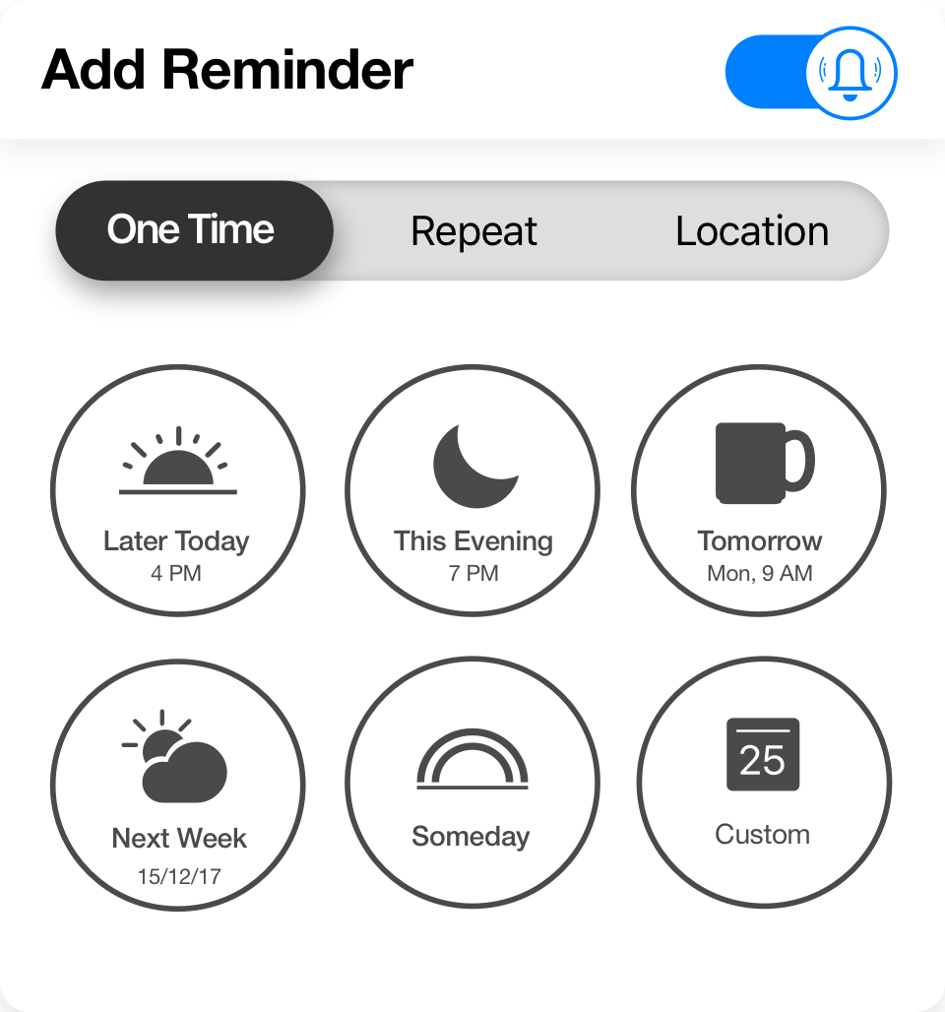
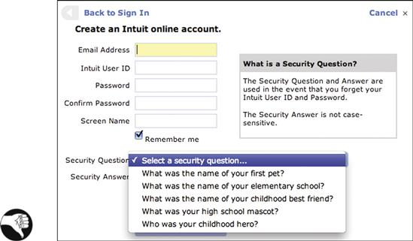
Designing for Long-Term Memory
Provide tools to prompt recall/recognition
EX. Reminders
Don’t burden a user with info that the system could store instead
EX. Reminders (also)
Utilize emotions in your design
EX. Security Questions vs PINs

Slide 7
Short-Term & Working Memory
Short-Term Memory: A combination of perception, attention, & retrieval from long-term memory.
Lasts for a few seconds or minutes.
Working Memory: The things we are aware of right now.
A very small subset (3-5 items) of the total perceptions and long-term memories available
Not a storage of information
EX. Mindfulness

Slide 8
Characteristics of Working Memory
Mainly seeks out important events & features in our environment
Drawn to movement (near or towards us), threats, faces, sex, or food
→ We are unaware of most things around us!
Easily forgets info when attention is redirected
Out of sight, out of mind
Remembers things in chunks/parts
→ Easier to remember dissimilar sets of stimuli than similar sets

Slide 9
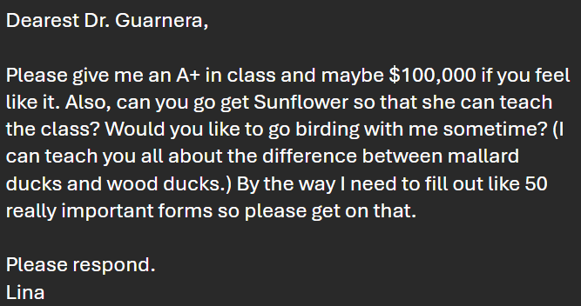
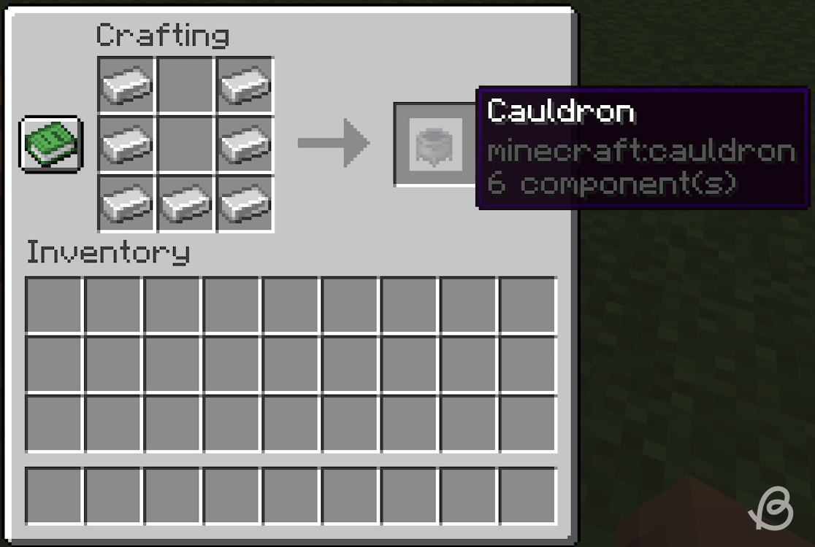
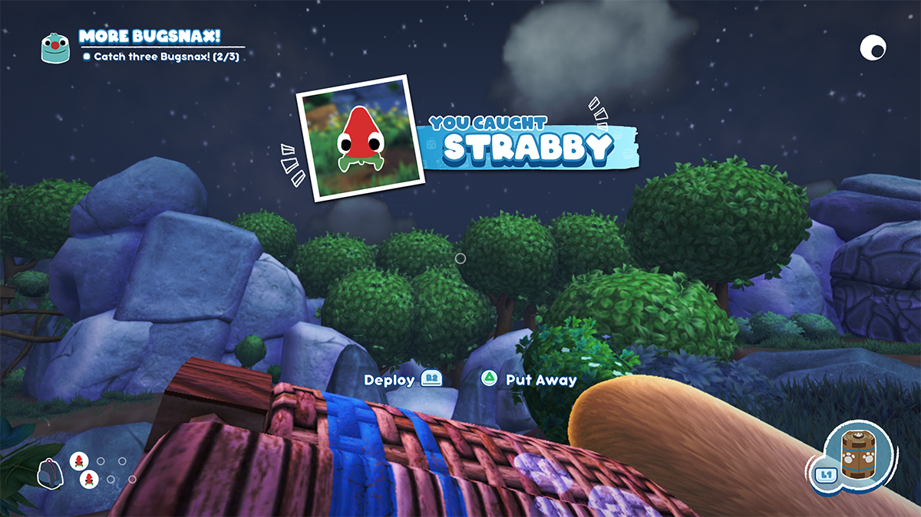
Designing for Working Memory
Restrict each message/page to one topic/call to action (“Do this!”)
Make modes obvious (with signifiers/feedback)
Remind your user of what they just searched
Make navigation hierarchies broad & shallow
Provide breadcrumbs for deeper systems
Provide written instructions that stay on screen & are clearly ordered

Slide 10
Storytime: Coffee Shop
Notes:
You enter a bustling coffee shop on a rainy Tuesday. The barista, in a red apron with a green leaf pin, grinds beans loudly while humming a tune. You order a caramel latte with oat milk. Outside, a gray van splashes through a puddle, startling a dog tied to a pole with a chewed leash. A customer in a yellow raincoat drops their phone near a stack of soggy newspapers and a tipped-over sugar jar. You grab your coffee, noticing a chalkboard menu with ‘Special: Pumpkin Spice’ in orange letters, then leave past a blue bicycle with a flat tire and a rusty bell.

Slide 11
Some questions
Question 1: What was on the barista’s apron besides the red color?
=> A green leaf pin
Question 2: What was written on the chalkboard menu?
=> Pumpkin Spice’ in orange letters

Slide 12
Limits on Attention Shape Our Perception
Chapter 8

Slide 13
Notes:
The Invisible Gorilla by Christopher Chabris and Daniel Simons explores how we notice a lot less than we think we do. These findings highlighted the significant limitations of human attention and the ease with which individuals can overlook even highly salient stimuli when focused on a specific task.
These results underscored the concept of inattentional blindness, demonstrating that focused attention can create a cognitive tunnel vision where unexpected elements in the environment go unnoticed. The research challenged the assumption that humans have a comprehensive awareness of their surroundings and revealed the selective nature of attention.

Slide 14
When people do a task, their attention is mainly focused on the goals and data related to that task.
People care about what they’re doing over how they’re doing it.
Tools tend to fade into the background—until they break.
Selective Attention
Notes:
💡 Design Tip: Build interfaces that stay out of the way. If your app is the focus, you’ve already lost.

Slide 15
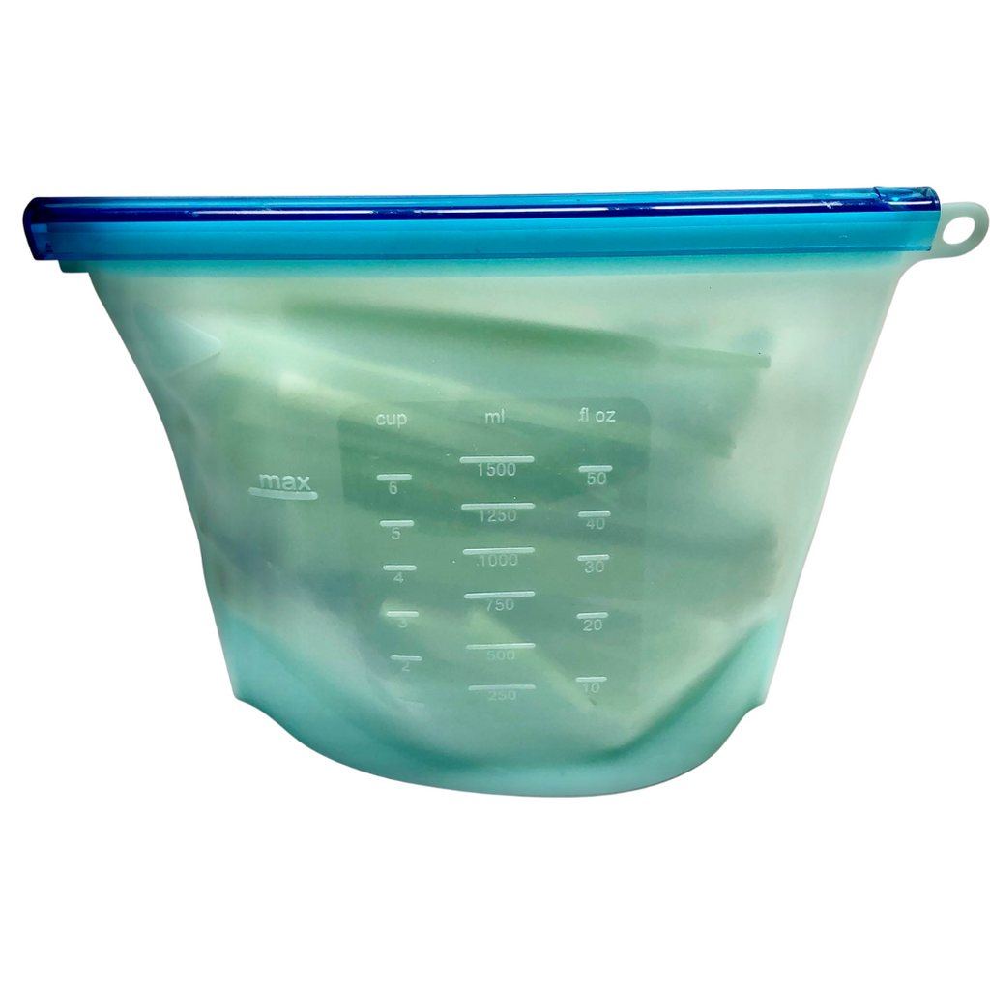
Inattentional & change blindness are real
Notes:
💡 Design Tip: Highlight changes (e.g., price updates) with movement, color, or animation. Don’t rely on users “just noticing.”

Slide 16
We notice things more when they are related to our goals

Slide 17
We use external aids to track progress as short-term memory is not functional
Notes:
💡 Design Tip: Show task progress, read/unread states, and let users mark stuff. If it's important, make it visible.

Slide 18
We as humans also chase literal cues
People look for keywords that match their goal.
“Flight to Berlin”? They’ll click anything with “flight” or “ticket.”
Notes:
💡 Design Tip: Label things in user language, not internal jargon. Boost that info scent.

Slide 19
Lazy, but efficient, we prefer familiar paths
Notes:
💡 Design Tip: Support fast paths, but keep the comfy old ones. Suggest shortcuts—don’t force them.

Slide 20
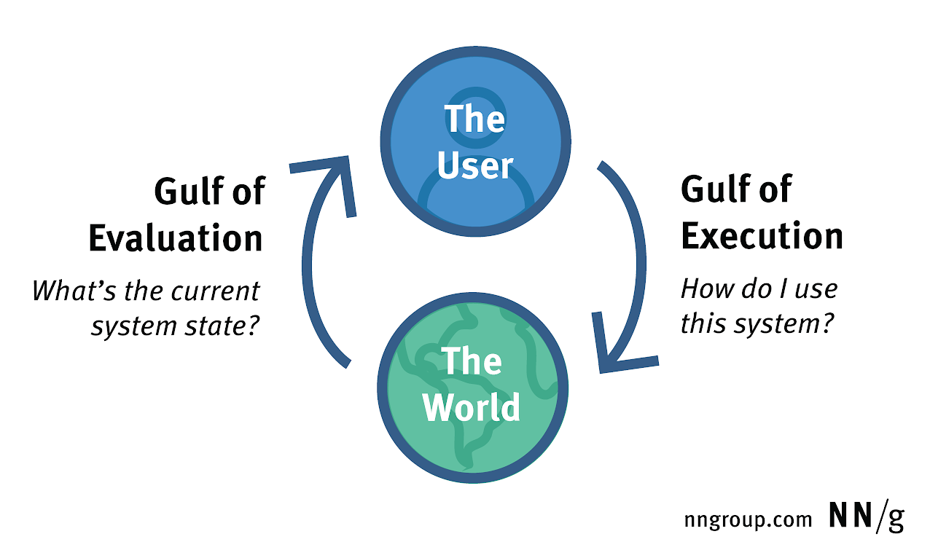
Our minds run on a goal–execute–evaluate loop
Every action is part of a cycle.
We form a goal → act → check results → repeat.
Notes:
💡 Design tip: give clear actions, obvious feedback, and gentle exits. Match UI to task flow, not code logic.

Slide 21
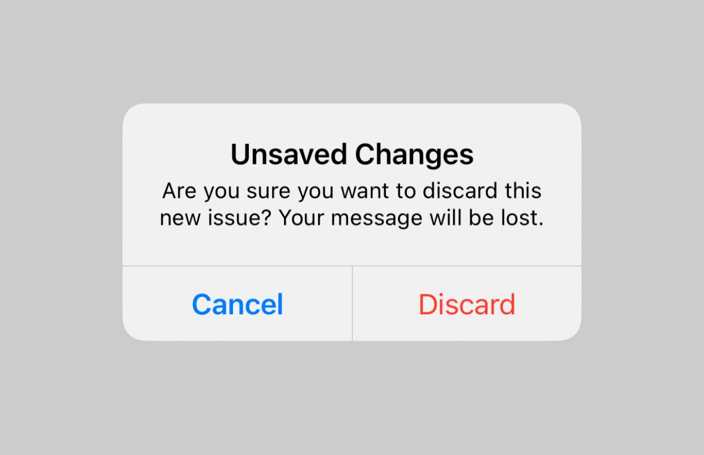
Cleanup steps are often forgotten, and that's where we get mad
After goal completion, our brains drop the mic and walk off.
That’s how headlights stay on or files stay unsaved.
Notes:
💡 Design tip: prompt users before they forget. Better yet—automate it.

Slide 22
Design for real minds
Attention limits = design rules
Users are goal-driven, distracted, forgetful creatures.
Good UX doesn’t fight this—it embraces it.
Attention-driven design
Notes:
💡 Design Tip: Make your UI invisible, obvious, familiar, supportive, and forgiving.
https://dorve.com/blog/attention-driven-design-principles-enhanced-ux/
Good for neurodivergence

