Slide 1
Designing with the Mind in Mind Ch 5-6.
Pem and Noelynn

Slide 2
Human Vision: Fovea vs. Peripheral Vision
Fovea:
High resolution (158,000 cones/mm²).
1:1 neural connections to the brain.
Processes 50% of the visual cortex.
Periphery:
Low resolution (9,000 cones/mm²).
Compressed data (multiple cells share one neural connection).
The periphery is like a blurry camera; the fovea is a spotlight.

Slide 3
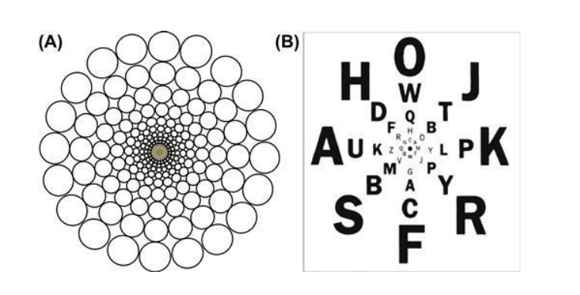
The Illusion of Sharp Vision
Eyes move constantly (3x per second) to sample details.
The brain "fills in" gaps using expectations.
Users don’t notice if non-foveal text is replaced with random noise.

Slide 4
What’s the Periphery Good For?
Guides the Fovea:
Spots cues (e.g., red blob in a form).
Detects Motion:
Evolutionary survival tool (e.g., moving predator).
Night Vision:
Rods in the periphery work better in low light.

Slide 5
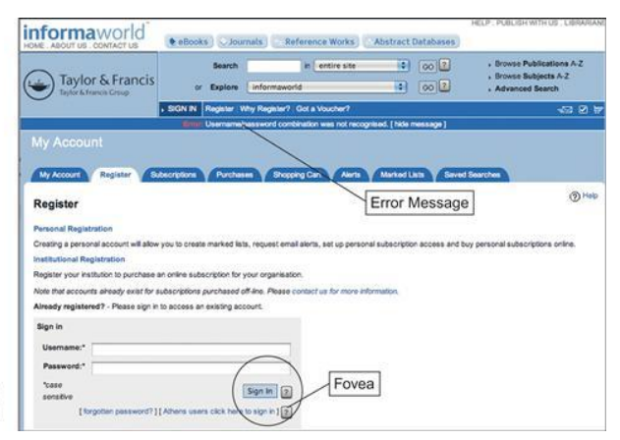
UI Pitfalls
Error messages in the periphery often go unnoticed.
Why?:
Peripheral vision is ~20/200 (legally blind).
InformaWorld’s distant error message caused user confusion.

Slide 6
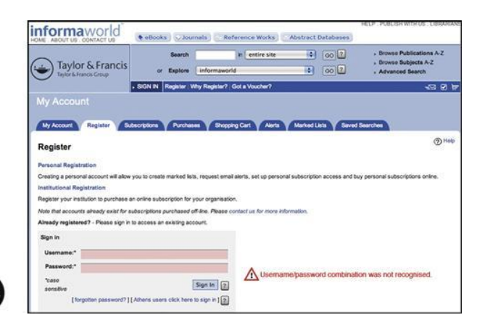
Fixing Visibility Issues
Place errors where users are looking (e.g., near buttons/fields).
Use symbols (⚠️) and red (but adapt for cultural contexts).
Example: AOL’s inline validation catches errors as users type.

Slide 7
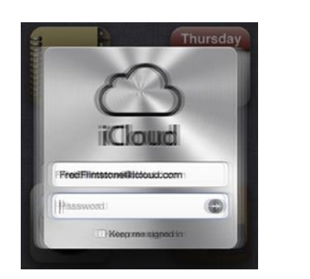
Heavy Artillery for Critical Alerts
Motion: Briefly shake/blink (e.g., Apple iCloud login error).
Sound: Use sparingly (disruptive in shared spaces).
Pop-Ups: Reserve for critical errors (e.g., data loss warnings).
Risk: Overuse leads to habituation (users ignore alerts).

Slide 8
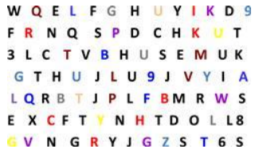
Visual Search Strategies
Linear Search: Slow, requires scanning (e.g., finding a “Z” in a grid).
Nonlinear “Pop”:
Use color, boldness, or motion to make targets stand out.
Example: Google Maps uses red to highlight traffic jams.

Slide 9
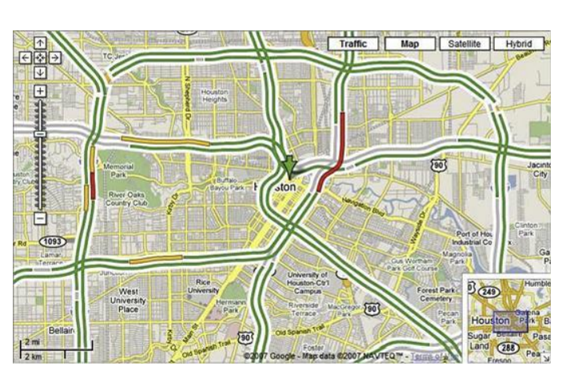
Design Takeaways
Do:
Place critical info in the foveal zone (1–2 cm on screens).
Use motion for <0.5 seconds to avoid annoyance.
Make icons/text distinct (color/shape) for peripheral detection.
Don’t:
Hide errors in the periphery.
Use red for non-critical info (unless culturally safe).

Slide 10
Understanding How We Read.
-Reading is not natural, but rather a learned skill.
-Our brains are wired for language but not for reading
-Designers should understand how reading works to create effective designs.
Ex. Why adults find learning a new language hard but can still speak naturally unlike reading( requires effort).

Slide 11
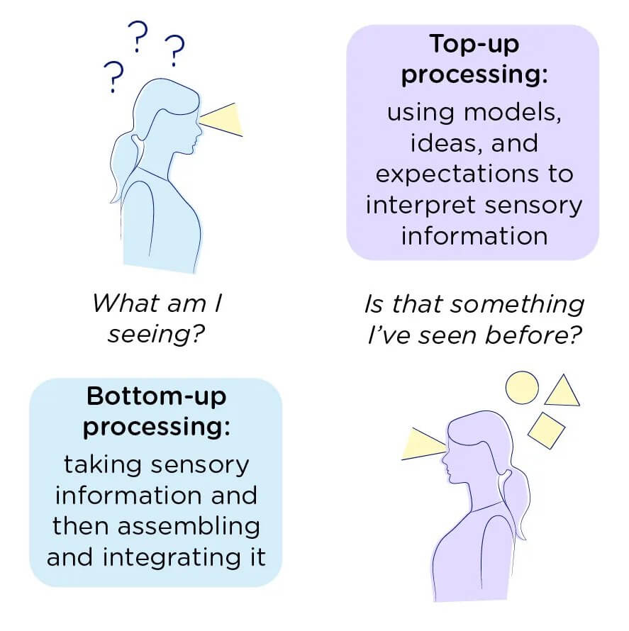
The Reading Process
Eye reading is not smooth; it happens in jumps called saccades and brief pauses to process the words called fixations.
Bottom – up( Feature- Driven): Recognizing letters, words, and patterns.
Top- down ( Context- Driven): Using prior knowledge to predict words.
Skilled readers rely more on feature- driven reading, while less skilled readers rely on context to guess meaning.
Ex. Why bold headings and bullet points help readers navigate text faster.
Example of scrambled text where first and last letters remain in place, but people can still read it (e.g., Tihs snetecne is esay to raed).

Slide 12
Disrupting Reading.
What disrupts reading?
-Unfamiliar vocabulary slows down comprehension and increases cognitive load.
-Difficult or tiny fonts make text harder to recognize.
-Patterned backgrounds & poor contrast reduce readability.
-Centered text and excessive repetition disrupt scanning.

Slide 13
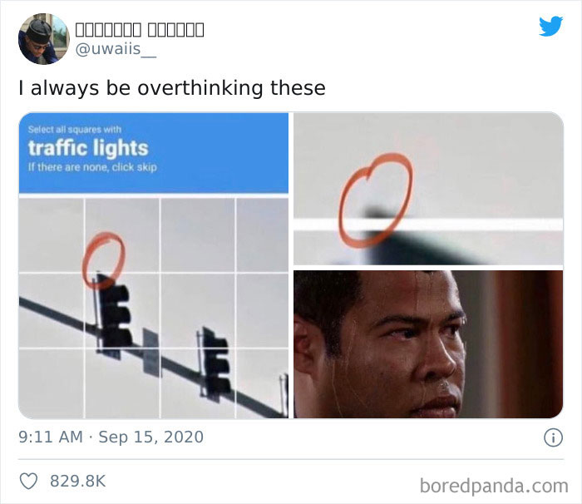
Design Implications.
-Use clear, readable fonts ( avoid all CAPS , tiny text).
-Avoid text over busy backgrounds.
-Use headings , bullet points, and lists for easy scanning.
-Write in plain, simple language : avoid jargon.

Slide 14
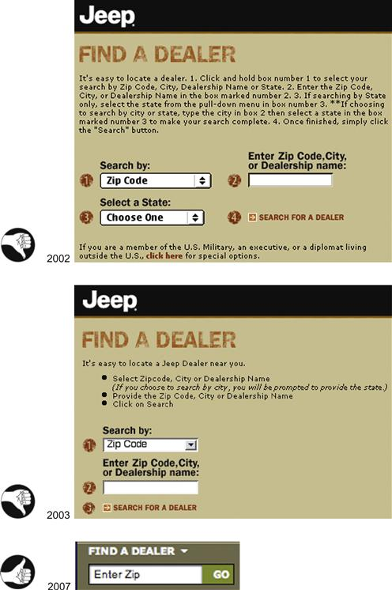
Minimizing the need for reading.
-Keep instructions and product descriptions concise. -Provide quick summaries and let users choose to read more. -Test designs on real users to ensure readability and efficiency. Less Reading = Better User Experience – this demonstrates how reducing unnecessary text improves engagement.

Slide 15
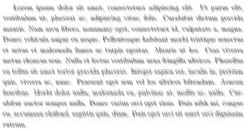
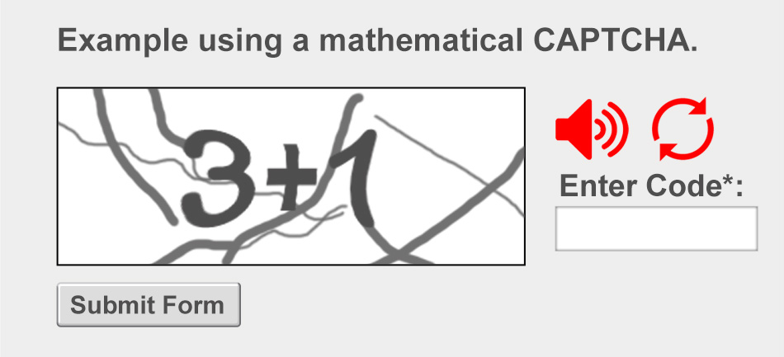
Creating Effective Text-Based Interfaces
-Reading is not automatic—design must support it.
-Minimize cognitive load by keeping text simple & scannable.
-Test designs with users to optimize readability and usability.
Being fluent in spoken language doesn’t guarantee strong reading skills.

