Slide 1
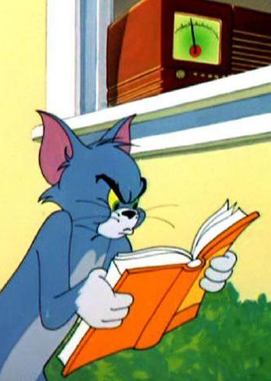
📖 DESIGN with the mind in mind – jeff johnson chapter 3 - 4
We Seek and Use Visual Structure
Our Color Vision is Limited
Lina, Minh | February 24, 2025

Slide 2
Visual Structure
Structure helps the user quickly scan for relevant/important information
Visual presentations should be structured & terse (minimize information)
Thus, the user experience is faster, easier, & less frustrating!

Slide 3
Visual Hierarchy
Visual Hierarchy: an arrangement of information that...
Breaks information into distinct sections
Breaks large sections into subsections
Labels each section & subsection
Prominently & clearly!
Presents the sections/subsections as a hierarchy
Higher-level sections presented more strongly than lower-level ones
Result: we can instantly sort the information by type & importance!

Slide 4
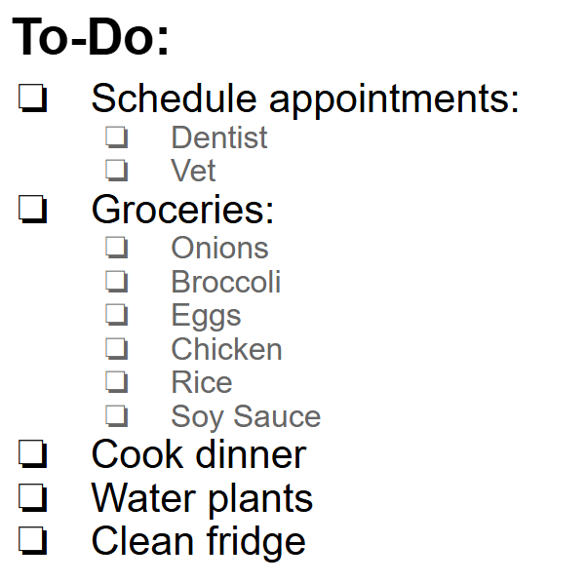
Example: To-Do List
Which would you rather use?
V.S.

Slide 5
Activity: Matching
Imagine that this poster is advertising a campus event. Match the fields of information to the slots on the poster:
Title
Entry Price
Description
Time, Date, & Place
Host (organization)

Slide 6
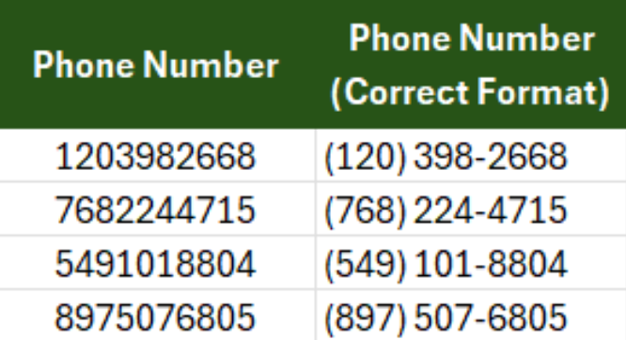
Techniques for Creating Visual Structure
Break long numbers into smaller groups parts to ease scanning
Controls designed specifically for entering specific types of data, rather than plain text fields

Slide 7
Techniques for Creating Visual Structure
Group together repetitive information
Use common visual structures like tables, boxes, or bullet lists

Slide 10
"Our Color Vision is Limited"
SO, MOVING ON...
What does that mean?

Slide 11
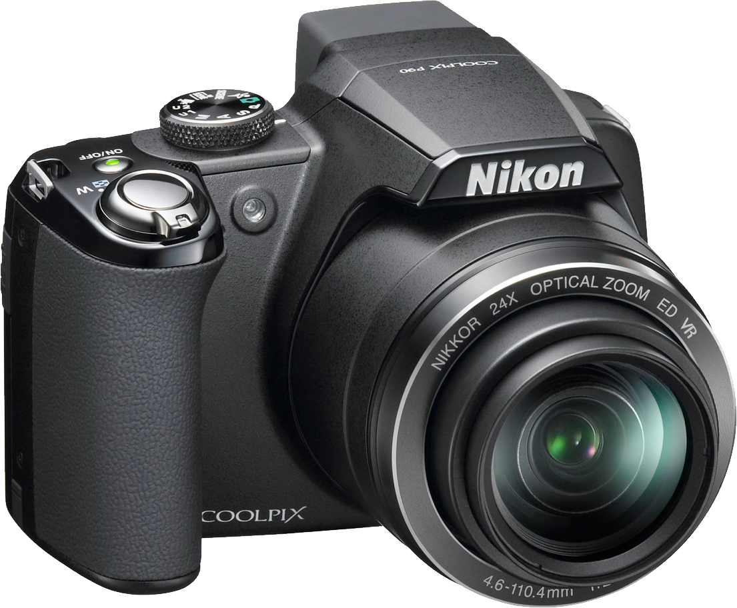
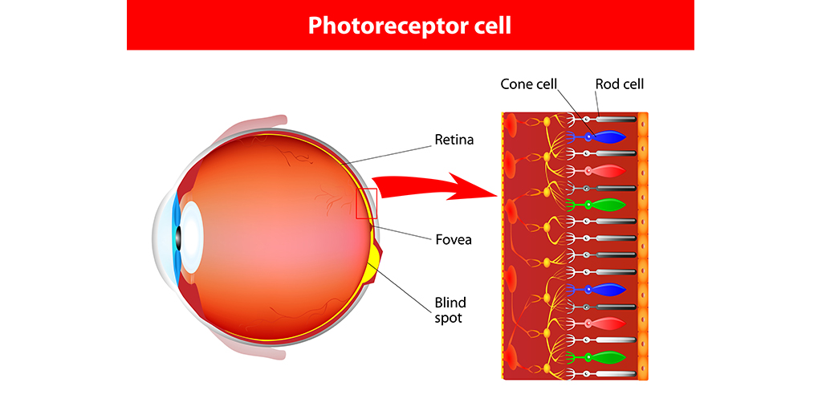
THE DIGITAL CAMERA HELPS US UNDERSTANDING HUMAN'S VISION
Notes:
Our eyes are able to look around a scene and dynamically adjust based on subject matter, whereas cameras capture a single still image. Our eyes can compensate as we focus on regions of varying brightness, can look around to encompass a broader angle of view, or can alternately focus on objects at a variety of distances.
Talking colors, the digital camera emulates a lot of the main mechanism of our vision system. our color vision is similar to video cameras and computer displays, which detect or project a wide variety of colors through combinations of red, green, and blue pixels.

Slide 12
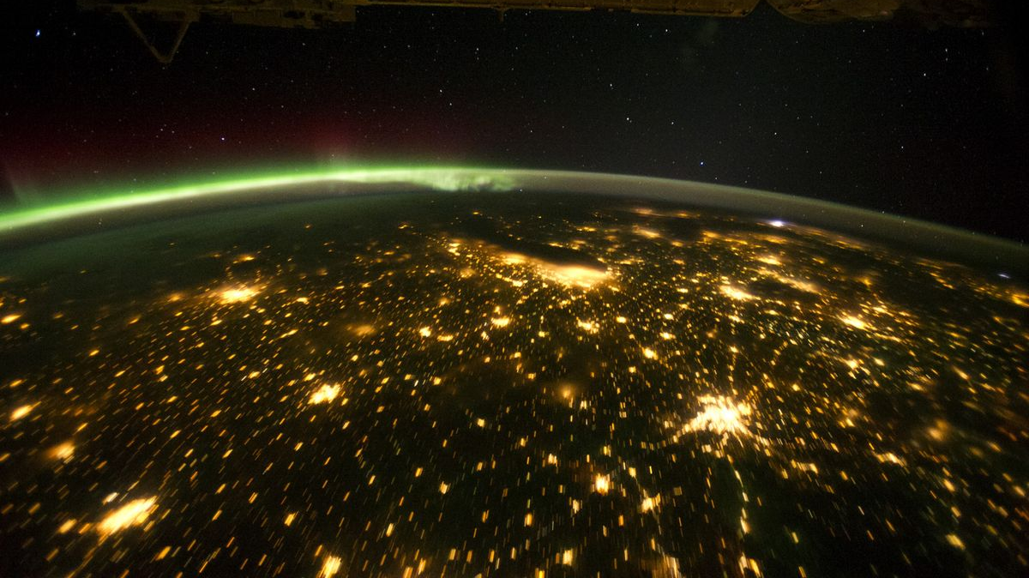
Notes:
Reliance on artificial lights, regardless of day and night, completely maxed out our rod usage.
In bright daylight and modern artificially lighted environments—where we spend most of our time—our rods are completely maxed out, providing no useful information.
Most of the time, our vision is based entirely on input from our cones

Slide 13
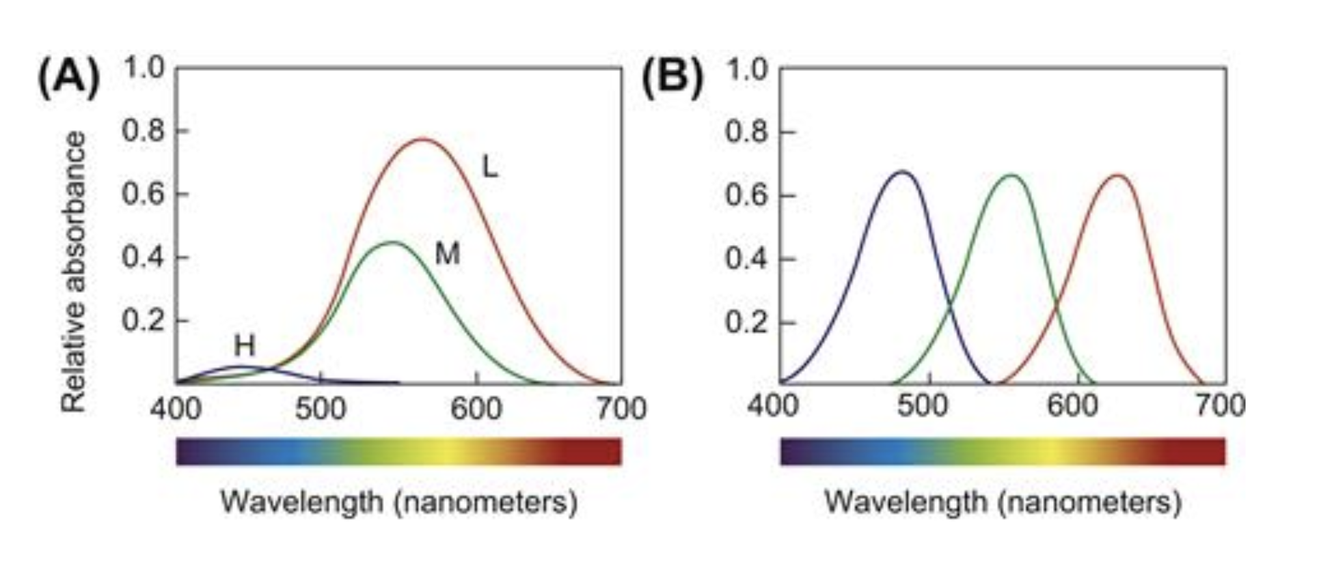
How Color Vision Works
Overlapping Sensitivities:​ Each cone covers a broad range of frequencies with overlapping responses.​
Subtractive Processing:​ The brain “subtracts” signals to create red–green and yellow–blue channels plus a luminance channel.
Artificial receptor
Photoreceptor cell
Notes:
Each type of cone is sensitive to a wider range of light frequencies than you might expect, and the sensitivity ranges of the three types overlap considerably.
• Low frequency. These cones are sensitive to light over almost the entire range of visible light, but are most sensitive to the middle (yellow) and low (red) frequencies.
• Medium frequency. These cones respond to light ranging from the high-frequency blues through the lower middle-frequency yellows and oranges. Overall, they are less sensitive than the low-frequency cones.
• High frequency. These cones are most sensitive to light at the upper end of the visible light spectrum—violets and blues—but they also respond weakly to middle frequencies, such as green. These cones are much less sensitive overall than the other two types of cones, and also less numerous. One result is that our eyes are much less sensitive to blues and violets than to other colors.

Slide 14
Vision is Optimized for Contrast, not Brightness
Notes:
Each type of cone is sensitive to a wider range of light frequencies than you might expect, and the sensitivity ranges of the three types overlap considerably.
• Low frequency. These cones are sensitive to light over almost the entire range of visible light, but are most sensitive to the middle (yellow) and low (red) frequencies.
• Medium frequency. These cones respond to light ranging from the high-frequency blues through the lower middle-frequency yellows and oranges. Overall, they are less sensitive than the low-frequency cones.
• High frequency. These cones are most sensitive to light at the upper end of the visible light spectrum—violets and blues—but they also respond weakly to middle frequencies, such as green. These cones are much less sensitive overall than the other two types of cones, and also less numerous. One result is that our eyes are much less sensitive to blues and violets than to other colors.

Slide 15
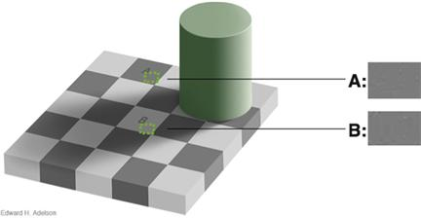
Vision is Optimized for Contrast, not Brightness
Notes:
Our visual system is engineered to spot differences (edges) rather than uniform shades.
Example: Checkerboard illusions (see how the same gray can appear different because of surrounding colors).
This contrast sensitivity helped our ancestors spot a lurking leopard in any light condition.

Slide 16
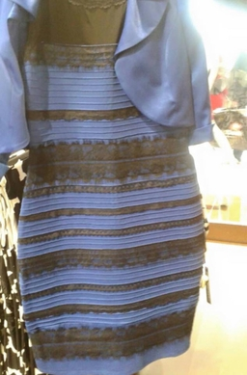
When Colors Get Tricky
Paleness: Subtle, low-saturation colors can merge into one another.
Size Matters: Tiny or thin color patches are hard to distinguish (think of small text or chart legends).
Separation: Colors that are too far apart may be misinterpreted because our eyes need context.

Slide 17
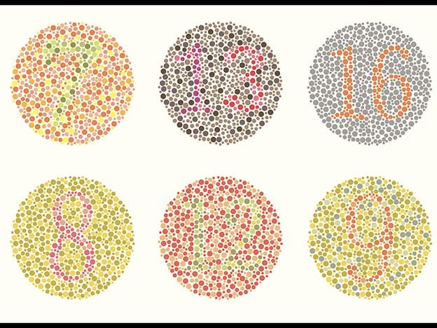
When Colors Get Tricky
Paleness: Subtle, low-saturation colors can merge into one another.
Size Matters: Tiny or thin color patches are hard to distinguish (think of small text or chart legends).
Separation: Colors that are too far apart may be misinterpreted because our eyes need context.

Slide 18
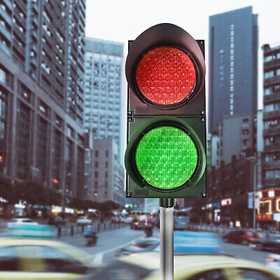
Not Everyone Sees Color the Same
Color-Blindness: ~8% US men have difficulty distinguishing certain hues.​
External Factors: Variability in display technologies, ambient light, and even viewing angles can distort colors.​
Real-World Impact: A design that looks vibrant in the office might fade on a bank ATM under sunlight.​

Slide 19
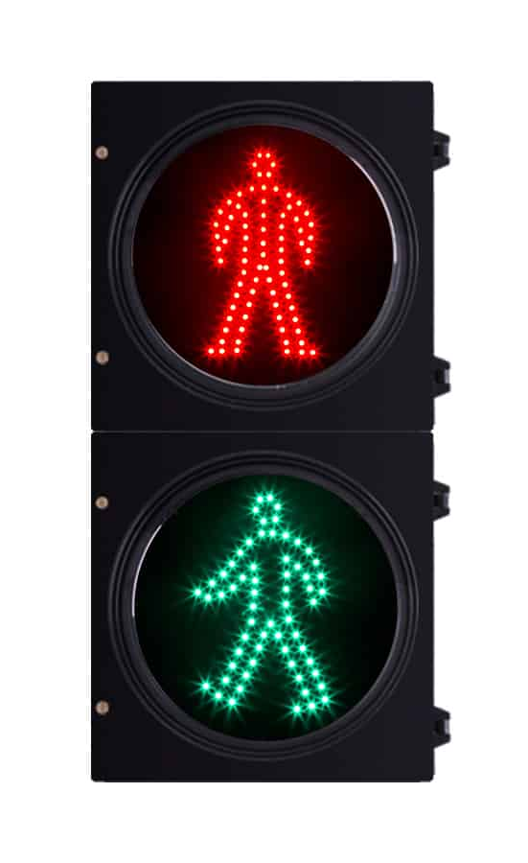
DesigNing with Color
Use Saturation & Brightness: Ensure differences are clear—if colors look the same in grayscale, they’re too similar.
Choose Distinctive Colors: Stick to the heavy hitters (red, green, yellow, blue, black, white).
Avoid Problematic Pairs: Don’t pair dark red with black, blue with purple, etc.
Redundancy: Don’t rely on color alone—add shapes, patterns, or labels.
Separate Opponent Colors: Avoid placing clashing colors side-by-side to prevent visual “shimmer.”

Slide 20
Our visual system functions like a digital camera when it comes colors
Our eyes are optimized to detect contrasts and edges (relative contexts) rather than absolute brightness levels.
Color discrimination varies greatly based on how colors are presented and individual differences, including color-blindness.
Effective color usage in design requires high contrast, distinctive colors, redundancy with other cues, and careful avoidance of problematic color combinations to ensure clarity and accessibility for all users.
KEY TAKEAWAYS

