Slide 1
DWTMIM Ch. 1 & 2
Perception Bias & The 7 Gestalt Principles
By Jeff Johnson
Presented by Balti & Julian

Slide 2
Introduction to Perception
Our perception is not a mirror of reality
Three key biasing factors shaping our perception
Understanding these biasing factors are crucial
Notes:
Our perception is not a mirror of reality
Three key biasing factors shape our perception
Understanding these biases is crucial for design

Slide 3
Three Biasing Factors
Reality vs. Perception Gap
Actively constructs experience through various filters
Create designs that work with, not against, natural perceptual tendencies
Notes:
The human mind doesn't simply record reality like a camera - it actively constructs our experience through various filters and mechanisms. This understanding is fundamental to creating effective designs that work with, rather than against, our natural perceptual tendencies. Our perception is continuously shaped by our past experiences, present context, and future goals, making it a dynamic and highly personalized process.

Slide 4
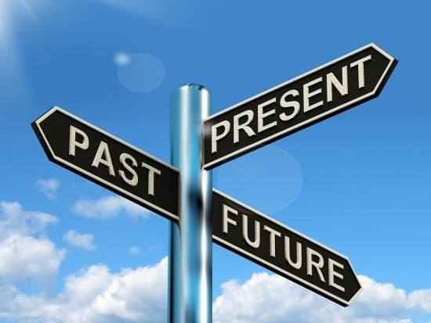
Three Biasing Factors
2. The Triadic Framework
Past: Creates expectations and experience
Present: provides immediate environmental cues and influences
Future: direct our attention and filter incoming information
Notes:
The human mind doesn't simply record reality like a camera - it actively constructs our experience through various filters and mechanisms. This understanding is fundamental to creating effective designs that work with, rather than against, our natural perceptual tendencies. Our perception is continuously shaped by our past experiences, present context, and future goals, making it a dynamic and highly personalized process.

Slide 5
Three Biasing Factors
3. Design Implications
Understanding these is crucial for great design
Anticipate how users will approach a product
Notes:
The human mind doesn't simply record reality like a camera - it actively constructs our experience through various filters and mechanisms. This understanding is fundamental to creating effective designs that work with, rather than against, our natural perceptual tendencies. Our perception is continuously shaped by our past experiences, present context, and future goals, making it a dynamic and highly personalized process.

Slide 6
Experience Based Perception
Perceptual Priming shapes expectations
Familiar Patterns create shortcuts
Habituation Affects Sensitivity

Slide 7
Power of Priming
Influences how we interpret ambiguous information
With specific expectations, users more likely to see what they’re looking for
Relevant in interface design
Notes:
Perceptual priming significantly influences how we interpret ambiguous information. When users are given specific expectations, they're more likely to see what they're looking for, even in unclear situations. This effect is particularly relevant in interface design, where users often come with predetermined expectations about how elements should look and function. Understanding priming helps designers create more predictable and user-friendly interfaces.

Slide 8
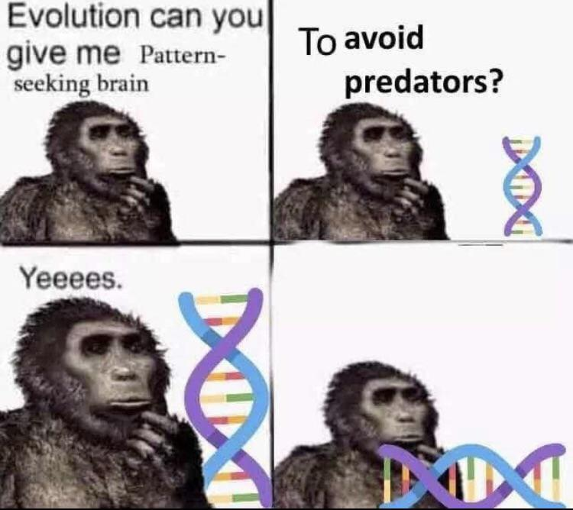
Pattern Recognition
Stock market analyst
Notes:
Our brains are pattern-matching machines, constantly looking for familiar structures and experiences. In web design, users expect certain elements to be in conventional locations - navigation at the top, footer at the bottom, logo in the upper left. These patterns become so ingrained that users might "remember" seeing standard elements even when they weren't present, highlighting the importance of following established design conventions.

Slide 9
Pattern Recognition
Notes:
Our brains are pattern-matching machines, constantly looking for familiar structures and experiences. In web design, users expect certain elements to be in conventional locations - navigation at the top, footer at the bottom, logo in the upper left. These patterns become so ingrained that users might "remember" seeing standard elements even when they weren't present, highlighting the importance of following established design conventions.

Slide 10
Pattern Recognition
Constantly looking for familiar structures and experiences
Users expect certain elements to be in conventional locations
Navigation at the top, footer at the bottom, logo in the upper left
Users might "remember" seeing standard elements even when they weren't present
Notes:
Our brains are pattern-matching machines, constantly looking for familiar structures and experiences. In web design, users expect certain elements to be in conventional locations - navigation at the top, footer at the bottom, logo in the upper left. These patterns become so ingrained that users might "remember" seeing standard elements even when they weren't present, highlighting the importance of following established design conventions.

Slide 11
Habituation Effects
Repeated exposure to similar stimuli gradually reduces our sensitivity to them
Users might start ignoring frequently appearing elements like pop-ups or notification sounds
Must remain constant for it to take place
Notes:
Habituation Effects Repeated exposure to similar stimuli gradually reduces our sensitivity to them. This principle explains why users might start ignoring frequently appearing elements like pop-ups or notification sounds. Designers must carefully balance the need for important information with the risk of habituation, ensuring critical messages remain noticeable while avoiding overwhelming users with constant stimuli

Slide 12
Context Based Perception
Current context influences interpretation
Cross-modal effects impact perception
Expectations persist over time
Notes:
Our brains are pattern-matching machines, constantly looking for familiar structures and experiences. In web design, users expect certain elements to be in conventional locations - navigation at the top, footer at the bottom, logo in the upper left. These patterns become so ingrained that users might "remember" seeing standard elements even when they weren't present, highlighting the importance of following established design conventions.

Slide 13
Contextual Interpretation
Surrounding context heavily influences how we perceive individual elements
Just as the same letter can be interpreted differently based on its surrounding letters (as in the "cat" example)
Design elements are interpreted based on their surrounding context
Notes:
Contextual Interpretation The surrounding context heavily influences how we perceive individual elements. Just as the same letter can be interpreted differently based on its surrounding letters (as in the "cat" example), design elements are interpreted based on their surrounding context. This understanding is crucial for creating cohesive designs where all elements work together to convey the intended meaning and functionality.

Slide 14
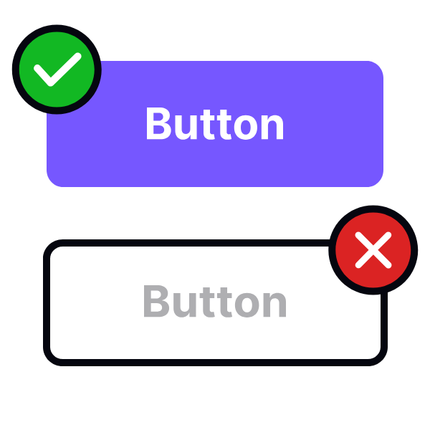
Pressable
Non-interactable

Slide 15
Multi-Sensory Integration
Integrates information from multiple senses to create a unified perceptual experience
Explains phenomena like the McGurk effect and ventriloquism;
how different sensory elements (visual, auditory, sometimes tactile) work together to create a coherent user experience.
Notes:
Multi-Sensory Integration Our brain integrates information from multiple senses to create a unified perceptual experience. This integration explains phenomena like the McGurk effect and ventriloquism, where visual information influences auditory perception. In digital design, this means considering how different sensory elements (visual, auditory, sometimes tactile) work together to create a coherent user experience.

Slide 16
Persistent Expectations
Perceptual expectations can persist for extended periods
Initial user experiences with an interface can create long-lasting expectations about how similar interfaces should work
Careful about breaking established patterns
Notes:
Multi-Sensory Integration Our brain integrates information from multiple senses to create a unified perceptual experience. This integration explains phenomena like the McGurk effect and ventriloquism, where visual information influences auditory perception. In digital design, this means considering how different sensory elements (visual, auditory, sometimes tactile) work together to create a coherent user experience.

Slide 17
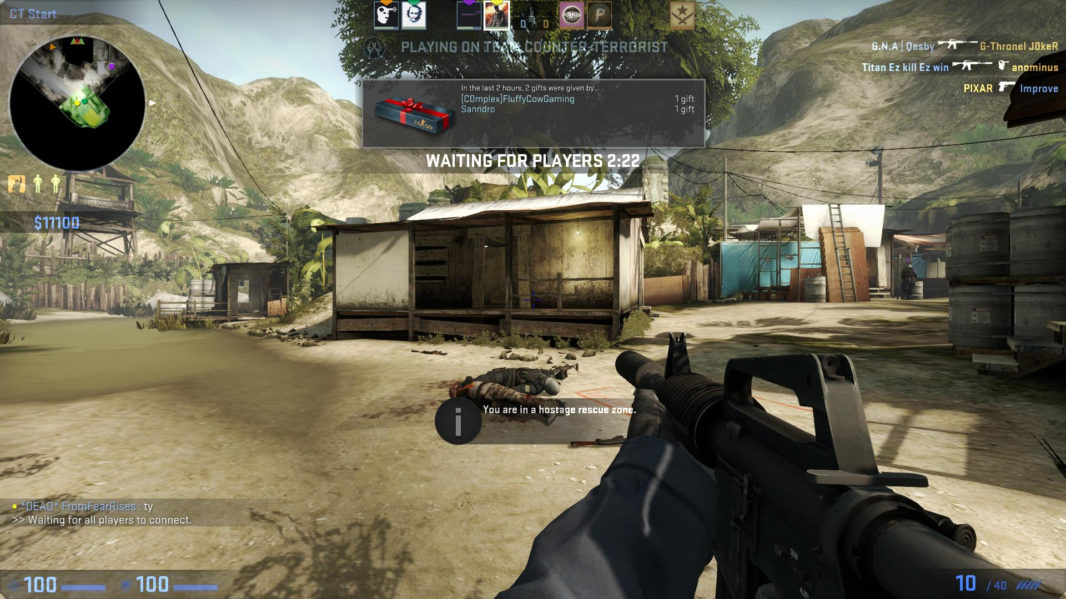
Explains why people are always against UI updates
Especially in video games

Slide 18
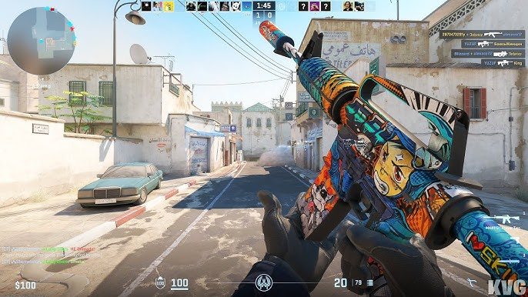
Explains why people are always against UI updates
Still causing outrage in the community

Slide 19
Goal-Directed Perception
Goals guide perceptual focus
Selective attention filters information
Age affects perception patterns
Notes:
Multi-Sensory Integration Our brain integrates information from multiple senses to create a unified perceptual experience. This integration explains phenomena like the McGurk effect and ventriloquism, where visual information influences auditory perception. In digital design, this means considering how different sensory elements (visual, auditory, sometimes tactile) work together to create a coherent user experience.

Slide 20
Goal-Driven Navigation
Goals actively shape what we notice and ignore in our environment
Users visit a website with specific objectives, they often unconsciously filter out information unrelated to their goals
Notes:
Goal-Driven Navigation Our goals actively shape what we notice and ignore in our environment. When users visit a website with specific objectives, they often unconsciously filter out information unrelated to their goals. This selective perception means that important information must be clearly presented and aligned with common user goals to ensure it doesn't get overlooked in the user's goal-directed scanning.

Slide 25
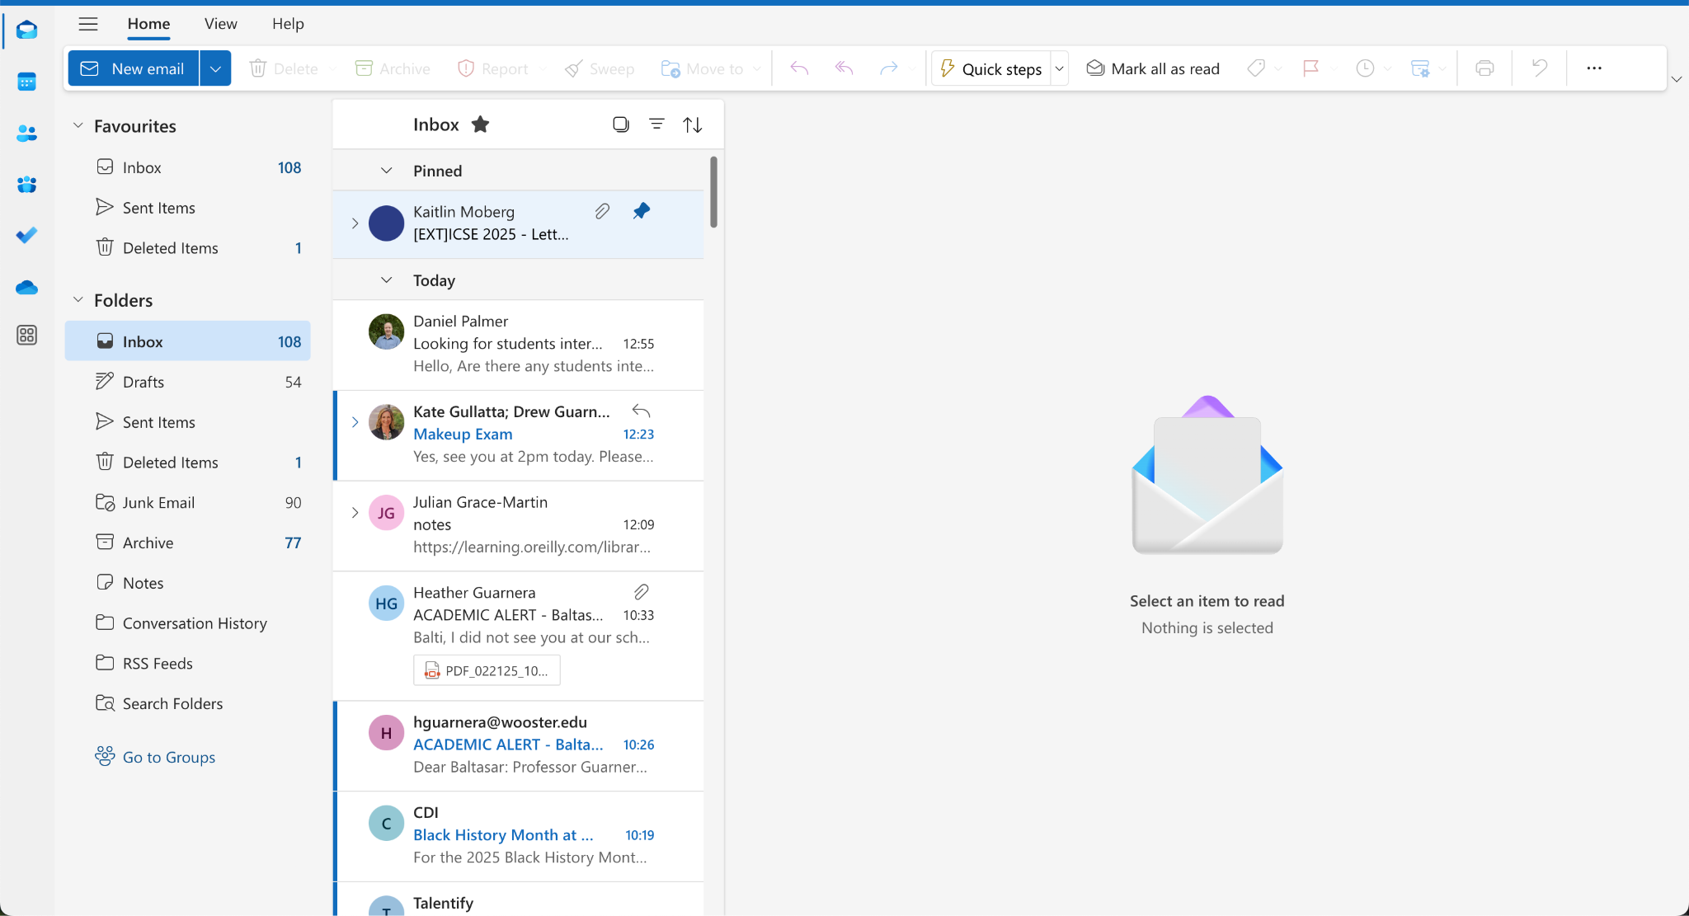

Slide 27
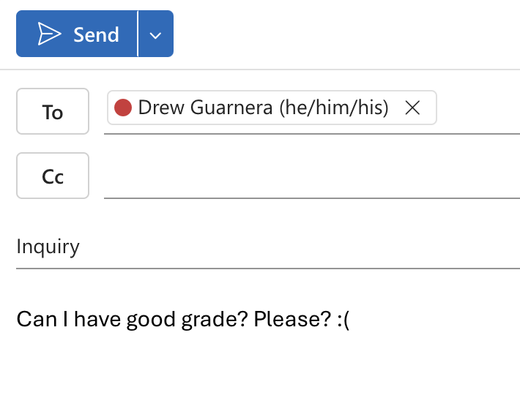

Slide 28
Goal-Driven Navigation
Important information must be clearly presented and aligned with common user goals to ensure it doesn't get overlooked in the user's goal-directed scanning.
Notes:
Goal-Driven Navigation Our goals actively shape what we notice and ignore in our environment. When users visit a website with specific objectives, they often unconsciously filter out information unrelated to their goals. This selective perception means that important information must be clearly presented and aligned with common user goals to ensure it doesn't get overlooked in the user's goal-directed scanning.

Slide 29
Attention Filtering
Sophisticated mechanisms for filtering information based on relevance to current goals
Filtering happens preconsciously
Users might never even register elements that don't align with their objectives
Notes:
Attention Filtering The human brain has sophisticated mechanisms for filtering information based on relevance to current goals. This filtering happens preconsciously, meaning users might never even register elements that don't align with their objectives. Designers must ensure that critical information is presented in ways that align with typical user goals and stands out even during focused task completion.

Slide 30
Age-Related Differences
Children and adults process information differently
Children being more stimulus-driven
Adults more goal-driven
Notes:
Age-Related Differences Children and adults process information differently, with children being more stimulus-driven and adults more goal-driven. This difference affects how different age groups interact with interfaces - children might be more easily distracted by engaging elements, while adults might be more focused on completing specific tasks. Understanding these differences is crucial for designing age-appropriate interfaces.

Slide 31
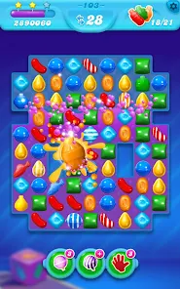

Slide 33
Attention Filtering
Children might be more easily distracted by engaging elements, while adults might be more focused on completing specific tasks
Notes:
Attention Filtering The human brain has sophisticated mechanisms for filtering information based on relevance to current goals. This filtering happens preconsciously, meaning users might never even register elements that don't align with their objectives. Designers must ensure that critical information is presented in ways that align with typical user goals and stands out even during focused task completion.

Slide 34
Introduction to Gestalt Principles
Overview of Gestalt psychology
Importance in visual perception
Application in modern design
“Chap. 2: Our Vision is Optimized to See Structure”
Notes:
Attention Filtering The human brain has sophisticated mechanisms for filtering information based on relevance to current goals. This filtering happens preconsciously, meaning users might never even register elements that don't align with their objectives. Designers must ensure that critical information is presented in ways that align with typical user goals and stands out even during focused task completion.

Slide 35
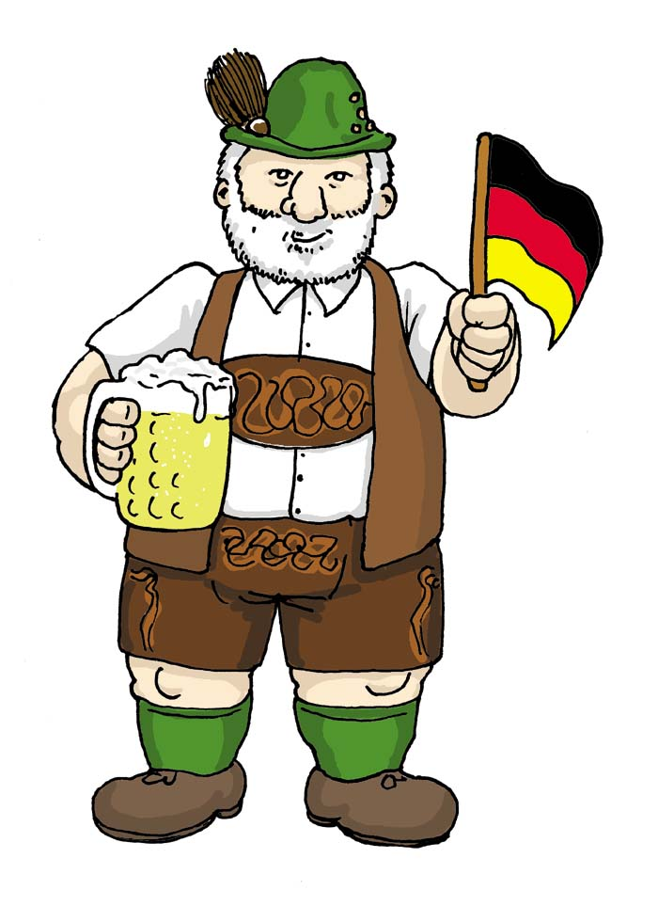
Introduction to Gestalt Principles
Gestalt; means “shape” or “figure”
Forms the cornerstone of how humans perceive and organize visual information
Explain how our minds naturally group elements, recognize patterns, and create meaning from visual arrangements
Notes:
Gestalt Foundation Gestalt principles, derived from the German word for "shape" or "figure," form the cornerstone of how humans perceive and organize visual information. These principles explain how our minds naturally group elements, recognize patterns, and create meaning from visual arrangements. Understanding these principles is crucial for designers as they provide a framework for creating intuitive and effective visual hierarchies.

Slide 36
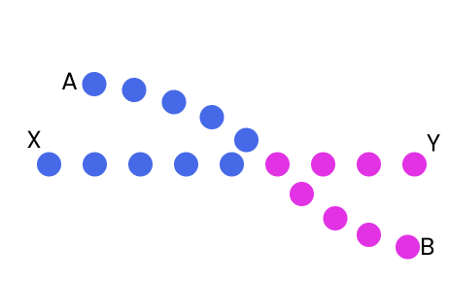
“Grouping” Principles
Three of the Gestalt principles explain how our minds group items together based on certain factors
Proximity: groups based on placement
Similarity: groups based on type
Common fate: groups based on movement

Slide 37
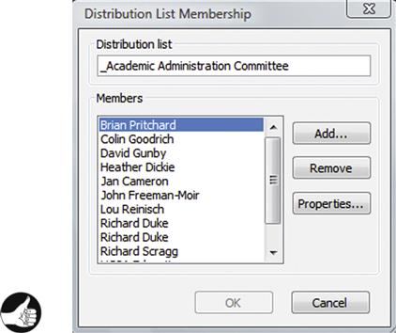
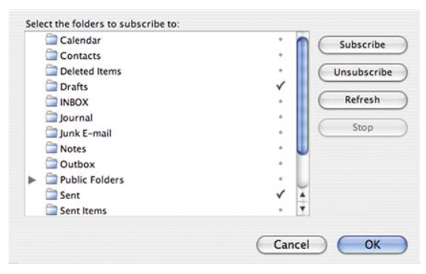
Gestalt Principle: Proximity
Notes:
Gestalt Foundation Gestalt principles, derived from the German word for "shape" or "figure," form the cornerstone of how humans perceive and organize visual information. These principles explain how our minds naturally group elements, recognize patterns, and create meaning from visual arrangements. Understanding these principles is crucial for designers as they provide a framework for creating intuitive and effective visual hierarchies.

Slide 38
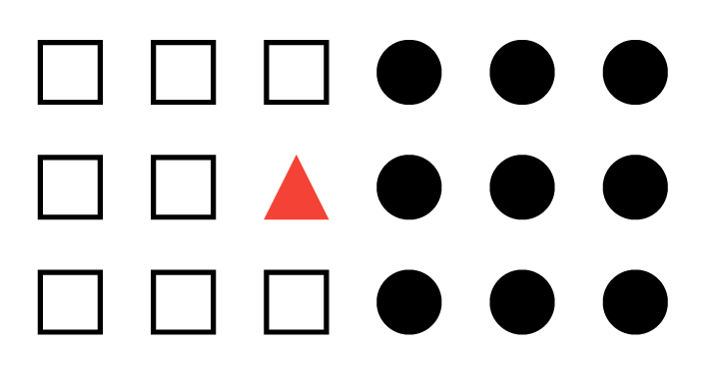
Gestalt Principle: Similarity
Notes:
Gestalt Foundation Gestalt principles, derived from the German word for "shape" or "figure," form the cornerstone of how humans perceive and organize visual information. These principles explain how our minds naturally group elements, recognize patterns, and create meaning from visual arrangements. Understanding these principles is crucial for designers as they provide a framework for creating intuitive and effective visual hierarchies.

Slide 39
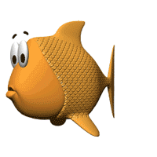
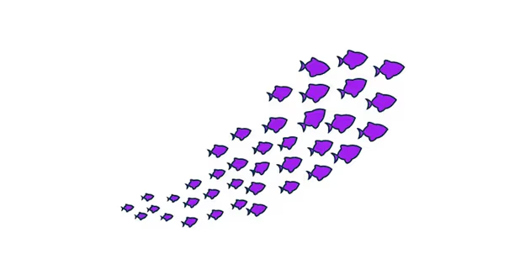
Gestalt Principle: Common Fate
Fishies !!
Notes:
The Gestalt principle of Symmetry explains our tendency to simplify complex visual scenes by organizing them into symmetrical, less complex shapes. When presented with multiple possible interpretations, our vision favors the simplest, most symmetrical one

Slide 40
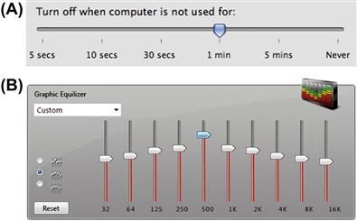
Gestalt Principle: Continuity
Notes:
Slider controls are a user-interface example of the Continuity principle. We see a slider as depicting a single range controlled by a handle that appears somewhere on the slider, not as two separate ranges separated by the handle (see Fig. 2.10A). Even displaying different colors on each side of a slider’s handle doesn’t completely “break” our perception of a slider as one continuous object, although ComponentOne’s choice of strongly contrasting colors (gray vs. red) certainly strains that perception a bit (see Fig. 2.10B).

Slide 41
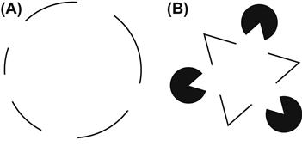
Gestalt Principle: Closure
Notes:
Closure: Human vision is biased to see whole objects, even when they are incomplete

Slide 42
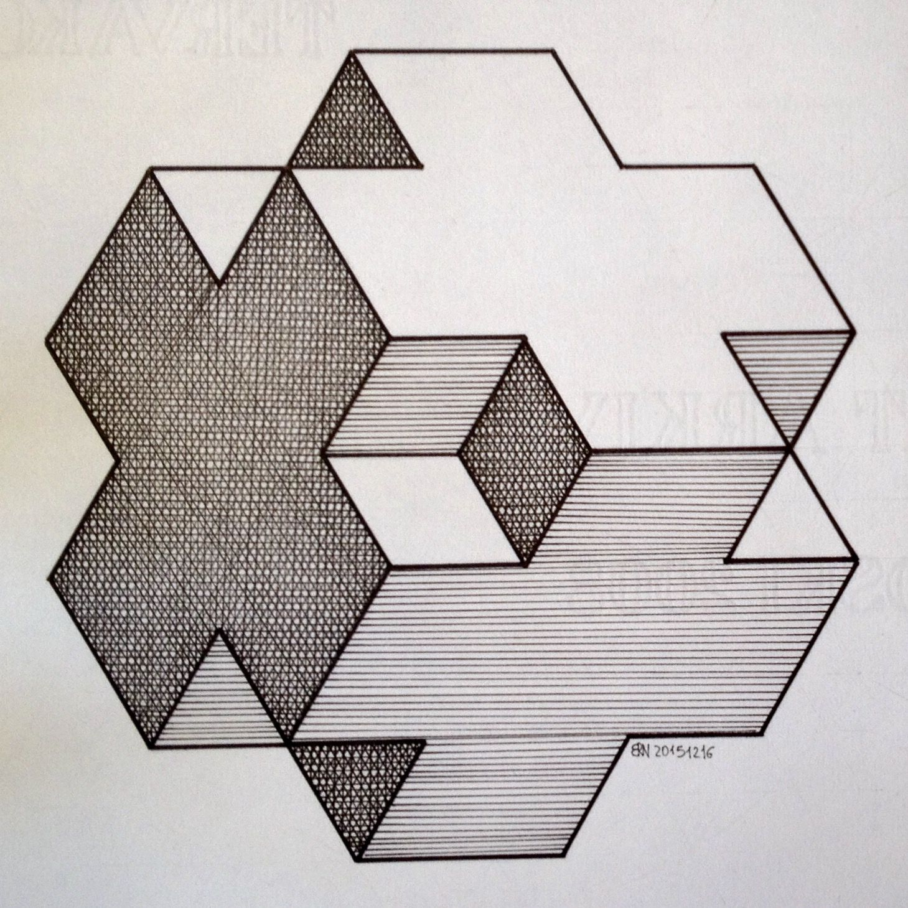
Gestalt Principle: Symmetry
Notes:
The Gestalt principle of Symmetry explains our tendency to simplify complex visual scenes by organizing them into symmetrical, less complex shapes. When presented with multiple possible interpretations, our vision favors the simplest, most symmetrical one

Slide 43
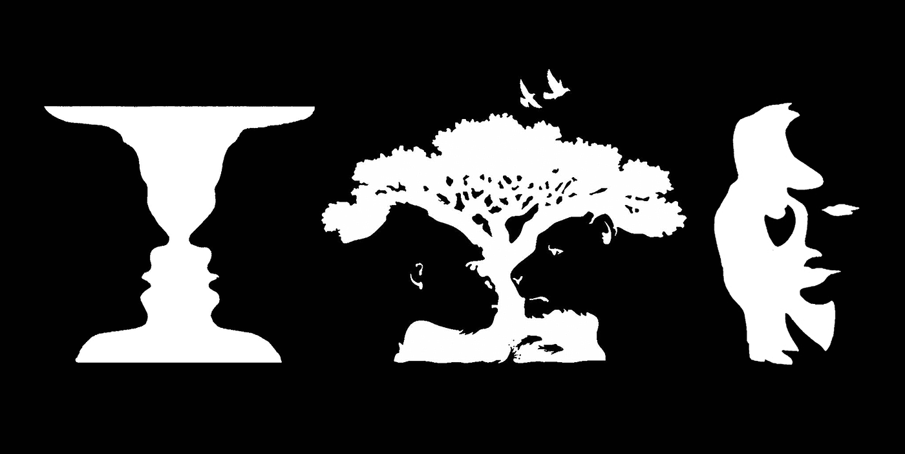
Gestalt Principle: Figure/Ground
Notes:
The Gestalt principle of Symmetry explains our tendency to simplify complex visual scenes by organizing them into symmetrical, less complex shapes. When presented with multiple possible interpretations, our vision favors the simplest, most symmetrical one

Slide 44
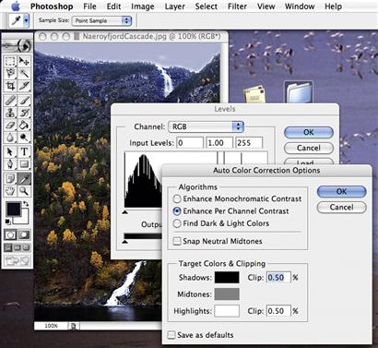
Gestalt Principles: Combined
Six of the principles
1. Proximity
2. Similarity
3. Continuity
4. Closure
5. Symmetry
6. Figure/Ground
Notes:
The previous six Gestalt principles concerned perception of static (unmoving) figures and objects. One final Gestalt principle—Common Fate—concerns moving objects. The cCommon Fate principle is related to the Proximity and Similarity principles—like them, it affects whether we perceive objects as grouped. The Common Fate principle states that objects that move together are perceived as grouped or related.

Slide 45
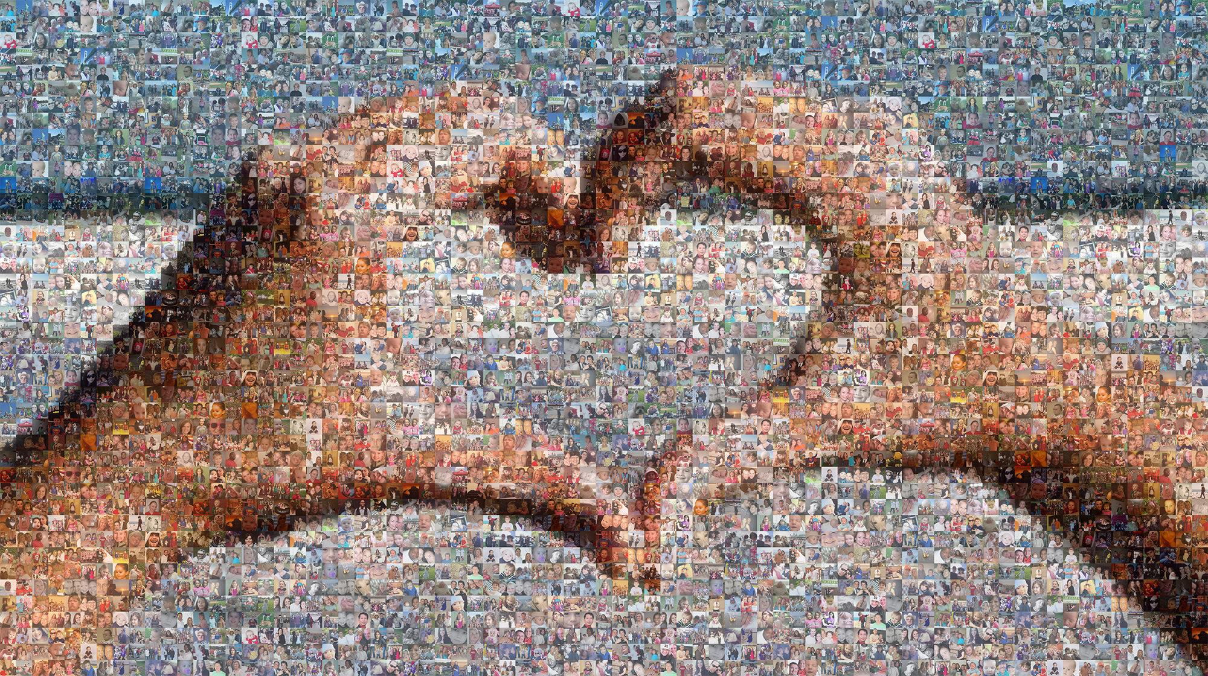
Gestalt Principles: Combined
When designing, make sure to…
Test the perception of all at once
Go over each principle on its own
Some relationships happen unintentionally
Notes:
The previous six Gestalt principles concerned perception of static (unmoving) figures and objects. One final Gestalt principle—Common Fate—concerns moving objects. The cCommon Fate principle is related to the Proximity and Similarity principles—like them, it affects whether we perceive objects as grouped. The Common Fate principle states that objects that move together are perceived as grouped or related.

Slide 46
Questions!!!!!
Are these perceptions and principles something you noticed specifically in your own experience, and have you intentionally used them before?
Do these perceptions and principles seem more useful to implement over ignoring them, something you have to watch out to not get harmed by, or both?
Do you like knowing these now so you’ll notice them in the wild?
Are the principles in chapter 2 biases in the same way as the perceptions in chapter 1, or are they different in some way? For example, are the downsides of how they work less likely to have an effect?

