Slide 1
Design Thinking
Grace, Noelynn, and Rm

Slide 2
Double-Diamond Model of Design
Broad design process
Phase 1: Find the right problem
Discover: diverge (brainstorm, research) to find root cause
Define: converge (whittle down) on single problem statement
Phase 2: Find the right solution
Develop: diverge to find all possible solutions
Deliver: converge on proposed solution

Slide 3
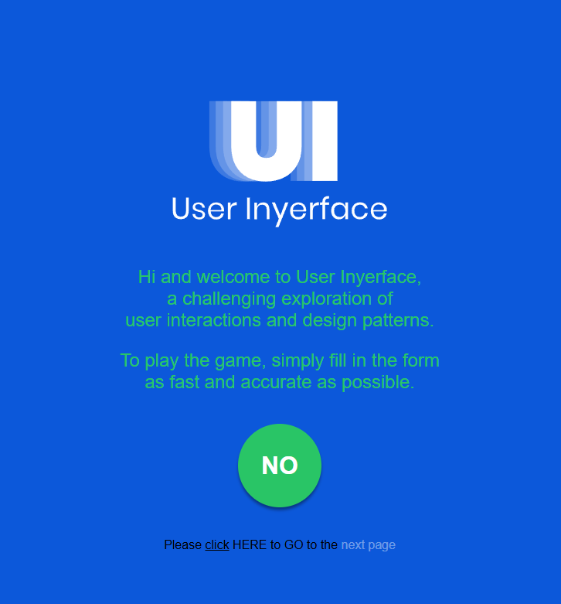
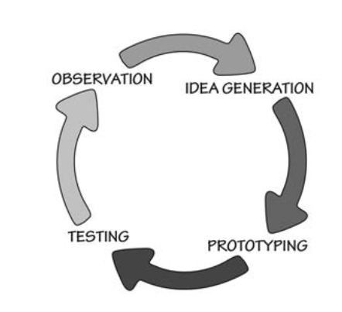
Human-Centered Design?
How do we find the right problem and how do we find the right solution?
Observation
Ideation
Prototyping
Testing and Iteration

Slide 4
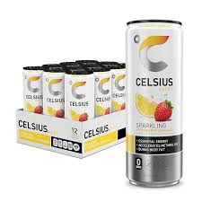
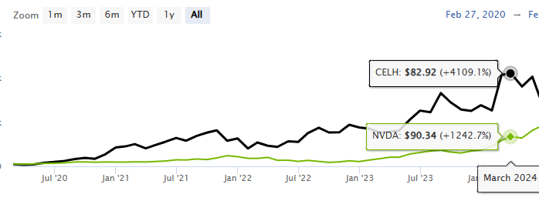
Observation
Find the Right Problems
Understand Users: Research who they are & how they interact with products.
Actions vs. Words: What people say ≠ what they do (survey bias).
Real-World Context Matters: Observe users in their natural environment.
Applied Ethnography: Studying real behaviors gives better insights.
Design vs. Market Research:
Design: Qualitative, deep insights, time-consuming.
Market: Quantitative, data-driven, visually impressive.
Product-Market Fit

Slide 5
Ideation and Prototyping
Ideation
The most fun part of design, go wild with ideas!
Break the rules, question everything, ask “stupid” questions.
Think beyond the obvious, creativity thrives in the unexpected!
Prototyping
Fake it till you make it
Build quick prototypes-sketches, foam models, even skits!
Learn from existing examples

Slide 6
Testing then Iteration
Testing
Feedback is gold! One person uses the prototype, the other interprets the re‍sult.
Use video recordings to capture real insights and understand user behavior.
Testing is all about learning and refining.
Iteration – Fail Fast, Learn Fast
Prototype as quickly as possible and keep improving.
Waterfall (Linear) vs Agile/Scrum (Iterative)
Time Constraints: Product development is a race against the clock, with deadlines and budgets in play.

Slide 7
Activity-Centered and Human-Centered Design
HCI – focused on individuals and experiences, yields probably amazing results.
What about a product that accomodates people from different cultures under one product?
Activity Centered Design
Product conceptual model around the conceptual model of the activity
Need based: People tend to learn systems that essential to their activity
Designing for a higher level activity, not concerning tasks
ACD is an enhancement of HCI
Notes:
Apple's success is because it supported the enitre activity of music. Brilliant design + support for the entire activity of music development

Slide 8
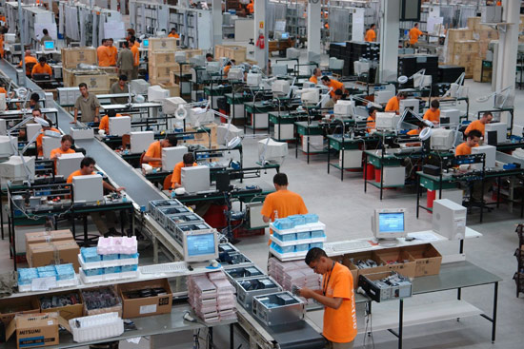
Does this Actually Work in Reality?
"In theory there is no difference between theory and practice.
In practice, there is"
Time shapes everything in design
The day a product development process starts, it is behind schedule and above budget (Don Norman's Law of Product Development)
Engineering products – feature addition increases exponentially
Solution
Separate the design process from other parts of product development
All the different disciplines in product development need to get well together
Multidisciplinary team in the design process as well

Slide 9
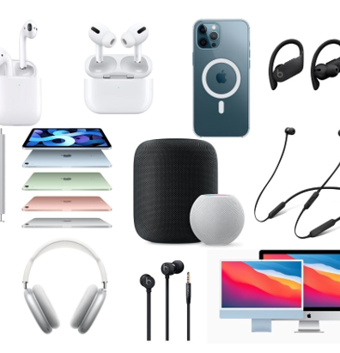
The Complexity of Design
Design is more than just making things look good
⁠It involves psychology, engineering, business, and usability
⁠Good design solves problems, but many designs fail due to conflicting priorities. Apple iPhone, which balances aesthetics, usability, and technology. Its sleek design is user-friendly, functional, and aligned with Apple’s brand.
Another example is Amazon’s website: while not the most visually appealing, it prioritizes usability and business goals, making it easy for customers to shop.

Slide 10
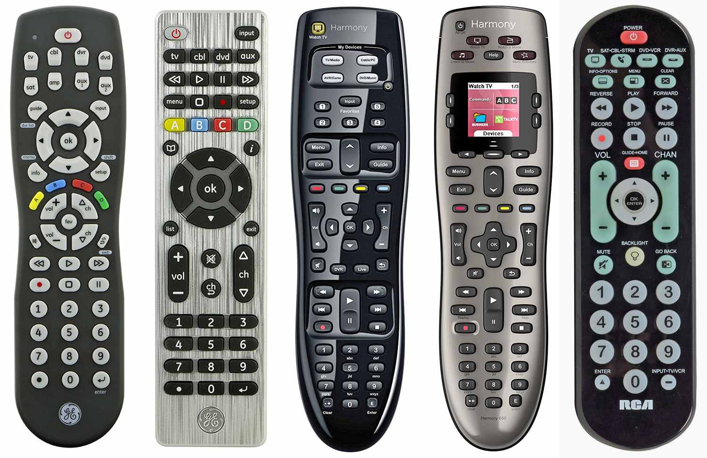
Conflicting Requirements in Design
⁠Designers must balance:
Users vs. Buyers(e.g., landlords buy appliances, not tenants)
Marketing vs. Functionality(what sells isn't always usable)
Cost vs. Quality(cheaper manufacturing can harm usability)
Example ; Complex TV remotes designed to look advanced but hard to use

Slide 11
Bad Design in Everyday Life
Poor design leads to frustration and inefficiency
Example: Office copiers
Purchased based on price, not usability
Users struggle with cluttered interfaces & unclear labels
Results in wasted time, errors, and hidden costs

Slide 12
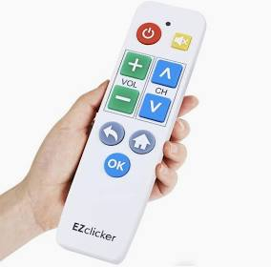
The Problem of Isolated Design Teams
Many companies separate engineering, marketing, and usability teams.
Poor collaboration leads to inconsistent or confusing products
Solution: Involve users & multidisciplinary teams early in design
Example: Tv remote ;Some remotes have too many small buttons, making them hard to use.

Slide 13
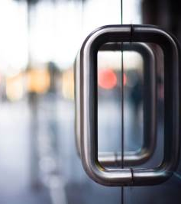
Designing for All Users.
There is no “average user”
⁠Consider physical and cognitive diversity - Left-handed users, elderly users, people with disabilities.
Inclusive design improves usability for everyone.
Example: Automatic doors vs. revolving doors (which exclude some users)

Slide 14
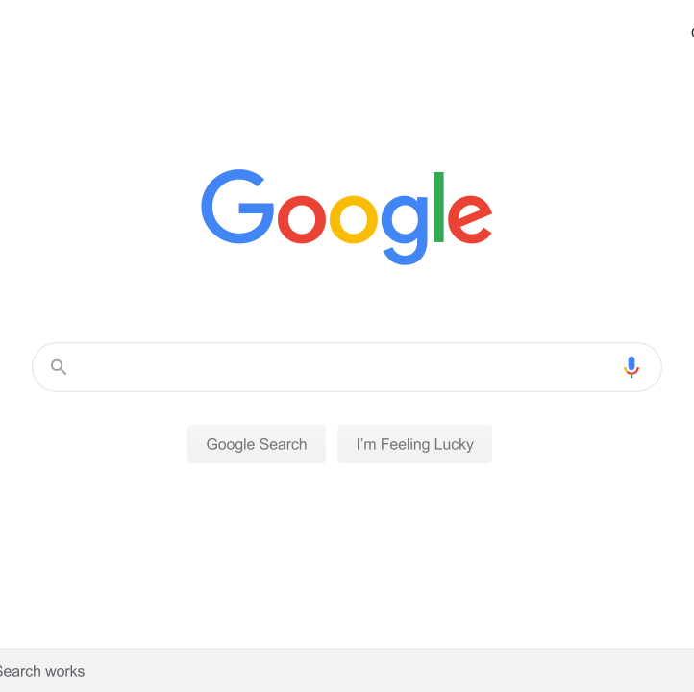
Why Design Matters
⁠Good design is invisible – it works so well, we don’t notice it
Example: Google’s Homepage
Bad design leads to frustration, mistakes, and lost productivity
Final takeaway: Design isn’t just aesthetics; it’s about making things work for people

Slide 15
Complexity vs. Confusion
Complexity is necessary because life is complex
Confusion is undesirable and results from poor design
Good design removes confusion without eliminating necessary complexity
Example: A kitchen is complex but makes sense to those who use it

Slide 16
The Kitchen Example
⁠A kitchen has many tools and appliances
Unfamiliar kitchens feel confusing at first
⁠Confusion is not in the kitchen; it’s in the mind due to lack of familiarity

Slide 17
Why Complexity Exists
People often ask: “Why can’t things be simpler?”
Answer: Tools must match the complexity of real-life tasks
Simplicity isn’t always the solution; clarity is
Example: A basic tool may not handle a complex task effectively

Slide 18
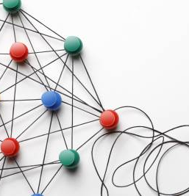
How to Tame Complexity?
• ⁠Provide a strong conceptual model
Users should understand the logic behind a system’s organization
Even exceptions can make sense within a structured system
Example: A cluttered kitchen drawer may still make sense to its owner

Slide 19
Other points
Standardization
Easier for users (example: driving)
Long and difficult process to implement
Too soon = stuck with bad standards
Too late = too many established options (digital time)
Deliberately making things difficult
Security, dangerous equipment, secret doors/cabinets, child-proofing
Know the rules so you can break them

Slide 20
The Goal of Design
The Goal of Design
Complexity is not the enemy; confusion is
Good design helps users navigate complexity intuitively
Final takeaway: The best designs are not necessarily simple but clear and usable.
Discussion question: Can you think of a complex system that is well-designed and easy to use?

