Slide 1
The Design of Everyday Things
Chapter 3: Knowledge in the Head and in the World
Author: Don Norman
Jungho Park & Leah Goodall

Slide 2
Precise Behavior from Imprecise Knowledge
Constraints
Natural constraints eliminate the vast majority of possibilities when interacting with an object
If a door is in your way, “phase through it” is not a valid course of action
Cultural constraints eliminate most “non-common sense” forms of interaction
If a door is in your way, “take it off at the hinges and steal it” is not a valid course of action
Knowledge in the world
Objects have labels
Keyboards, doors, computer programs are (hopefully) designed in a way to allow people who have never seen them before know how to make them work
Unexpected Precision
When internal knowledge disagrees with physical reality, problems arise

Slide 3
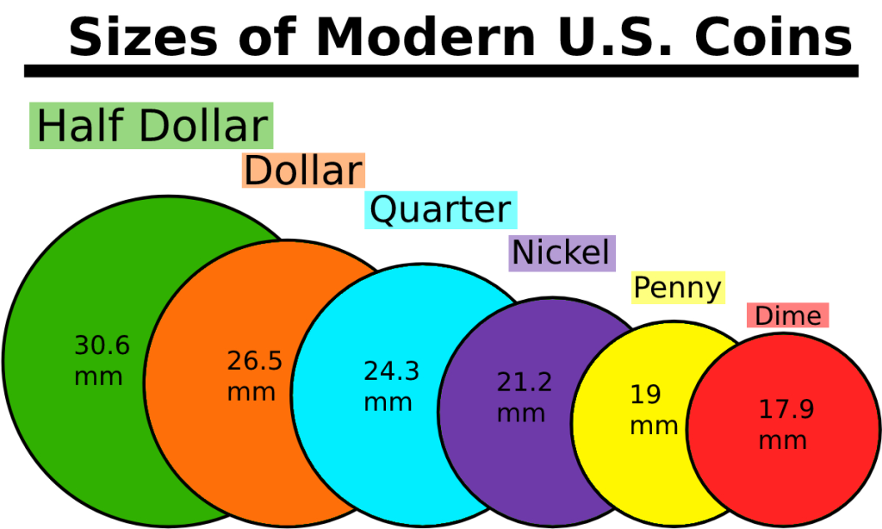
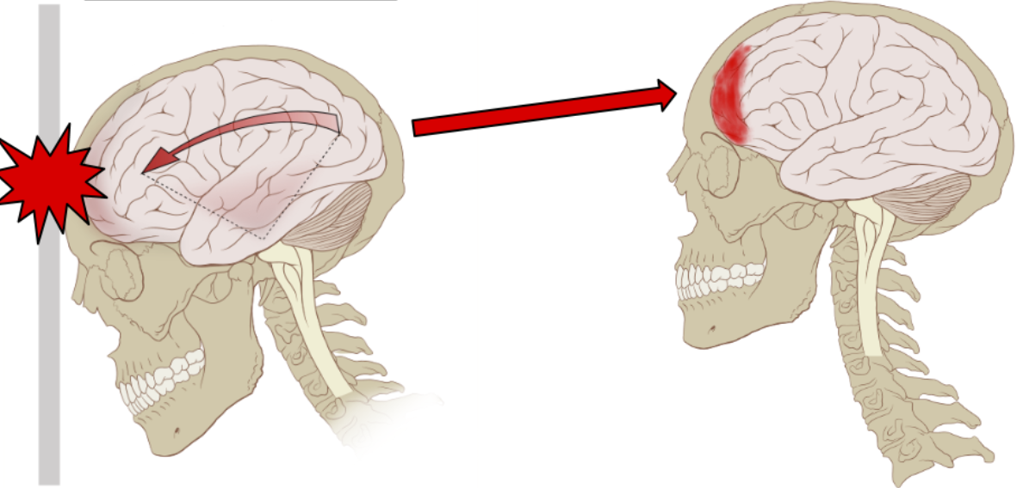
Precise Behavior from Imprecise Knowledge
Constraints on opening a door
Unexpected precision in US coinage

Slide 4
Memory is Knowledge in the Head
In a computer focused world a lot of information is designed to be easy for computers
We are not computers, long strings of numbers for phone numbers, zip codes, passwords like “U1N@g&17#Z%4&p” are hard to remember
Password safety is difficult because remembering things is hard
(and even after everything, it doesn't matter because no one is trying to guess your password in the first place, they're just stealing it)
At the end of the day, we don't know how to make things like passwords both difficult to crack and easy to remember.

Slide 5
The Structure of Memory
Short Term Memory
Information is very easy to place in and retrieve from STM
STM is volatile so complicated information tends to get mixed around a bit
Multiple smaller sets of information are easier to remember compared to singular longer strings
I.e. 2,165,552,918 as a number would probably slip your mind, however the phone number (216) 555 - 2918 is much easier to remember
Designers shouldn't count on a user’s STM when designing programs
If a system requires one sense, make auxiliary notifications use different senses to prevent overwhelming situations

Slide 6
The Structure of Memory
Long Term Memory
Information is difficult to place into and retrieve from LTM
It is very difficult to search LTM, where would you start? There's no file system, no UI you can type a search query in. You have to make the memory and sometimes it just doesn't.
Arbitrary Memory
Things that are remembered in a certain way simply because that's how they were presented
The only reliable way to place into LTM is memorization as there aren't any connections to be made
Meaningful Memory
Memories which are moved to LTM either by relating them to other things in LTM, or by mapping them to actions
Much easier than placing arbitrary memories in LTM

Slide 7
Approximate Models: Memory in the Real World
The rule of “good enough”
An exact solution is not always needed, sometimes just being fairly close is good enough for a practical activity
The idea that you can have five things in short term memory at a time and trying to add a 6th makes you remove one at random
Fundamentally false
Works
Even if a solution to a problem is wrong, it can sometimes make the user do the correct thing subconsciously

Slide 8
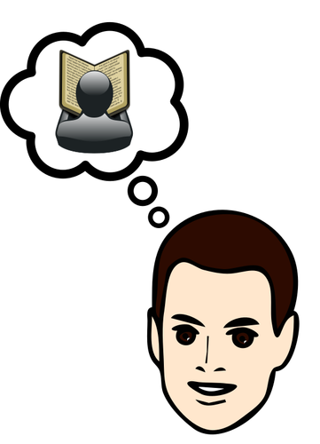
Knowledge in the Head and Knowledge in the World
Prospective Memory(Memory for the future) = Remniding
Multiple ways to remember: ex) relying on memory, writing it down
Signal(trigger) & Message(content)
Knowledge in the head and the knowledge in the world have to work together

Slide 9
Memory in Multiple Heads, Multiple Devices
Transactive Memory: Each individual memory adds their bit of knowledge, slowly constraining the choices, recalling something that no single one of them could

Slide 10
The Tradeoff Between Knowledge in the World and in the Head
Knowledge in the head: Efficient(no need to search), but we have to store and retrieve
Knowledge in the world: Requires no learning, but can be difficult to use. Relies heavily upon the continued physical presence of the knowledge

Slide 11
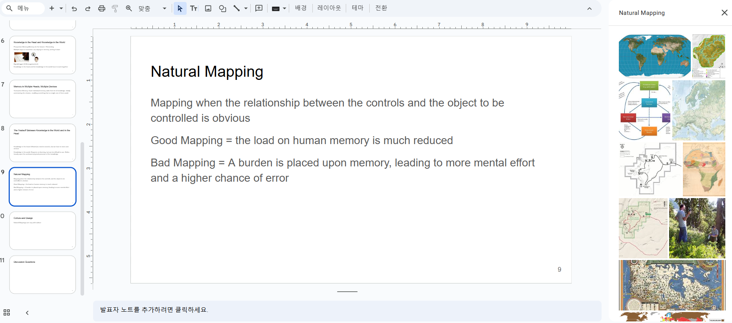
Natural Mapping
Mapping when the relationship between the controls and the object to be controlled is obvious
Good Mapping = the load on human memory is much reduced
Bad Mapping = A burden is placed upon memory, leading to more mental effort and a higher chance of error

Slide 12
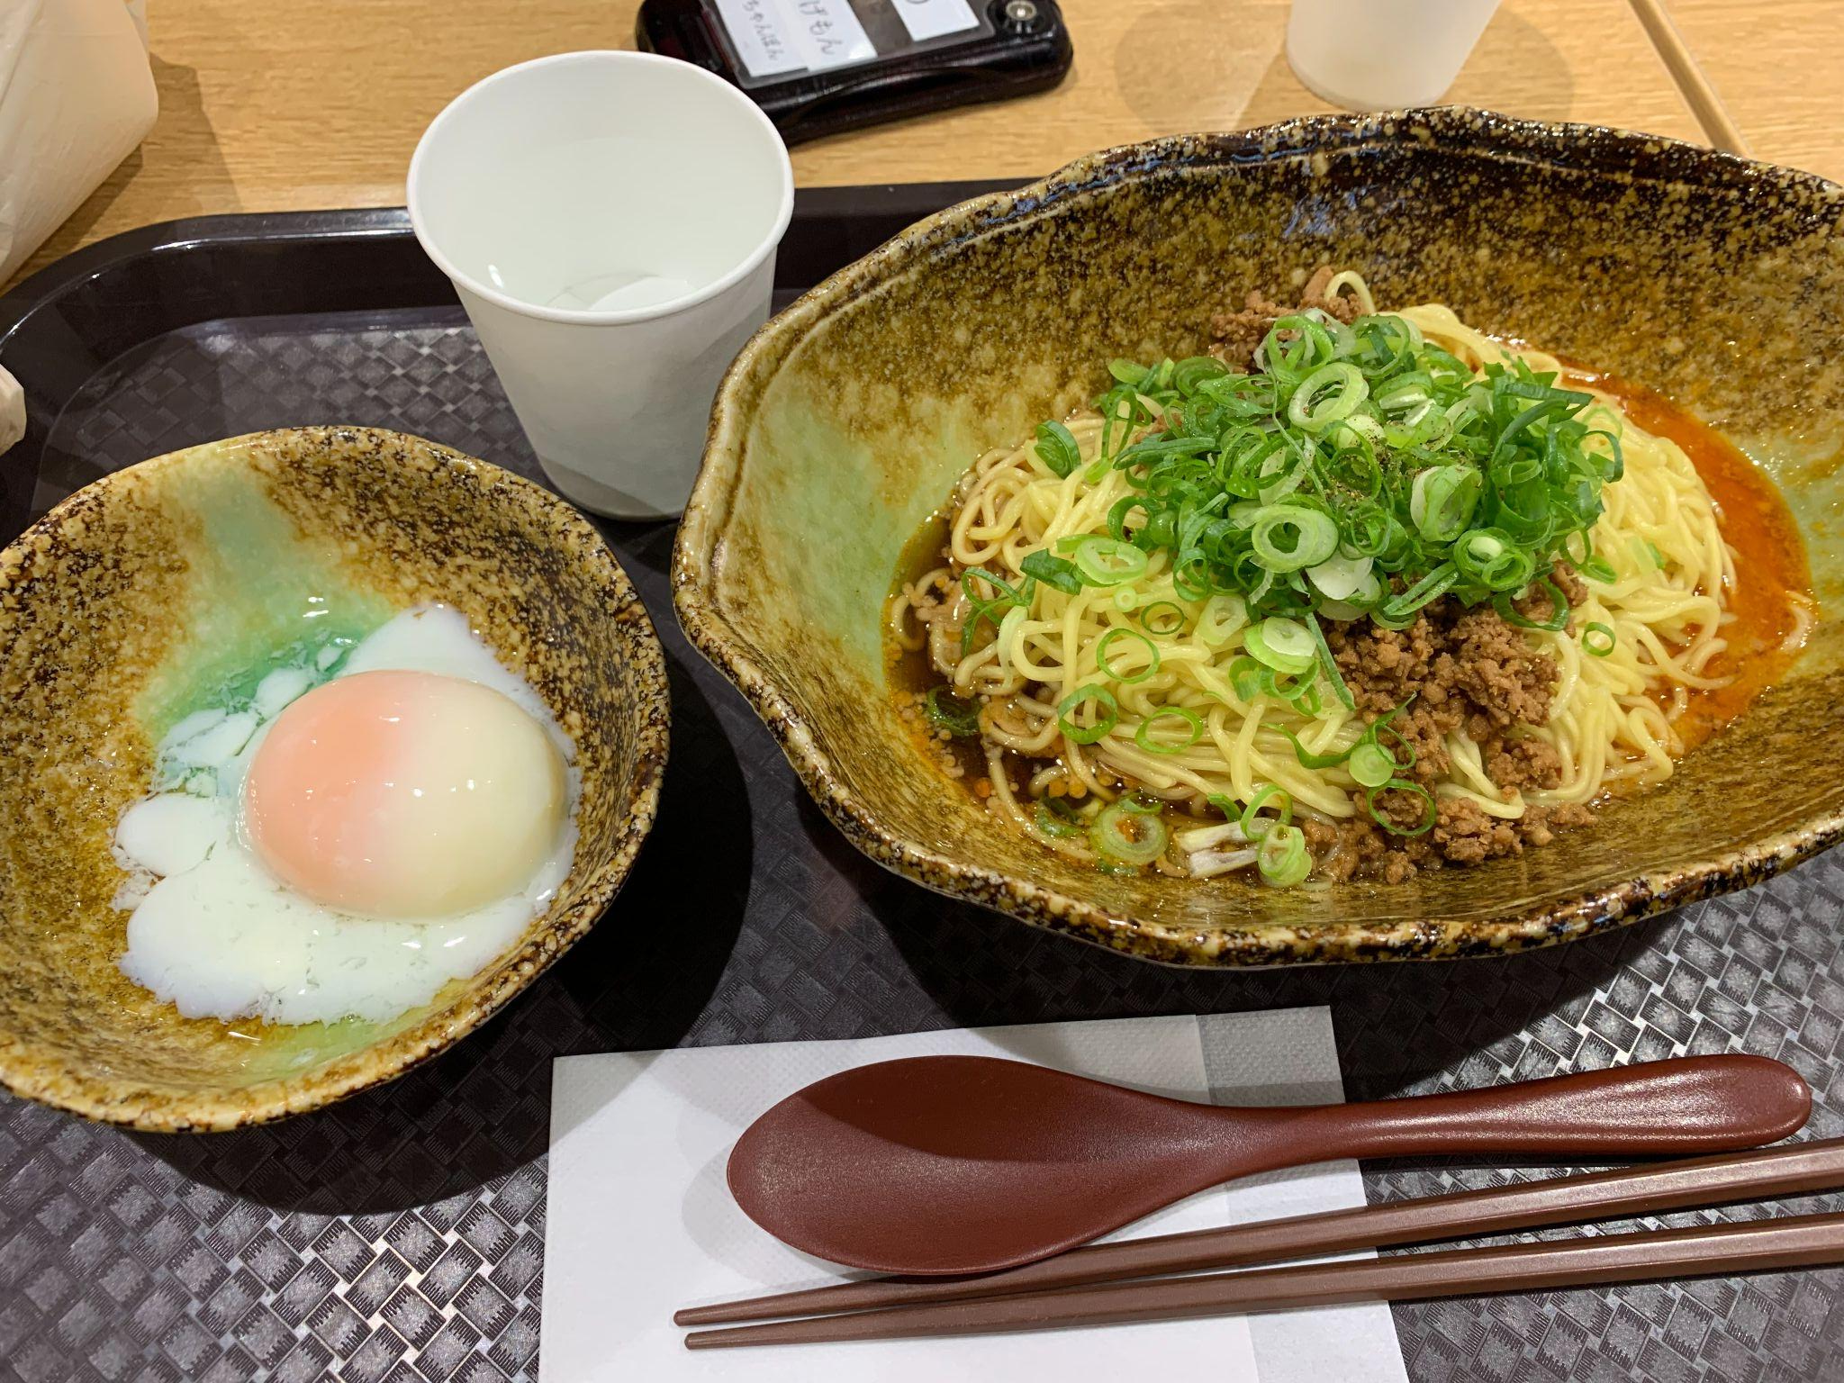
Culture and Design
Natural Mappings can vary with culture
Have you ever experienced natural mappings different from your culture?

