Slide 1
The Psychology of Everyday Actions
How do people do things?
January 24th, 2025
📚 The Design of Everyday Things by Don Norman - CH02
Presenters: Balti, Minh
Notes:
[Minh] Welcome ~ Feel free to stop us for any questions

Slide 2
🤔 How might we...
Understand the way humans think?
Bridge the gap between what people intend to do and what they actually achieve? 💡
📚 The Design of Everyday Things by Don Norman - CH02
Page 2
Notes:
[Minh] Welcome ~

Slide 3
🤔 How might we...
Understand the way humans think?
Bridge the gap between what people intend to do and what they actually achieve? 💡
📚 The Design of Everyday Things by Don Norman - CH02
Page 2

Slide 4
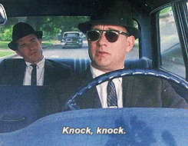
Key concepts
Gulfs of Execution and Evaluation
Seven Stages of Action
Three Levels of Processing
Human Conceptual Models & Errors
Seven Design Principles
📚 The Design of Everyday Things by Don Norman - CH02
Page 3
Notes:
[Minh] An overview of how Don Norman answer this question through these following concepts

Slide 5
How did Tom Hanks plan to catch con-man Leonardo di Caprio?
📚 The Design of Everyday Things by Don Norman - CH02
Page 4
Notes:
[Minh] Let's watch a snippet from the classic, true-story-inspired Catch Me if You Can of Frank Abagnale. See What is Tom Hank's goal in this video? And how did he do it?

Slide 6
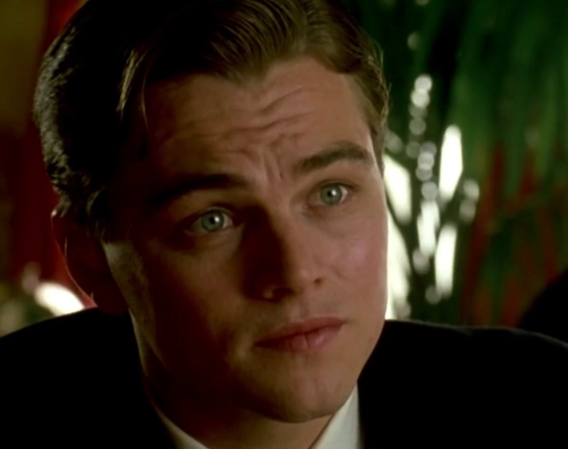
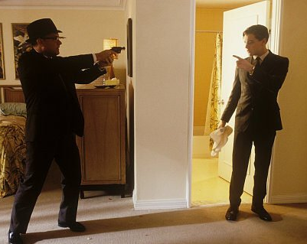
First,
First, have a goal and an action plan
Goal Arrest the suspect
Action Approach and catch the suspect
📚 The Design of Everyday Things by Don Norman - CH02
Page 5

Slide 7
Second, create sub-goals and sub-actions
Second,
Goal: Arrest the suspect
Action: Approach the suspect
• Have the right skills & tools
• Enter the location
• Identify the suspect
….
• Catch!
​
• Have criminal evidence
• Have a sketch of the suspect
• Locate the suspect​
...
​
📚 The Design of Everyday Things by Don Norman - CH02
Page 6
Notes:
[Minh] one step further into a typical thinking process, he will be concerned with the smaller steps to achieve his plan. Namely, within the overarching goal of arresting di Caprio, he needs.... Likewise, with sub-actions, he obviously need ....

Slide 8
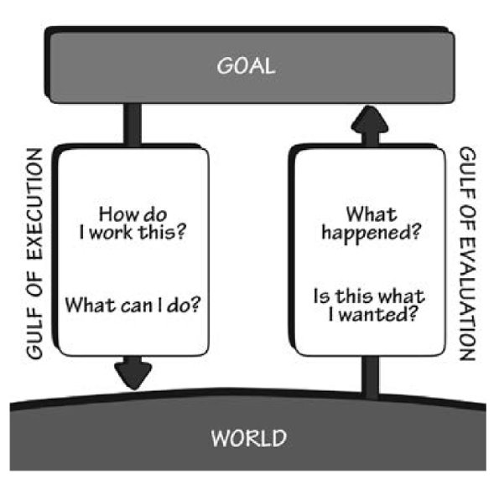
The mental process to figure out what to expect and to do is called a gulf
📚 The Design of Everyday Things by Don Norman - CH02
Page 7
Notes:
Within each of our mind, Don Norman argued that the mental... When operating something for facing a situation that requires a person to interact with an object/device, we face 2 gulfs to map between our intention (the goal) and reality (the world)

Slide 9
The mental process to figure out what to expect and to do is called a gulf
📚 The Design of Everyday Things by Don Norman - CH02
Page 8
Notes:
[Minh] rotating this, we can match it to our previous example. Tom Hank was essentially working all the mental math to intercept the goal of catching his suspect and actually facing the suspect.

Slide 10
The designer's role is to bridge these gulfs by understanding how humans act, think, and believe.
User research
📚 The Design of Everyday Things by Don Norman - CH02
Page 9
Notes:
[Minh] With this theory of how people think, designers .... In the design industry, User Research stands on its own as a field that focuses on examining the way human act, think, believe to create digital products like apps and games for billion-dollar companies. Beside effective business purpose, this understanding allows for designers/product developers like us to empathize with the human experience, make our products better.

Slide 11
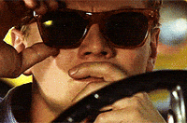
What exactly help us act?
📚 The Design of Everyday Things by Don Norman - CH02
Notes:
Pose a case study scenario

Slide 12
7 stages of an action
Goal: end goal or objective
Plan: How do we get there?
Specify: Which action should I choose? Decision-funneling.
Perform: Let’s do this!
Perceive: okay okay, what happened
Interpret: What happened? What does it mean?
Compare: Is this what I expected?
📚 The Design of Everyday Things by Don Norman - CH02
Notes:
Pose a case study scenario

Slide 13
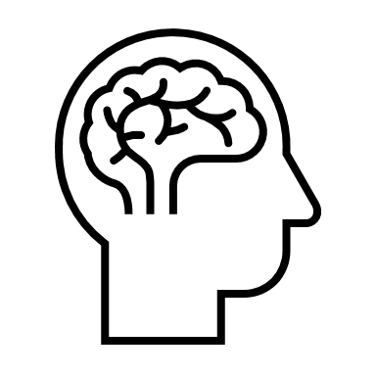
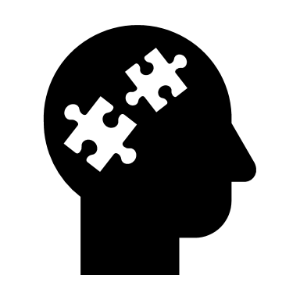
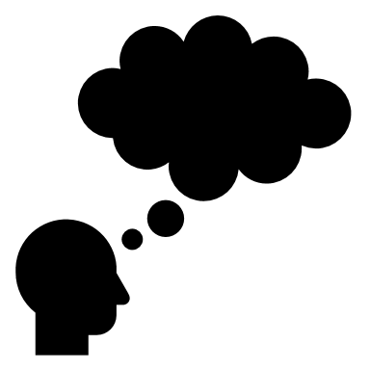
How do we think about these actions?
Visceral - subconscious, instinctive reactions to immediate sensory stimuli
Behavioral - manages learned skills, subconscious actions, and emotional responses based on expectations and feedback
Reflective - conscious thought, deep understanding, reasoning, and emotional evaluation of past and future events
📚 The Design of Everyday Things by Don Norman - CH02
Notes:
Pose a case study scenario

Slide 14
What could impact our belief?
When there is a mismatch in real life with pre-existing conceptual models
Expected Suspect is supposed to look panicked
World Suspect is a chill guy who can apply reversed psychology
📚 The Design of Everyday Things by Don Norman - CH02
Notes:
Belief system is constructed by your personal experiences through tested goal-action scenario that re-enforce you of what is meant to happen.

Slide 15
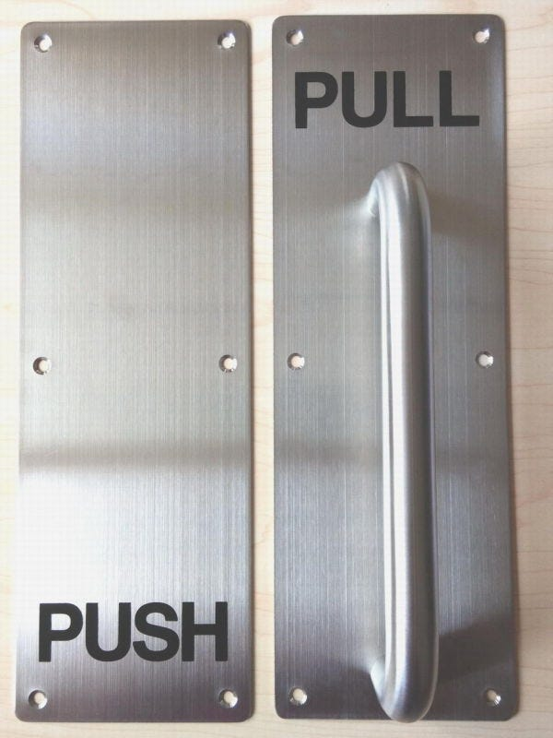
Misled conceptual models lead to frustrating user experience & tragic consequences, oh yeah.
📚 The Design of Everyday Things by Don Norman - CH02
Page #
Notes:
[Minh] Leo was a masterful experience designer here in the sense that he deceived Tom Hank into believing he's not the suspect. In the movie, it resulted in Tom Hank feeling offended and frustrated. Yet, in reality, products that induce misled conceptual models create frustration and even worse, tragedies. Take the Push and Pull dilemma that Don Norman often hinges on. (talk about my study abroad experience with the DIS building door). But when a fire accident happen, people are just wired to panic and lose their mind, and therefore got trapped just because of a poorly designed door.

Slide 16
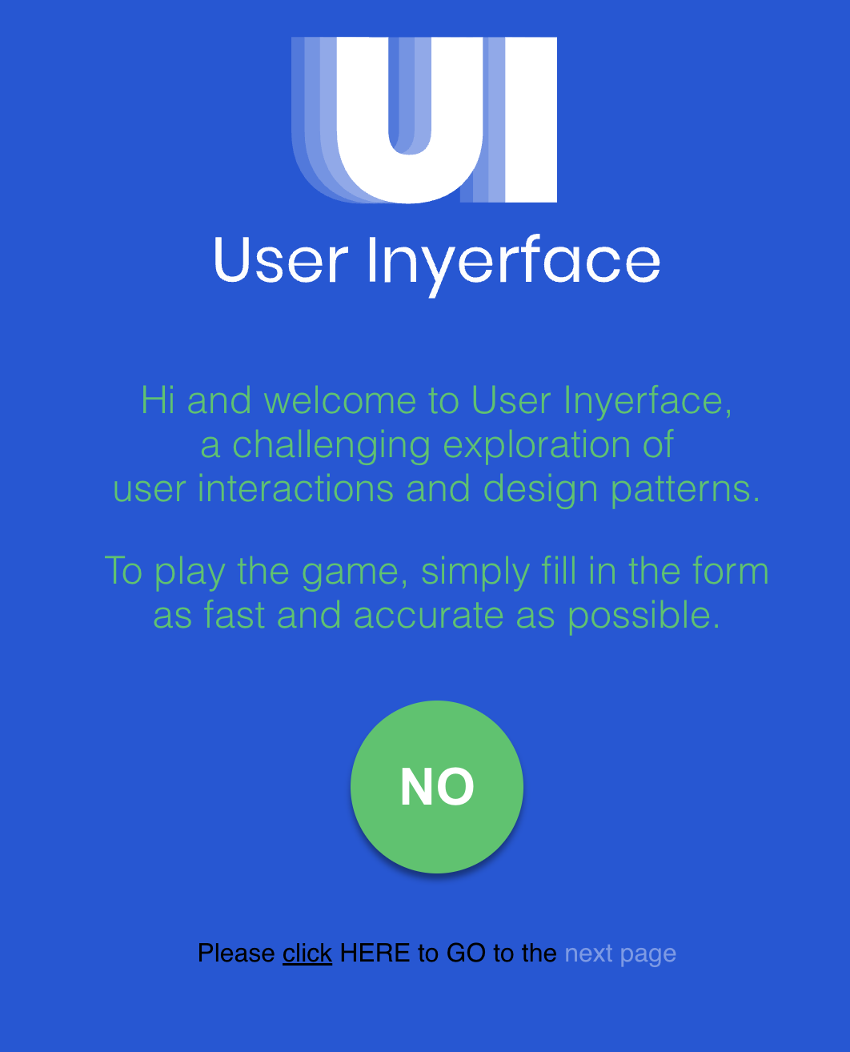
Remember this?
1. Green button
2. Click here
📚 The Design of Everyday Things by Don Norman - CH02
Page #
Notes:
Scenario

Slide 17
Remember this?
1. Green button
2. Click here
Page #
📚 The Design of Everyday Things by Don Norman - CH02
Notes:
Scenario

Slide 18
Most of the times, it's not productive to blame the human users.
Learned helplessness
Instead, we need to take responsibilities as designers.
Positive psychology
📚 The Design of Everyday Things by Don Norman - CH02
Page #
Notes:
Learned helplessness: instead of thinking “this product is designed poorly,” they think “I clearly have no business doing this; I can’t; I’m not good enough to figure this out,” and so they throw their hands up in surrender the next time they encounter it.
Positive psychology: Norman uses this space to emphasize (with bullet points!) the need for approaching feedback with guidance, encouragement, and support. Toss out the unhelpful error message codes. Ensure all designs have exit routes that don’t require users to start over again, and most importantly, be accountable: stop blaming the users for your design’s shortcoming.

Slide 19
🤔 How might we...
Understand the way humans think?
Bridge the gap between what people intend to do and what they actually achieve? 💡
📚 The Design of Everyday Things by Don Norman - CH02
Page 15
Notes:
Pose the question
Connect to the User Inyerface Form

Slide 20
Discoverability
Users can see what actions are possible
Current state of device is clearly visible
7 design principles
Page #
Notes:
1. Discoverability. It is possible to determine what actions are possible
and the current state of the device.
2. Feedback. There is full and continuous information about the results
of actions and the current state of the product or service. After an
action has been executed, it is easy to determine the new state.
3. Conceptual model. The design projects all the information needed
to create a good conceptual model of the system, leading to under-
standing and a feeling of control. The conceptual model enhances
both discoverability and evaluation of results.
4. Affordances. The proper affordances exist to make the desired ac-
tions possible.
5. Signifiers. Effective use of signifiers ensures discoverability and that
the feedback is well communicated and intelligible.
6. Mappings. The relationship between controls and their actions fol-
lows the principles of good mapping, enhanced as much as possible
through spatial layout and temporal contiguity.
7. Constraints. Providing physical, logical, semantic, and cultural con-
straints guides actions and eases interpretation.

Slide 21
Discoverability
Feedback
Users can see what actions are possible
Current state of device is clearly visible
Actions provide clear responses
System State changes clearly communicated
7 design principles
Page #
Notes:
1. Discoverability. It is possible to determine what actions are possible
and the current state of the device.
2. Feedback. There is full and continuous information about the results
of actions and the current state of the product or service. After an
action has been executed, it is easy to determine the new state.
3. Conceptual model. The design projects all the information needed
to create a good conceptual model of the system, leading to under-
standing and a feeling of control. The conceptual model enhances
both discoverability and evaluation of results.
4. Affordances. The proper affordances exist to make the desired ac-
tions possible.
5. Signifiers. Effective use of signifiers ensures discoverability and that
the feedback is well communicated and intelligible.
6. Mappings. The relationship between controls and their actions fol-
lows the principles of good mapping, enhanced as much as possible
through spatial layout and temporal contiguity.
7. Constraints. Providing physical, logical, semantic, and cultural con-
straints guides actions and eases interpretation.

Slide 22
Discoverability
Feedback
Conceptual Model
Users can see what actions are possible
Current state of device is clearly visible
Actions provide clear responses
System State changes clearly communicated
Design shows how system works
Relationship between actions/results is clear
7 design principles
Page #
Notes:
1. Discoverability. It is possible to determine what actions are possible
and the current state of the device.
2. Feedback. There is full and continuous information about the results
of actions and the current state of the product or service. After an
action has been executed, it is easy to determine the new state.
3. Conceptual model. The design projects all the information needed
to create a good conceptual model of the system, leading to under-
standing and a feeling of control. The conceptual model enhances
both discoverability and evaluation of results.
4. Affordances. The proper affordances exist to make the desired ac-
tions possible.
5. Signifiers. Effective use of signifiers ensures discoverability and that
the feedback is well communicated and intelligible.
6. Mappings. The relationship between controls and their actions fol-
lows the principles of good mapping, enhanced as much as possible
through spatial layout and temporal contiguity.
7. Constraints. Providing physical, logical, semantic, and cultural con-
straints guides actions and eases interpretation.

Slide 23
Discoverability
Feedback
Conceptual Model
Users can see what actions are possible
Current state of device is clearly visible
Actions provide clear responses
System State changes clearly communicated
Design shows how system works
Relationship between actions/results is clear
Affordances
Physical Characteristics suggest proper usage
Design enables intended actions naturally
7 design principles
Page #
Notes:
1. Discoverability. It is possible to determine what actions are possible
and the current state of the device.
2. Feedback. There is full and continuous information about the results
of actions and the current state of the product or service. After an
action has been executed, it is easy to determine the new state.
3. Conceptual model. The design projects all the information needed
to create a good conceptual model of the system, leading to under-
standing and a feeling of control. The conceptual model enhances
both discoverability and evaluation of results.
4. Affordances. The proper affordances exist to make the desired ac-
tions possible.
5. Signifiers. Effective use of signifiers ensures discoverability and that
the feedback is well communicated and intelligible.
6. Mappings. The relationship between controls and their actions fol-
lows the principles of good mapping, enhanced as much as possible
through spatial layout and temporal contiguity.
7. Constraints. Providing physical, logical, semantic, and cultural con-
straints guides actions and eases interpretation.

Slide 24
Discoverability
Feedback
Conceptual Model
Users can see what actions are possible
Current state of device is clearly visible
Actions provide clear responses
System State changes clearly communicated
Design shows how system works
Relationship between actions/results is clear
Affordances
Signifiers
Physical Characteristics suggest proper usage
Design enables intended actions naturally
Clear indicators show where action is possible
Visual cues communicate available interactions
7 design principles
Page #
Notes:
1. Discoverability. It is possible to determine what actions are possible
and the current state of the device.
2. Feedback. There is full and continuous information about the results
of actions and the current state of the product or service. After an
action has been executed, it is easy to determine the new state.
3. Conceptual model. The design projects all the information needed
to create a good conceptual model of the system, leading to under-
standing and a feeling of control. The conceptual model enhances
both discoverability and evaluation of results.
4. Affordances. The proper affordances exist to make the desired ac-
tions possible.
5. Signifiers. Effective use of signifiers ensures discoverability and that
the feedback is well communicated and intelligible.
6. Mappings. The relationship between controls and their actions fol-
lows the principles of good mapping, enhanced as much as possible
through spatial layout and temporal contiguity.
7. Constraints. Providing physical, logical, semantic, and cultural con-
straints guides actions and eases interpretation.

Slide 25
Discoverability
Feedback
Conceptual Model
Users can see what actions are possible
Current state of device is clearly visible
Actions provide clear responses
System State changes clearly communicated
Design shows how system works
Relationship between actions/results is clear
Affordances
Signifiers
Mappings
Physical Characteristics suggest proper usage
Design enables intended actions naturally
Clear indicators show where action is possible
Visual cues communicate available interactions
Controls logically relate to their actions
Spatial layout matches real world relationships
7 design principles
Page #
Notes:
1. Discoverability. It is possible to determine what actions are possible
and the current state of the device.
2. Feedback. There is full and continuous information about the results
of actions and the current state of the product or service. After an
action has been executed, it is easy to determine the new state.
3. Conceptual model. The design projects all the information needed
to create a good conceptual model of the system, leading to under-
standing and a feeling of control. The conceptual model enhances
both discoverability and evaluation of results.
4. Affordances. The proper affordances exist to make the desired ac-
tions possible.
5. Signifiers. Effective use of signifiers ensures discoverability and that
the feedback is well communicated and intelligible.
6. Mappings. The relationship between controls and their actions fol-
lows the principles of good mapping, enhanced as much as possible
through spatial layout and temporal contiguity.
7. Constraints. Providing physical, logical, semantic, and cultural con-
straints guides actions and eases interpretation.

Slide 26
Discoverability
Feedback
Conceptual Model
Users can see what actions are possible
Current state of device is clearly visible
Actions provide clear responses
System State changes clearly communicated
Design shows how system works
Relationship between actions/results is clear
Affordances
Signifiers
Mappings
Physical Characteristics suggest proper usage
Design enables intended actions naturally
Clear indicators show where action is possible
Visual cues communicate available interactions
Controls logically relate to their actions
Spatial layout matches real world relationships
Constraints
Physical limits prevent incorrect actions
Logical restrictions guide proper usage
7 design principles
Page #
Notes:
1. Discoverability. It is possible to determine what actions are possible
and the current state of the device.
2. Feedback. There is full and continuous information about the results
of actions and the current state of the product or service. After an
action has been executed, it is easy to determine the new state.
3. Conceptual model. The design projects all the information needed
to create a good conceptual model of the system, leading to under-
standing and a feeling of control. The conceptual model enhances
both discoverability and evaluation of results.
4. Affordances. The proper affordances exist to make the desired ac-
tions possible.
5. Signifiers. Effective use of signifiers ensures discoverability and that
the feedback is well communicated and intelligible.
6. Mappings. The relationship between controls and their actions fol-
lows the principles of good mapping, enhanced as much as possible
through spatial layout and temporal contiguity.
7. Constraints. Providing physical, logical, semantic, and cultural con-
straints guides actions and eases interpretation.

Slide 27
Example 1:
Instagram

Slide 28
Friends; people I know
Your own page
static images; people unknown/memes/infographics
Reels; TikTok basically, most effective means of

Slide 30
Funnels you directly into reels; most addictive and engaging tool they have

Slide 31
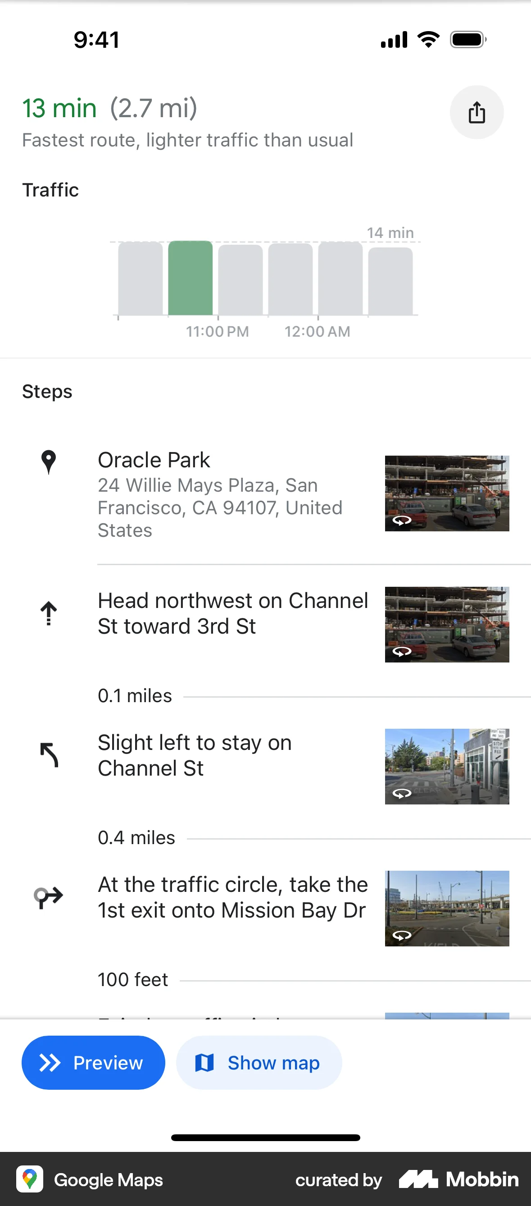
Example 2: Google Maps
Notes:
Google Maps was built on the foundation of street names and address numbers. The product worked by inputting known locations and providing turn-by-turn directions between those locations.

Slide 32
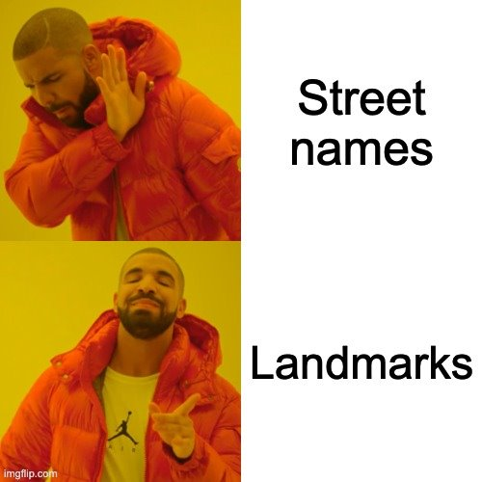
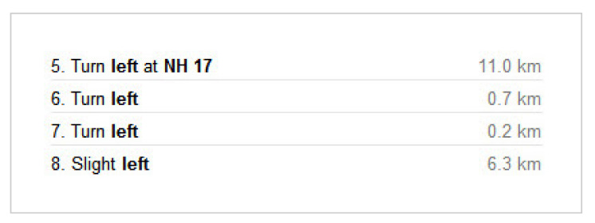
Welcome to India 🇮🇳
"Turn right where the hardware store used to be​"
Notes:
Heavily localized navigation in India and Vietnam

Slide 33
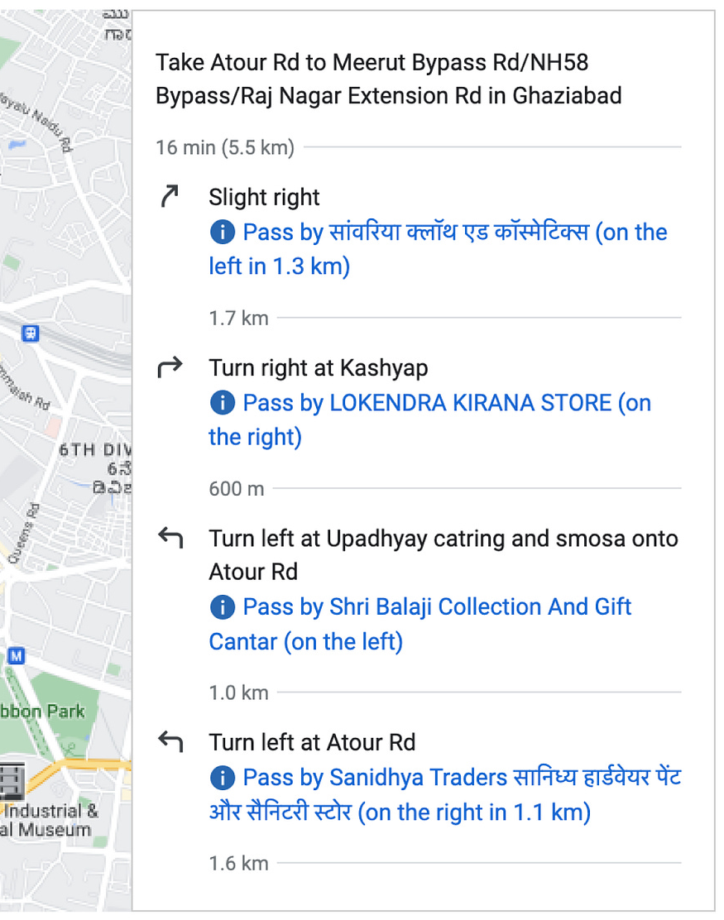
How did they adapt to the 🇮🇳 Indian's mental model for street navigation?

Slide 34
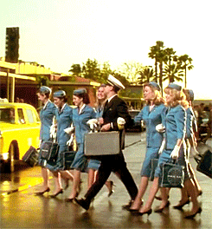
Takeaway
How do people do things?
By forming goals, executing actions based on their mental models, and evaluating feedback to ensure alignment with their intentions.
A designer's goal is to bridge the gulfs of execution and evaluation while leveraging human cognitive, emotional, and behavioral processes.
📚 The Design of Everyday Things by Don Norman - CH02
Page #

