Slide 1
Rocket Surgery Made Easy Chapters 8-12
Author: Steve Krug
Presented by Amelia, Will S., Raymond
Notes:
Amelia

Slide 2
What Is Usability Testing?
Qualitative, Quantitative, and Do-It Yourself Usability Testing
Quick tests to receive immediate feedback through observations and user comments
Notes:
Amelia
Notes:
Quantitative: Scientific, rigorous, large sample size, want to prove something
Qualitative: Informal, not as scientific, want insight to improve something
Do-it Yourself: A type of Qualitative testing that is unscientific, fast feedback
These chapters focus on how to setup a run a do-it yourself usability test

Slide 3
Conducting the Test Session
Notes:
Amelia
Notes:
Do-it yourself usability testing starts with preparing the testing session
which includes:
the facilitator
test room
pre-test prep
move the test along if the user is stuck.

Slide 4
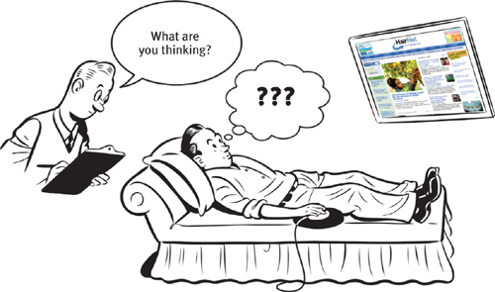
The Facilitator
A core part of the testing process includes someone there to facilitate the process. The role of the facilitator:
Act as a Tour Guide
Act as a Therapist
Characteristics of a Good Facilitator:
Personal Interest in the Project
Sociable/ Good Listener
Notes:
Raymond

Slide 5
The Test Room
It is important to have the required equipment in the test room. This includes:
Laptop with Internet
Screen Sharing/Recording Software
Tracks what is happening while the software is being tested.
Useful for "scrubbing"
Standard Mouse
USB Microphone
Notes:
Raymond
Make sure to include “scrubbing”, why screen share?, remote testing opinion

Slide 6
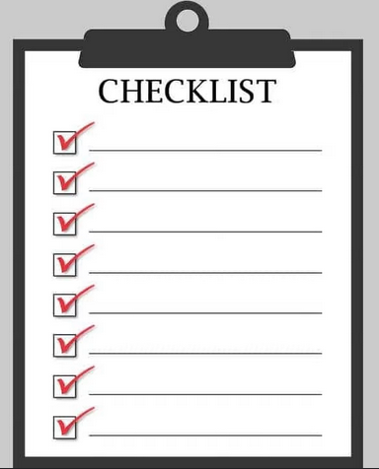
Pre-Test Prep
Before you test, you must ensure that everything is ready in the room.
This includes:
Screen Recording
Screen Sharing
Disabling Software
Bookmarking Pages
Audience QOL
Resetting Everything
Only after preparation can one begin the test session.
Notes:
Will
Audience QOL changes refer to items such as cursor size and screen scaling so that attendees can view the page easier.

Slide 7
Prompting the Users
Begin with a welcome prompt:
Short, to the point, explains how the test will work.
Prepare this speech – improvising can accidentally give the wrong idea.
Next, provide the pre-test questions:
These get participants comfortable talking and show that you will be listening.
After, have the subject provide a tour of the Home page:
This helps them create a narrative of what they think the purpose of the website is.
This can illuminate issues about the website not found through DIY testing.
Lastly, have them complete the tasks and probe for information:
Tasks should not take a large amount of time, so view their emotions.
After, asking follow-up questions can illuminate why the subject did something.
Notes:
Will
Why ask questions?, Have they completed the task?

Slide 8
Observers
"You can observe a lot by watching."
Notes:
Amelia
A main part of usability testing are the observers

Slide 9
Why Observe Usability Testing?
Seeing is believing
“watching usability testing makes you realize that your users aren’t just like you”
Notes:
Amelia
Seeing is believing
Most individuals do not understand how other might interact with something
We all have different perspectives and experiences
Use slide image as example

Slide 10
How To Get Observers?
It is important to get a diverse group of users to test with.
Designers, developers, bosses, writers, etc.
As such, do (almost) anything in your power to get people in the room.
(Including quality snacks)
Notes:
Will
Make it easy to attend
Advertise (weeks) in advance
Make it clear what's in it for them – WE HEAR YOUR VOICE!!!
Trick people into coming (upper management)
Provide good snacks

Slide 11
What Do Observers Do?
Watch and Learn (take notes)
Make a list at the end of each session
Write down 3 most important usability problems
Suggest questions to the facilitator
Enjoy Snacks!
Go to debriefings
Notes:
Amelia
Take Notes!!!
So you don't forget
Good practice is to jot down a list of important points throughout observing
Be active observers and ask questions to get more out of the testing
Snacks are one of the many incentives to getting observers to attend
Debrief at the end to discuss problems and fixes

Slide 12
Debriefing
"There are some men here to flood the bed for skating."
Notes:
Will

Slide 13
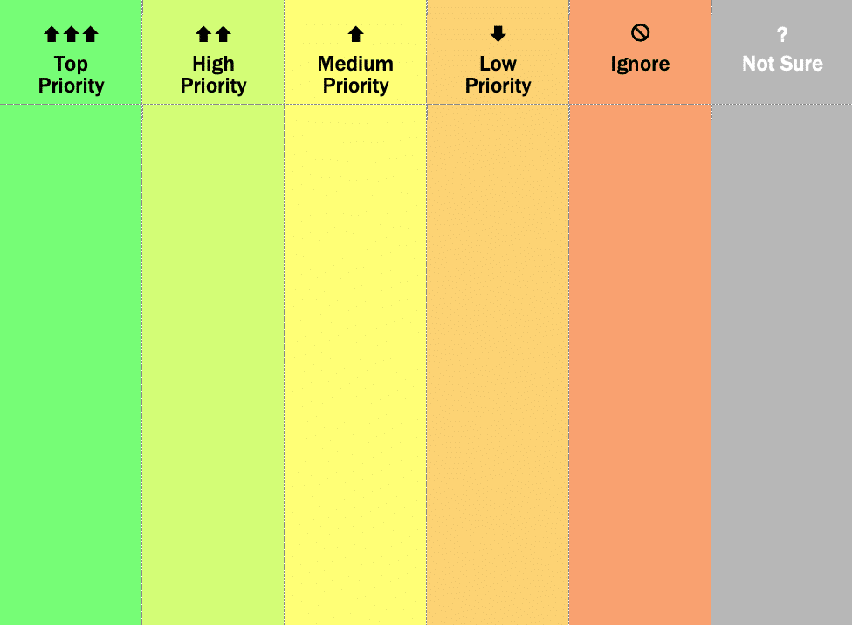
Ranking the Biggest Problems
Many problems uncovered during testing
Problems should be ranked according to severity
Severity of problems decided based on frequency and/or impact of the problem
Notes:
Raymond

Slide 14
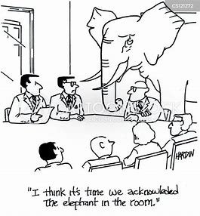
Worst Problem First
"All sites have usability problems"
There are limited time/resources available to put towards each problem
It is important to put focus on the biggest issues first (Top Priority Problems)
Notes:
Raymond

Slide 15
Fixing Problems
“What’s the smallest, simplest change we can make that’s likely to keep people from having the problem we observed?”
Notes:
Amelia

Slide 16
Do As Little As Possible!
Fixing a problem does not always mean finding a complete and permanent solution.
Make it better for the user now instead of later!
Notes:
Amelia
Many people try and find permanent solutions
Takes longer
The problem is still their affecting people
Takes longer time to implement
A temporary or quick fix is better because it can continually be tweaked

Slide 17
Tweaking vs. Redesigning
To accomplish this, it is important to tweak designs instead of redesigning.
This avoids the common pitfalls that occur when making new designs.
There are nine reasons why tweaking is better than redesigning.
Notes:
Will
1. Tweaks cost less.
2. Tweaks require less work.
3. Tweaks don’t ruin lives, break up families, and wreck careers.
4. Small changes can be made sooner.
5. Small changes are more likely to actually happen.
6. If you make larger changes, you’re more likely to break other things that are working fine in the process.
7. Most people don’t like change, so a redesign annoys them.
8. A redesign means making a lot of changes at once, with the attendant complexities and risks.
9. A redesign means involving a lot of people in a lot of meetings. Enough said.

Slide 18
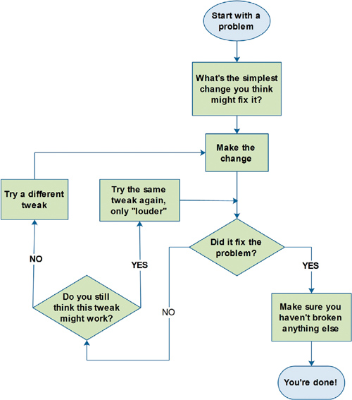
Notes:
Will
Maybe have a problem for the audience to work through using this slide.

Slide 19
The Usual Suspects
Notes:
Raymond

Slide 20
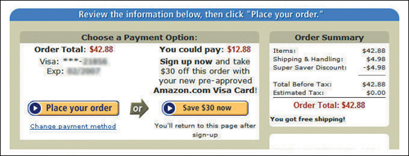
Emphasis on Importance
A common issue is the lack of distinction between basic and important elements.
Critical tools must stand-out among other information on the website.
Notes:
Raymond

Slide 21
Home Screen
The home screen connects everything
“Its job is to clarify who you are and what you do quickly”
Notes:
Amelia
The home screen connects everything
that’s why it is very important to develop a good a intuitive design for it
If a user doesn't know where to find something they will go to the home screen
It is important to be able to navigate and find things from the home screen
It needs to be clear and concise

Slide 22
Discussion Questions
1. Would there be any benefits to having a user repeat usability testing to see if the discovered problems were fixed effectively?
2. Would familiarity of a test room or facilitator affect the observations and results from a usability test?
3. What differences come about from doing usability tests in person versus remotely?
4. At what point is a redesign justified from a usability test – if at all?
Notes:
Will (2), Raymond (1), Amelia (1)

