Slide 1
Chapters 1-7
Chris, Saleh, Cameron

Slide 2
Types of Usability Testing
Quantitative
Purpose: The designer is interested in proving something
Exp: "Is this latest version better than the last?"
Rigorous, scientific, large sample of participants
Qualitative
Purpose: Get insights to improve your product
No data collection
Informal and unscientific
Test fewer users and is less resource intensive than quantitative

Slide 3
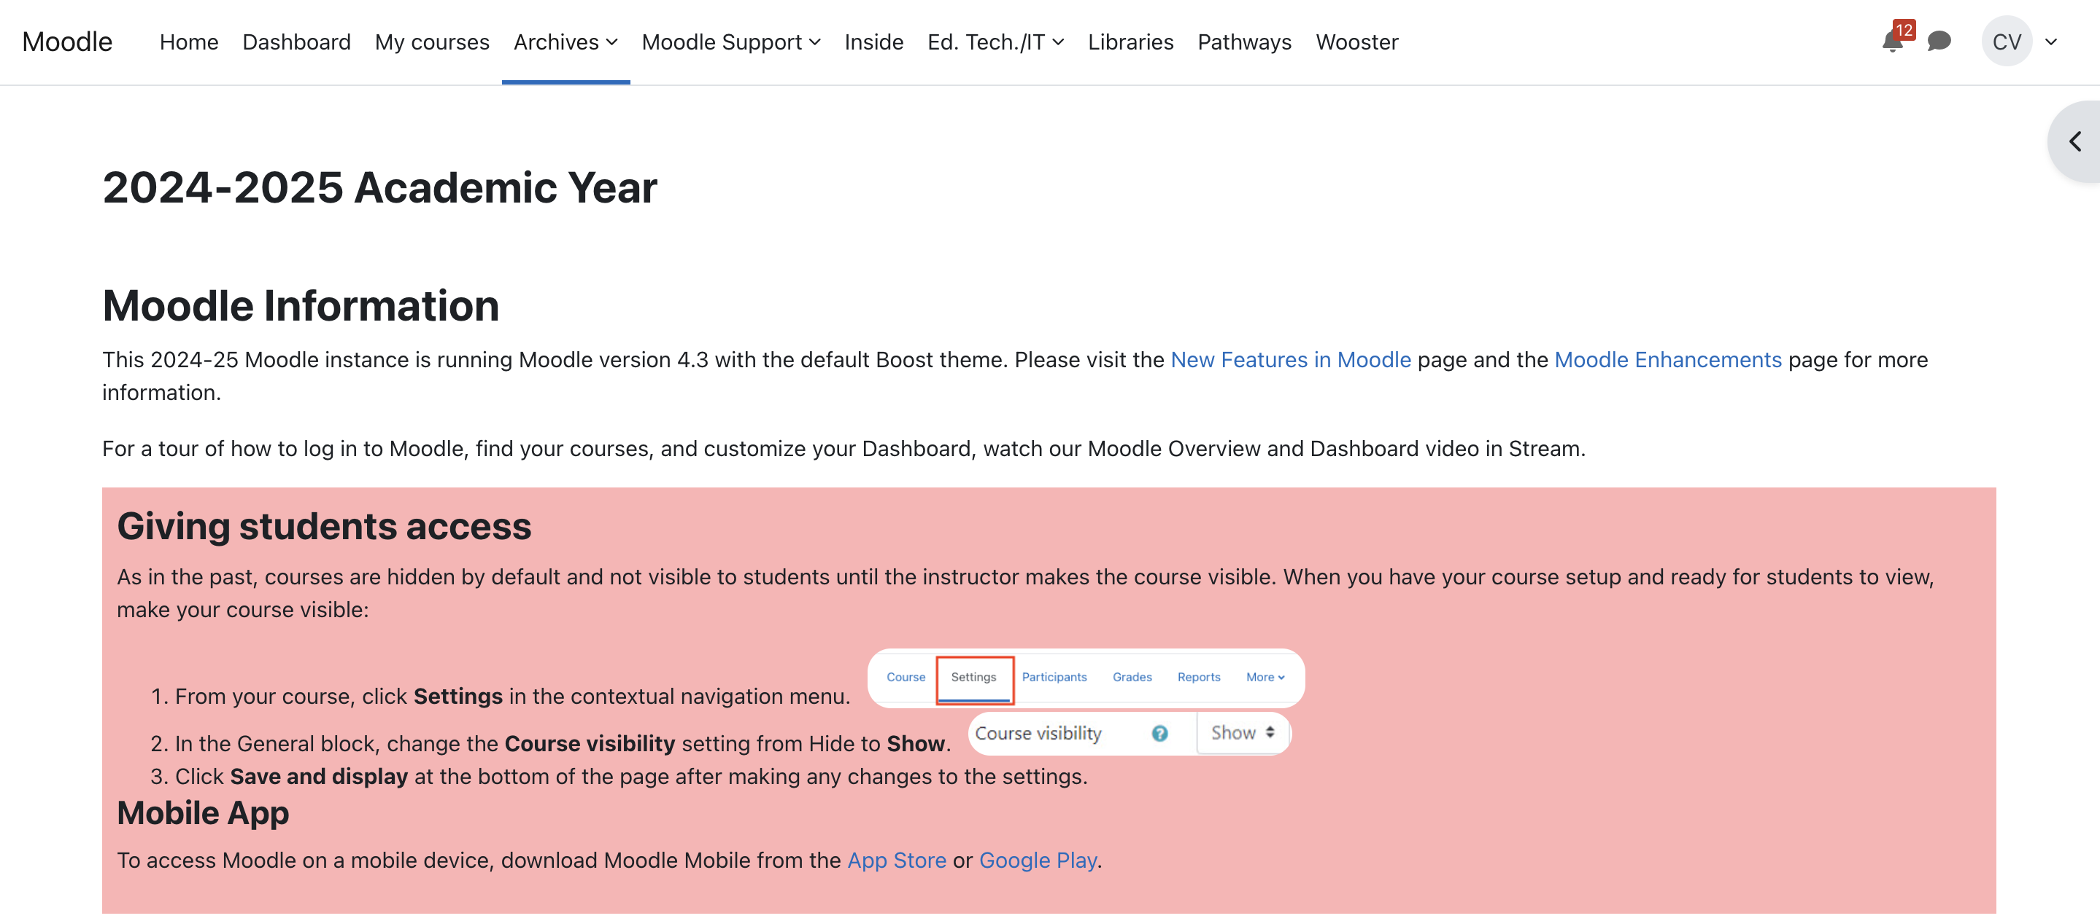
"Do-it Yourself Usability Testing"
A qualitative usability study that is unscientific, informal, and does not need to be resource intensive
Why it works:
All sites have problems.
Most serious problems are easy to find
Watching users makes you a better designer
Why so little of it gets done:
Lack of firsthand experience
Reluctance to show unfinished work
People think it must be a big production (main reason)

Slide 5
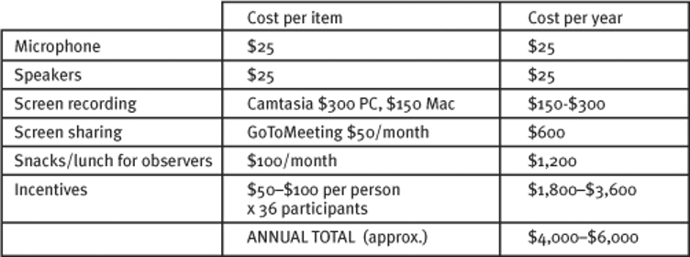
Useful Approach: "A Morning A Month"
Two words to focus on:
Morning: Limit the testing to half a day – which means only test 3 participants
Simplifies recruiting and allows for more observers
Month: Monthly is about as often as most teams can afford and helps identify enough problems to keep your team busy
Making this a routine eliminates deciding when to test
Time and resource efficient

Slide 6
When to Test
One Thing Professionals agree on:
Start Testing as early as possible
Inherent Paradox: the worst shape it's in, the less you want to show it – and the more you can benefit if you do.
It is possible to detect serious usability problems early on
Far easier and less costly to fix
Prevents embedded issues

Slide 7
Ways to Test Your Ideas
"Sketch on a Napkin" Testing:
Rough sketches and drawings
How to test it:
Ask anyone if they can explain the drawing
What you get out of it:
Learn Whether Your Concept is easily understandable
2. Wireframe Testing:
Schematic diagram of page – shows where different kinds of content will go
How to test it:
Ask users how they would find things and what they would expect when clicking a link
What you get out of it:
Ensure the categorization scheme and naming makes sense
3. Web Page Testing:
How to test it:
Start with the home page and ask the user how each page should work
What you get out of it:
Allows the designer to identify usability issues in the visual layout and approach
4. Prototypes and beyond:
These will all be working pieces you can test
What you get out of it:
All the insights you need to further improve your website

Slide 8
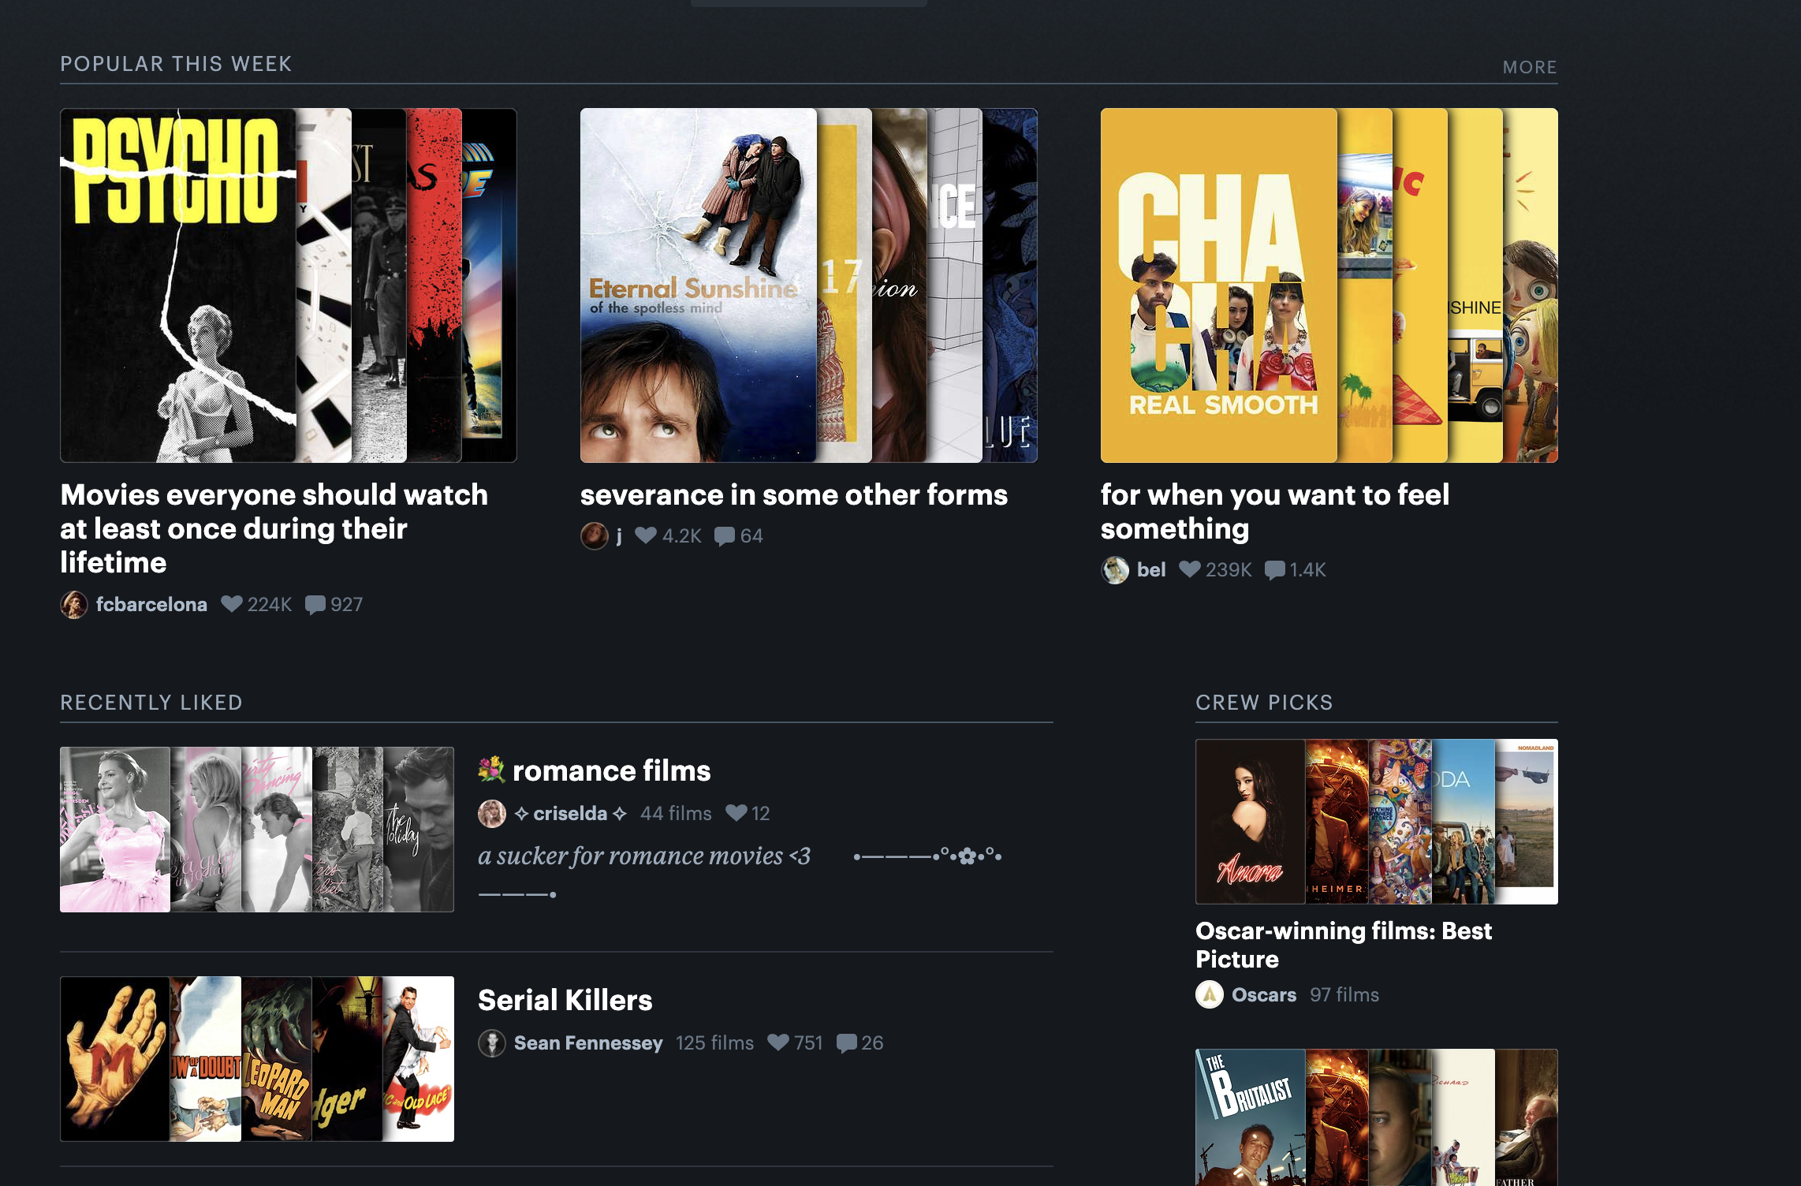
Testing Other Sites
Underutilized resource that can lessen your workload
How to test:
Have users do key tasks from your website on two or three competitors' sites
Discuss what can be applied to your own project
What you get out of it:
Learn what works and what doesn't from competitors
Exp: Letterboxd list feature – can use as motivation for your media site

Slide 9
Who do you test with?
Motto: "Recruit loosely and grade on a curve"
2 parts to consider:
Recruit Loosely:
Try to find users that reflect your target audience, but don't get hung up about it
Your audience is likely more diverse than you think (beginners who do not have domain knowledge will still need to use your site)
You can learn things by watching almost anyone use your application
Grade on a curve:
Make allowances for the differences between the people you test with and your real users
If your participant was not familiar with the subject matter of your website take this into consideration when determining if this would be an issue for a real user

Slide 10
How many people do you test?
Three is enough
Why should you test with three?
Likely to encounter the most significant issues
Less work than finding more
More rounds of testing
Possible to test and debrief the same day
Easier to encourage people to come and observe
Less focus from observers with more than three participants
Testing with more than three makes it harder to process notes
Testing with too many users can uncover and overwhelming and dispiriting amount of problems

Slide 11
Where do you find them?
The easy way out – Make it someone else's problem and higher a recruiter
Usually around $100 per participant
Doing it yourself
Look in places where your audience congregates
Exp: senior citizens: senior centers and libraries
Consider friends, family, and neighbors
Consider remote testing
Warning: Testing with people who work for your organization may be a bad idea if they know too much about the website (new employees might work)

Slide 12
Steps After Finding Candidates
Screen the most promising candidates
See if they are available
Make sure they are qualified
Make an appointment
Follow up
Give directions, instructions of where to park, a phone number, etc.
Have a substitute available in case a participant does not show up

Slide 13
Finding Things For Participants to Do

Slide 14
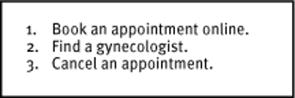
Step 1: Choose Tasks to Test
Make a list of five to ten of the most important things people need to be able to use your site
Narrow this list down based on which ones you want to test in this month's round of testing
Factors to consider:
What are your most critical tasks?
What's keeping you awake at night?
What does your other user research suggest may not be easy to use
Notes:
Another good idea that the book had is to have a filler task for people that finish early. An example of a filler task is to have the participant do the same task but on a competitors website
Factors to consider
Things that people must be able to do for your site to not be a failure
Things that you suspect people might not be able to do or have trouble with
Ask customer support what problems they frequently hear about

Slide 15
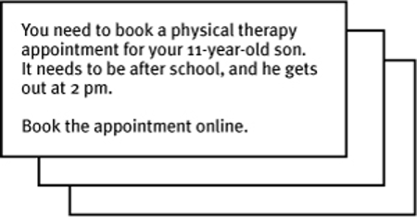
Step 2: Expand Tasks Into Scenarios
Add context to these tasks by writing descriptions a user can read, understand, and follow
Pre-test scenarios to make sure they are clear, complete, and unambiguous (test can be with anyone)
Print scenarios for you and your participant to use during testing
Notes:
Talk about personal story w/Amelia's IS usability study
Something important to remember is to phrase the tasks so that they're clear and easy to understand but don't give away what needs to be done
Bad Ex. Customize your LAUNCHcast station
Good Ex. Choose the kind of music you want to listen to

Slide 16
Final Note: Create Checklists
There are a lot of things that can happen and things to keep track of during usability tests
Checklists can prevent you and your team from forgetting important tasks
Exp:
Three weeks before
• Figure out what you’re going to be testing (site, wireframes, prototype, etc.)
• Create your list of tasks to test
• Decide what kind(s) of users you want to test with
• “Advertise” for participants
• Book a test room for the entire morning with Internet access, table or desk and two chairs, and speakerphone
• Find a place near the test room for participants to sit and wait when they arrive
• Book an observation room for the entire morning with Internet access, table and enough chairs for observers, speakerphone, and projector and screen (or plan to bring a projector or large monitor)
• Book the observation room or a similar-size room for the debriefing lunch

Slide 17
Discussion Questions
If I find a bunch of problems during a test, how do I figure out which ones to fix first, especially when everything feels important?
What do I do if a participant completely misunderstands the task or scenario? Do I help them or just let it play out?
What if the supervisor thinks it’s too early to test? How can I convince him that it’s worth doing even with just a sketch or wireframe?
Sometimes users in a test get stuck just because they’re not familiar with the topic, How do I know if it’s a real usability issue or just something specific to that person?

