Slide 1

Effective Web Design: Layout, Content, and User Experience
Hello Web Design by Tracy Osborn
Aidan, JoJo, Ben

Slide 2
Table of Contents (Section 2.5 – 2.9)
Section 2.5 - Layout and Hierarchy
Section 2.6 - Content
Section 2.7 - User Experience
Section 2.8 - Images and Imagery
Section 2.9 - Extra Tidbits

Slide 3
Layout and Hierarchy
Definition: Layout refers to how information is arranged and prioritized on a webpage.
Definition: Hierarchy refers to the arrangement of elements on a page to guide users' attention to what's most important
Key Factors for Visibility:
  Size
  Color
  Positioning
  Contrast
  White Space
  Typography
Notes:
Real-World Example: News websites like BBC and CNN use size and contrast to highlight breaking news.
Audience Question: Have you ever struggled to find key information on a website? Why?

Slide 4
Real-World Example
News websites like BBC and CNN use size and contrast to highlight breaking news.

Slide 5
Content Structuring for Readability
Problem: Dense paragraphs cause clutter and discourage reading.
Solution: Use the F-pattern scanning model:
  Users scan the intro and the first sentence of each paragraph.
  Breaking content into digestible sections with bullet points.
Notes:
Real-World Example: E-commerce websites like Amazon use bullet points for product descriptions instead of dense paragraphs.
Audience Question: Do you prefer reading long paragraphs or scanning bullet points?

Slide 6
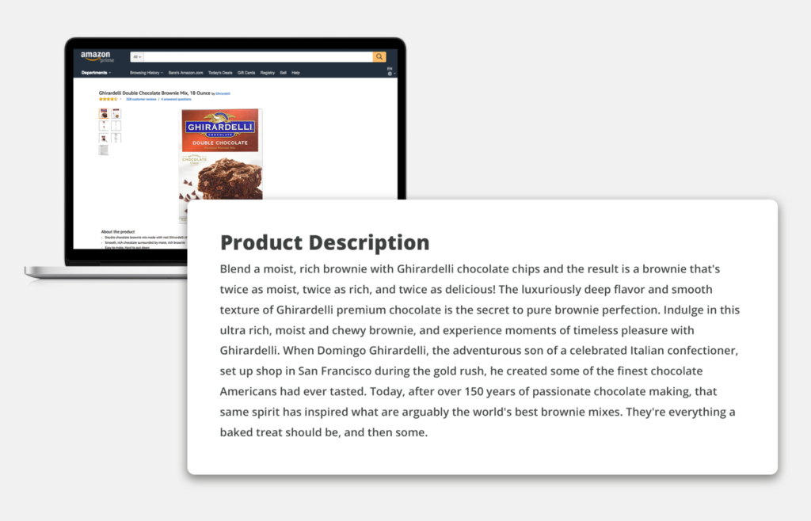
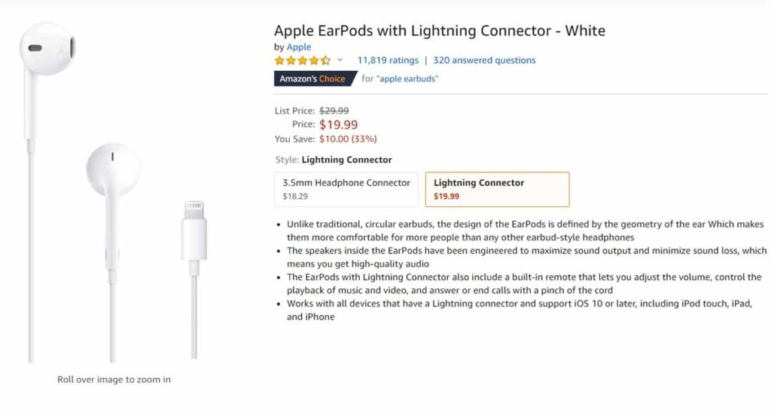
Real-World Example
E-commerce websites like Amazon use bullet points for product descriptions instead of dense paragraphs.

Slide 7
Understanding User Experience (UX)
Definition: UX is the overall experience a user has while interacting with a website.
Key Considerations as a Developer:
  Identify the ideal user and their goals.
  Understand business objectives.
Notes:
Audience Question: Can you think of a website with an excellent user experience? What made it effective?

Slide 8
Competitive Analysis
Key Considerations as a Developer:
  Research competitors to identify strengths and weaknesses.
  Aim to create a superior experience to attract users.
Notes:
Real-World Example: Spotify vs. Apple Music – Both platforms analyze user experience and improve interfaces based on competition.
Audience Question: Have you ever switched from one website or app to another due to a better user experience? Why?

Slide 9
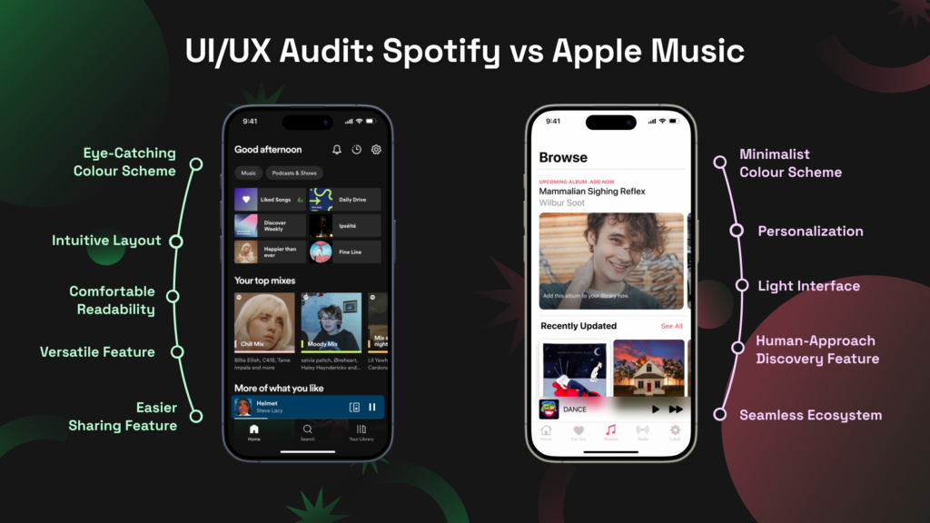
Real-World Example: Spotify vs. Apple Music –
Both platforms analyze user experience and improve interfaces based on competition.

Slide 10
User Research Methods
Primary Questions:
  Who is your ideal user?
  What is their personal goal?
  What are your business goals?
Techniques:
  Surveys and Interviews:
    Don't design for people you don't understand
    Gather direct user feedback – what you both want
  Wireframes & Prototypes:
    Fast, low-fidelity mock-ups of your design for early testing
    Feedback on layouts and interactions
    Figma and client meetings
Audience Question: If you could improve one feature on your favorite website, what would it be?
Notes:
Real-World Example: Airbnb continuously tests new features via A/B testing and usability feedback.
Audience Question: If you could improve one feature on your favorite website, what would it be?

Slide 11
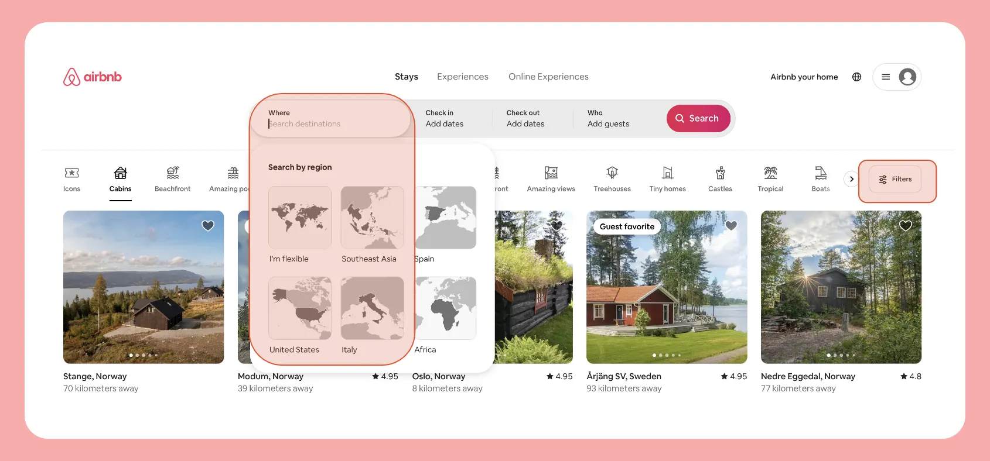
Real-World Example
Airbnb continuously tests new features via A/B testing and usability feedback.

Slide 12
Post-Launch Testing
Key Metrics to Track:
Bounce Rate: Percentage of visitors who leave immediately.
Conversion Rate: How many users complete the desired action.
Methods:
A/B Testing: Comparing two design versions to determine effectiveness.
Usability Testing: Gathering user feedback post-launch.
Audience Question:
Have you ever left a website immediately because of poor usability? Why?

Slide 13
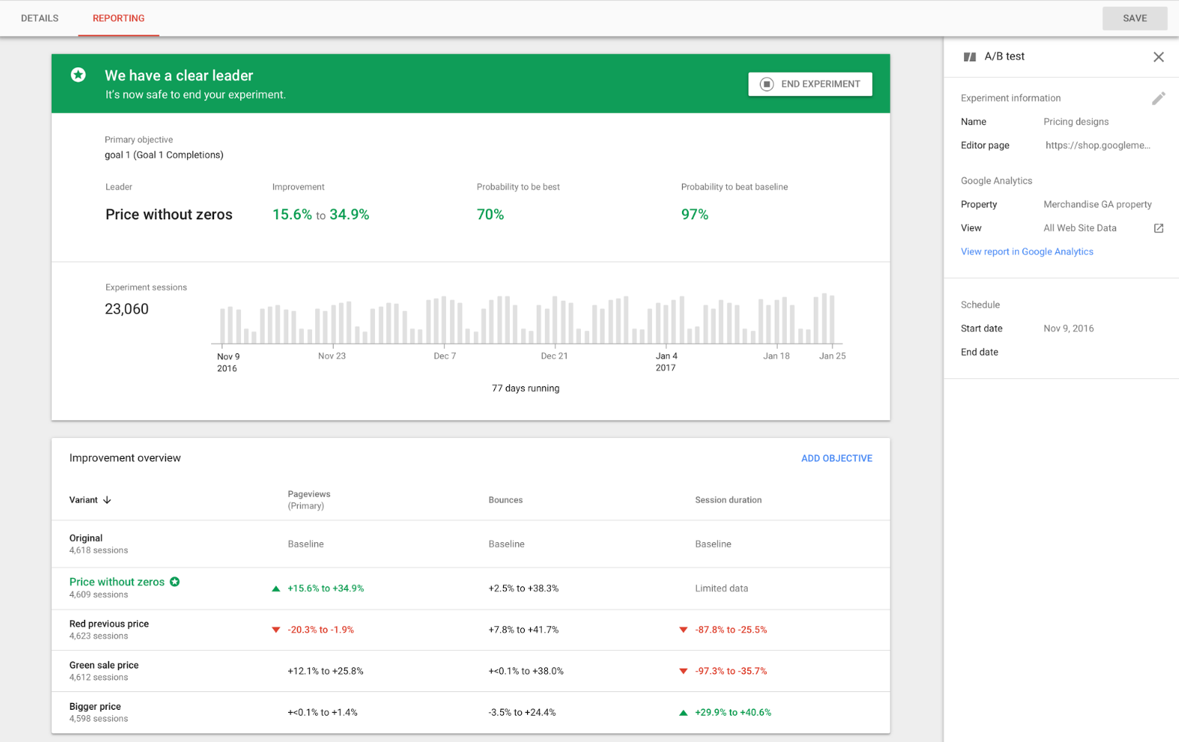
Shortcuts
Make desired actions easy to find and use
  Submit buttons
Website Size
  Slow downloading deters users
Run Usability Tests
Include Analytics
  Google runs A/B tests on search algorithms and user interfaces frequently.

Slide 14
Optimizing Images & Icons
Don't Take Any Image You Find!
Types of Image Licenses:
  Rights-Managed
    Additional terms for allowed uses
  Royalty-Free
    Correspond to the terms
    Not-for-profit
  Creative Commons
    Creators denote use terms (non-commercial, attribution, no alterations, etc.)
  Don't use if there are no use specifications!
Best Practices:
  Avoid bloated file sizes for faster loading times.
  Use retina and non-retina images to optimize for different screens.
  Images and Icons are not required – Screenshots
  Faces are powerful
  Icons – supporting characters
Notes:
Real-World Example: Unsplash and Pexels provide high-quality, royalty-free images.
Audience Question: Have you ever been frustrated by slow-loading images on a website?

Slide 15

Real-World Example
Unsplash and Pexels provide high-quality, royalty-free images.
There are many more online resources (Creative Commons) for images, icons, etc.
Notes:
Real-World Example: Unsplash and Pexels provide high-quality, royalty-free images.

Slide 16
Additional Design Principles
Best Practices:
  Start Simple: Avoid overcomplicating interfaces.
  Rule of Thirds: A principle used in photography and design for balanced composition.
Notes:
Real-World Example: Apple’s minimalist design approach.
Audience Question: Have you seen a website where the design felt overwhelming? What made it difficult to navigate?

Slide 17
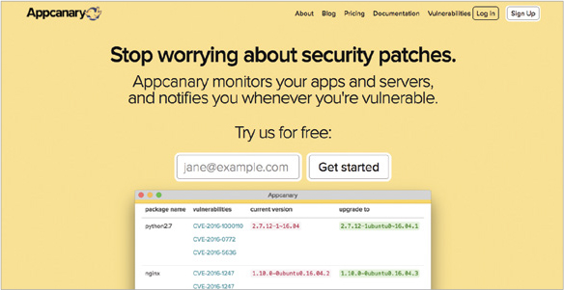
Real-World Example
Appcanary’s simple website

Slide 18
Additional Design Principles
Best Practices:
  Start Simple: Avoid overcomplicating interfaces.
  Rule of Thirds: A principle used in photography and design for balanced composition.
  Avoid Pure Black: Use off-black tones for a more natural look.
  Lighting from Above: Mimics natural light sources.
  Use Contrast Wisely: Highlights important elements.
Notes:
Real-World Example: Apple’s minimalist design approach.
Audience Question: Have you seen a website where the design felt overwhelming? What made it difficult to navigate?

Slide 19

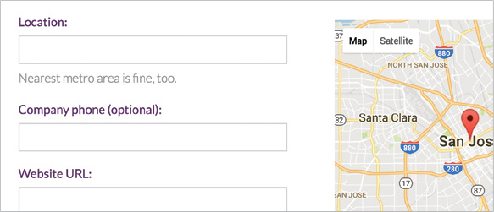

Real-World Example
Example of Lighting: Sign up button
Example of Contrast: The form’s help is lighter compared to the main text

Slide 20
Key Takeaways
Good layout and hierarchy improve readability.
User experience research leads to better engagement.
Optimized content and images enhance usability.
Testing and analytics ensure continuous improvement.
Notes:
Final Audience Question: What’s one change you’d make to a website you use frequently to improve its user experience?
Call to Action: Apply these principles to your next web project and test for effectiveness!

Slide 21
Discussion Questions
Which key metrics are most important to your team's application (Bounce Rate, Conversion Rate)?
What designs would benefit from a lack of images or icons?
What are some strategies to avoid overcomplicating interfaces?
How does layout and hierarchies change based off the function of the website? Do they become more or less complex?

