Slide 1
Hello Web Design Ch. 1: If You Read Only One Chapter, Make It This One Ch. 2.1-2.4: Theory and Design Principles Author: Tracy Osborn
By: Anany, Hiruy, and Will

Slide 2
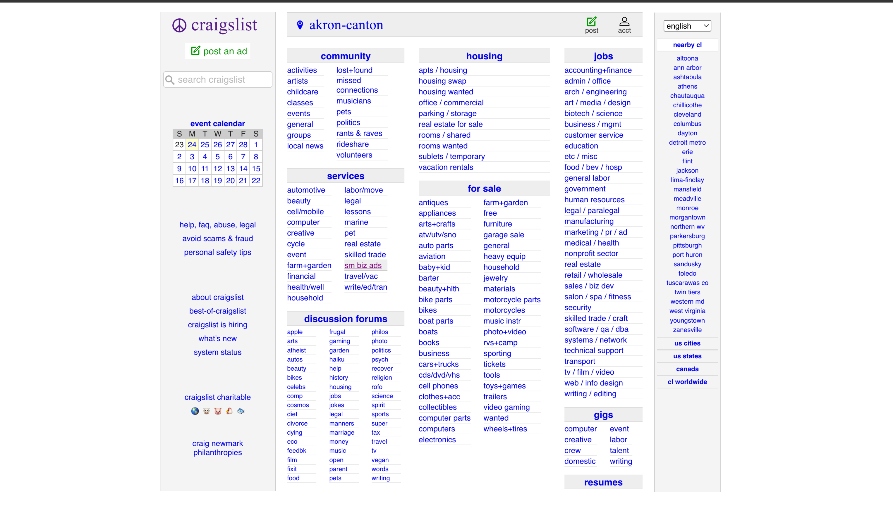
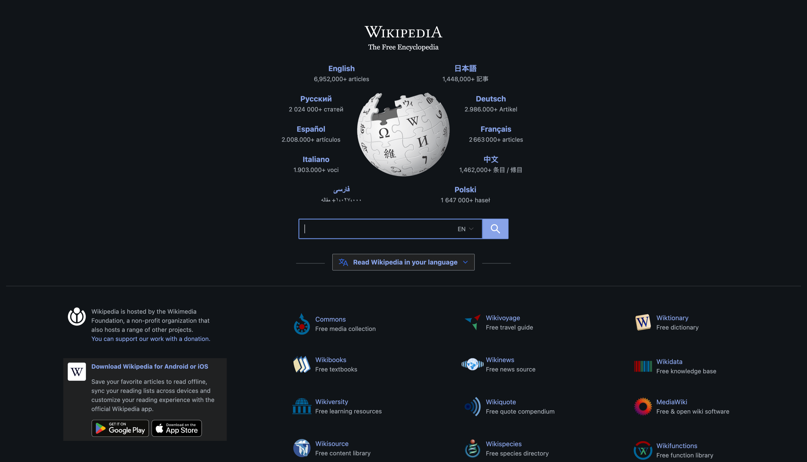
“If You Read Only One Chapter, Make It This One” (Chapter 1)
The way your design works > how it looks
Craigslist
Wikipedia

Slide 3
Reminder: looks matter far less than whether your design succeeds in what you and your users want it to achieve.

Slide 4
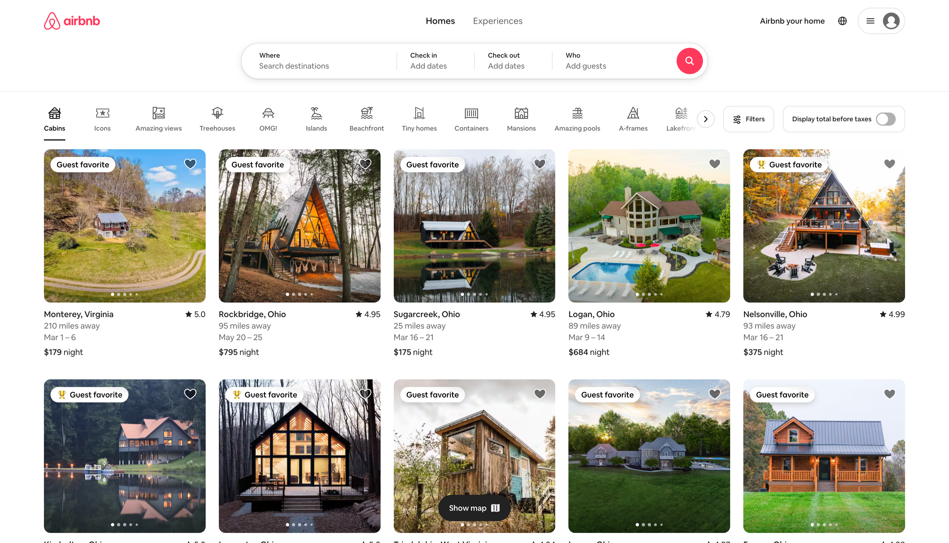
Two steps to ensuring that your design results in a good UX:
1) Knowing what you want your design to accomplish
- What does success look like?
Conversion Rate
2) Getting feedback from others
Ask people to view and review your design

Slide 5
Quick tips on improving your design
Reduce Clutter: Clean up busy, chaotic elements to improve both aesthetics and functionality.
Use a Grid: Establish a structural framework to align elements and create a sense of order.
Limit Colors: Stick to a specific palette to prevent visual overload and ensur

Slide 6
More about improving design
Restrict Typefaces: Use no more than two different typefaces to avoid a chaotic appearance.
Simplify Text: Use short sentences, bullet points, and headlines to make content easily digestible.
Add White Space: Incorporate space between elements to create a modern, airy, and inviting design.
Core Message: Focus on designs that work well while minimizing clutter for an optimal user experience.

Slide 7
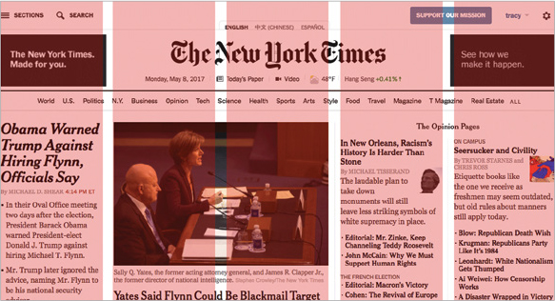
Section 2.1: Grid – The Foundation for a Clean, Cohesive Layout.
Line Things Up: Even minor misalignments (e.g., a two-pixel difference) can create visual chaos.
Use a Grid: A grid acts as an invisible skeleton, aligning elements for a consistent, tidy layout.
Real-World Example: The New York Times uses a five-column grid with gutters to organize vast information.

Slide 8
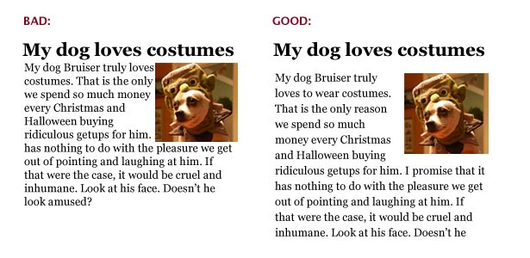
More about grid
Versatility: A 12-column grid is commonly used for its flexibility in design.
Design Constraint: Grids help plan layouts by limiting where elements can be placed, promoting cohesiveness.
Key Takeaway: Align elements horizontally and vertically to enhance overall design consistency.

Slide 9
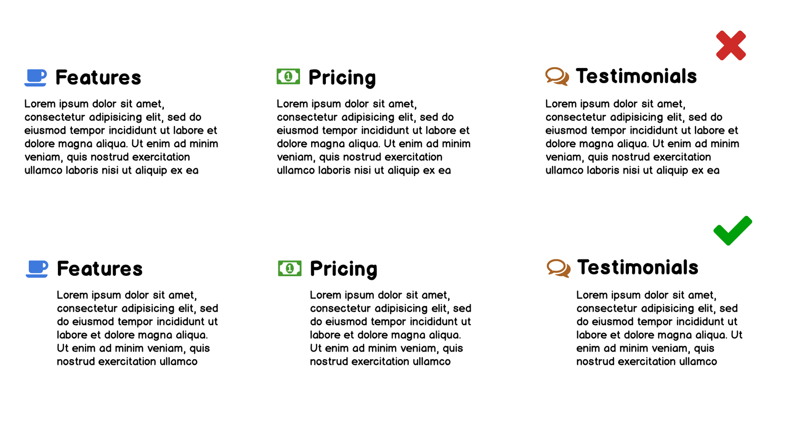
Shortcuts
tools can help enforce a consistent grid in your design.
Grids in Mock-Up Programs:
Use guides in tools like Photoshop, Sketch, or GIMP to overlay your design.
Grid templates can help structure your layout like your web framework.
Guides in Slide Programs:
Programs like Keynote offer guide features to align elements across slides.
For slides, only a few guides are needed to maintain consistent alignment.

Slide 10
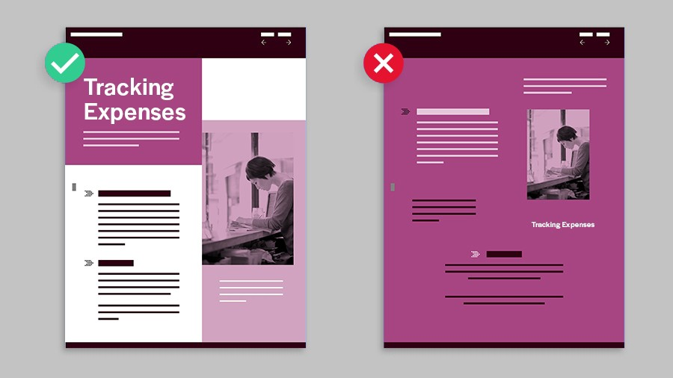
More on shortcuts
Templates for Complex Designs:
When designing more complex layouts, download multi-column templates (e.g., 960.gs) to jumpstart your grid system.
Grids for Web Design:
Leverage CSS frameworks with built-in grids (Bootstrap, Foundation, Skeleton, mini.css, or PureCSS) to automatically align elements.
HTML classes in these frameworks help maintain alignment, though extra margins/padding may sometimes cause slight misalignments.
Emergence of CSS Grid:
CSS Grid, a new CSS module, simplifies grid-based design even further.

Slide 11
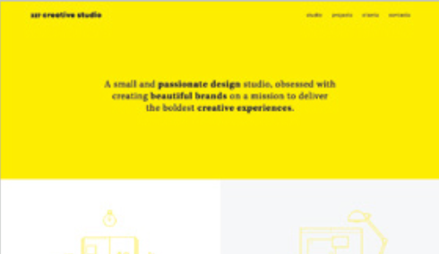
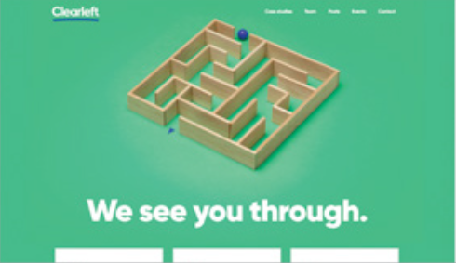
Color Theory: A Primer
Color can be used to bolster design
Color psychology: different color choices can be used to evoke specific emotions and sensations
Red: aggression, importance, passion
Yellow: friendliness, happiness, attention
Blue: trust, comfort, relaxation
Green: growth, nature, success
Important to keep in mind cultural differences
Mourning color is black in Western cultures
White in Chinese culture

Slide 12
Vibrancy and Color Schemes
I bet you didn’t see this before I pointed it out
Notes:
In color psychology, blues are relaxing, but the bright, eye-popping blue feels more energetic
Color psychology shortcuts enable easier color choices – less overwhelming
Avoid picking colors at random for your design. Choosing two to four colors for your site and limiting all of your elements to the colors on your palette will help your site feel less busy
Use vibrancy wisely – can allow for colors to pop around intended focal points

Slide 13
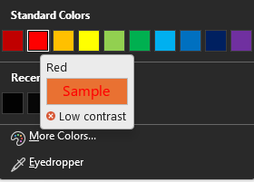
Horrible Contrast Choices
POV a dark mode enjoyer sees a light mode user’s screen
You definitely didn’t see this one
Even the computer agrees!
Same slide position, text size and color by the way ☺

Slide 14
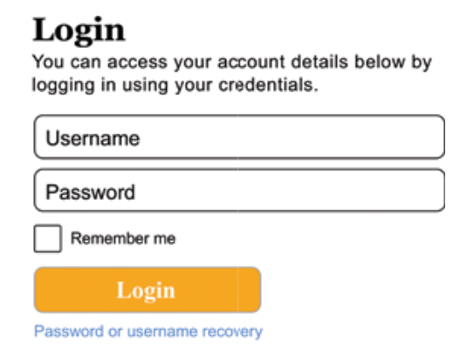
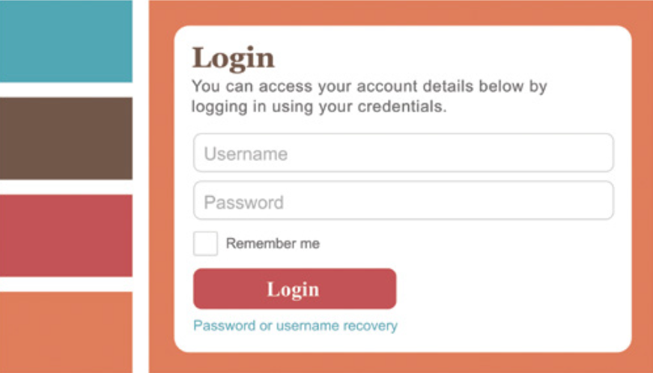
Visually Appealing Design with Color
Before (Boring)
After (Cool)
Still there ☺
Notes:
Online tools and websites can be used to design color palettes to designer taste (Adobe Color CC, Colormind – deep learning option)
Don’t get to attached to a color palette, original favorite might not be ideal
Try different color palettes with yourself and with other people to gain a consensus

Slide 15
Typography: The Art of Arranging Text
Bane of college students trying to design presentations
Bauhaus 93 is a typeface, Bauhaus 93 Bold is a font
People use the terms interchangeably
Hard to strike the difficult balance between being too distracting with your typefaces while also not overusing boring system defaults
Never, ever use Comic Sans for any reason
This is an example of an obnoxious and pretentious typeface on a slide that intentionally has no pictures to demonstrate the point that the slide is boring, uses six different fonts, and is too wordy.
Still there ☺
Notes:
- Typography, the bane of PowerPoint presentation drafts

Slide 16
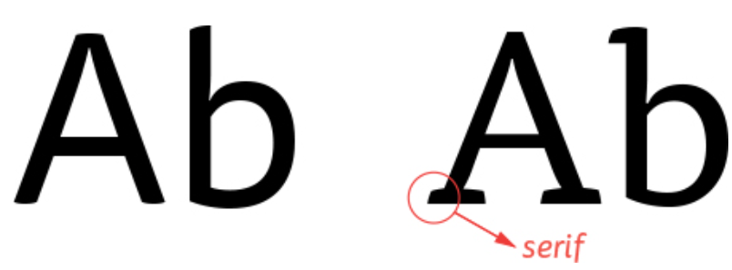
Typefaces and Categories
Serif vs. Sans Serif
Tisa Pro is a serif typeface
Tisa Sans Pro is a sans-serif typeface
Slab serifs (Chaparral Pro)
Monospaces (Courier New)
Display (Broadway)
Handwriting (Dreaming Outloud Pro)
Also, Edwardian Script ITC
Still there ☺
Notes:
Tisa Pro is a serif typeface - appears better on printed texts
Tisa Sans Pro is a sans-serif typeface – appears better on computers
Distinction is starting to fade with the advent of high-resolution monitors
Slab serif: Serifs are “slab”-like — more square and angular than typical serifs.
Monospace: Every letter takes up the same amount of space. In other typefaces, thin letters such as “i” take up less space than wide letters such as “m.”
Display: Fancy, often swooshy fonts, not particularly readable but nice when used sparingly to create emphasis in headlines or large text.
Handwriting: Fonts that look like someone’s handwriting. These are often lumped together with display fonts (also that obnoxious Edwardian Script ITC typeface from the last slide)

Slide 17
Leading and Line height
Make sure your lines of text aren’t too close together, which creates a feeling of clutter. The space between lines of text in a paragraph is known in typography-land as “leading”. In CSS, this is referred to as “line height”.
Make sure your lines of text aren’t too close together, which creates a feeling of clutter. The space between lines of text in a paragraph is known in typography-land as “leading”. In CSS, this is referred to as “line height”.
Make sure your lines of text aren’t too close together, which creates a feeling of clutter. The space between lines of text in a paragraph is known in typography-land as “leading”. In CSS, this is referred to as “line height”.
Make sure your lines of text aren’t too close together, which creates a feeling of clutter. The space between lines of text in a paragraph is known in typography-land as “leading”. In CSS, this is referred to as “line height”.
⬅️ 0.5x
⬅️ 0.9x
Usually, Aim for a Goldilocks ratio which is 1.6x font size to line height.
However, different spacing may work situation.
⬅️ 1.6x
⬅️ 2x
Still there ☺

Slide 18
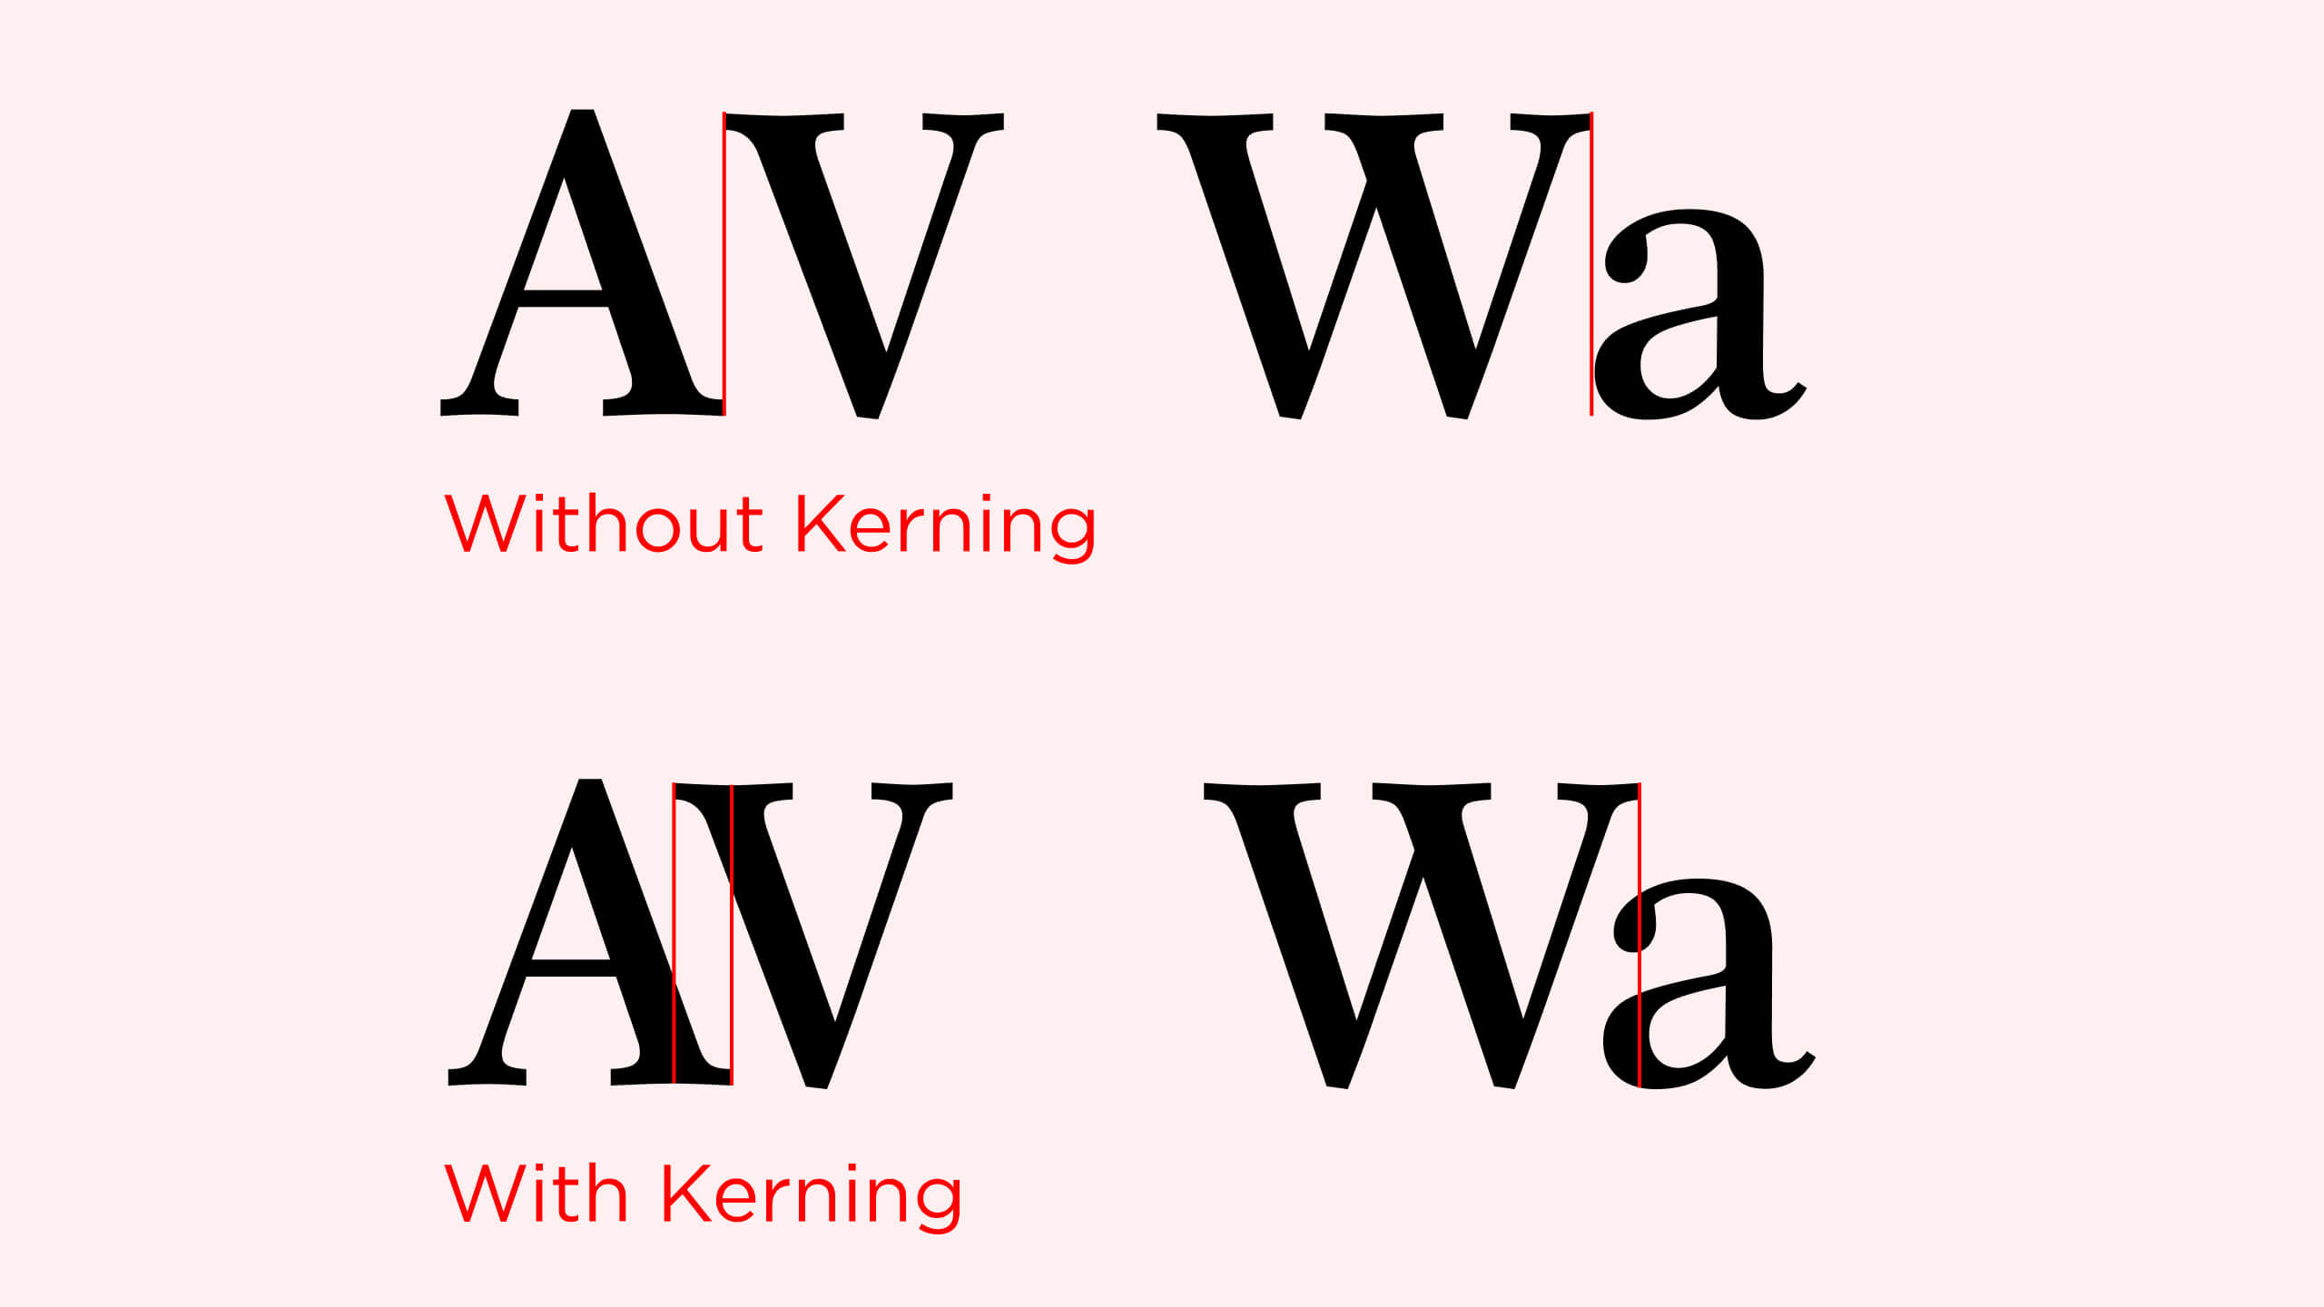
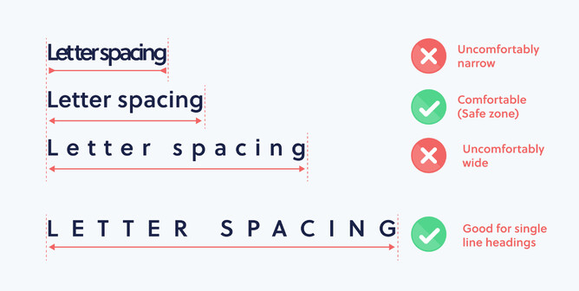
Kerning & Letter Spacing
Kerning: Adjusting space between specific letters
Letter spacing: Adjusts space between all letters
Graphics programs also allow you to tinker with kerning.
CSS allows you to adjust letters spacing using the letterspacing property.
You can use slight adjustments for better readability but usually the defaults set for us when text is displayed are fairly ideal, so you won’t need to change them for most cases.
Still there ☺

Slide 19
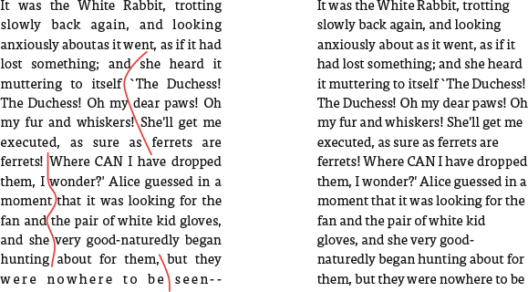
Typography Best Practices
Limit designs to two typefaces (Refer to slide 15)
Avoid justifying or centering text
- Justified text is text that fits entirely in a column.
“Ragged-right” text (right), is easier to read than justified text (left).
Spacing words out to fit a column can add large, unsightly spaces between words.
- Centered text is as the name says, centered text.
Centered text can work for headlines, but when in doubt, left align your text against an underlying grid so it all lines up for easier readability.
Centered text can work for headlines, but when in doubt, left align your text against an underlying grid so it all lines up for easier readability.
Still there ☺

Slide 20
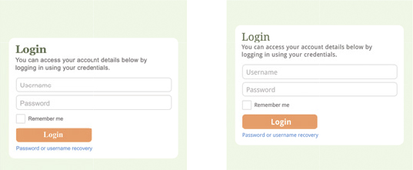
Keep line length between 45-75 characters
A paragraph becomes significantly harder to read if there are more than 75 or fewer than 45 characters per sentence
Finally, using the power of typography for our login page

Slide 21
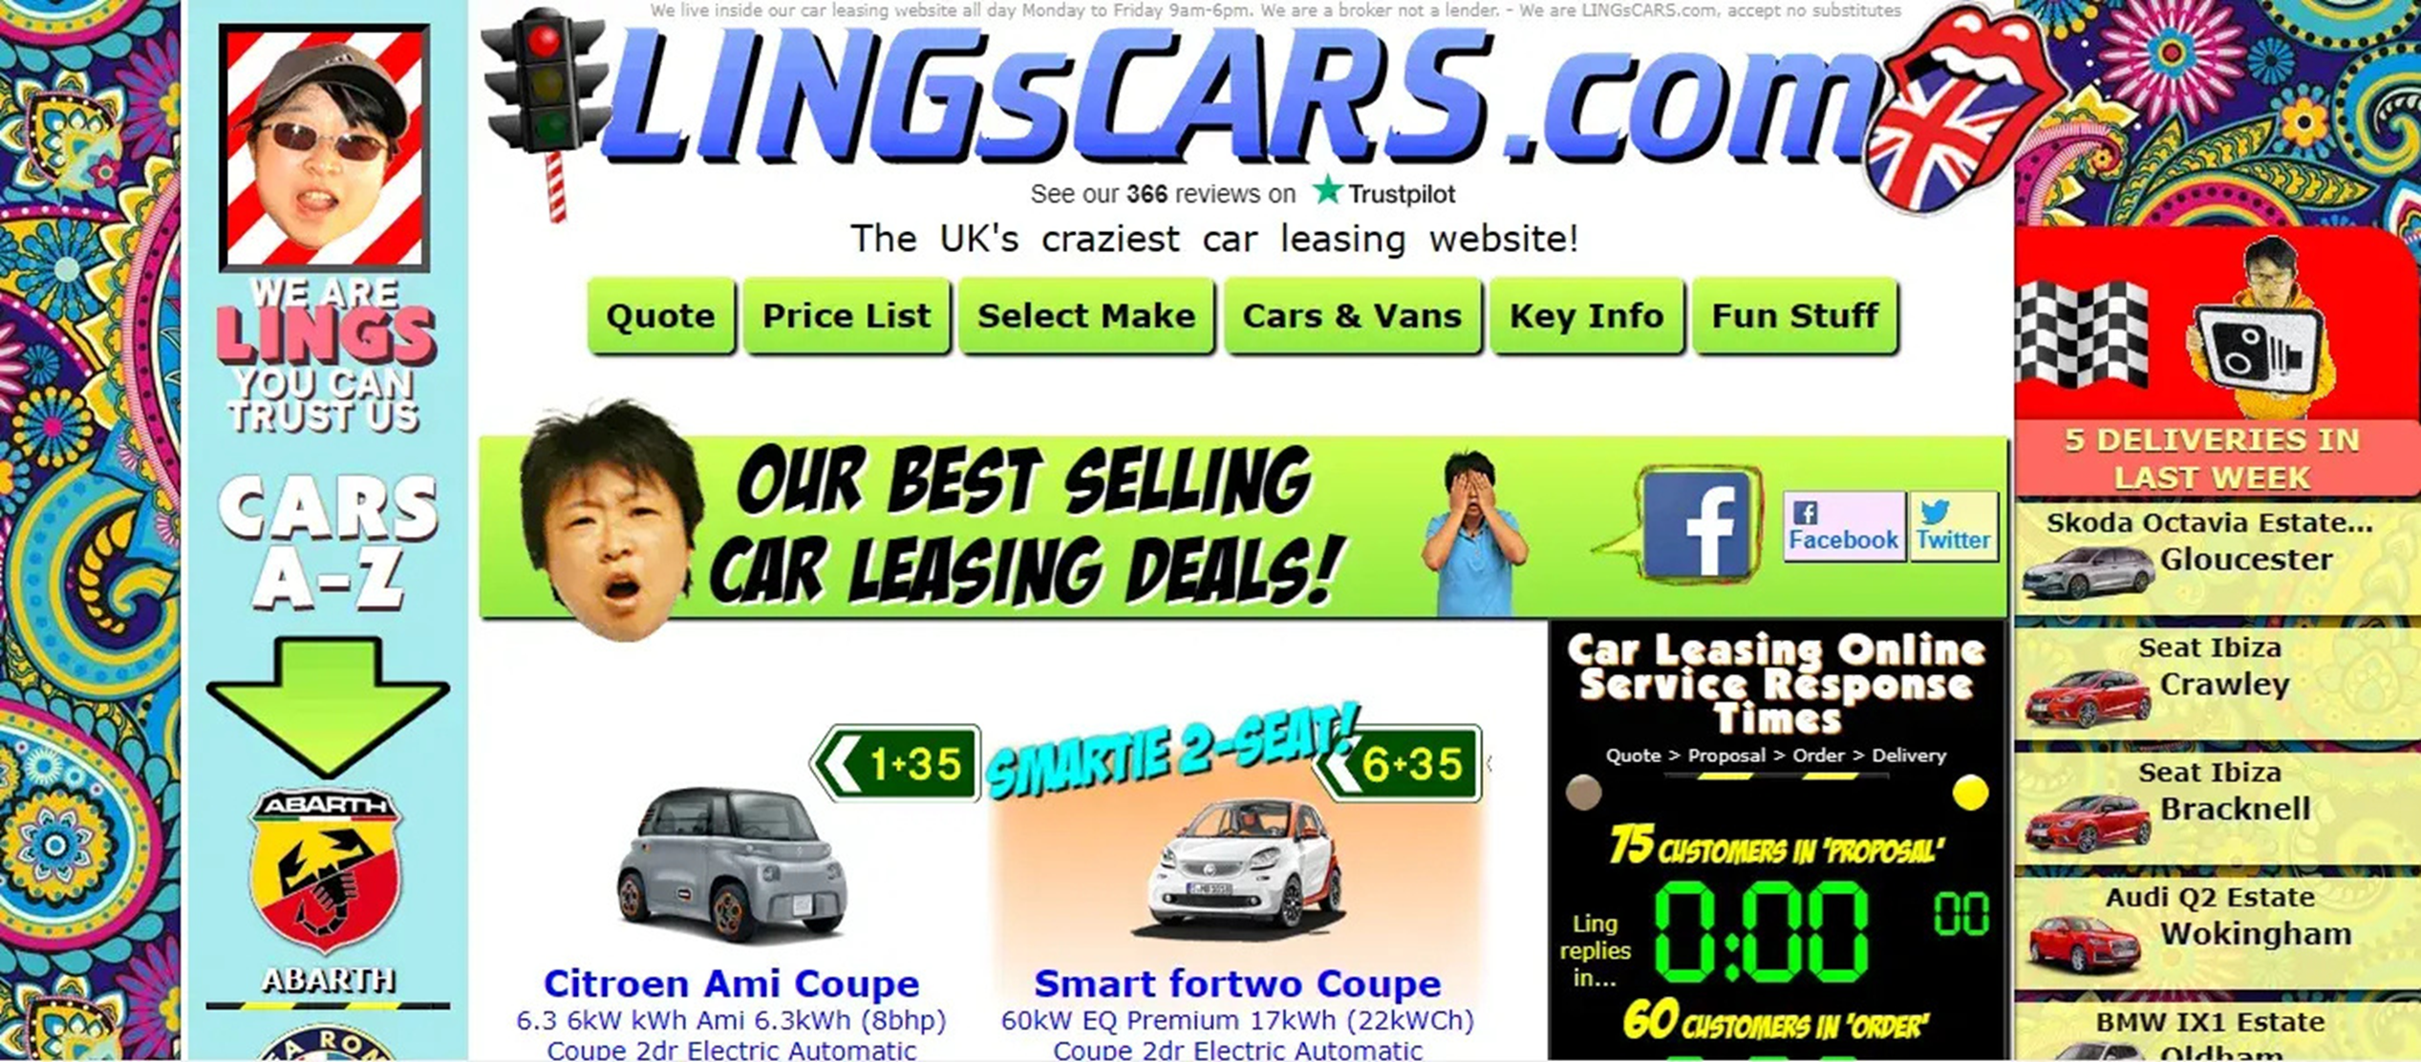
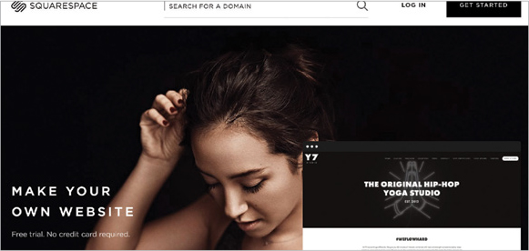
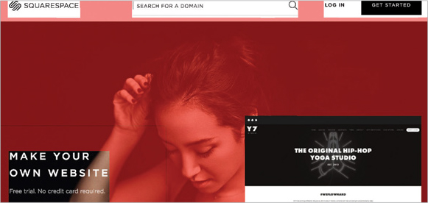
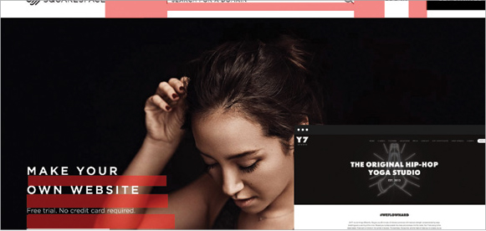
The power of White Space
White space, also called negative space, is the ultimate clutter reducer. Essentially, this is the space in your page left blank as well as the space between your elements.
Background images and textures generally count as white space.
White space also refers to space between elements and lines of text.

Slide 22
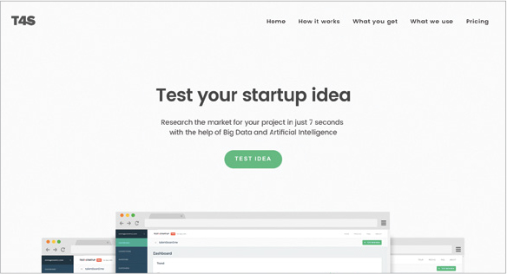
Some Fundamentals
Open, blank space is associated with luxury and quality, whereas designs with less space are seen as thrifty. More white space helps sets a tone of luxury, professionalism and elegance.
Cluttered websites are also harder to follow, while simpler design makes it easier for user to digest what you want to present. In this way, White space improves comprehension.
Kerning, letter spacing and leading all constitute whitespace. Proper use of whitespace in these instances helps improve readability.
Finally, White space improves call to action.

Slide 23
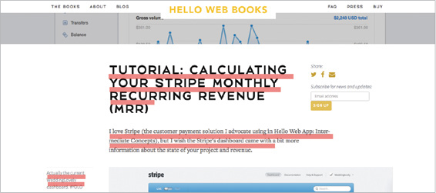
White space in action
White space in the form of space between lines of text improves readability.

Slide 24
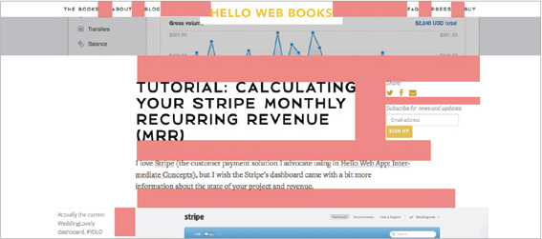
White space in action
White space in the form of space between elements creates structure. It helps us tell different elements apart from each other.

Slide 25
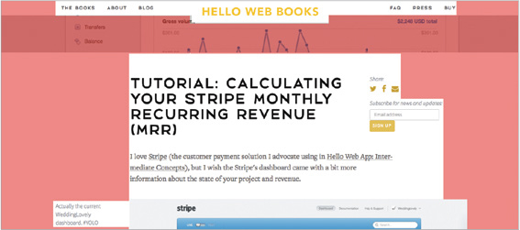
White space in action
White space in the form of space between groups of elements improves hierarchy.

Slide 26
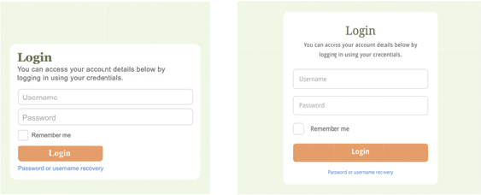
Some Final Tips
Double your white space – More is usually better!
Use consistent spacing between elements.
Test readability – Use typography techniques to your advantage.
Our Login Page after using Whitespace

Slide 27
Discussion Questions
How does using a grid system enhance both the aesthetics and functionality of a design, and under what circumstances might intentionally breaking from the grid lead to better outcomes?
What are some color schemes that a development team could consider for a website centered around music recommendations?
Are there certain fonts that should only be used in specific circumstances?
Some website like craigslist serves their purpose well without needing whitespaces. What other situations are whitespaces not a neccessity?

