Slide 1
GUI Bloopers 3: Navigation
Jeff Johnson
Saidamir Osimov, Akhmad Mamirov

Slide 2
Cues to users
Where they are
Where they have been
Where they can go

Slide 3
Where am I ?
Title & Highlight of the current page
HTML window title tag is not helpful
Core principles are still relevant in modern web sites
Hover effect is widely being used

Slide 5
Common bloopers
CTRL+C & CTRL+V: Search page named Help & Accessibility
I work on the Home page you work on About?
Can't think of a better name? Reuse the title ✅
Result: Angry CEO & messed up SEO

Slide 6
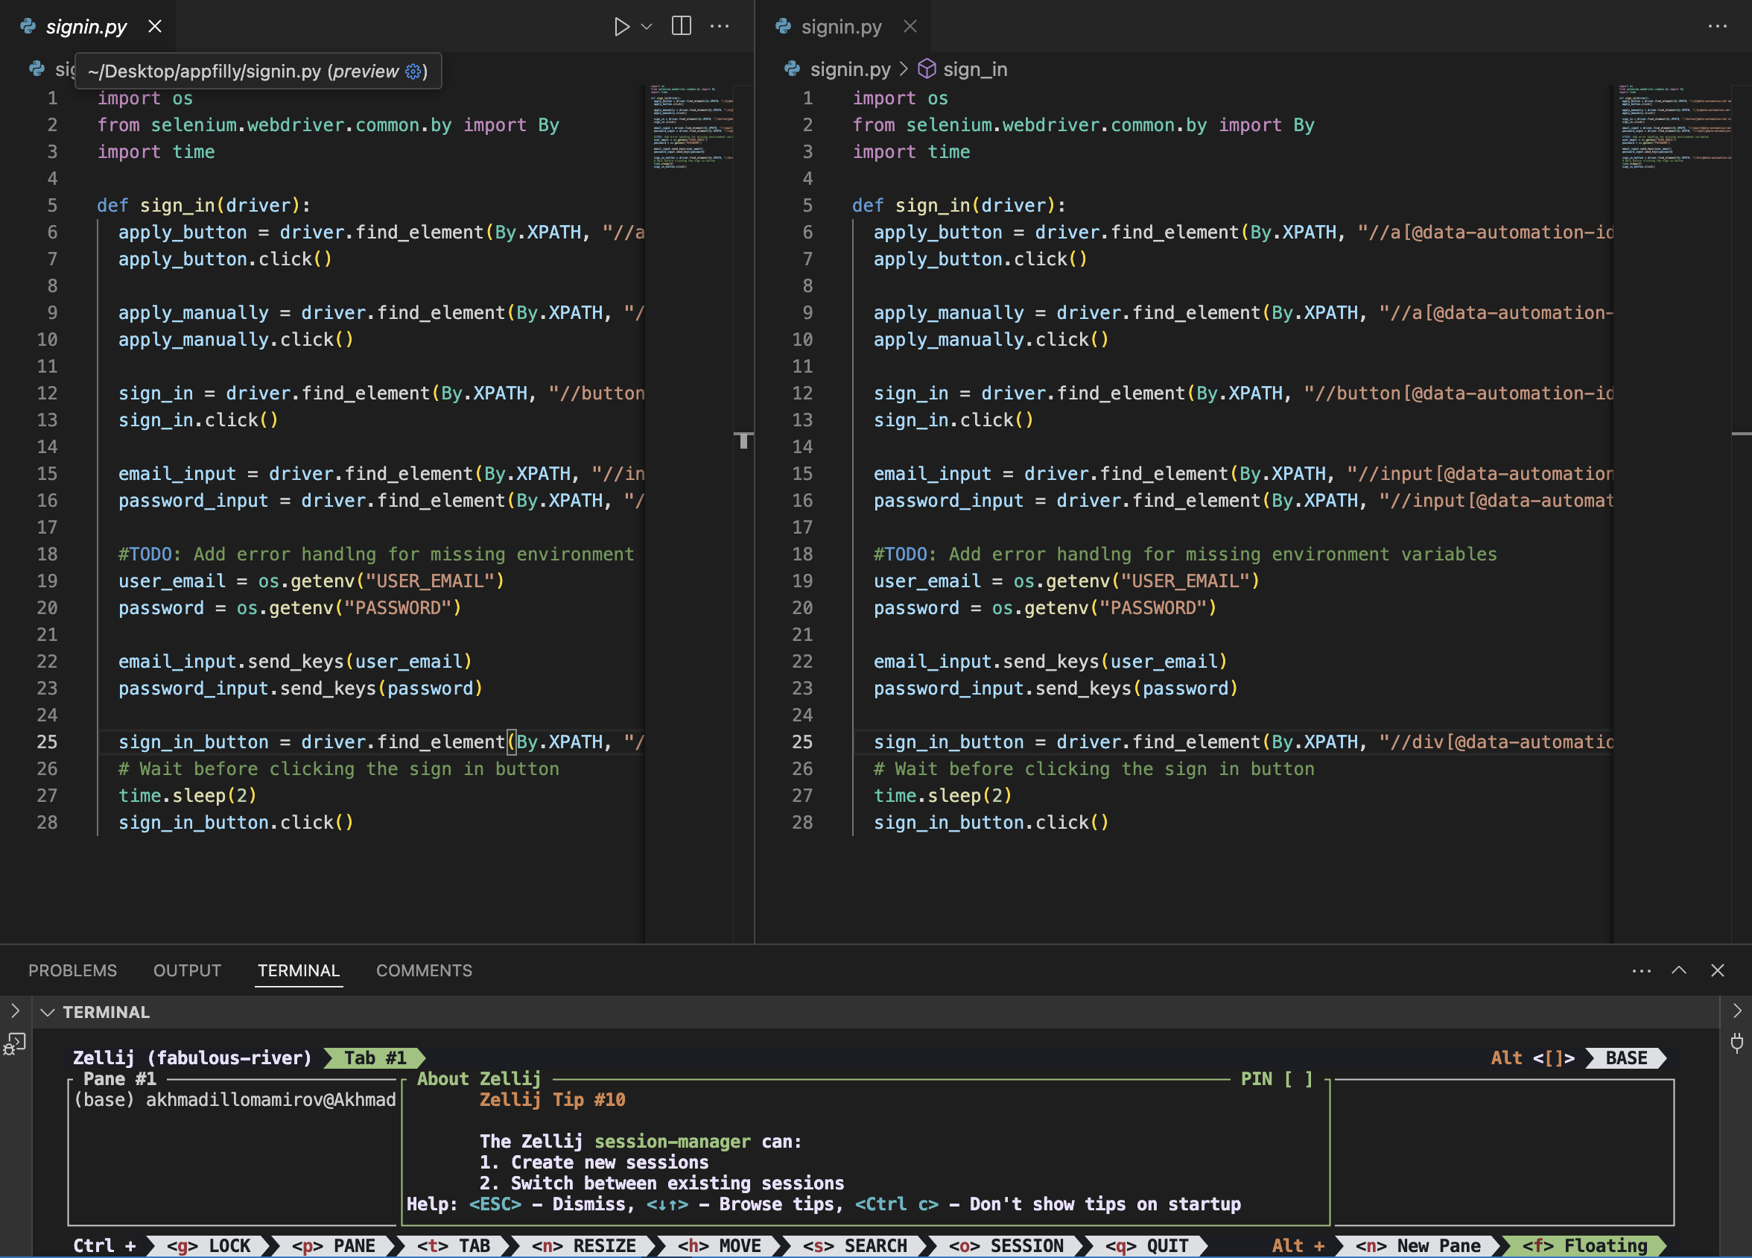
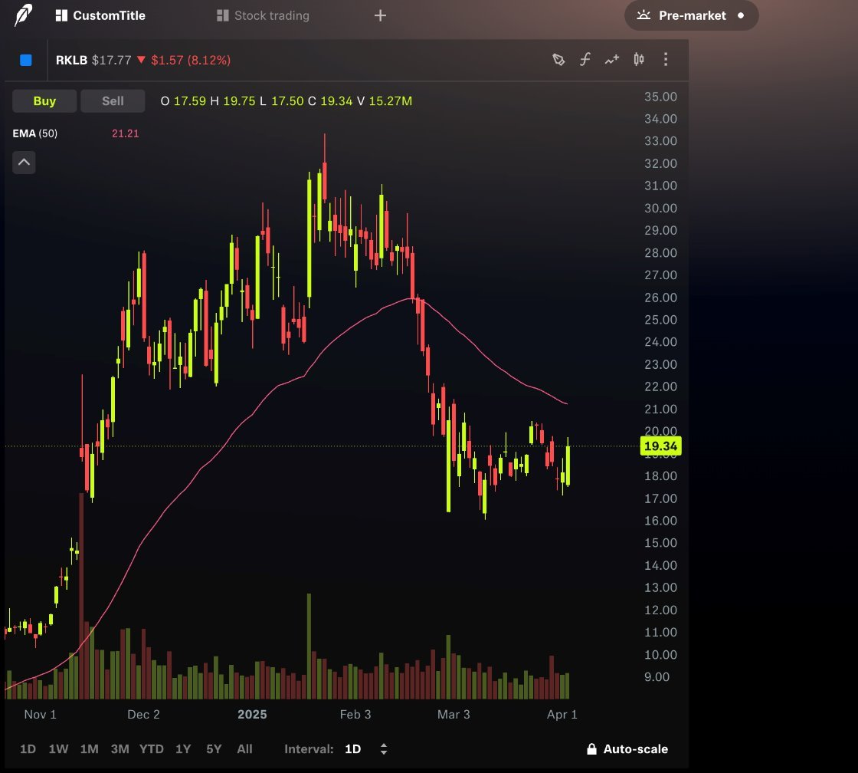
Special use cases

Slide 7
Common bloopers 2
Words should follow actions: Click Change --> Computer Name Change
Don't confuse users with differently worded windows
Non-native users may be confused if the window displays a slightly different title

Slide 8
Guide
Software should guide users to their goal
User trying to lighten their dark screen
User habits stay the same, while interfaces change
Users skim through, they want clues & clarity
They don't read carefully
Don't distract users from their primary goal
Links that display additional info (terms & conditions) should pop up in a different window

Slide 9
Blooper 17: Self-Links
Self-link
After clicking Self-link

Slide 10
Self-Link in the Navigation Bar
<a href="#">Teach on Udemy</a>

Slide 11
Self-links Elsewhere

Slide 12
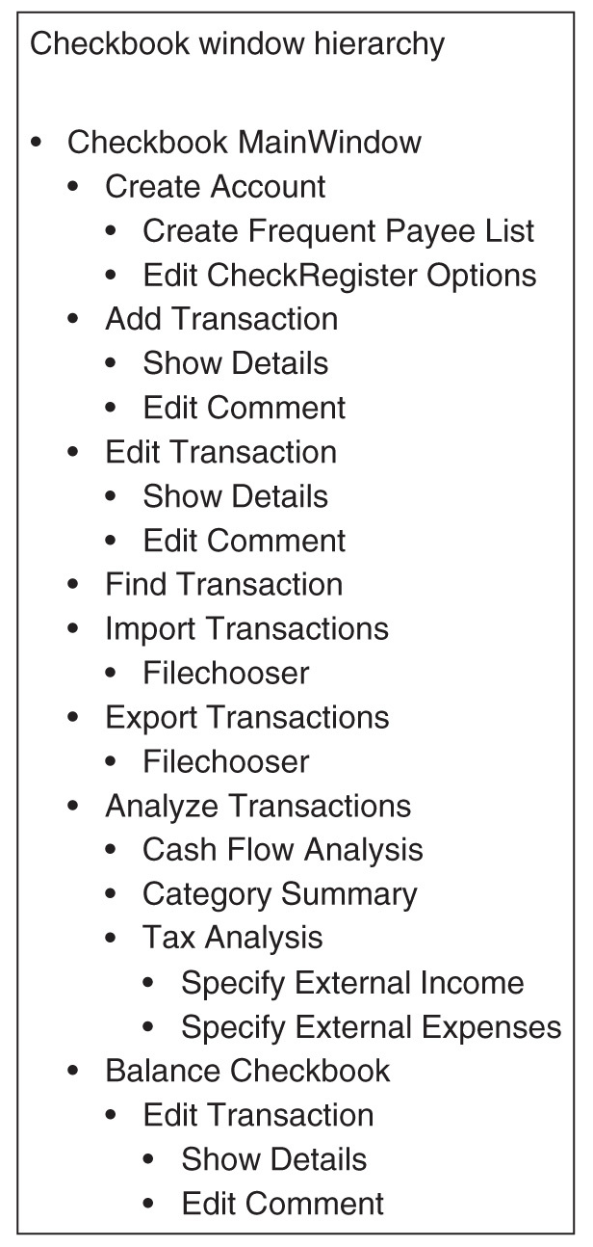
Blooper 18: Too many levels of Dialogue Boxes
Chart
Outline

Slide 13
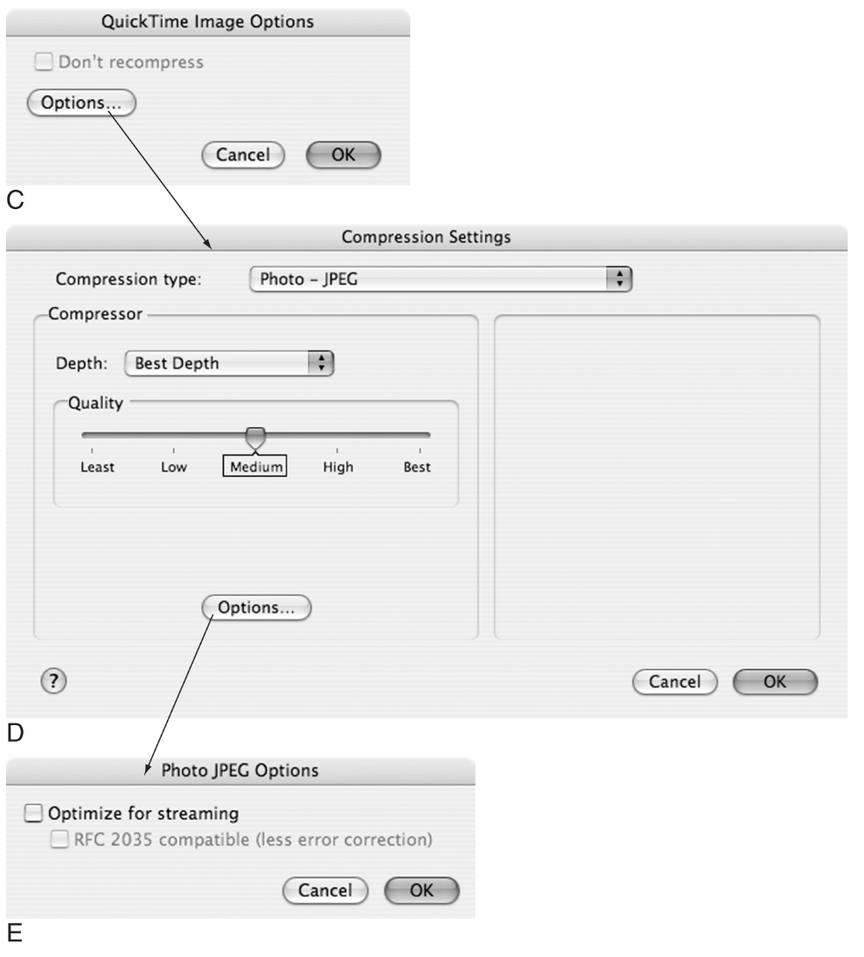

Slide 14
Blooper 19: Competing Search Boxes

Slide 15
Avoiding Blooper 19
Less is more
Providing multiple ways in a UI to do the same thing costs users time and distracts them from their main tasks.
The home page should have one general search box. Options should be confined to the “Advanced Search” page.

Slide 16
Blooper 20: Poor Search Results Browsing

Slide 17
Avoiding Blooper 20
Search results should remind users of their search terms and show the number of hits.
Browsing through the results should be easy.
If there are many pages, users should quickly see how many and access any page within one or two clicks.

