Slide 1

Overview
Basic Principles
Conclusion
GUI BLOOPERS 2.0 CHAPTER 1
Presenters
Author
Raymond, Khaleel, Theo
Morgan Kaufmann

Slide 2

Overview
Chapter Overview
  “This book describes common user-interface bloopers found in software-based products and services and provides design rules and guidelines for avoiding each one.”
  The guidelines for avoiding these interface bloopers are broken down into nine basic principles.

Slide 3
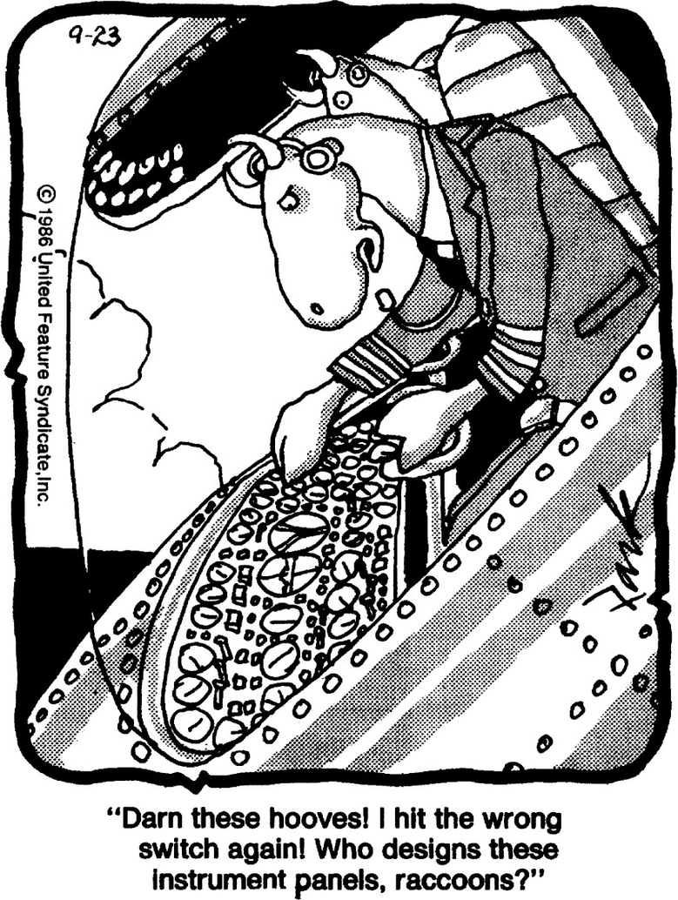
Basic Principles
Principle #1
Focus on the User’s and There task, not on the technology
The key aspect of this principle is to focus on understanding the users and what they want instead of what you want.
Before starting software development you should answer a few questions:
  For whom is this software being designed?
  What is the software for?
  What problems do the intended users have?
  What are the skills and Knowledge of the intended users?

Slide 4

Basic Principles
Principle #2
Consider Function First, Presentation Later
  During development do not begin by thinking what your software UI will look like
  When undertaking software design you should consider:
    What concepts will be visible to the users?
    What data will users create, view, or manipulate with the software?
    What options, choices, settings, and controls will the application have?
  This principle is best applied through the development of a Conceptual Model.
    Task Focused
    Provides Consistency
    Defines Important Features
Notes:
this principle does not express that one should ignore the UI features until after they finished because this “seldom produces sucsseful software.
Software applications

Slide 5
Basic Principles
Principle #3
Conform to the User’s View of The Task
When designing software you must focus on making the experience for the user as natural as possible. Things to Avoid:
  Imposing Arbitrary Restrictions
  Using Unnecessary Jargon (tech vocabulary)
  Detailing the Software's Internal details
  Making Programs to Complex (Too many features
There are a few different ways to the
  Sensible Defaults
  Generic Commands
  Task-Specific Design
  Customizability

Slide 6
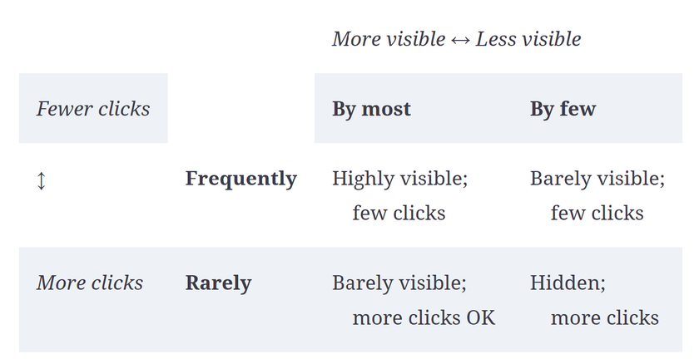
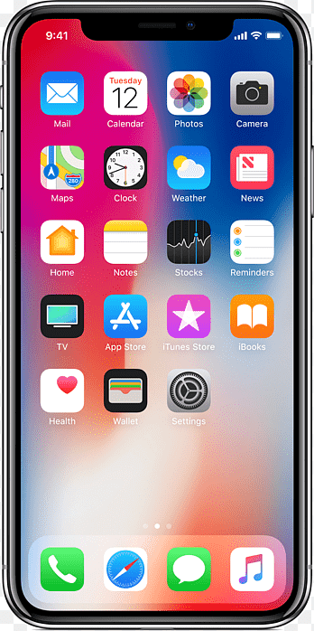

Principle #4: Design for the common case
Two types of common in terms of software features:
  How many users- How many will possibly need the feature? Will it be used by all or just the majority, possibly even a small percentage.
  How often- How often will users need the feature? Will it be frequently used? WIll it be used every second, minute or hour? Possibly even a greater distance.
The more frequently a feature will be used, the fewer clicks it should require
Features that users use repeatedly at short time intervals should not require much user input to invoke and control. They should require very few keystrokes and clicks. Some features are needed so frequently that they should require no clicks.
The more users will use a feature, the more visible it should be
The greater the percentage of users who will need a function, the more visible and prominent it should be to ensure that everyone finds it. Actions that few users will need can be less prominent—maybe just hinted at in the UI; maybe even hidden,
Combinations: frequent by many, frequent by few, infrequent by many, infrequent by few
Interesting design issues arise when the two dimensions of “commonness” are considered together. For simplicity, we divide each dimension into only two levels: high and low. How does one design a UI for a feature that is used often by most users? How would that compare to the UI for a feature used rarely by most users, often by few users, or rarely by few users?

Slide 7
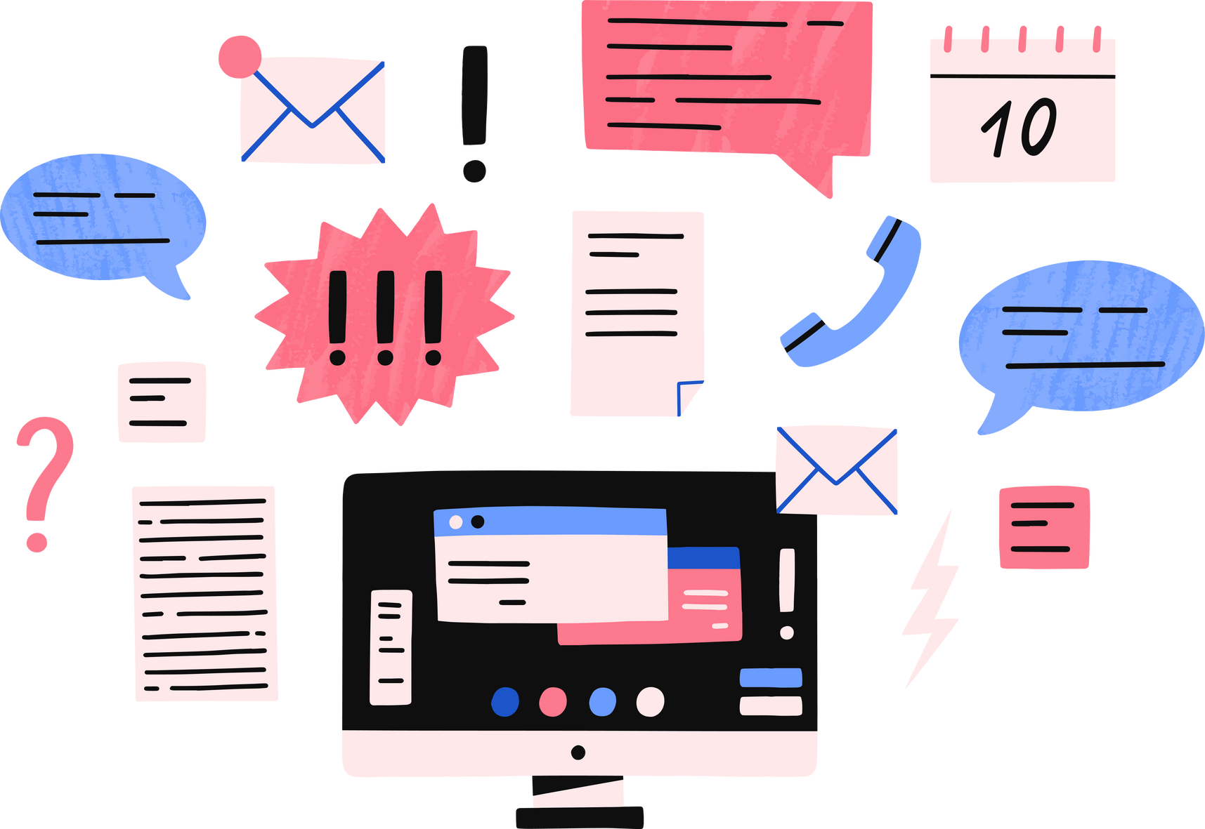


Principle #5: Don’t distract users from their goals
Software systems should not distract users from their own tasks and goals. Don’t make people actively think about the software they are using. Operating the software should be in the background, not the foreground, of users’ consciousness. User interfaces that force users to stop thinking about their own goals and think about the UI are design failures.
Don’t give users extra problems
They don’t need or want to be distracted from those problems and goals by extra problems imposed by computer products and services
Software should let users focus their attention on their own problems and goals, whatever they may be
Software should support problem solving in the target task domain, but it should minimize or eliminate the need for users to spend time problem solving in the domain of computer technology.
Don’t make users reason by elimination
Minimizing the need for problem solving in the domain of computer technology includes not requiring users to figure out how software works by a process of elimination.
“Hmmm. This checkbox is labeled ‘Align icons horizontally.’ I wonder what happens if I uncheck it. Will my icons be aligned vertically, or will they simply not be aligned?”
“This online banking service is asking me for a ‘PIN.’ But the card they sent me has a ‘password.’ I wonder if that’s it? They haven’t sent me anything called a ‘PIN.’”

Slide 8
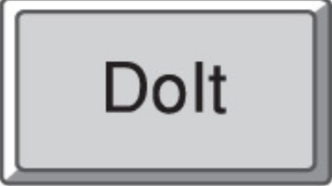

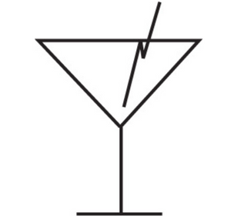
Principle #6: Facilitate learning
The user interface of an application can facilitate learning in several different ways.
Examples
  Textual Ambiguity
Most designers think inside-out: they use their own knowledge of the software to judge whether the displays and controls make sense. They assume that users perceive and understand everything the way the designer intended it to be perceived and understood.
Nurse Helps Dog Bite Victim
Red Tape Holds Up Bridge
Two Ships Collide, One Dies
New Vaccine May Contain Ebola
  Ambiguous button label
Users don’t know what the designer knows about the software. They do not know the designer’s intentions. All they have to base their understanding on is what they see on the screen and, perhaps, what they read in the software’s documentation.
  Graphical ambiguity

Slide 9
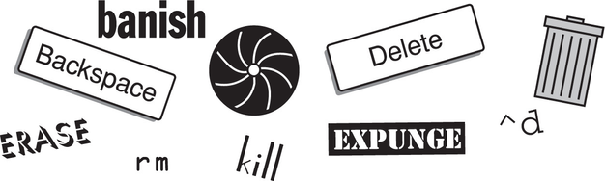
Principle #6: Facilitate learning Part Two
THINK OUTSIDE IN
Consistency
Thinking outside-in when designing a UI means making sure it makes sense to people who do not know everything you know about it. What users don’t know is your intentions. They don’t know the intended meaning of the various parts of the display. They don’t know what depends on what.
User interfaces should foster the development of usage habits. When using interactive software and electronic appliances, users want to fall into unconscious habits as quickly as possible. They want to be able to ignore the software or device and focus on their work.
Dangers of naive consistency
When beginning a design, develop a conceptual model and perform an objects/actions analysis to expose operations that are common to many different types of objects.
■ Difficult to define: Many experts have tried without success.
■ Multidimensional: Items that are consistent in one dimension (e.g., function) may be inconsistent in another (e.g., location).
■ Subject to interpretation: What seems consistent to one person may seem inconsistent to another.
The alternative is to provide a bewildering array of different ways of doing more or less the same thing in different contexts.

Slide 10

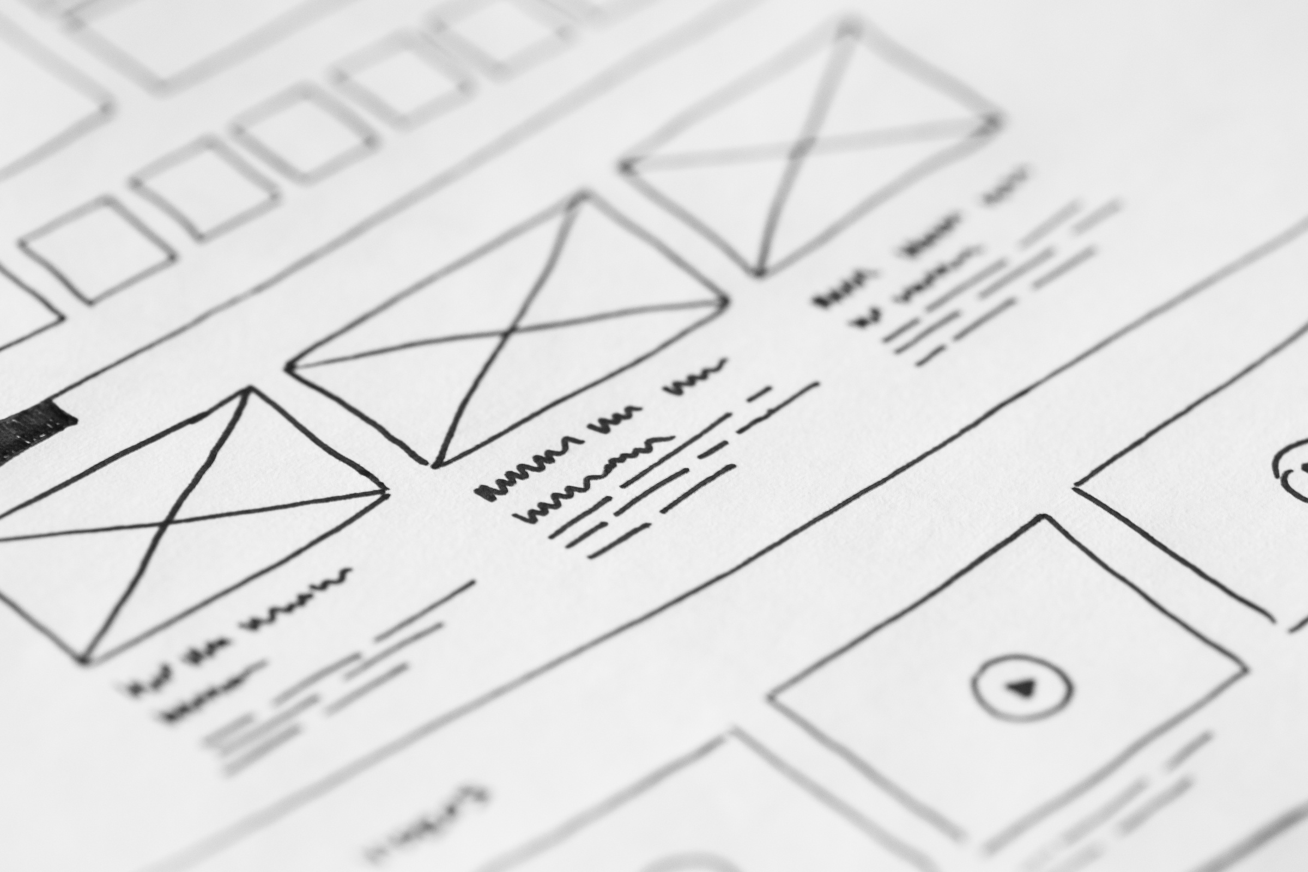
Principles
Principle #7
Deliver Information, not just data!
  Data ≠ information
  Careful GUI design
    Focus on important things
    Make it scannable
    Match your medium!
  “The screen belongs to the user”
  Preserve display inertia

Slide 11

Principle #8
Design for responsiveness
  Responsiveness is the most important factor users are satisfied by
  Responsive softwares provide good user feedback and engagement in the form of:
    instant responses
    smooth animation
    time estimates and the ability to cancel long-time actions
    letting users do other things while a long-time action runs

Slide 12

Principle #9
Try it on users, then fix it
  “test early and often”
  you’ll learn something even if you don’t know what
  testing has two purposes:
    informational - learn what needs to be fixed
    social - convince the devs to fix it

Slide 13

Discusion Questions
Discussion Questions
  What are popular websites/tools that seemingly ignore these basic principles?
  What would be the best way to summarize these nine principles into one comprehensive rule?
  What is a situation where violating one (or more) of these principles would be beneficial?
  Which of these nine principles is most overlooked in modern software design?

Slide 14
Overview
Basic Principles
Conclusion
THE END
Presenters
Author
Raymond, Khaleel, Theo
Morgan Kaufmann

