Slide 1
Designing with the mind in mind chapter 9 & 10 By: Jeff Johnson
Miles
Anany
Hiruy(Ru)

Slide 2
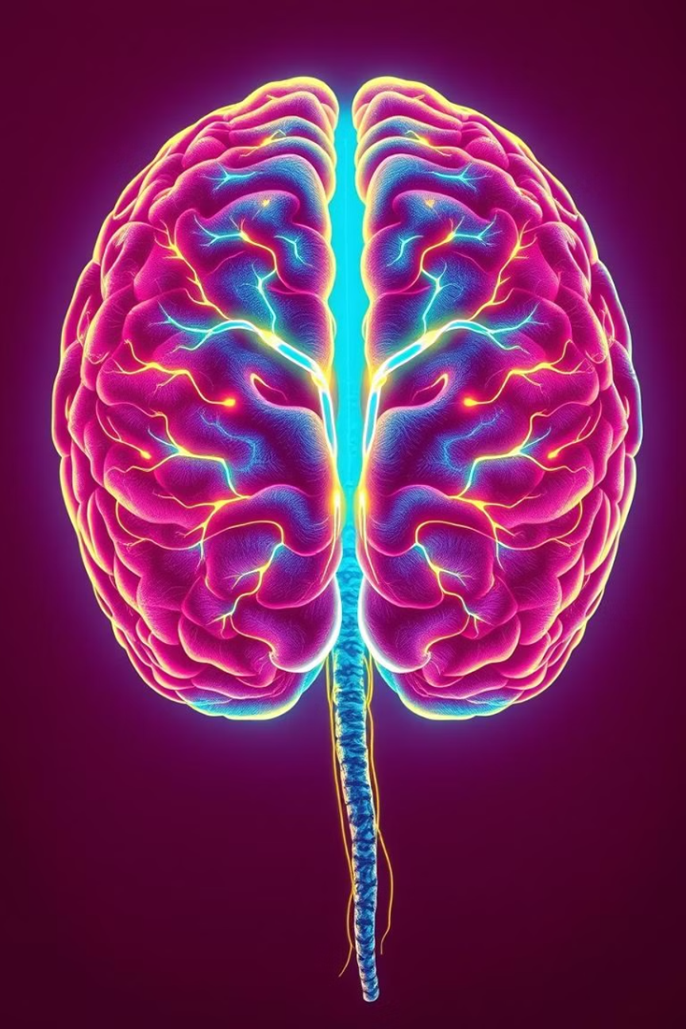
Chapter 9: Recognition is Easy; Recall is Hard
Introduction
“Have you ever forgotten someone’s name but instantly recognized their face?”
“This chapter explores how our brains are naturally wired to recognize things easily but struggle when we have to recall them from memory without help.”
“This difference between recognition and recall shapes how we design user interfaces from icons on your desktop to search bars on Google.”

Slide 3
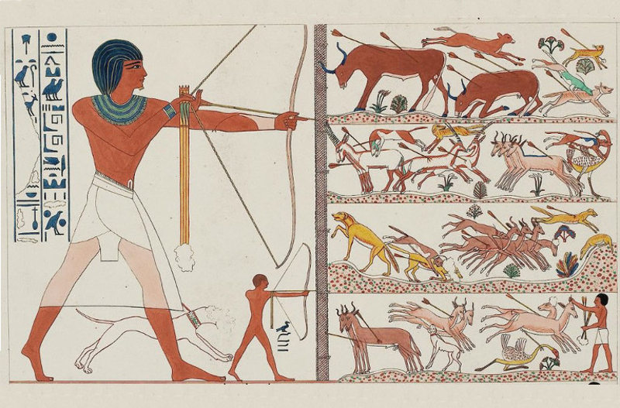
Recognition Is Easy
Main Point: The brain quickly matches what it sees with stored patterns in memory.
Key concepts:
-Evolution favored fast recognition.
-Recognition happens when perception matches a stored neural pattern.
-No “search” is required, just reactivation

Slide 4
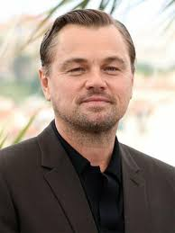
Recognition Game

Slide 5
Recognition Game

Slide 6
Recall Is Hard
Main Point: Recall doesn’t have perceptual support it’s internal and error-prone.
Example: remembering historical dates or someone’s phone number.
people use memory aids notes, calendars, cues.
ancient method of loci and modern tools like calendars and contact lists.
“Whatever the evolutionary reasons, our brain did not evolve to recall facts.”

Slide 7
Recognition Is Easy
Main Point: Interfaces should favor recognition over recall.
Design Rule 1: “See and choose” is easier than “recall and type”
GUI vs CLI: menus, icons, visual choices reduce memory burden.
GUI replaces the need to remember commands.

Slide 8
Design Rule 2: Use pictures to convey function
Desktop icons and dashboard symbols help users instantly understand functions.

Slide 9
Design Rule 3: Use thumbnails for visual overviews

Slide 10
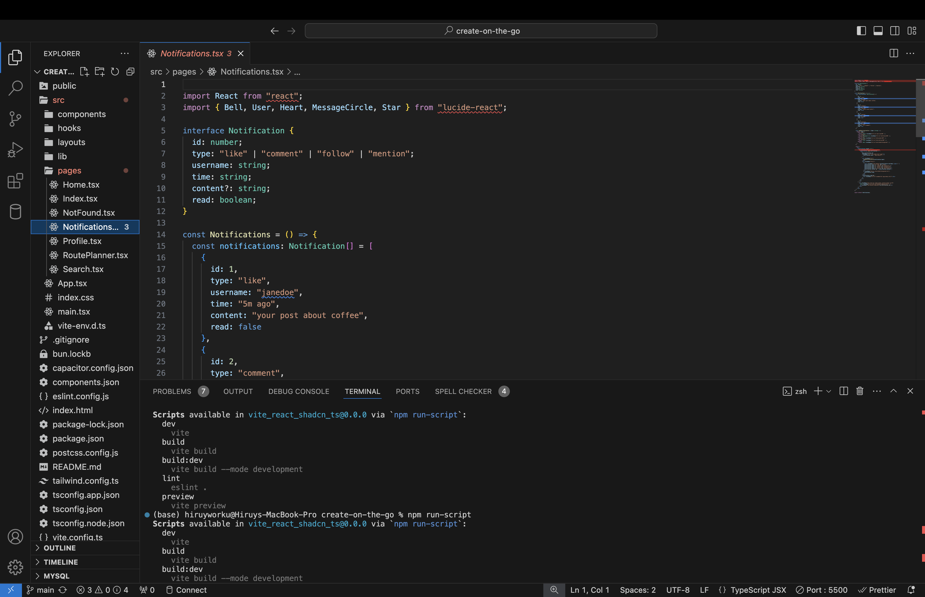
Design Rule 4: Make important functions visible
Avoid hiding essential tools, reduce reliance on memory.

Slide 11
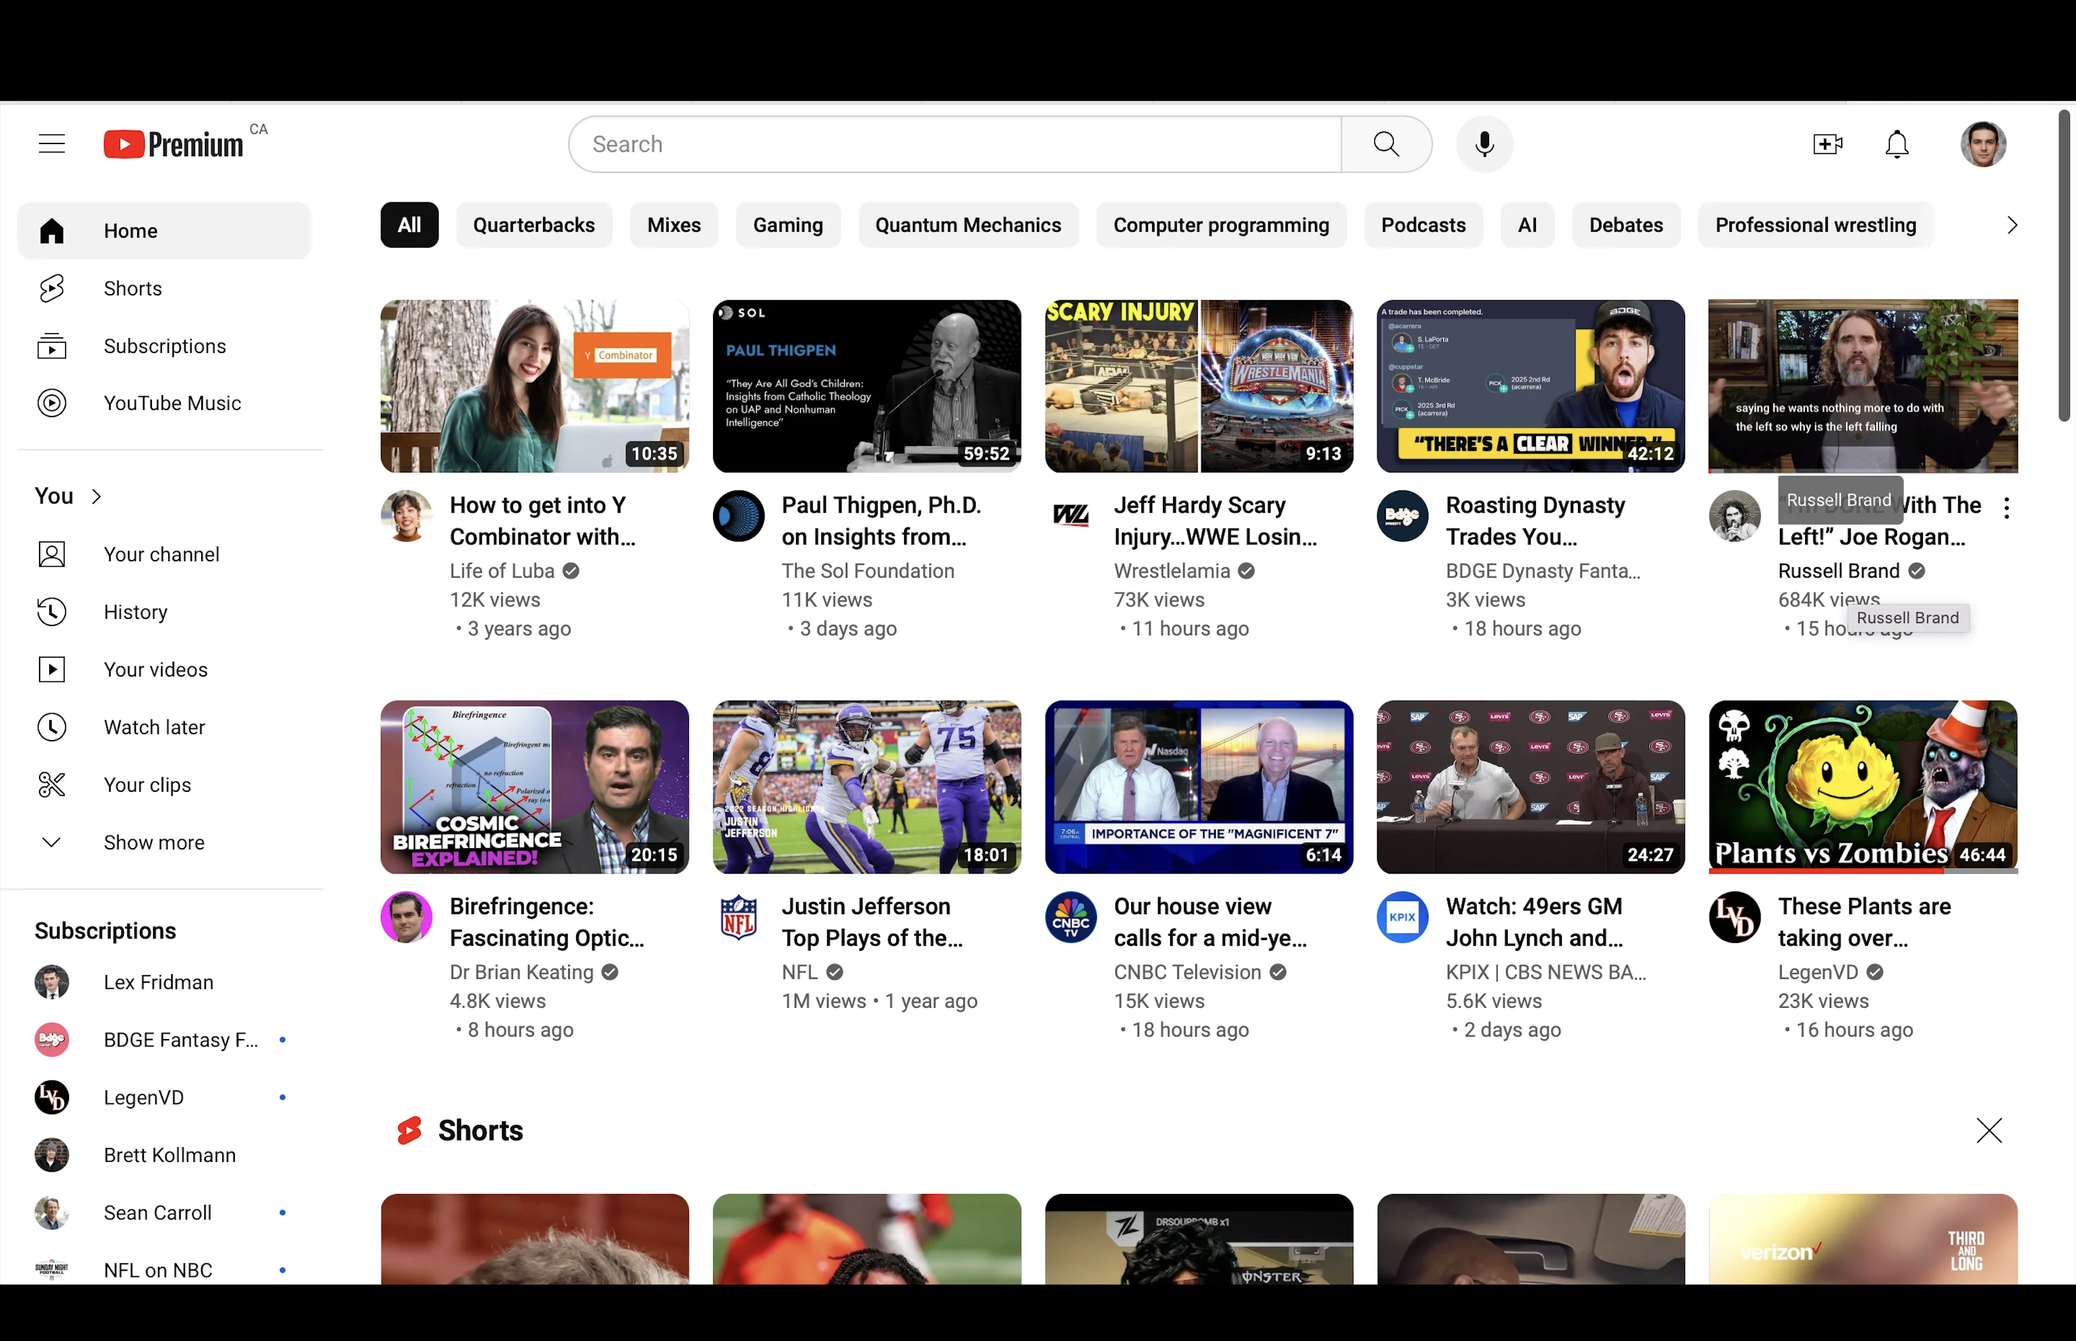
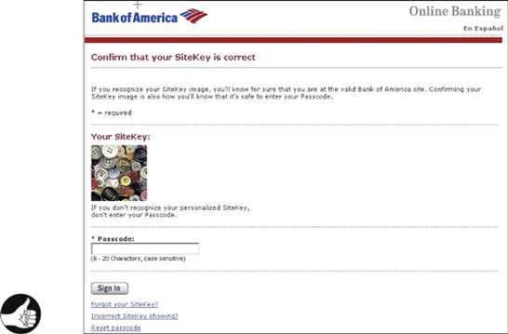
Design Rule 5: Use visual cues to signal “where you are”
SiteKey logo on Bank of America confirms site identity and recognition.

Slide 12
Authentication and Recall
Main Point: Passwords that require recall often lead to weak security practices.
People use easy-to-remember (and guess) passwords.
Good design allows password hints, familiar questions.
pros/cons of biometric authentication no recall needed, but privacy concerns exist.

Slide 13
Conclusion on Chapter 9
Three takeaways:
- Recognition is fast, intuitive, and perception-driven.
- Recall is slow, difficult, and error-prone so reduce reliance on it.
- User interfaces should always aim to support recognition through visuals, thumbnails, menus, and cues.
Next time you forget your password or stare blankly at a command prompt, remember it’s not you. It’s your brain doing exactly what it evolved to do.

Slide 14
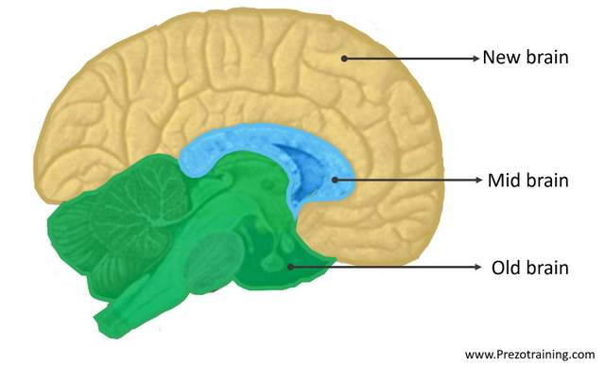
The Parts of the Brain
The Old Brain:
The brain stem where the spinal cord enters the brain
The most ancient part of the brain
Identifies objects as edible, dangerous, or sexy and regulates automatic functions
The Midbrain:
Beneath the cortex and above the old brain. It controls emotions
The New Brain
Mostly consists of the cerebral cortex
It controls intentional conscious activities, like planning

Slide 15
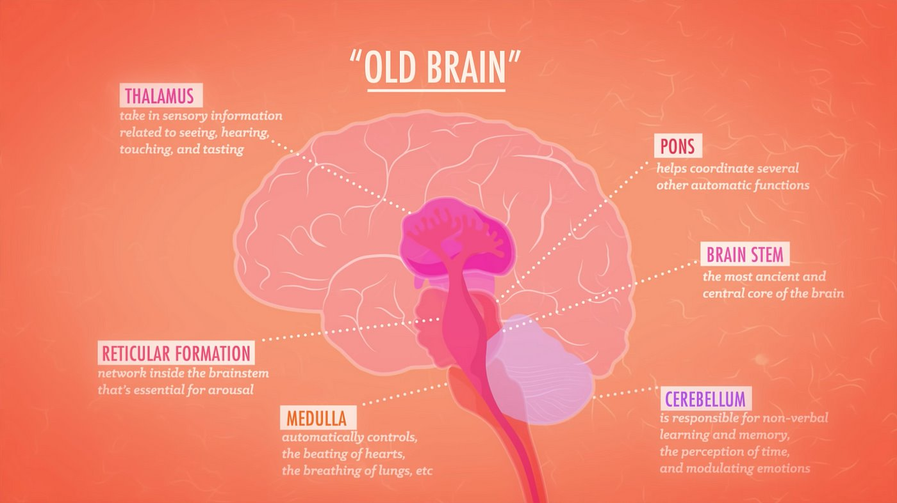
Old Brain and Mid Brain
Old brain and midbrain are a separate part of the mind from the new brain.
Old brain and midbrain are unconscious, automatic, and emotional
Known as System One because it is older
It operates 10 to 100 times as fast, but uses short cuts
It can be deceived by optical illusions!

Slide 17
System One Misses Some Bits
If a hard question is asked, system one may cause you to answer an easier question accidentally.
It bases everything on what it perceives and does not consider that there could be more information
It filters information with goals set by system two
System one controls us most of the time

Slide 18
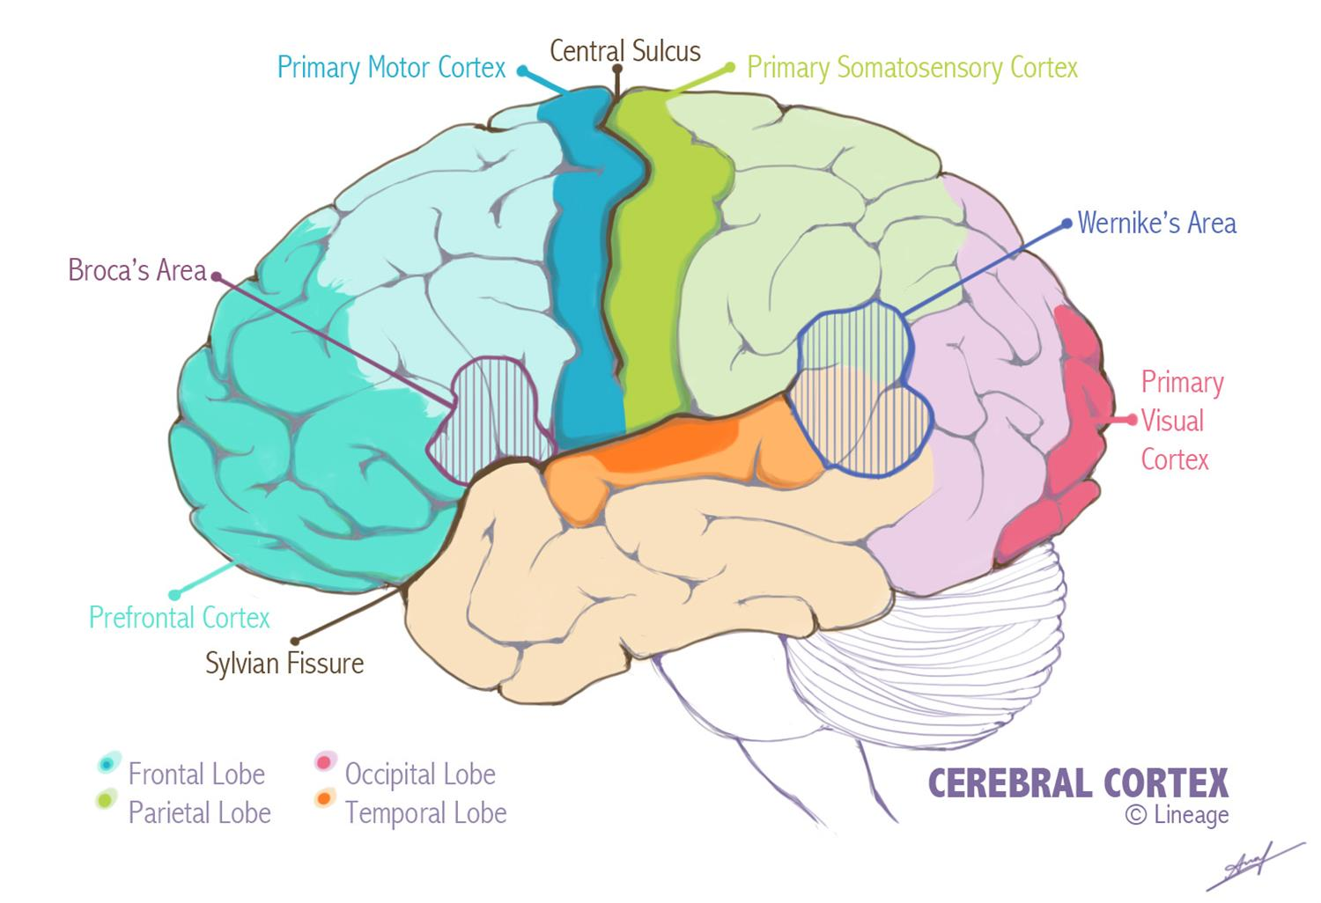
New Brain
The new brain is responsible for conscious
The new brain is rational, conscious, and us.
We are our rational mind. It is where our self-awareness is, and it thinks that it runs the show.
Known as System Two because it is newer

Slide 19
Why do we even have system two?
Most work falls on system one. Sometimes system one realizes something before system two.
System two requires conscious effort so it is often not used.
System two does allow us to change our goals
It helps us get goals exactly right not sort of right

Slide 20
Learning from Experience
How Humans Naturally Adapt and Generalize
Effortless Generalization: Humans constantly draw conclusions from specific observations, enabling swift behavioral adjustments.
Automatic Learning Mechanisms: Much of our experiential learning occurs without deliberate effort, driven by subconscious processes.
Everyday Examples: From avoiding spoiled food to managing emotional email replies, learning from experience guides daily choices.
Driven by System One: Learning does not require our being aware that we are learning and adjusting. System one can do it alone, without system two’s involvement or realization that its happening.

Slide 21
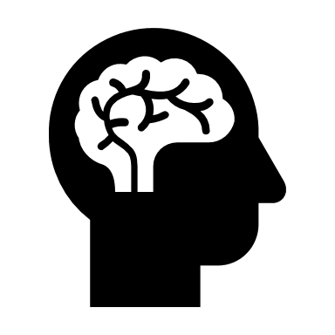
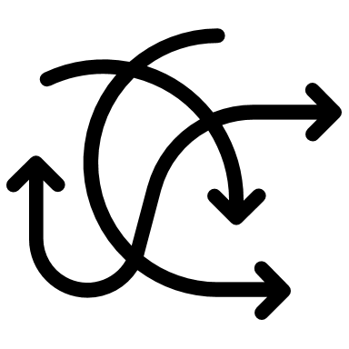
Limits to Learning from Experience
When Intuition and Habit Fall Short
Complexity Overload
People struggle to learn from environments with many variables, like stock markets or chaotic weather systems.
Personal Bias
Experiences of close others outweigh objective data, skewing conclusions—e.g., bad product reviews vs. Uncle Charlie’s opinion.
Faulty Attribution
People often fail to connect current problems with their past actions, undermining learning from mistakes.

Slide 22
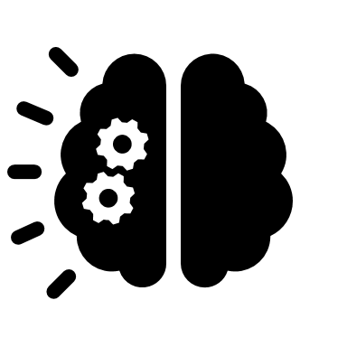
Overgeneralization
Let's talk about Pitbulls.
What comes to mind?
Aggressive? I agree. But...
Behavior depends more on how it's raised.
Pattern Bias System one uses limited exposure to form broad assumptions, like 'all pitbulls are aggressive'.
As a Feature This can still be useful in daily life but problematic in scientific research.
Danger of Extremes: However, overgeneralizing from few or atypical experiences can lead to poor decisions.

Slide 23
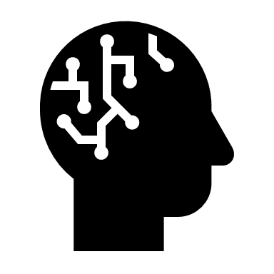
Evolutionary Roots of Experiential Learning
Learning Without a Cortex
Brain Structures Not Required
Even simple creatures like worms and insects can learn through neural clusters, without even an old brain.
Old Brain Learning
Only species with a cortex or similar brain structure can learn from others’ experiences.
Human Uniqueness
Possible only humans due to large new brain size relative to body can articulate what they have learned from experience

Slide 24
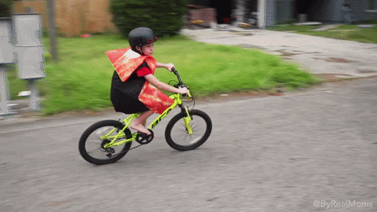
Performing Learned Actions Is Easy
Automaticity and the Power of Practice
Definition of Automaticity: Repeated practice transforms complex actions into automatic behaviors, bypassing the need for conscious oversight.
Minimal Cognitive Load: Routine behaviors require little to no conscious attention, freeing mental resources for other tasks.
Examples of Automatic Actions: Driving a familiar route, brushing teeth, or using well-known software interfaces are performed with ease after repetition.
Parallel Processing: Multiple automatic actions can be performed simultaneously, such as humming while cooking.
Practice Makes Automatic: The key to automation is repetition—just like mastering a musical instrument or sport.

Slide 25
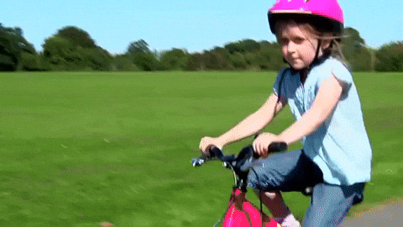
Performing Novel Actions Is Hard
The Cognitive Strain of Controlled Tasks
System Two Overload: New complex tasks demand full focus of system two that can quickly exceed our attention capacity (4 ± 1 items).
Initial Learning is Demanding: Learning to drive or use unfamiliar software involves constant monitoring and decisions, which can be overwhelming.
Practice makes Perfect: As parts of a complex tasks become automatic, system one takes over one by one.
Mixed Mode Operations: Real-world tasks often require both automated and controlled components. Like checking your mail.
Design for System One: People prefer to use automatic or semi-automatic ways to complete a task, so design tasks so they can be handled by the automatic functions of system one.

Slide 26
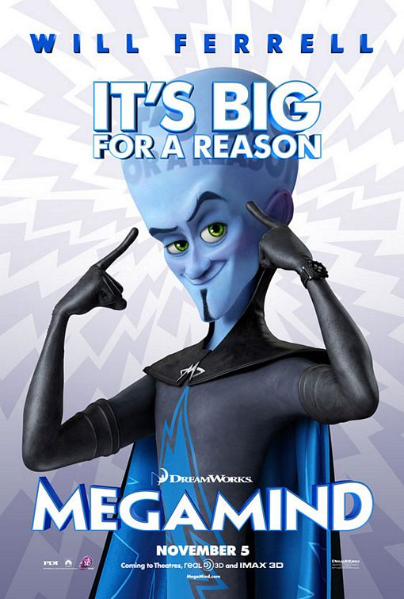
Problem Solving is Hard
The cerebral cortex (new brain) is required to cope with problems.
The larger the cortex is compared to the brain the better the ability to interpret situations on the fly, plan to cope with them, and execute those strategies.
Controlled processing requires completely focused attention.
It strains the limits of short-term memory.
System two has very limited storage capacity

Slide 27
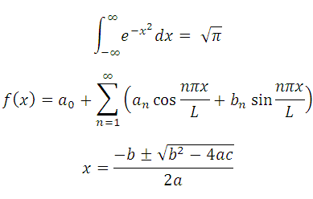
Calculation is Hard
Calculation could mean math or logic problems
We evolved the new brain before we learned math
Simple math is easy but more complex math gets hard
Problems that exceed short term memory limits, require retrieved information from long term memory, or have distractions can be challenging.
Interim goals can distract from the main task.
Any problem that requires, logic, knowledge, second guessing, or anything like that will require system two.

Slide 28
Implications for UI Design pt 1
Prominently indicate system status
If users can check their status easily with direct perception it will not exceed their short-term memory.
Guide users to their goals
Create a clear information scent to direct users to their goal. Maybe multi step dialogue boxes could do this.
Tell users exactly what they need to know
Don't make them use their own deduction.
Don't make users diagnose problems
Let them know what the issues they face are.

Slide 29
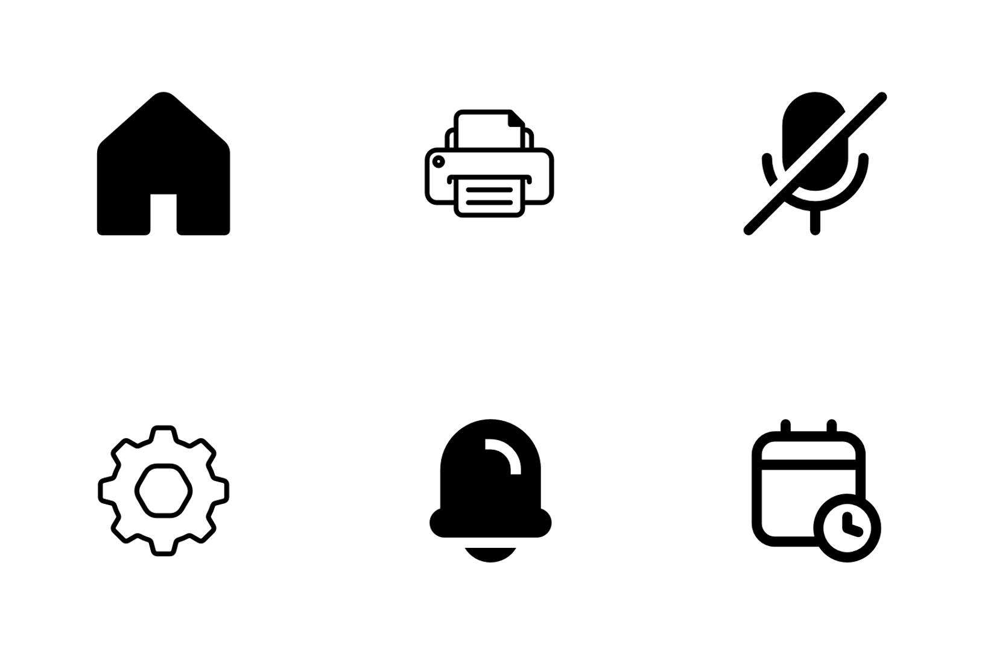
Implications for UI Design pt 2
Minimize the number of settings
Don't expect people to optimize the settings, too much thinking.
Let people use perception rather than calculation
You could let people scroll to the middle instead of finding the middle item.
Elements that look like they require calculation could be represented graphically.
Make the system familiar
Use images, terminology, and concepts the users are familiar with
Let the computer do the math

Slide 30
Discussion Questions
1, Why do you think some designers still rely on recall-heavy interfaces, even though recognition is proven to be easier for users? Is it laziness, tradition, or something else?
2, In what types of situations do you think recall might actually be more appropriate than recognition in interface design? Can you give an example in which relying on memory might be beneficial?
3, If a system requires very few steps, and it is logical that it would be this way, is it necessary to inform users of their progress towards their goals?
4, If an academic test is thoroughly studied for, is it enough to rely on system one's initial automatic impulses based on the learned knowledge or should you second guess with system two? Can system two cause harm when second guessing?

