Slide 1
Design with the Mind in Mind By: Jeff Johnson
Presented by: Mastewal, Kai, Theo
Chapters 7 & 8

Slide 2
Chapter 7: Our Attention is Limited; Our Memory is Imperfect

Slide 3
Short-term vs Long-term Memory
Short-term memory: Retains information for a few seconds to minutes
Long-term memory: Stores information for hours, days, or even a lifetime

Slide 4
A Modern View of Memory
Short- and long-term memory are functions of a single memory system, one that is more closely linked with perception
Long-term memory :
Perception and Context: Perceptions enter through sensory systems and activate patterns across the brain. Context plays a key role in shaping memory.
Memory Formation: Memories form through chemical signals and neural rewiring.
Activation (Recognition and Recall):
Recognition: A similar stimulus reactivates the memory.
Recall: Reactivated internally, without the original stimulus.
Overlap and Damage: Memories overlap across neural networks. Damage may reduce detail or erase memories if critical pathways are affected.
Types of Long-Term Memory:
Semantic: stores facts and relationships
Episodic: records past events
Procedural: remembers action sequences

Slide 5
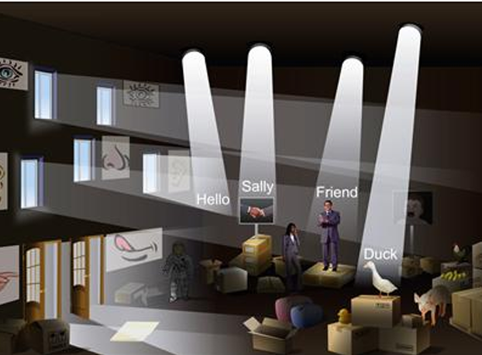
A Modern View of Memory
Short-Term Memory ( Working Memory):
Not a separate storage – It is a temporary activation of neural patterns rather than a fixed store.
Linked to perception – Brief residual traces from sensory input remain, like the lingering echo of a sound.
Working memory = current focus of attention

Slide 6
Characteristics of Attention and Working Memory
Working memory = current focus of attention
Attention is highly focused and selective : Our brain filters out unnecessary details to focus on important information.
Factors That Grab Attention:
Movement (objects moving toward us)
Threats (danger signals like a car swerving)
Faces (we instinctively recognize and focus on faces)
Basic Needs (sex, food things naturally grab our attention)
Capacity of attention (a.k.a. working memory):
Can hold only 3–5 items at a time (not the outdated "7±2" rule).
Related items can be chunked together to improve recall.
4, 7, 1, 8, 2, 9, 6 => 471 – 829 – 6
Volatile : new items arriving in working memory often bump old one out
Forgetting why you entered a room

Slide 7
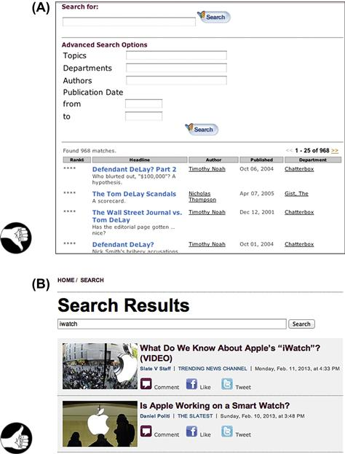
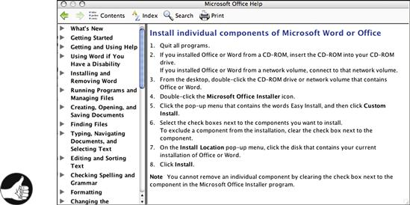
Implications of Working Memory Characteristics for User-Interface Design
Limited Capacity & Volatility – Users focus on their primary task and forget system status easily. Design should reduce cognitive load.
Modes: If used, must show clear mode feedback to avoid “mode errors.”
Search Results: Always display previous search terms
users forget quickly.
Calls to Action: Focus user attention
don’t overwhelm with too many choices.
Instructions: Keep multistep directions visible during task completion.
Navigation: Use shallow hierarchies and breadcrumbs to avoid confusion.

Slide 8
Characteristics of long-term memory
Distributed Storage: Memories aren't stored in one place—they're patterns spread across the brain.
Unlimited Capacity: Potentially limitless storage due to billions of neurons.
Compressed and Abstract: Memories are stored as feature sets, not exact details (e.g., "man with beard" instead of a full face).
Emotionally Weighted: Emotional experiences are remembered more vividly.
Error-Prone: Prone to distortions, omissions, or blending of details.
Retroactively Alterable: Memories can change over time based on new information or discussions.
Free-Associative & Idiosyncratic: Memory recall is often triggered by related concepts, not fixed paths.
Example: Forgetting where the "Insert Page Number" tool is in Word—may recall function, not location.

Slide 9
Implications for User-Interface Design
Design Considerations:
Support Memory, Don't Strain It:
Use visible cues, tooltips, and reminders.
Avoid requiring users to recall complex steps or rarely-used commands.
Provide External Memory Aids:
Use checklists, auto-fill, search histories, and saved preferences.
Minimize Cognitive Load:
Keep interfaces consistent.
Group related actions to support memory associations.
Embrace Redundancy:
Offer multiple paths to actions (icons + menus).
Reinforce concepts with labels and icons.
Account for Memory Errors:
Include forgiving features like “Undo,” “Help,” or easy error recovery.
Quote: "Software designers should try to provide software that fulfills [the] need [to augment memory]."

Slide 10
Chapter 8: Limits on Attention Shape Our Thought and Action

Slide 11
We Focus on Our Goals, Not the Tools
Our attention is limited – When users are working on a task, they devote nearly all of their attention to the goal (e.g., writing a paper), not the tool (e.g., the word processor).
Why this matters:
Users won’t explore menus or notice fancy features if it doesn’t immediately help with their goal.
If an interface is clunky or confusing, it pulls attention away from what really matters—completing the task.
Analogy: Like mowing the lawn—if the mower breaks, fixing it becomes the new focus. Once fixed, you may forget where you left off.
Something to note:
When designing interfaces, assume users aren’t thinking about your tool at all—they’re thinking about their goal. Help them stay focused by making the interface feel effortless.

Slide 12
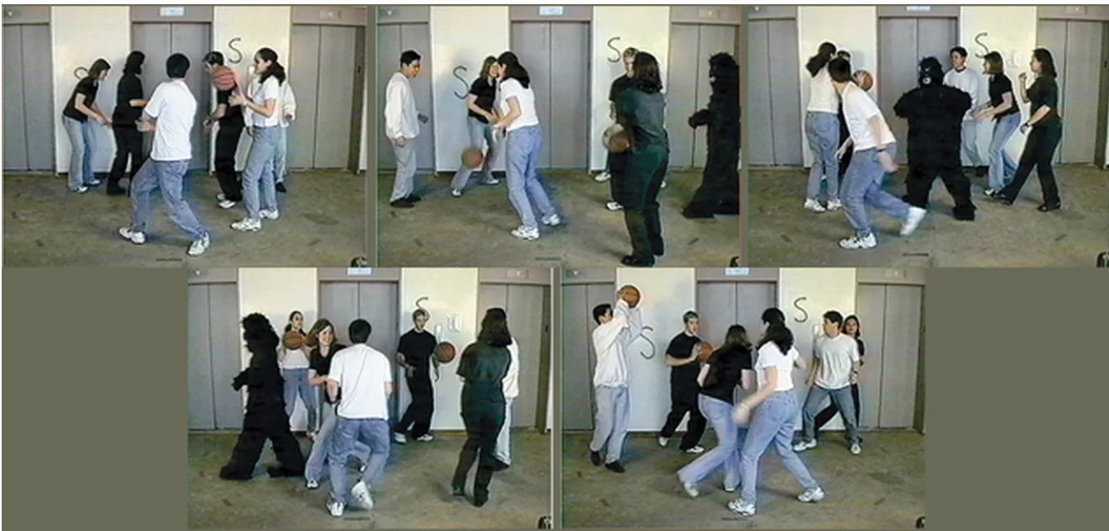
We Notice Things When They Align With Our Goals
We filter out distractions – Our brains are wired to tune into things that match our current goals.
Real-world examples:
The Invisible Gorilla video: People miss obvious things when focused on something else.
Change Blindness: We can miss major visual changes if they don’t seem relevant to our task.
Design Tip:
Make critical info stand out in the context of the user’s goal—not just visually.
Bad example: A pop-up about a new feature while the user is trying to check out.
Good example: Showing a password strength meter as the user types a new password.
Something to note:
If your interface puts info where users aren’t looking, they won’t see it. Align feedback and interaction cues with what they’re actively trying to do.

Slide 13
We use external aids to keep track of what we are doing
Short-term memory is bad, so we use visual and auditory aids to help remember:
Counting on fingers or with tools
Checklists and progress meters
Alarms, audio alerts, and songs
Next slide: find the colored words!!
House left: Green
House Right: Purple

Slide 14
We follow the information scent towards our goal
When people are thinking about doing a task, they tend to gravitate towards labels that state the goal they're trying to accomplish.
For example, when I said to find the purple words on this slide, it was probably subconsciously easier to find them because the purple words contain the task assigned to you whereas the green words don't.

Slide 15
We Prefer familiar paths
Humans are creatures of habit. When presented with a choice between the faster way and the way we know, we often choose the way we know.
From an evolutionary perspective, this makes sense: thinking takes a lot of energy. Minimizing energy consumption is good for a living thing to keep living.
Spoon Theory
Make it easy for users to learn unfamiliar things so they don't get frustrated

Slide 16
Thought Cycle: goal, execute, evaluate
Goal – come up with a task
Execute – do the task
Evaluate – how did the task go? Were you successful?
This cycle can run at multiple levels simultaneously. For example, forming a goal can require doing something else. Going to the beach requires preparing for the beach.

Slide 17
After we achieve a primary goal, we often forget cleanup steps
Once a goal is done, the brain doesn't want to spend more attention, and so loose ends of goals often get dropped
Systems should remind users if they have loose ends to ensure those ends get taken care of.

