Slide 1
DESIGN WITH THE MIND IN MIND CHAPTER 5 AND 6 By Miles Fike, Izzie Corley, and Alex Chavez

Slide 2
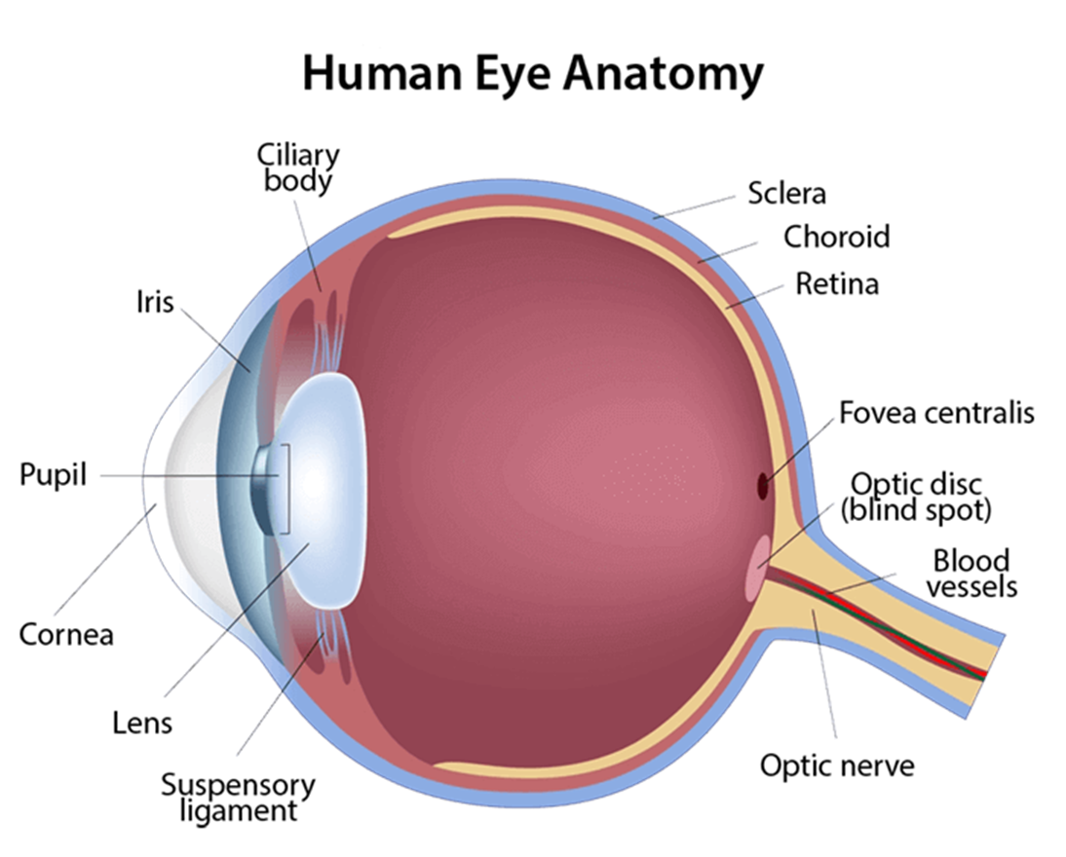
The Anatomy of the Eye
Cones detect color and rods detect brightness
Each eye has 6 to 7 million retinal cone cells
The fovea has 158,000 cone cells per square millimeter
The fovea is only 1% of the retina, but it accounts for half the visual cortex’s space

Slide 3
Peripheral vision
Each cell in the fovea connects to a ganglion neuron.
Elsewhere multiple rods and cones go to a single ganglion cell.
Only the fovea gives us high resolution images
Most people’s peripheral vision is 20/200
Our eyes never stop moving resulting in a perceived good image

Slide 4
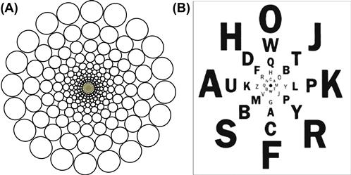
Then why do we even have peripheral vision?

Slide 5
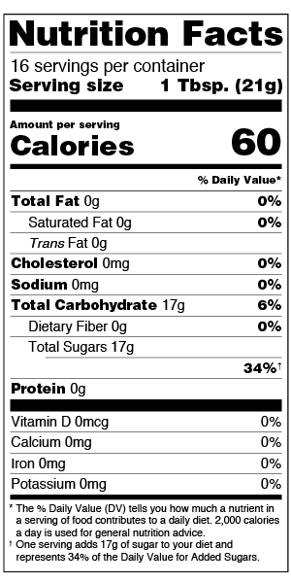
Peripheral Vision Guides the Fovea
The peripheral vision can help spot things for the fovea
If there is an indicator, like a splash of yellow in your peripheral when looking for bananas, you will know where to look
When you notice something in your peripheral vision, your fovea will be guided to the spot
Find the Calorie Count!

Slide 6
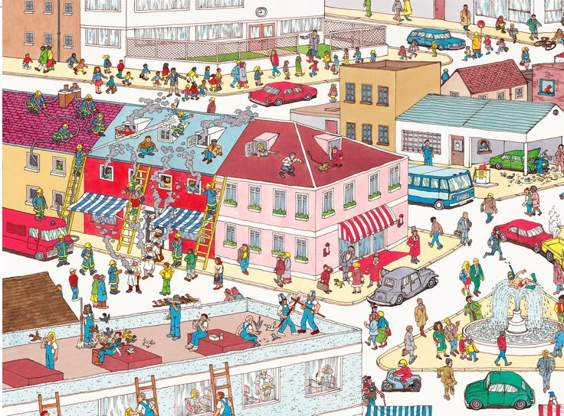

Slide 7
Peripheral Vision is Good for Detecting Motion
When something moves in your peripheral vision, you notice it.
This, and other features of the peripheral, were likely evolved traits to help us find food and avoid predators.

Slide 8
Peripheral Vision is Good for Detecting Motion
When something moves in your peripheral vision, you notice it.
This, and other features of the peripheral, were likely evolved traits to help us find food and avoid predators.

Slide 9
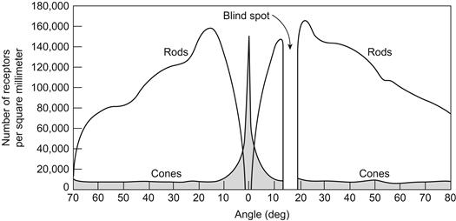
Peripheral vision helps us see in the dark
Although the fovea has bountiful cones, it completely lacks rods.
In the dark, we must rely on rods
It is easier to detect objects in your peripheral in darker conditions.

Slide 10
The Human Eye’s Blindspot
Although you may not notice it, our eyes have a blind spot
This occurs on the spot where our optic nerve and blood vessels exit from our eyes.
Other gaps in vision may occur from imperfect retina, damage, or strokes

Slide 11
The Application Of Vision In Design

Slide 12
We Only Notice What is Near Our Fovea’s Perception
When clicking, that is where the fovea is focused.
We will notice little outside of the area of the click.
Some changes in the peripheral may be noticed while others may not be.

Slide 13
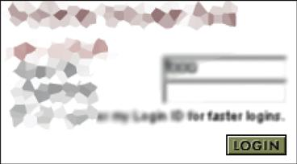
Another Instance In Which the Error is Out of the Fovea

Slide 14
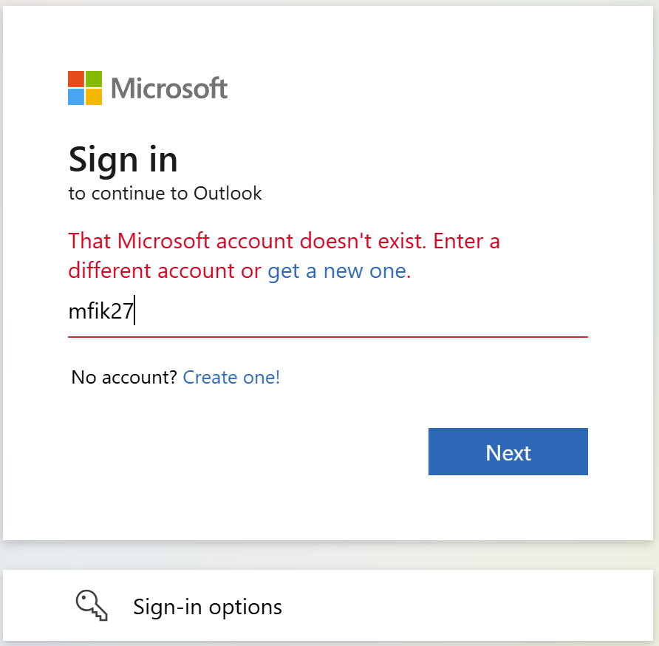
Methods of Making Messages Visible
Put the message where users are looking—In the West, people look from left to right. People also like to follow the mouse
Mark the message—Make the message very prominent
Use an error symbol
Reserve red for errors—Don’t use red anywhere but in error messages for clarity

Slide 15
Heavy Artillery Methods for Making Users Notice Messages
Three stronger methods can be used to force users to notice methods:
pop-ups in error dialogue boxes
use of sound
wiggles or blinking.
These methods should be used sparingly so the user does not get used to them.

Slide 16
Pop-up message in error dialog box
If you display an error message in a dialog box, it is in the users face immediately
It is good for critical situations, but annoying if the error can be ignored
Nonmodal pop-ups allow users to continue working
Application-modal pop-ups block any further work in the application
Some users may block popups, Beware!!!

Slide 17
Use Sound
We all know by now that sound is a powerful signifier
A beep tells a user that something has happened somewhere
In a quiet environment, to much noise from computers can be very annoying very fast.
In a very noisy environment, the sound may be masked by the background noise and be imperceptible
Sound should only be used in very select circumstances

Slide 18
Wiggle or Blink Briefly
Peripheral vision is great at detecting brief motion
Remember the red circles!
Motion causes the periphery to guide the fovea to a new location
Very little motion can change the focus
Most people consider wiggling and blinking to be annoying

Slide 19
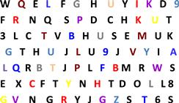
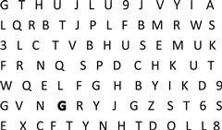
Visual Search is Linear Unless the Target Pops
When looking for something, both the fovea and periphery are utilized.
The peripheral vision drives the fovea to the target
The periphery is very good at finding things that stand out
Color pops even more than bolder characters

Slide 20
Help the Users Find Their Targets
Headings, bullets, boldness, and more help elements stand out
Try to make each item the user may look for distinctive
They need to be able to distinguish without focusing
If the target is words, do not attempt visual distinctiveness
Users will learn the positions of words over time, so never move anything!

Slide 21
Reading is Unnatural

Slide 22
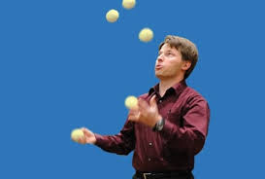
We're wired for language, but not for reading.
At a young age, picking up verbal language can be automatic
Picking up written language requires instruction & practice always
Speech – Evolved over thousands of years
Written language – Only appeared a few thousand years ago
Notes:
*Humans are built for language. Young children can pick up a verbal language without instructuion, just by absorbing the speech around them.
*Why is that? Because over the hundreds of thousands of years of human evolution, we have experienced natural selection that favored the development of language. CONVERSELY, writing has only existed for about 5 thousand years, which is much too short of a timeframe for a complete evolutionary overhaul in the way our brains work.
*Therefore, reading, like any other skill such as juggling or violin or computer programming, requires instruction and practice, no matter what age you're picking it up in. This means that a lot of people in the world actually never learn to read, even more than that never learn to read well, compared to the large majority of humans who learn how to speak.

Slide 23
Learning to read = training our visual system
Lines, contours, shapes
Characters
Morphemes
"farm" "tax"
"-ed" "-ing"
Words
Phrases, expressions, sentences
Paragraphs
Notes:
Since it's a skill that is not fully innate to our brains, we have to train our visual system to recognize the patterns in the written word.
This starts with the lines, contours, and shapes of text – our brain recognizes these things innately.
Shapes make up characters
A few characters make up morphemes, the building blocks of words, that’s like the root words and the suffix and such. "tax" and "-ing" are two morphemes.
Together they make up a whole word
Those words create meaning in phrases

Slide 24
How our eyes move when we read
Only fovea and perifovea
3-4 characters in fovea, 15-20 in perifovea, at standard font size
Saccadic eye movements
Notes:
Our eyes move across the page constantly as we read. The visual information we're taking in is pretty centered around the fovea, with some extra info coming in from the perifovea.
Saccadic eye movements don’t focus on articles or commonly repeated words

Slide 25
Is reading feature-driven or context-driven?
Does reading start bottom-up?
Lines, contours, shapes
Characters
Morphemes
"farm" "tax"
"-ed" "-ing"
Words
Phrases, expressions, sentences
Paragraphs
Or top-down?
Notes:
As people started trying to study how reading works on a psychological level, a question they came across is whether reading is feature-driven or context-driven. Do

Slide 26
They work in parallel!
Feature-driven (Bottom-up)
Most of reading is feature-driven
Skilled readers can use this automatically
Context-driven (Top-down)
Relied upon heavier by unskilled readers
Used by skilled readers for well-known or frequently repeated phrases
Does reading this rely on context or features?
Notes:
These processes work in paralllel!
Feature-driven reading works by identifying how basic shapes of letters combine into words. This is the majority of how reading works on a psychological level. However, the exact proportion of feature-driven to its counterpart context-driven depends on skill.
Skilled readers do feature-driven word recognition automatically, whereas it requires conscious effort for people at a lower skill level. People with lower skill levels rely somewhat more on context-driven

Slide 27
Reading causes different brain activity depending on skill level
Low Skill
Higher Skill
Occipital (visual) cortex
Wernicke's area (sounded out)
Occipitotemporal area (whole words)
Broca's area & frontal lobe (meaning found)
Front brain (meaning & mental image found)

Slide 28
Poor information design can disrupt reading

Slide 29
Unfamiliar Vocab
Avoid Using technical jargon or "Geek Speak"
Don’t use Legal Terms (heretofore, jurisprudence, obfuscate )
Use clear simple words
❌ Obfuscatory Communication
"Your session has expired. Please reauthenticate."
✅ Clear & Simple
"Your session has expired. Please log in again."
Why it Matters?
Non-technical users may not understand “reauthenticate.”
Simpler phrasing keeps reading smooth and intuitive.

Slide 30
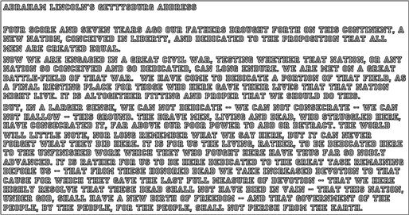
Font Type and Sizes
❌ Avoid using Decorative fonts (even tho they look cool)
Can you read this sentence efficiently
✅ Use san-serif fonts (Arial, Roboto, Cambria, etc...)
Can you read this sentence efficiently
❌ Avoid Using All Caps
❌ Avoid using tiny fonts Hello can you read this !
✅ Use Appropriate sizes for different sections: body text, headings, etc...

Slide 31
Noise
Visual Noise
Poor contrast between text and background
Focus more on deciphering the text instead of its meaning
Text should be scannable and easy to read
There are exclusion such as Captcha
Text Nosie
Avoid Repetition, readers wont focus on the necessary information

Slide 32
Too Much Text Disrupts Usability
Excessive text in user interfaces slows down reading and overwhelms users.
Even good readers struggle with long blocks of prose.
Shorter instructions improve clarity without losing meaning.
Product descriptions should be concise with an option for more details.
When in doubt, test your design.

Slide 33
Questions:
Going back to the login errors, where should Microsoft Outlook have placed their warning for the greatest impact? In that situation there were two possible inputs. The enter key and the “Next” button. Should there have been a warning for each or did just putting a warning near the fovea’s more frequent focus suffice?
Does the blind spot matter in the context of web design? Our eyes are constantly moving, for us to miss something completely, it would need to be on the screen for only a very brief moment. The blind spot is an interesting feature of anatomy but are there any situations when it could cause a problem?
When analyzing a presentation such as this one, is feature-driven or context-driven reading occurring more? Does the presenter’s speech and our recognition of words and ideas fill in the blanks for us all or do some of us use feature driven reading more heavily?
Could repetition serving to more clearly organize items in a longer list be beneficial? Can you think of designs that would organize it better? We were encouraged to avoid repetition in text, however, that example also showed that the backlit keyboards were grouped together by the repetition.

