Slide 1
CS 320: User Interface Design
Home
About
Content
Others
Design with the Mind in Mind
Chapters 3 & 4
-
Kai Francis, Wyatt Harris, Saleh Safi
1

Slide 2
CS 320: User Interface Design
Home
About
Content
Others
Ch. 3: We Seek and Use Visual Structure
People use visual structure to help them extract information from what they see.
This chapter gives examples of structured versus nonstructured information displays. For example, an important goal in presenting information is to provide a visual hierarchy—an arrangement of the information that breaks the information into distinct sections and subsections, labels sections prominently to clearly identify their content, and presents higher-level sections more strongly than lower-level ones.
This allows people, when scanning information, to separate what is relevant to their goals from what is irrelevant instantly, and to focus on the relevant information.
2

Slide 3
CS 320
Home
About
Content
Others
We Seek and Use Visual Structure
Key Concepts:
Visual Hierarchy – Breaking content into sections and subsections.
Grouping – Related elements should be visually connected.
Alignment – Consistent placement and spacing aid usability.
Contrast – Highlights key content and distinguishes elements.
3

Slide 4
CS 320
Home
About
Content
Others
Visual Hierarchy & Information Scanning
A well-structured hierarchy lets users focus on relevant information.
Sections and subsections should be clearly labeled.
Higher-level sections should be more prominent than lower-level ones.
Example: Structured vs. unstructured airline flight information (Fig. 3.1).
4

Slide 5
CS 320
Home
About
Content
Others
Structuring Data for Readability
Search Results: Eliminating repetitive “noise” enhances scanning.
Tables and Forms: Proper spacing and alignment reduce errors.
Credit Card & Phone Numbers: Segmenting data improves comprehension.
5

Slide 6
CS 320
Home
About
Content
Others
6

Slide 7
CS 320
Home
About
Content
Others
7
Award: Website of the Month (2022), CSS Design Awards

Slide 8
CS 320
Home
About
Content
Others
Data-Specific Controls for Better Structure
Segmented Fields: Enhances readability for phone numbers, dates.
Pop-Up Menus: Reduce input errors for date selections.
Email Address Fields: Structure improves accuracy (Fig. 3.10).
8

Slide 9
CS 320
Home
About
Content
Others
Designing with Visual Structure - Best Practices
Design Tips:
Use clear section labels for easier scanning.
Reduce wordiness; make content concise.
Apply whitespace strategically to separate content.
Ensure user-friendly layout in forms and control panels.
Example: Good vs. poor UI control panel designs (Fig. 3.12).
9

Slide 10
Chapter 4:
Our Vision is Limited
10

Slide 11
Key Concepts in Color Vision
• Our vision detects contrast (edges), not absolute brightness
• Color perception depends on display and environment
• Color-blindness does not mean an inability to see colors
• Display and viewing conditions affect perception
eg : A red apple appears the same color in sunlight and shade due to contrast detection rather than absolute color recognition
11

Slide 12
How Color Vision Works
•The retina contains two types of photoreceptor cells:
Rods : detect brightness but not color.
cones: are responsible for color vision.
There are three types of cones
> each sensitive to a different range of wavelengths:
- low-frequency cones respond to red and yellow.
- medium-frequency cones detect greens and yellows.
- high-frequency cones are most sensitive to blues and violets.
12

Slide 13
Sensitivity of Cones
•Each type of cone cell has a different sensitivity range, with significant overlap between them.
Low-frequency cones respond most strongly to warm colors like red and yellow, while medium-frequency cones detect greens and oranges.
High-frequency cones, which are the least numerous and least sensitive overall, primarily detect blues and violets.
This uneven distribution of sensitivity means that we perceive some colors more vividly than others. For instance, blue text on a black background can be difficult to read due to our lower sensitivity to blue light.
This biological limitation must be considered when designing interfaces that rely on color differentiation.
13

Slide 14
Vision is Optimized for Contrast
•Our visual system is highly sensitive to differences in color and brightness rather than absolute brightness levels. This contrast sensitivity helps us recognize objects under different lighting conditions. For example, a gray bar placed against different backgrounds may appear darker or lighter, even though its actual color remains unchanged. This effect highlights how the brain prioritizes contrast over true brightness values.
14

Slide 15
Limitations in Color Discrimination
•Our ability to distinguish colors is influenced by several factors.
Paler colors are harder to differentiate because they have lower saturation. Similarly, small or thin objects make it more challenging to perceive color distinctions, which is why text color can sometimes be difficult to determine. Furthermore, when color patches are separated by a significant distance, it becomes harder to compare them accurately, especially if eye movement is required.
15

Slide 16
Design Implications
•Understanding color perception limitations is essential for effective design. To improve readability and usability, designers should use high-contrast color combinations and avoid pale or similar shades for key elements. Text colors should be chosen carefully to ensure clarity. In charts and diagrams, increasing the size of color patches can help users distinguish them more easily.
16

Slide 17
Chapter 4 part 2
Color Blindness
Does not mean the inability to see colors
It just means that one or more of the color subtraction channels aren’t working correctly
It affects about 8% of men and 0.5% of women.
multiple types with red-green being most common
17

Slide 18
External Factors that influence colors
Color Variation
Computer displays often vary how they display colors
This can be due to technology, driver software, or color settings
Even displays of the same model with the same settings can have color variation
18

Slide 19
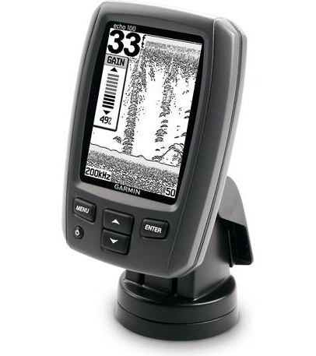
Grayscale Displays
Most devices now all use color displays, except for few small handheld devices. Like this fishfinder.
19

Slide 20
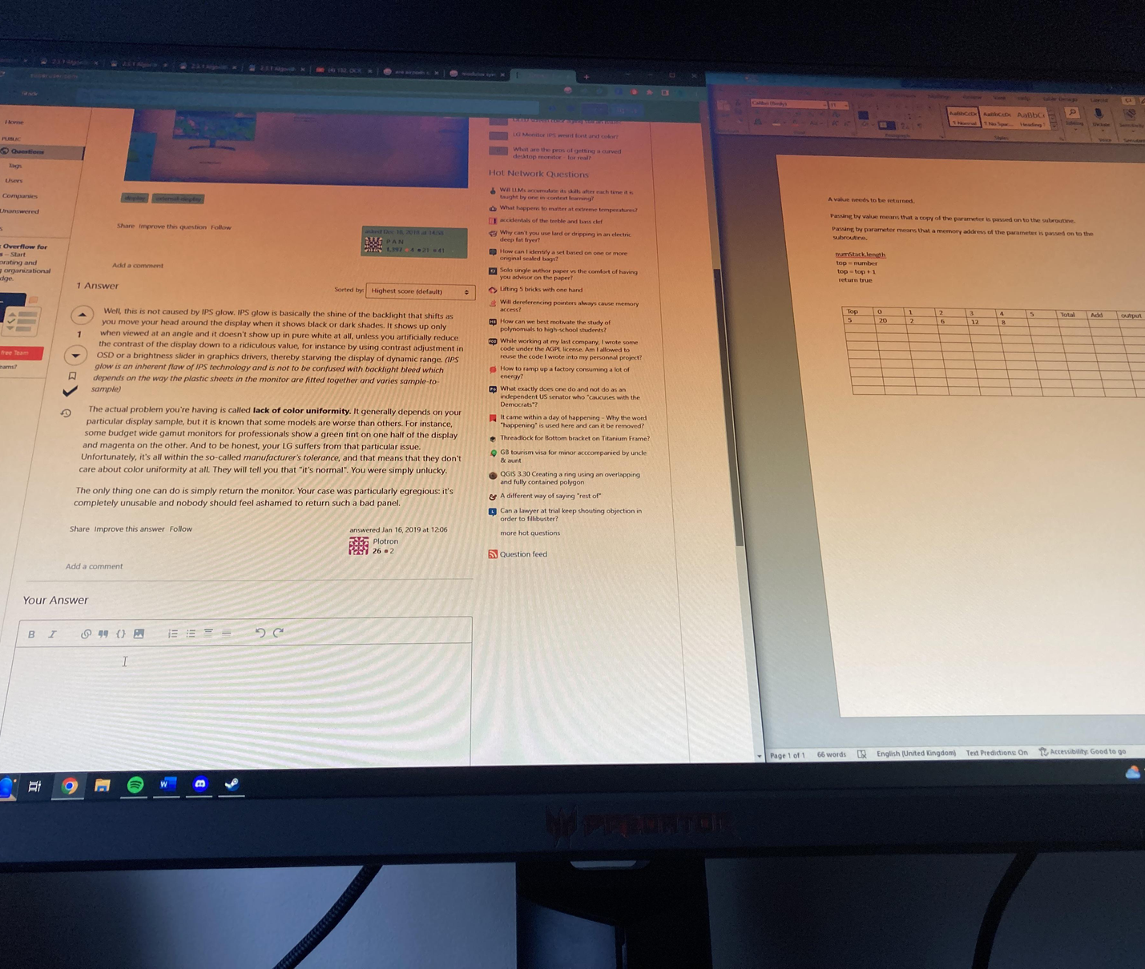
Display angle & ambient illumination
Some displays, mostly LCD ones, will have discoloration when viewed at odd angles. They work best when straight on.
Ambient lighting, such as sunlight, can dull colors, making displays appear nearly grayscale.
20

Slide 21
Guidelines for using color
1.Distinguish colors by hue, saturation, and brightness
Ensure strong contrast between colors and avoid subtle differences. To test if colors are distinct enough, view them in grayscale—if they blend together, they lack sufficient contrast.
21

Slide 22
Another Grayscale Example
22

Slide 23
2. Use Distinctive colors
Our visual system processes color through three opponent channels: red-green, yellow-blue, and black-white . Red, green, yellow, blue, black, and white—are the easiest colors to distinguish, as they all activate a strong signal on one of the three color-perception channels. Other colors activate multiple channels, making them harder to differentiate quickly.
23

Slide 24
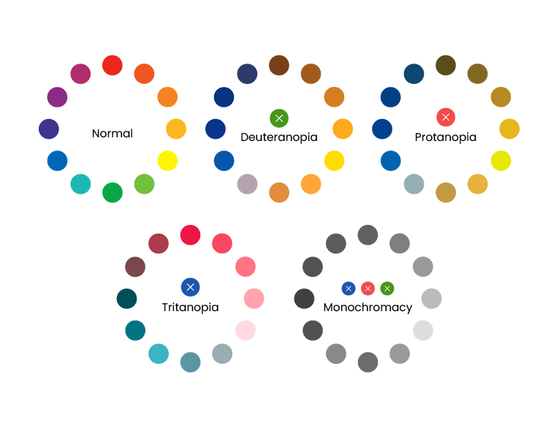
3.Avoid color pairs that color-blind people cannot distinguish.
Avoid pairing dark reds, blues, or violets with other dark colors like black or dark green. Instead, contrast them with light yellows and greens. Again, to test if a webpage or design is color-blind-friendly, put it in grayscale. If colors are distinguishable, then you’re good.
24

Slide 25
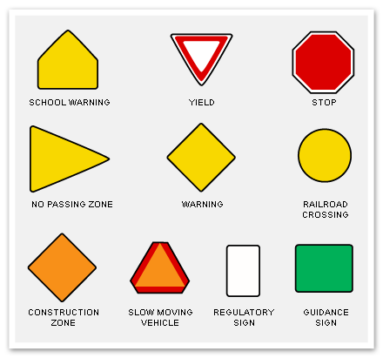
4. Use color redundantly with other cues.
Don't rely only on color for distinction—use symbols, shapes, or other markers for clarity.
25

Slide 26
5. Separate strong opponent colors.
Don’t place opponent colors on, or near each other. It looks bad!
26

Slide 27
Discussion Questions
Think about a website or app you use frequently. How does it apply (or fail to apply) the principles of visual hierarchy and grouping? How does this impact your experience as a user?
In what ways have you encountered poorly structured information displays in real life (e.g., forms, search results, website navigation)? What improvements would you suggest based on the concepts from Chapter 3?
Designers should aim to minimize cognitive load when creating user interfaces. What are some real-world examples of interfaces that make tasks easier by reducing cognitive effort? What strategies do they use to achieve this?
Chapter 4 discusses how users’ limited attention affects interface design. Can you think of an example where too much visual noise or unnecessary distractions made it difficult for you to complete a task on a website or app? How could the design have been improved?
27

