Slide 1
Design with the Mind in Mind By: Jeff Johnson
Presented BY: Akhmad Mamirov, Mastewal Berhe, Ryan Yonek
Chapters 1 & 2

Slide 2
Chapter 1: Our Perception is Biased
The past: our experience
The present: the current context
The future: our goals

Slide 3
Perceptual priming

Slide 4
Familiar Perceptual Patterns or Frames
•

Slide 5
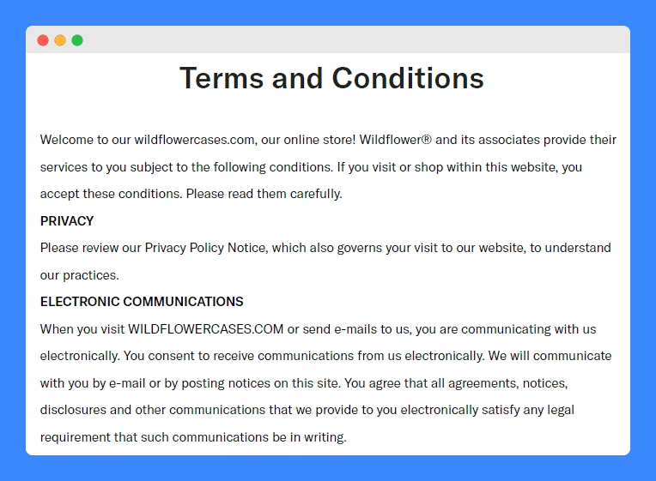
Habituation
Repeated exposure to the same, dull perceptions
Attention blink:
When we see something familiar/important
We are deaf and blind for some time

Slide 6
Perception Bias by the Current Context
Credits: Vsauce

Slide 7
Perception Bias
Credits: Vsauce

Slide 8
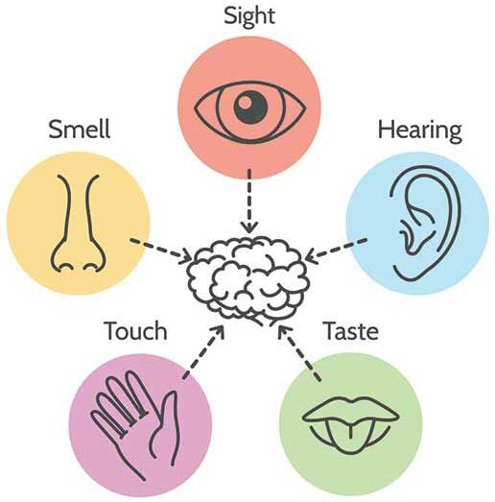
Perception Bias
Perceptions in any of our five senses may affect simultaneous perceptions in any of our other senses.

Slide 9
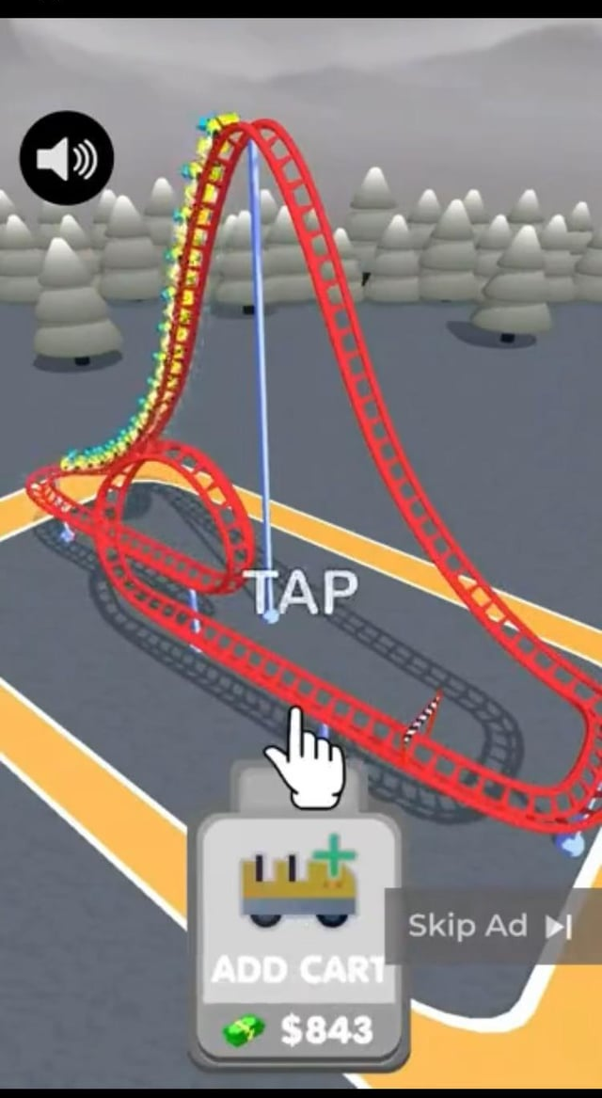
Perception Biased by Goals
Our perception is guided by our goals, helping us focus on relevant information while filtering out distractions.
Mechanisms
Guiding Where we look
Sensitizing to features

Slide 10
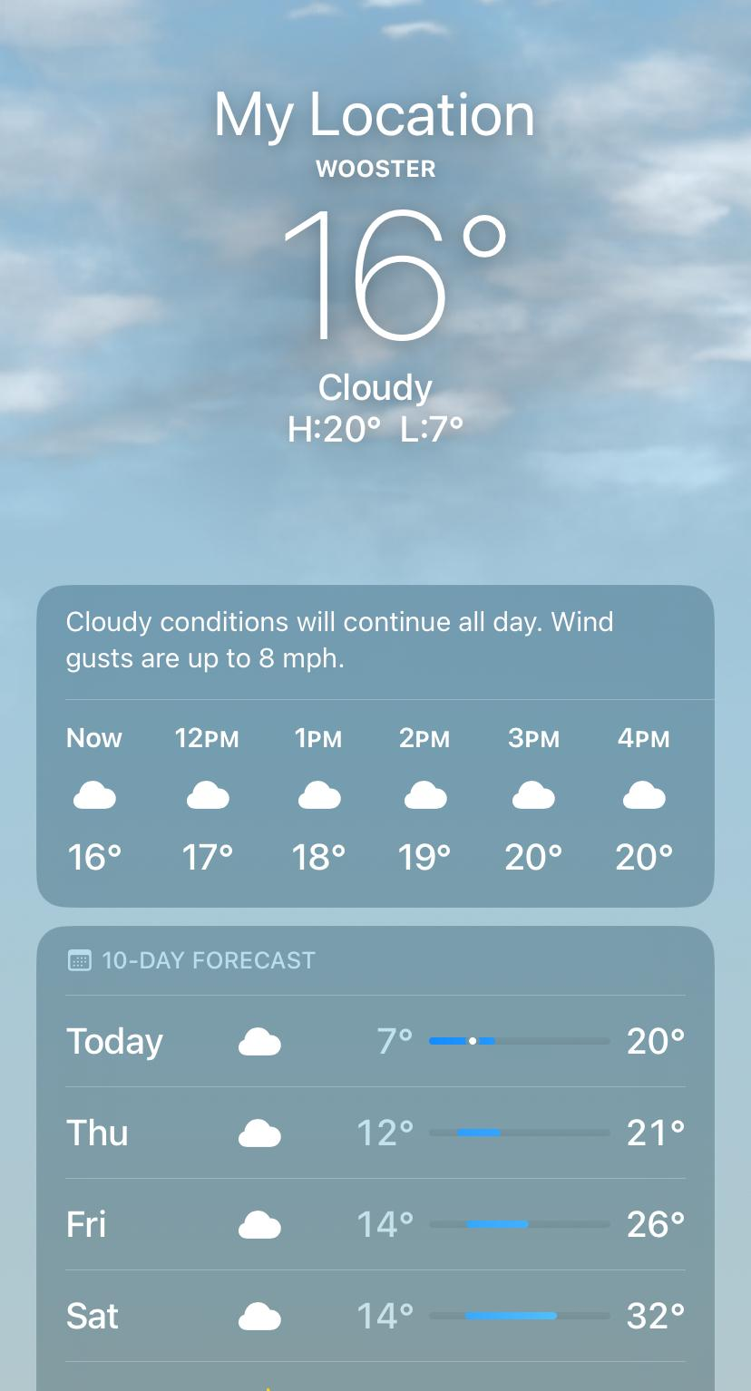
Taking Biased Perception into Account When Designing
Avoiding ambiguity
Ensure displays are clear and universally interpretable.
Use standards or prime users when ambiguity is unavoidable.
Be consistent
Keep placement, colors, fonts, and controls uniform across screens.
Consistency helps users quickly recognize and use elements.
Understanding the goals
Make relevant information clear, available, and aligned with user needs.

Slide 11
Chapter 2: Our Vision is Optimized to See Structure
Gestalt principles:
Proximity
Similarity
Continuity
Closure
Symmetry
Figure/Ground
Common Fate

Slide 12
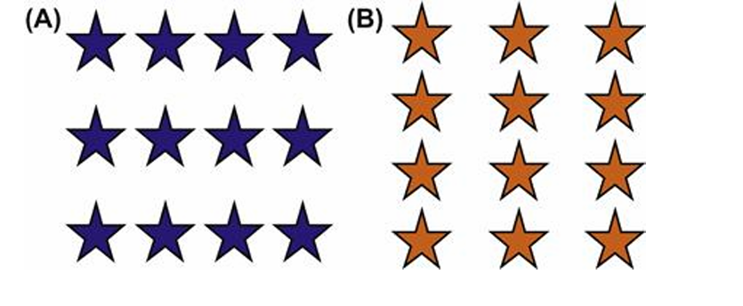
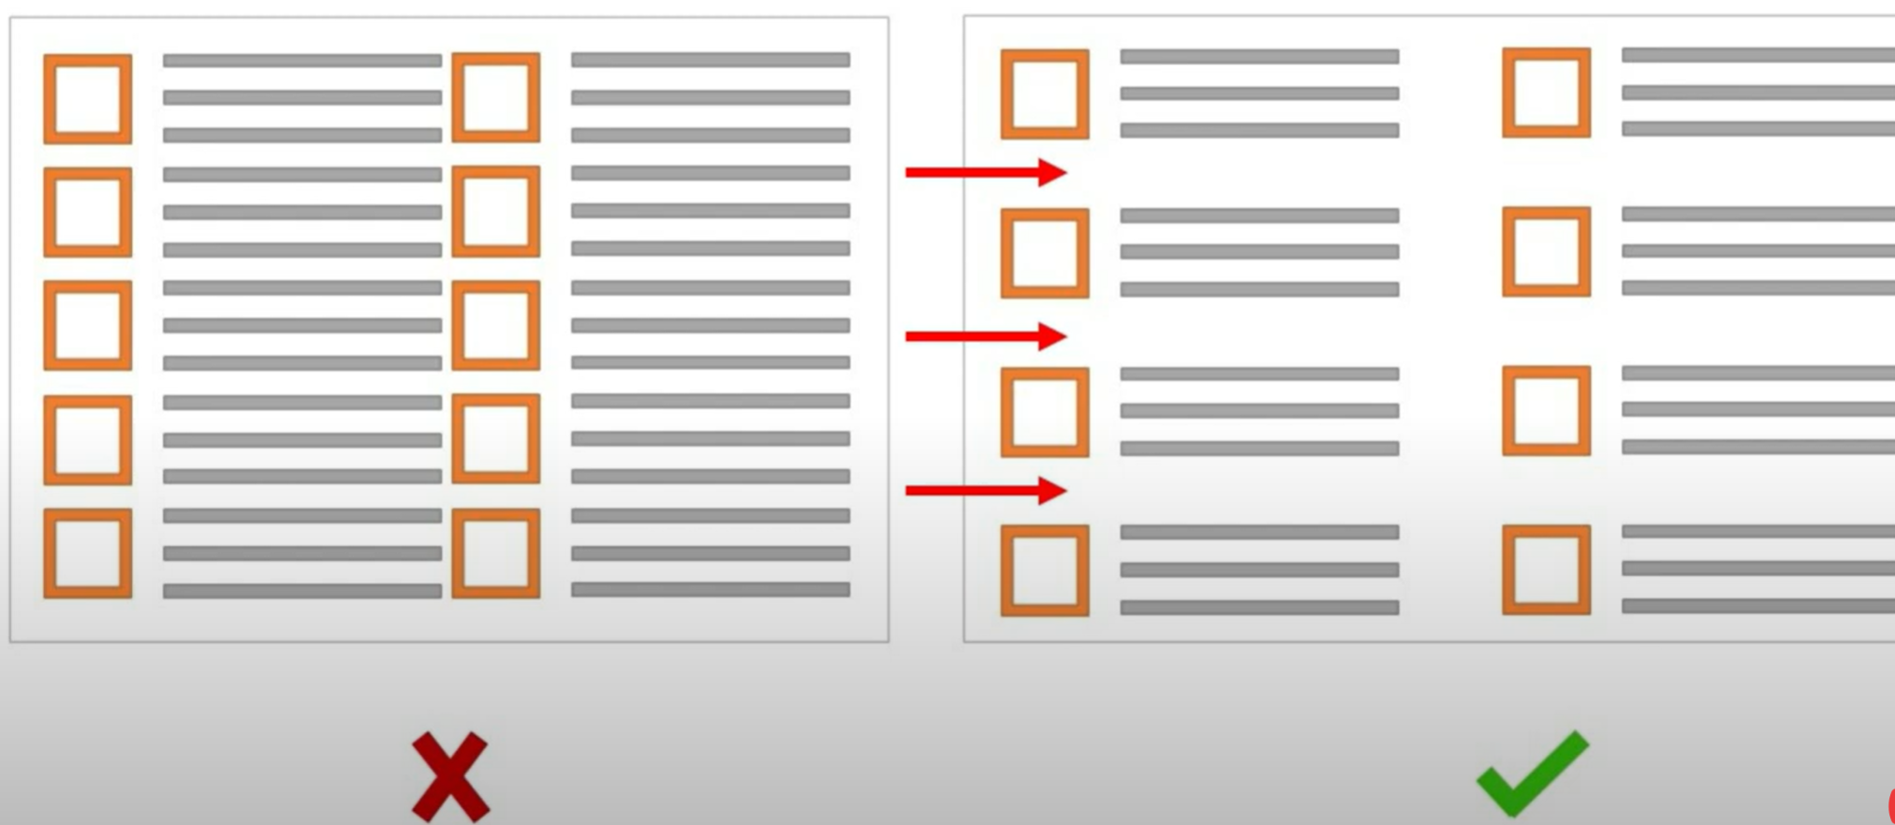
Gestalt Principle: Proximity
Objects that are near each other appear grouped, while those farther apart do not.
No visible borders to reduce visual clutter and code size in a user interface
Avoid Poor spacing

Slide 13
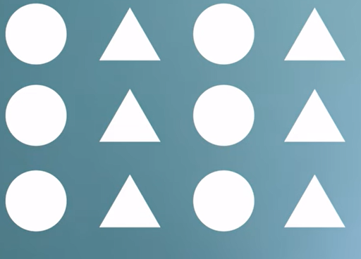
Gestalt Principle: Similarity
Objects that look similar appear grouped, all other things being equal.

Slide 14
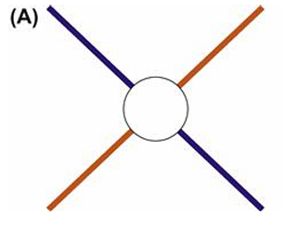
Gestalt Principle: Continuity
Our visual perception is biased to perceive continuous forms rather than disconnected segments. This principle helps us resolve ambiguity and fill in missing data to perceive whole objects.
Adding missing data

Slide 15
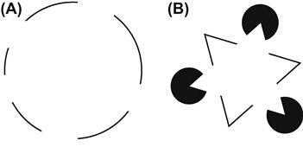
Gestalt Principle: Closure
Human vision is biased to see whole objects, even when they are incomplete.
Partially visible objects are perceived as whole.

Slide 16
Gestalt Principle: Symmetry
View complex scenes in a way that reduces the complexity
Can represent three-dimensional objects in two-dimensions

Slide 17
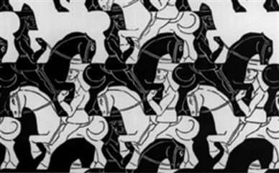
Gestalt Principle: Figure/Ground
The human mind splits up what we see into the figure (the foreground) and ground (the background)
When objects overlap, we see the smaller, often closer object as the figure and the larger one as the ground.
Ex: Pop-ups, advertisements
https://www.istockphoto.com/photos/multicolor-butterfly

Slide 18
Gestalt Principle: Common Fate
Only principle referring to objects in motion, not static
Objects that move together are perceived as grouped or related
http://gimpchat.com/viewtopic.php?f=25&t=18337
https://www.freepik.com/premium-vector/flock-birds-sunset-vector-abstract-silhouette-flying-birds-pattern-sunrise-geese-ducks_33161851.htm

Slide 19
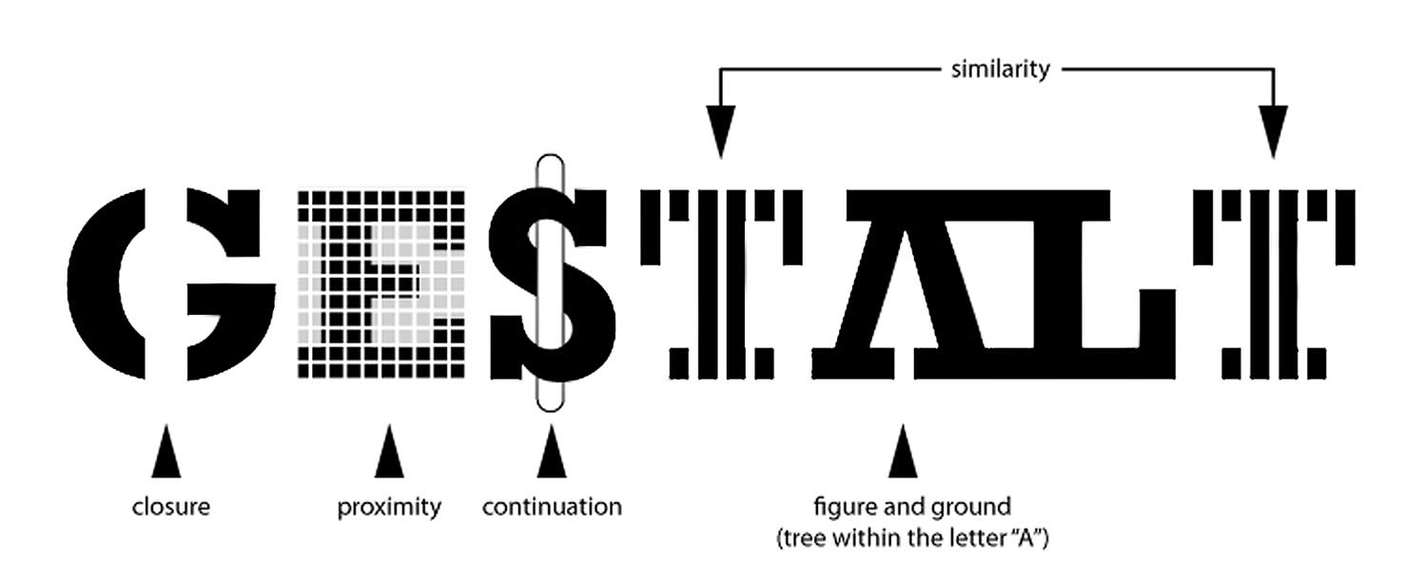
Gestalt Principles Combined
Gestalt principles work together, not in isolation
Caution: Unintended visual relationships can be implied by a design
View design with each of the Gestalt principles in mind
https://www.neurosciencemarketing.com/blog/articles/gestalt-principles.htm

Slide 20
Discussion Questions
What is the most important Gestalt Principle to consider when designing a GUI?
How can designers better appeal to the bias of user goals?
How can a designer prevent users from getting attention blink in their GUI?
What are some examples of how designers can take advantage of typical patterns users perceive often?

