Slide 1
DOET Chapter 6 The Design Challenge
Ben Carroll, Saidamir Osimov, Will Sieber

Slide 2
Solving The Correct Problem
Common Design Flaw: Solving the wrong problem due to incomplete understanding of user needs.
Designers often rush to create solutions without fully defining the problem.
Example: Elevator Problem
Solution: Focus on identifying the underlying issue rather than the surface symptoms.
Observe
Ask Why?
Redefine

Slide 3
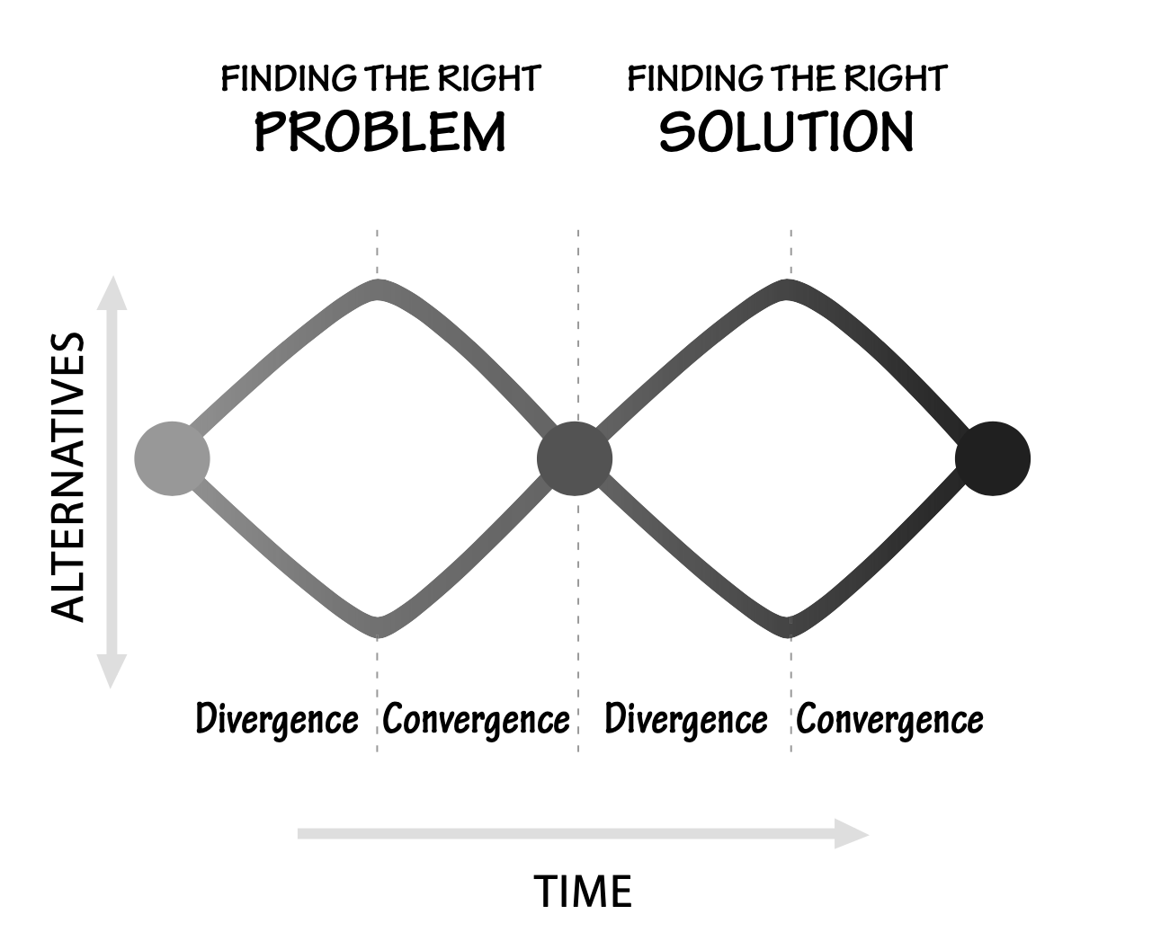
The Double Diamond Model
DD Model: A framework for solving design problems through divergence and convergence.
Two Phases:
First Diamond: Discover and Define the problem.
Second Diamond: Develop and Deliver the solution.
Purpose: Ensure that the correct problem is identified and addressed effectively.

Slide 4
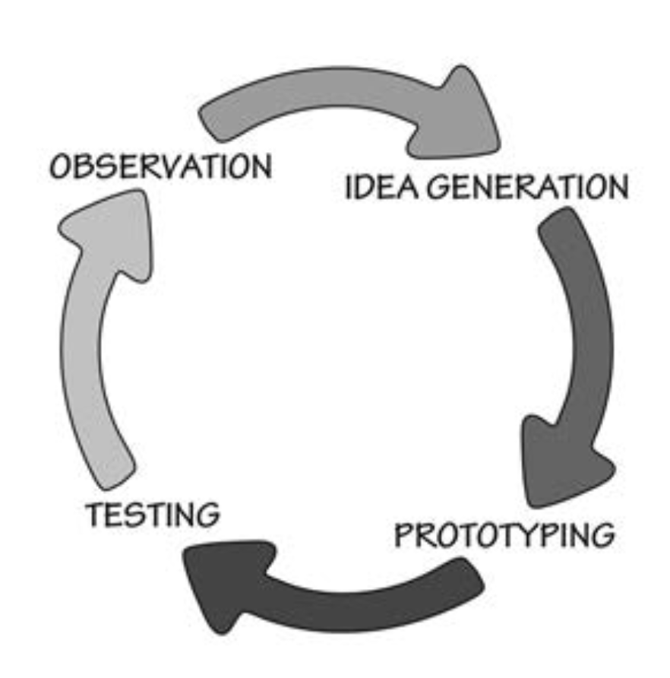
The Human Centered Design Process
HCD Process: A design approach that prioritizes the needs, behaviors, and limitations of users.
4 Steps:
Observation
Design Vs. Market
Idea generation
Generate Ideas
Be creative, no limits
Question EVERYTHING
Prototyping
Wizard of Oz method
Testing

Slide 5
Iteration in the Human Centered Design Process
Iteration is a key component of HCD
Continuous refinement of the design based on feedback and testing.
Process:
Test prototypes with users.
Identify pain points or gaps.
Modify and retest until the solution meets user needs.
Mindset: Failure is part of the process; we must embrace learning from mistakes.

Slide 6
Activity VS Human Centered Design
How can we design so that everyone on Earth can use our product?
The answer is to focus on activities rather that the individuals
Let the activity define the product and the structure
ACD works because people's activities around the world are similar
ADCs are far better suited for large populations rather than HCD

Slide 7
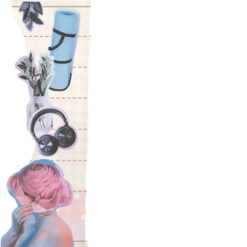
Difference Between Tasks and Activities
Understanding the Difference:
Activity = High-level goal (e.g., going shopping).
Task = Specific action within an activity (e.g., driving to the store, picking a basket).
Activities encompass multiple tasks, all working toward a common goal.
Why Design for Activities, Not Just Tasks?
Focusing only on tasks is too restrictive and may overlook the broader user experience.

Slide 8
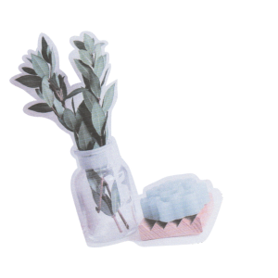
Iterative Design VS Linear Stages
Waterfall (Linear) Method:
Progresses in one direction with rigid phases.
Difficult to revise decisions once made.
Used in large, complex projects (e.g., automobiles, operating systems).
Iterative (Human-Centered) Design:
Cyclic process with continuous testing and refinement.
Allows backtracking and rethinking early decisions.
Best for early-stage design but hard to scale for large projects.

Slide 9
(It Doesn’t Really work like that)
"In theory, there is no difference between theory and practice. In practice, there is."
The Human Cenered Design process describes the ideal, but the reality often forces people to behave differently from that ideal.
Even though some companies might profess to believe in user experience, in practice there are only 2 drivers of new products:
Adding fetures to match the competition
Adding features driven by a new technology

Slide 10
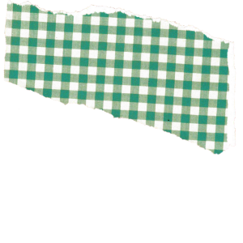
The Design Challange
Designing is hard, but it a very rewarding process
01
Designers try hard to determine people's needs and fulfill them whereas marketing is concerned about what people will actually buy
02
What people need and what people buy are two different things but both are important
03
It doesn’t matter how great the product is, if nobody buys it
04

Slide 11
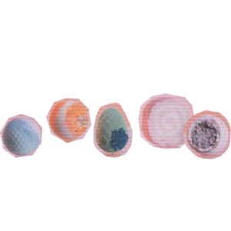
Designers vs Clients vs End Users
Designers create products, but their primary customers are often the purchasers, not the end users.
Major household appliances are often purchased by housing developers, landlords, or corporate buyers.
Purchasers prioritize price, size, and appearance over usability.

Slide 12
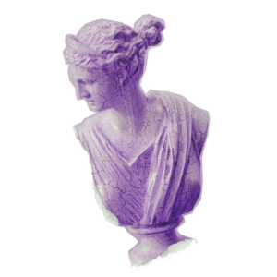
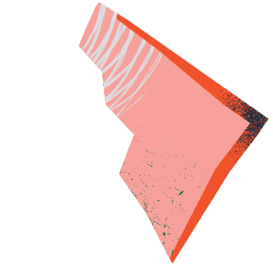
The Business Perspective on Usability
In corporate settings, cost dominates purchasing decisions.
Example: Office copiers are selected based on price and features, not usability, training costs, or maintenance.
Poor usability can lead to:
Increased service calls and training expenses.
Wasted employee time and reduced productivity.
Designers must study both purchasers and end users to create better products.

Slide 13
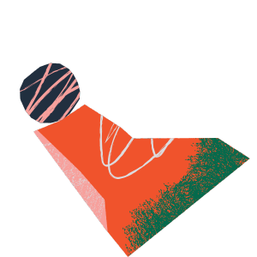
Designing for special people
Creating a universally accommodating product is often impossible.
Even if a design serves 95% of the U.S. population, that still leaves 15 million people unserved.
Designing for the 99th percentile globally still excludes 70 million people.
Some challenges cannot be resolved with minor adjustments—the best solution is to develop multiple product versions tailored to different needs.

Slide 14
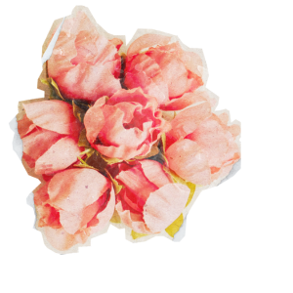
The Stigma Problem
“I don’t want to go into a care facility. I’d have to be around all those old people.(Comment by a 95-year-old man.)"
Design can be rejected by its intended user.
Many people would avoid using a wheelchair, a walker, crutches or a cane even if they need them, because of the stigma.
The best solution to the problem of designing for everyone is flexibility: allowing people to adjust their seatbelts, change lighting, font size, contrast, and so on.

Slide 15
Complexity is Good
Much of us use devices every day that are exceedingly complex.
It's not complexity that is the problem, though – it's confusion.
A better design avoids confusion by providing good conceptual models.
Even exceptions and "apparent randomness" fits.
Notes:
Kitchens, Software (DAWs, Game Engines), Instruments.
In other words, by giving reason behind the design.
– if there's no other place for a tool, that is of itself a reason.

Slide 16
Standardization
Advancements in technology often come from improvements made naturally over time.
For example, CPUs getting faster & compact.
However, it is arguably just as important that standardization is made within an industry.
For example, HDMI and USB.
Establishing standards comes at a cost, though.
Can often be a lengthy and politicized issue.

Slide 17
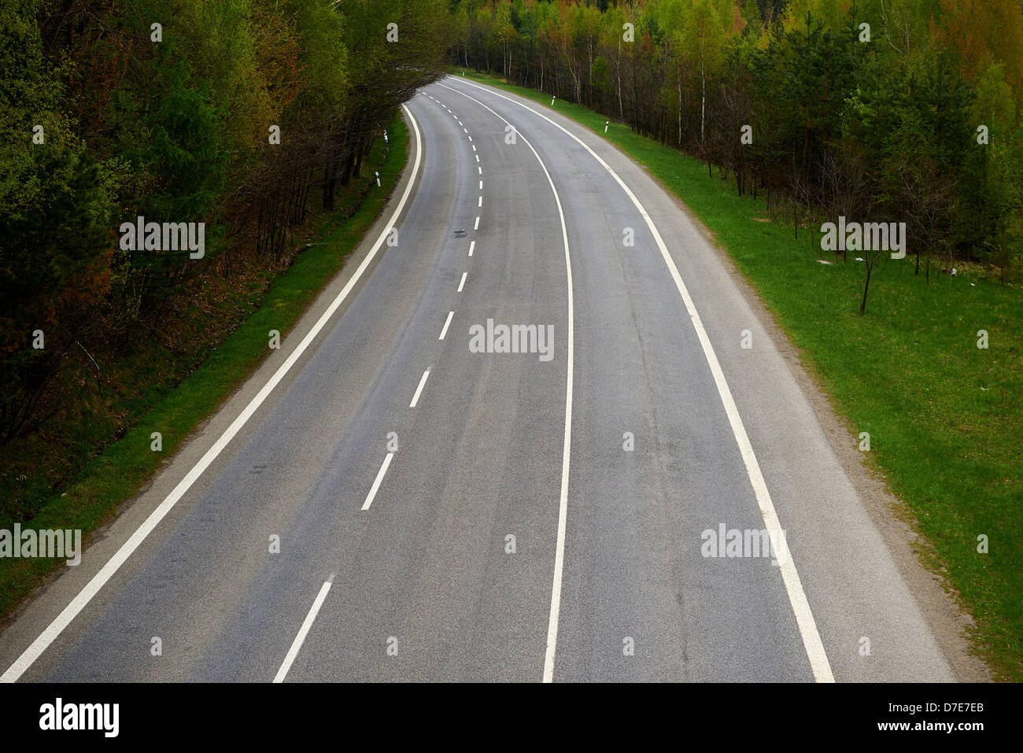
Why Standards are Necessary
Unstandardized products can cause confusion.
This is due to there being multiple logically consistent designs.
Are cars coming toward or from in the photo?
Ideally, good standards prevail – and others will naturally fizzle out.
Swatch International Time

Slide 18
Deliberately Making Things Difficult
Some designs require that only some afford an action to an object.
"Filtering out" should not hinder the design for those that afford the action on the object.
Therefore, good design practice should be maintained, even for those who "know what they're doing".
Notes:
For example, a keycard into a locked door.
Remember the Hawaii Missile Alert?

Slide 19
Conclusion
Design naturally evolves over time, but this may not be the best approach.
Proper design arises from asking what the user needs over several iterations:
Define the Problem
Deliver the Solution
"Complexity" != "Confusion"
One should be embraced, and the other avoided
Proper design is important to everyone.

Slide 20
Discussion
What are some examples of tools where complexity is a necessary evil in their design?
How does the design process relate to Agile Development?
What is an example of a standard today that would be difficult to live without?

