Slide 1
DOET CH 3
Knowledge in the Head and in the World
By Don Norman
Presented By Alex, Aidan, and Cam

Slide 2
Precise Behavior from Imprecise Knowledge
Knowledge is both in the head and in the world
Great precision is not required
Natural constraints exist in the world
Knowledge of cultural constraints and conventions exists in the head
Notes:
Head knowledge and World knowledge
Head knowledge is knowledge in the human memory system
World knowledge is knowledge that is readily available in the world
The need for us to learn it diminishes
I don’t need to know off the top of my head what classes are held in the first floor of Taylor, I could just ask someone else.
Order in which parts can go together and the ways by which an object can be moved, picked up, or otherwise manipulated.
Cultural constraints - learned artificial restrictions on behavior that reduce the set of likely actions
Head knowledge that once learned, can apply to a wide variety of circumstances
Ex. Knowing that a room on the second floor will be numbered between 200-299

Slide 3
Precise Behavior from Imprecise Knowledge Cont.
“Because behavior can be guided by the combination of internal and external knowledge and constraints, people can minimize the amount of material they must learn, as well as the completeness, precision, accuracy, or depth of the learning.”
People function on two kinds of knowledge
Notes:
Personal Anecdotes
Knowledge of and knowledge how
Knowledge of is knowledge of facts and rules (Stop at red traffic lights, don’t punch people) Doesn’t mean they’re always followed…
It also doesn’t mean they’re always true
Knowledge how is best taught by demonstration and best learned through practice (learning an instrument or playing a sport)

Slide 4
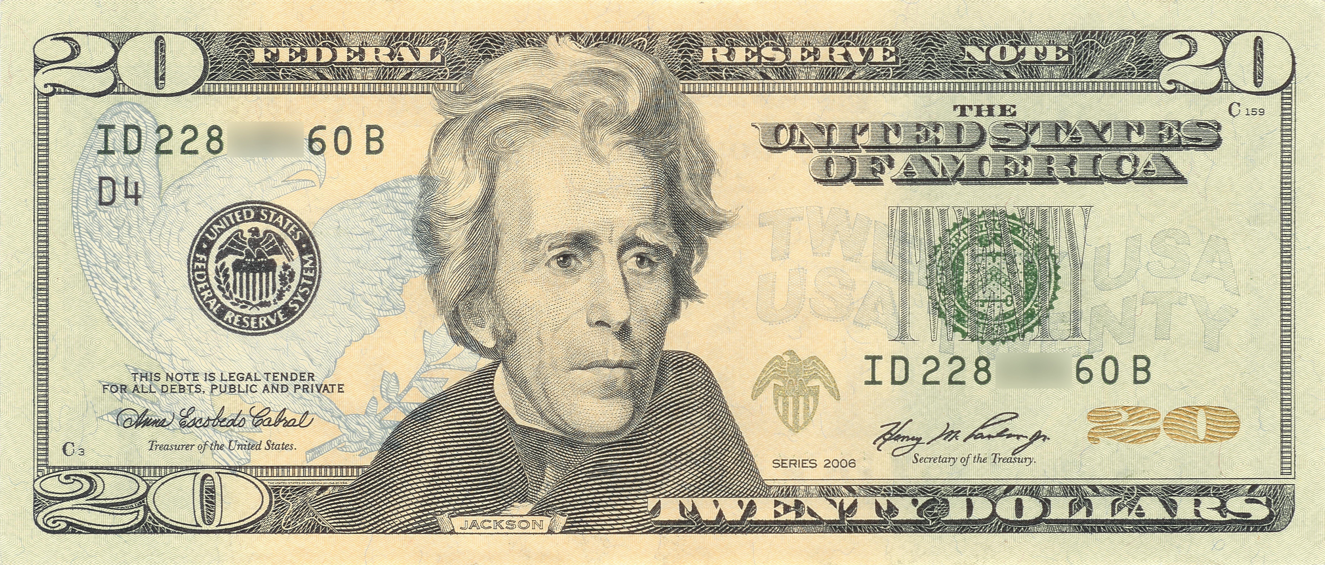
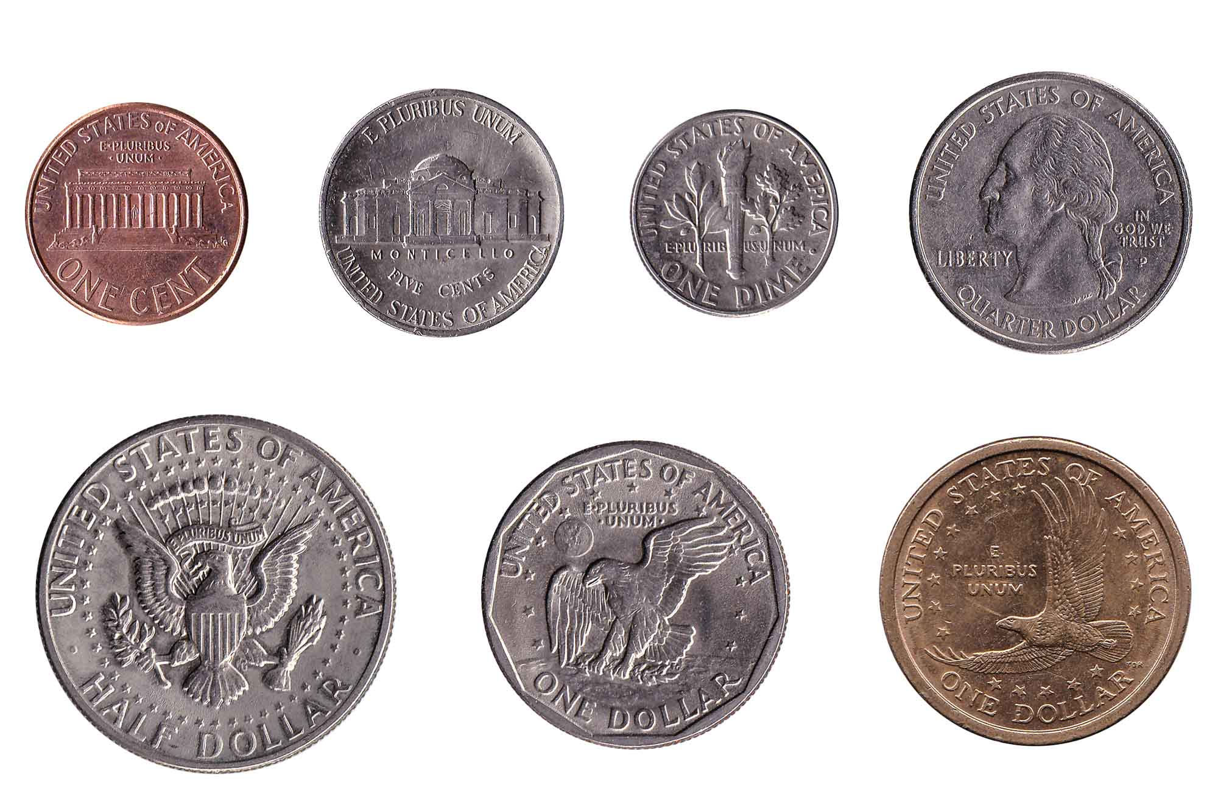
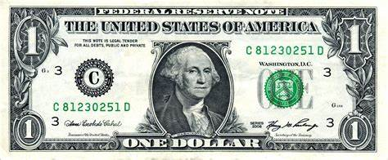
When precision is unexpectedly required
When the combined head and world knowledge is no longer enough

Slide 5
Constraints Simplify Memory
Constraints of rhyming
Car, bar, far, star, gar, char, par, tar
How about having a word with a particular meaning rhyme with another word
Waffle, falafel
Dramatic reduction in word choice
I am thinking of three words: one means “A mythical being”, the second is “the name of a building material” and the third is “a unit of time”
Same three words “A mythical being rhyming with ‘post’”, “A building material rhyming with ‘eel’”, and “A unit of time rhyming with ‘ear’”

Slide 6
The Structure of Memory
Two major classes of memory
Short Term & Long Term
Short term or working memory
Severely limited information retainment levels
Minor distraction can wipe out the stuff we are trying to hold on to in short term memory
Long term memory
Sleep plays an important role in strengthening the memories of each day’s experiences
A major difficulty with Long term memory is organization
Notes:
Ex. If you tried to multiply 27 times 293 in your head you would probably fail
Ex. My phone #
“tip of the tongue”, there is a feeling of knowing, but the knowledge isn’t consciously available

Slide 7
Approximate Models: Memory in the Real World

Slide 8
Consciousness
Initial Learning
Practice
Subconsciousness
Expert, skilled behavior
Unexpected Situations

Slide 9
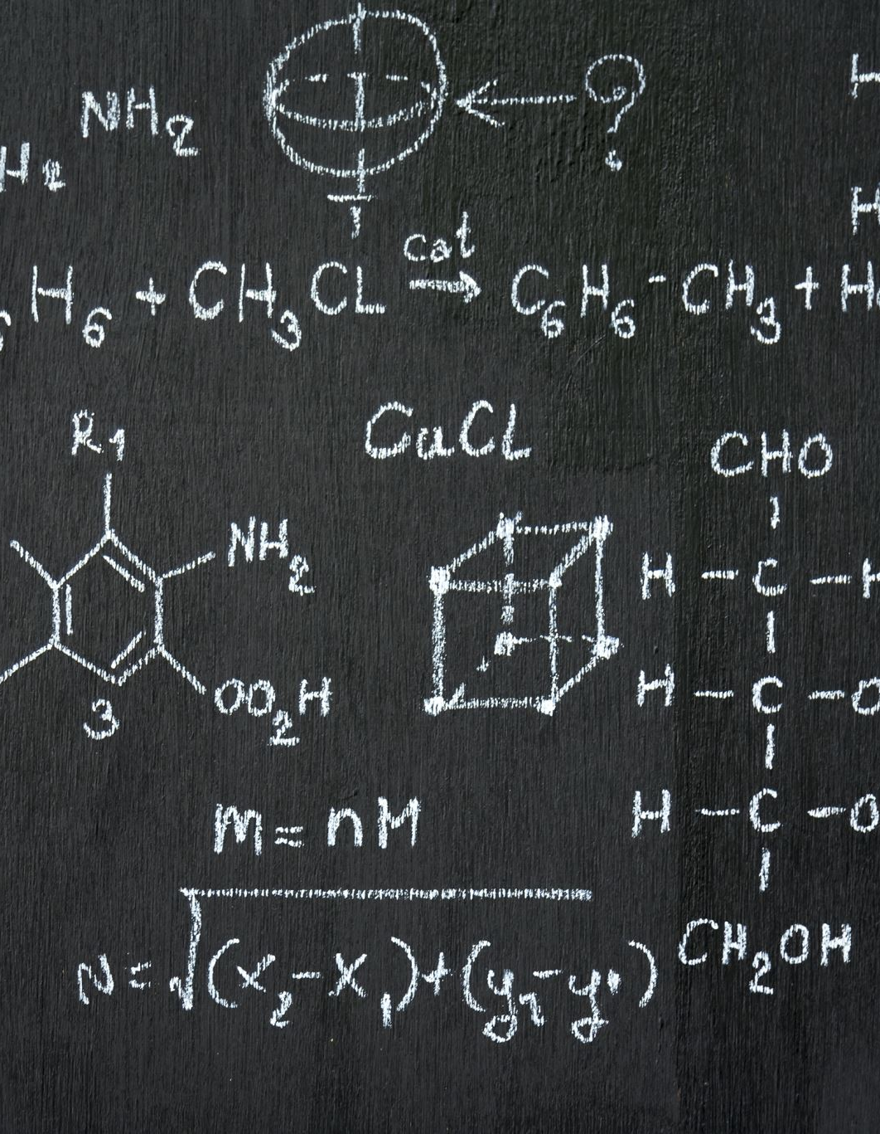
Simplifying Thought
Use Simplified Models for approximation
Science uses absolute truths
Small details
Approximations are good enough for practical application
Solutions that are "good enough"
Ease of use
We do not need absolute truth

Slide 10
Examples
Fahrenheit to Celsius
55 F
C = (F - 32) x 5 / 9
12.8 degrees
C = (F - 30) / 2
12.5 degrees
Motorcycle Turn Signal
Click turn signal in direction of turn
Steer opposite direction
Subconscious
Inaccurate
Usable design
Does it lead to correct behavior?

Slide 11
Knowledge in the Head

Slide 12
Memory
External Knowledge
Right place, right time
Otherwise, becomes knowledge in the head
"Out of sight, out of mind"
Effective memory uses all available clues

Slide 13
Pilot Example
Frasca 141, cleared to Mesquite airport, via turn left heading 090, radar vectors to Mesquite airport. Climb and maintain 2,000. Expect 3,000 in 10 minutes after departure. Departure frequency 124.3, squawk 5270.
Write down critical info
Enter info into equipment
Remember as meaningful phrases
Familiar information
Transform into memory in the world
Reduce chance of memory error
Digital transmission

Slide 14
Kim's Game Example

Slide 15
Prospective Memory - Reminders
Knowledge in head – not ideal for commonplace events
Forget details
Transfer burden to knowledge in the world
Interacting with objects
Signal – Knowing there is something to be remembered
Message – The actual information to be remembered
Environmental cues – right place and time
Reminding too early or too late is unhelpful
All Knowledge can reside in the world

Slide 16
Reminder examples
Tying a string around your finger
What's wrong with this?
Writing a note
What's wrong with this?

Slide 17
The Tradeoff Between Knowledge in the World and in the Head

Slide 18
Knowledge in the World and the Head
Both are essential to daily functionality
You can lean on one more than the other
Tradeoffs exist in this case, resulting in gains and losses of advantages

Slide 19
World v.s. Head

Slide 20
Memories In Multiple Heads / Devices
ThePhoto by PhotoAuthor is licensed under CCYYSA.

Slide 21
Memories cont.
Knowledge is distributed across people, tools, devices
Ex : Calanders / task managers
Reduce resilience on individual memory
Over-dependence on external systems
Good design seamless integration of shared knowledge

Slide 22
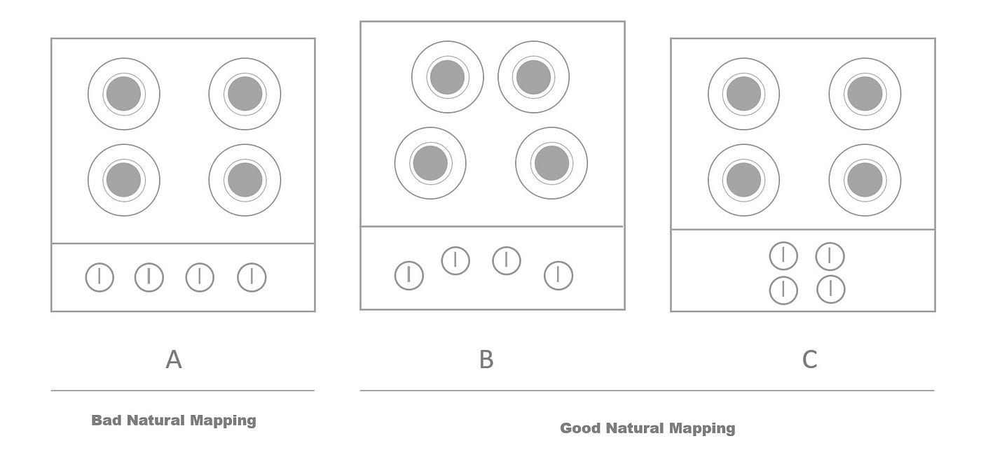
Natural Mapping
Align controls/displays with human expectations
Ex: Stove controls , Car steering wheel
Whats good mapping?
Natural mapping
Reduces cognitve load with errors

Slide 23
Natural Mapping Varies with Culture
Natural depends on POV
Cultural norms influence perceived naturalness.
Example: Direction of writing affecting button placement (left-to-right vs. right-to-left cultures).
Designers must consider cultural differences to ensure usability.

Slide 25
Discussion Questions
Are there situations where simplified or approximate solutions are insufficient?
Is there a "best" tool for reminders that provide both the signal and message?
Has there ever been a time where you had to use more world knowledge to look proficient in a situation? What head knowledge did you or could you have used?
Are there any examples of mapping that are different in culture from your own that you’ve seen in other countries?

