Slide 1
THE DESIGN OF EVERYDAY THINGS The Psychology of Everyday Actions (Chapter 2)
Author: Don Norman
Chris, Jojo, and Will

Slide 2
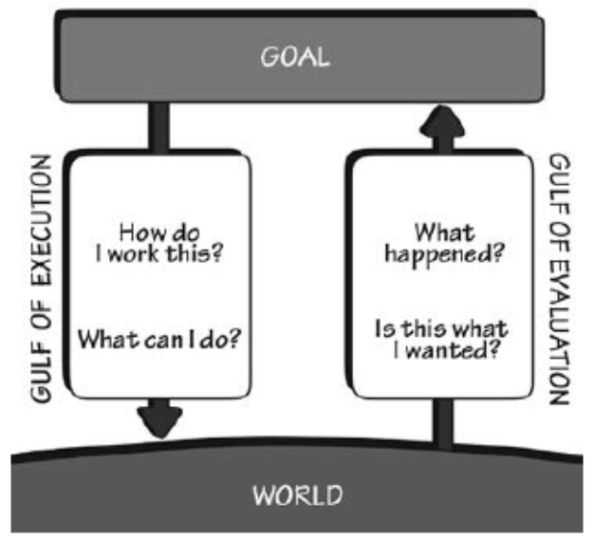
The Gulfs of Execution and Evaluation
The Gulf of Execution: Figuring out how something operates
The Gulf of Evaluation: Figuring out what happened
Amount of effort to interpret physical state of device and determine how well these expectations were met
Role of designer is to help bridge these gulfs

Slide 3
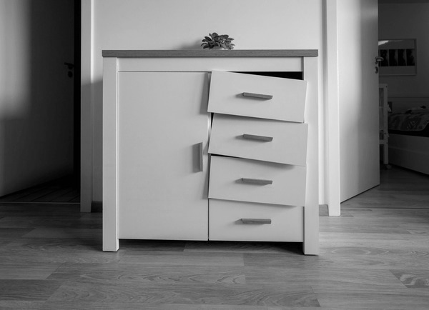
The Gulfs Exemplified
Gulf of Execution : The handle helps bridge the gulf when everything is working
Big gulf when there is a jam and this does not work
Gulf of Evaluation : Easily bridged with cabinet
Quickly able to determine a failure to reach the goal when the cabinet did not open

Slide 4
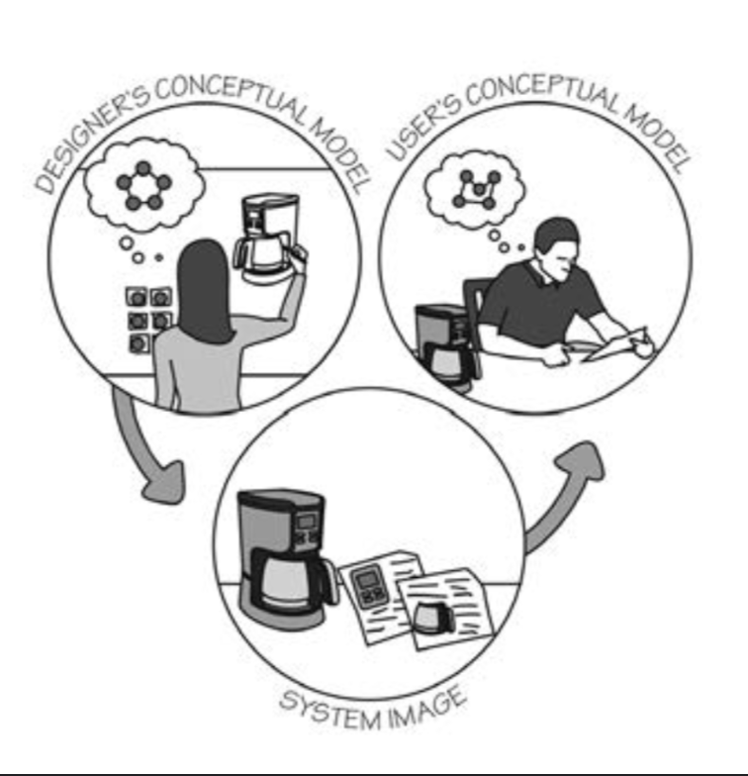
How do we bridge these Gulfs
Execution
Signifiers
Constraints
Mappings
Conceptual model
Evaluation
Feedback
A good conceptual model

Slide 5
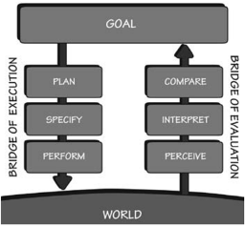
The Seven Stages of Action
Goal (form the goal)
Plan (the action)
Specify (an action sequence)
Perform (the action sequence)
Perceive (the state of the world)
Interpret (the perception)
Compare (the outcome with the goal)
Useful framework for understanding human activity
Not all activity in these stages are conscious

Slide 6
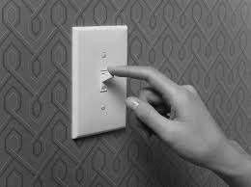
Root Cause analysis - Feedback loop for actions
Root Cause Analysis – Essentially asking what the real goal is by going through all the subgoals
One activity used to direct further ones (sub-goals)
Example:
Sub-goal : Turn on a light
Sub-goal : Get more life
Sub-goal : Make it easier to read
Sub-goal : Read to prepare a meal
Sub-goal : Cooking a meal to eat
Overall goal Satisfy hunger

Slide 7
Where does this action cycle start?
Can start from the top
Goal-driven behavior – starts with goal and goes through 3 stages of execution
Exp: Studying for exam
Can also start from the bottom
Event-driven behavior – starts with the world and goes through 3 stages of evaluation
Exp: Traffic Light System
Opportunist actions

Slide 8
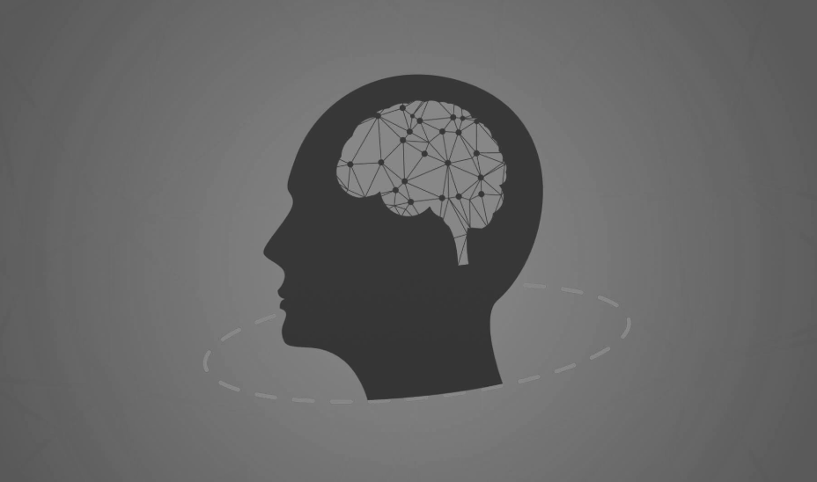
Human Thought: Mostly Subconscious
Human mind is complex and the subject of many disciplines
Philosophy, social sciences, neuroscience, information science, etc.
Most Human behavior is the result of subconscious behavior (unaware of process)
Flinching
Mirroring
Blinking

Slide 9
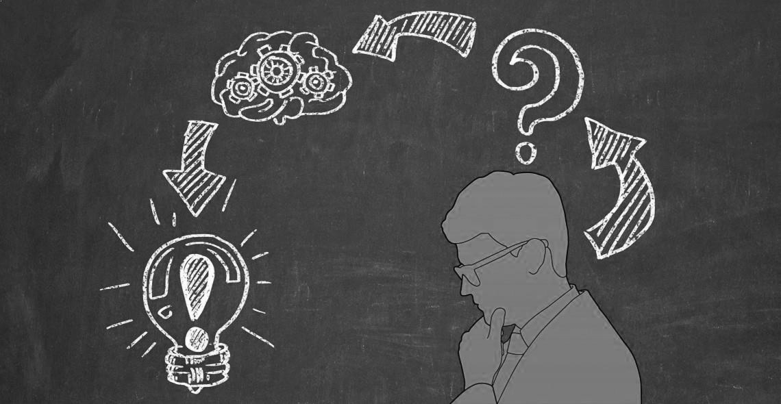
Human Thought: Conscious Thought
Necessary to learn most things
Slowly ponder decisions, think through alternatives, compare difference choices
Comparing, rationalizing, and finding explanation
Formal logic and mathematics are conscious thought
Example: Designing this presentation

Slide 10
Conscious Thought vs Subconscious Thought
Do not always talk to each other, we use logic and reason after the fact to justify our decisions to other and ourselves
Both powerful and essential to human life
Both subject to errors and failures

Slide 11
Human Cognition and Emotion: The Three Levels of Processing

Slide 12
Human Cognition and Emotion: Introduction
Emotion drives cognitive thought
Cognition provides understanding, emotion provides judgment
Positive Emotional State: ideal for relaxation and creative thought
Negative Emotional State: provides focus to maintain attention
Ex: Feeling unsafe in a dark alley can affect your decision making even without a real threat
Notes:
A lot of people believe that you can fully objective thinking without emotion, but that is not really how the brain works
Emotion is the fundamental basis of cognitive thought, with the cognition providing the understanding, while the emotion helps formulate the context and make judgements
The different emotional states a person can be in can drive different thoughts and lead to different parts of the brain being used
Positive = creative, relaxed
Negative = focused, methodological, alert
Example
Human cognition can be broken up into three different levels

Slide 13
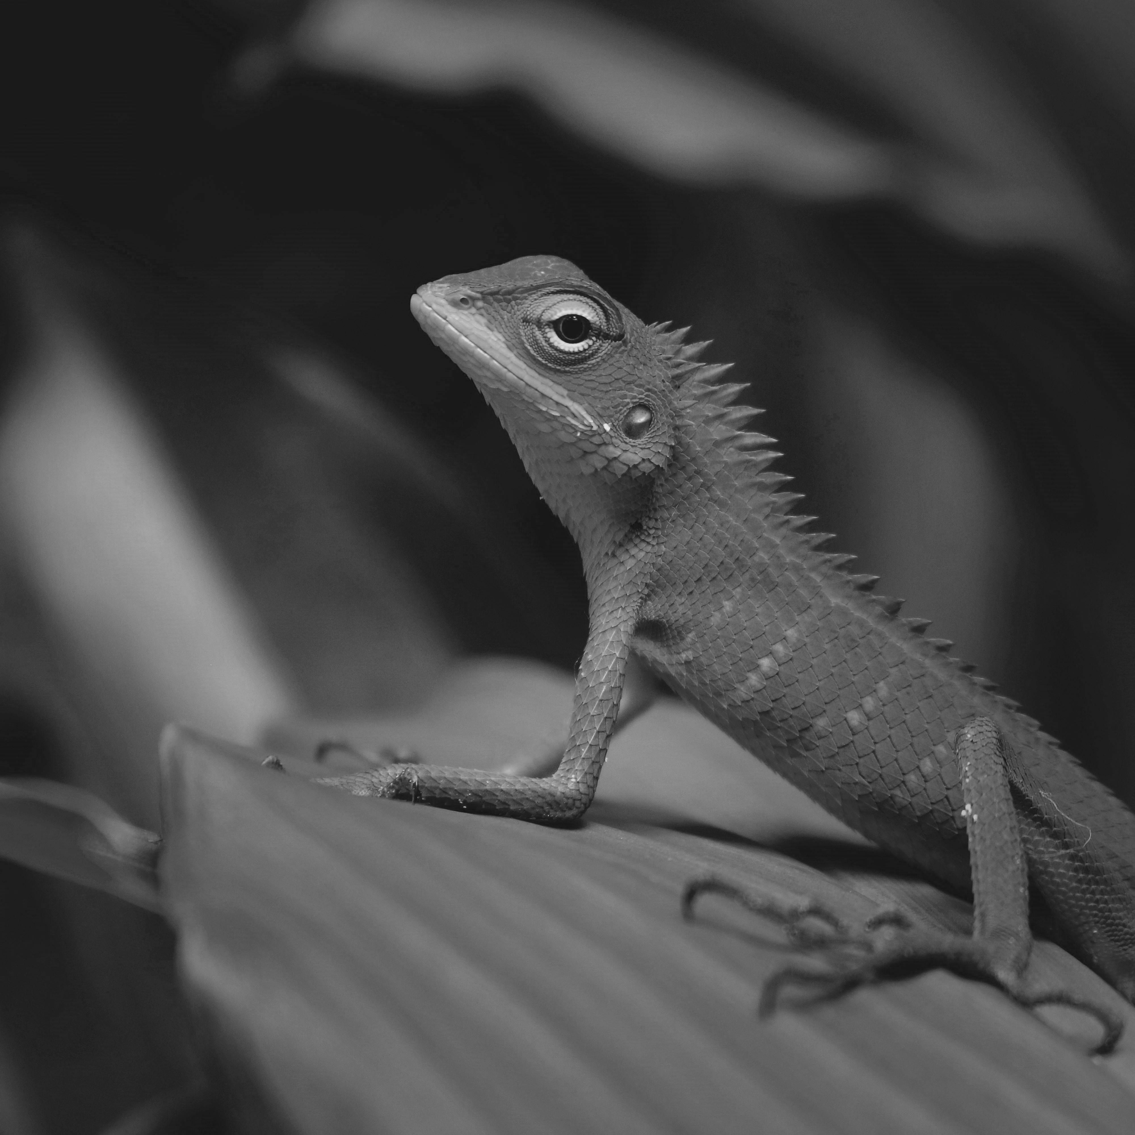
The Visceral Level (The Lizard Brain)
The most basic level of processing
Rapid, automatic, subconscious reflexes and responses
Innate
Biologically simple
Uniform across all humans
Great designers design with visceral responses in mind
Sameera Madusanka
Notes:
- The visceral level is the most primitive form of cognition present in most species
Encompasses baseline reflexes and responses that are innate and unlearned, happen automatically
Biologically simple and conserved, displaying little to no variation across humanity
Many designers often neglect this level of cognition, but great designers take advantage to make something stimulating, tactile, and satisfying to use
Preferences, sensory, hunger responses, pain responses, and fear responses – lizard example

Slide 14
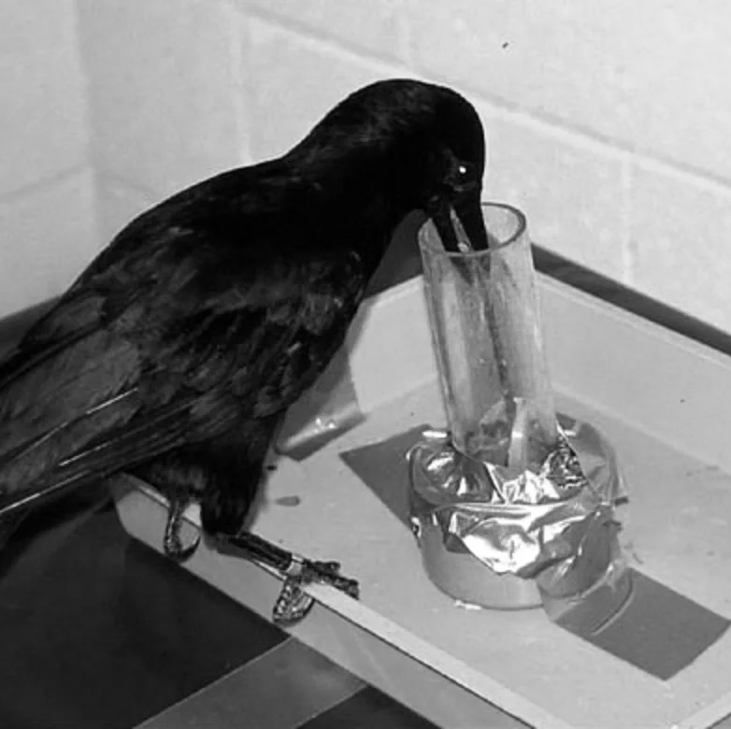
The Behavioral Level (Learned Skills)
Largely unconscious – driven by muscle memory and pattern recognition
Learned, goal-oriented behaviors – every action associated with expectation
Feedback proves/disproves expectations
Leads to variable emotional responses
Valences (+ or -)
https://www.nbcnews.com/id/wbna15503722
Notes:
The behavioral level largely resides in the subconscious
Involved heavily practiced skills that rely solely on pattern recognition and muscle memory
Consciously learned at some point, but at a certain level, it became engrained and can be retrieved without much conscious effort – crow using hook tool it made to retrieve food
BL deals with goal-oriented behaviors, following the expectation that an action will lead to an expected result
Expectation and reality align through feedback, which leads to different emotional reactions, or valences
Explain valences

Slide 15
The Reflective Level (Conscious Cognition)
Conscious, deep, and slow cognition
Home of reasoning and decision making
Causality and predictions determined at this level
Helps assign emotional context and causal analysis to experienced events
https://www.betterup.com/blog/self-reflection
Notes:
Reflective level is where we find conscious cognition
Most advanced form of cognition, often taking the most time and having the highest cognitive load
Logical reasoning and decision making fall under these categories
Helps us determine the causality of specific events, as well as make predictions about the future based on past information
Also helps us assign emotional context and reflect on the past meaningfully
Humans use all three levels of cognition constantly to fill in gaps in our knowledge and use the environment to inform us of how we should approach tasks

Slide 16
Good Design
Good design must take place at all three levels
Visceral and behavioral important in the moment
Reflective is most important – helps form good/bad memories
All three work together to form a person's opinion of a product or service
Allows emotion and cognition to happen simultaneously
Notes:
Thus, a designer must take all three levels into account during the design of a product or service, as each can have a profound effect on different parts of user experience
Visceral is the immediate tactile experience
Behavioral is the long-term ease of use and functionality
Reflective is the way the product is remembered – most important, as this is what leads to reviews and recommendation
All three form a person’s user experience, and therefore, their opinion of a product or service
This is a strong example of emotion and cognition happening simultaneously, with each having an impact on the perception of the product or service

Slide 17
Good Design (cont.)
A device with strong visceral feedback but poor behavioral feedback may lead to recommendations despite frustrations with usage.
A device with strong behavioral feedback but poor visceral feedback may lead to bad reception despite good functionality.
Examples:
A new computer that has issues when you first buy it, but overall it feels good to use and you think looks good on your desk
A printer that consistently breaks and is frustrating to use despite working as intended

Slide 18
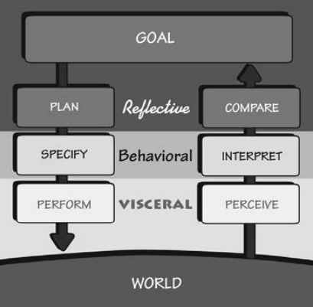
Levels and Stages in Tandem Flow State!
Notes:
With the different cognition levels and stages of action in tandem, you get this chart, which outlines one key factor of user experience every design should try to hit
Too easy, and the user is bored
Too challenging/confusing, and the user is frustrated
Hitting the sweetspot in the middle is called Flow State – the ideal design
Flow state is the Goldilocks Zone where there is the perfect balance of challenge and stimulation provided by a product or service

Slide 19
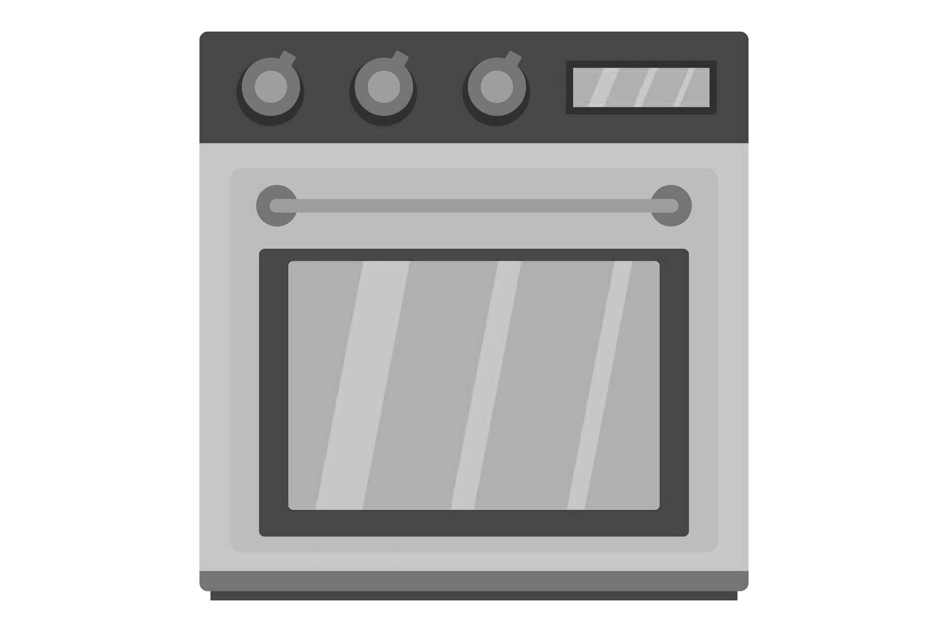
People as Storytellers
People are innately disposed to look for causes of events and to form explanations and stories (people often implicate the wrong causes)
Conceptual models are a form of story where we predict the outcome of our actions based on these models
Faulty models lead to everyday frustrations
Example: Oven Temperature

Slide 20
Blaming The Wrong Things
People use their own conceptual model of the world to determine the perceived causal relationship between the thing being blamed and the result
There is a faulty conceptual model if this relationship does not exist
Example: Blaming cold weather for getting sick rather than the virus

Slide 21
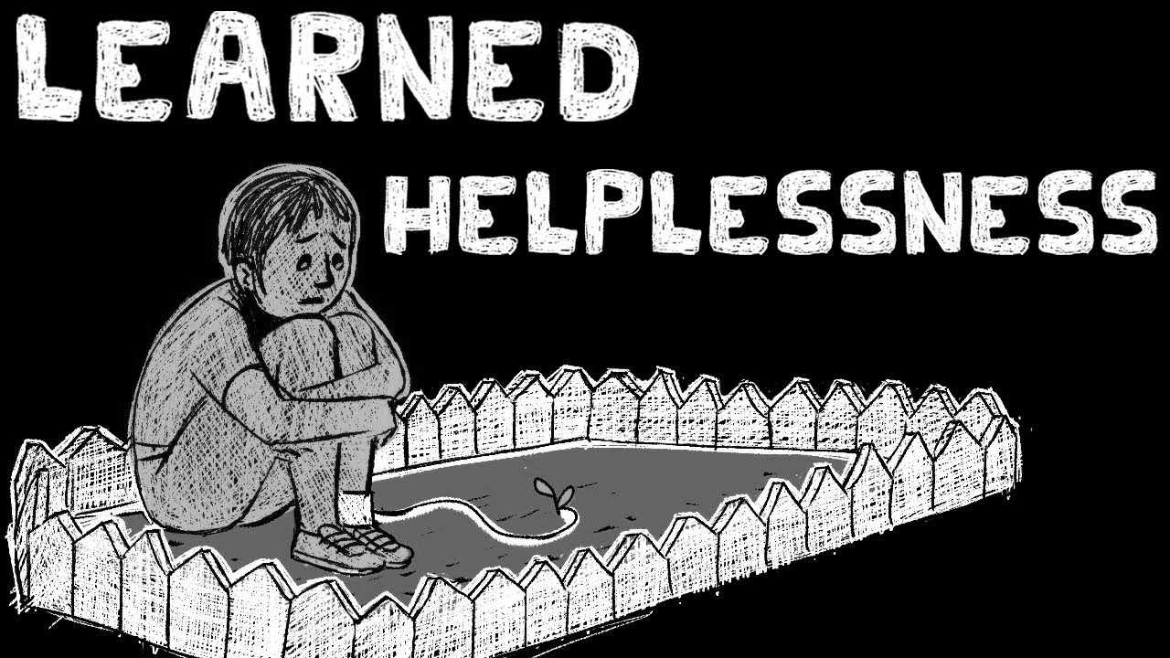
Learned Helplessness
When people experience repeated failure, they believe the task cannot be done by them, so they stop trying
In extreme cases this can lead to depression
When having issues with poorly designed technology people often blame themselves
Self-fulfilling – When you fail something and blame yourself, you believe you cannot do it the next time

Slide 22
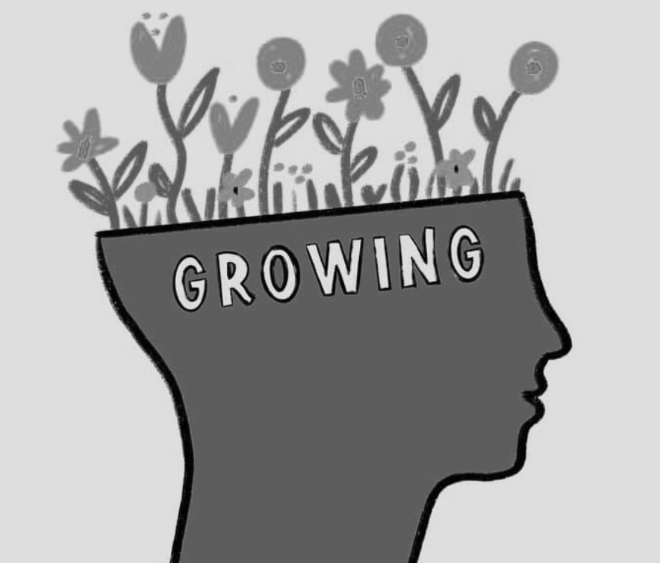
Positive Psychology
Positive Philosophy of design:
Do not blame people when they fail to use your products properly.
Take people’s difficulties as signifiers of where the product can be improved.
Provide help and guidance (instead of error messages)
Make it possible to correct problems directly from help and guidance messages.
Think positively, for yourself and for the people you interact with.
Notes:
To fail is to learn, we learn more from failures than success
Designers need to fail to explore new and creative solutions

Slide 23
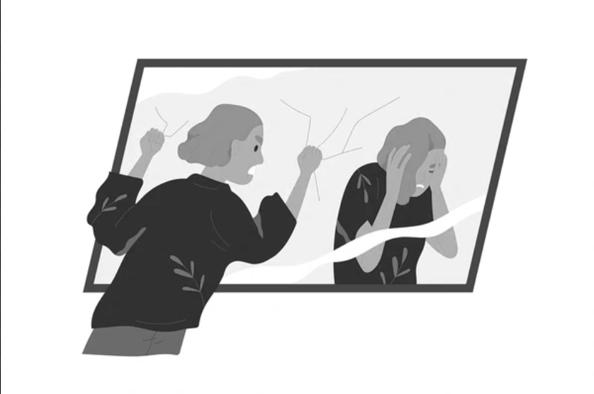
Falsely Blaming Yourself
People feel guilty and either try to hide the error or blame themselves
The idea that a person is at fault when something goes wrong is deeply entrenched in society.
Blame is considered "human error" rather than the error of designs that force humans to perform abnormally to human behavior
We are not mechanical and precise like machines – design should account for this

Slide 24
How Technology Can Accommodate Human Behavior
Machines should judge human input before acting to prevent errors
Responsive and understandable feedback so users can understand what happened, the state of the system, and how to fix the machine.
Designers should not force arbitrary and rigid inputs that go against human nature
Example: Microsoft Calendar Program (many date formats)

Slide 25
Seven Fundamental Design Principles
Discoverability – what actions are possible?
Feedback – cause and effect?
Conceptual Model – is the design easy to understand?
Affordances – what does an object/service allow?
Signifiers – is the feedback well communicated?
Mappings – is the relationship between design elements clear?
Constraints – is it clear what the design can and cannot do?

Slide 26
Discussion Questions
If I am designing new statistical computer software, how could I use the design principles to balance ease of use and robustness?
What are some ways in which humanity could benefit from eliminating the usage of the term "human error"?
What do you think happened first, emotion or cognition?
What are some experiences you have had where the design of a product forced arbitrary and rigid inputs?

Slide 27
Questions Designers Should Ask
What do I want to accomplish?
What are the alternative action sequences?
What action can I do now?
How do I do it?
What happened?
What does it mean?
Is this okay? Have I accomplished my goal?

