Slide 1
Testing
White Box and Black Box Testing

Slide 2
Objectives
Emphasize importance of testing
Note time and effort devoted to maintenance
What techniques do you currently use to test your code?

Slide 3
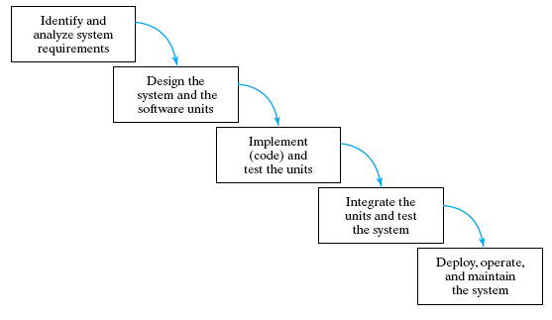
5 Phases of Software Life Cycle
Waterfall Model – is this realistic?

Slide 4
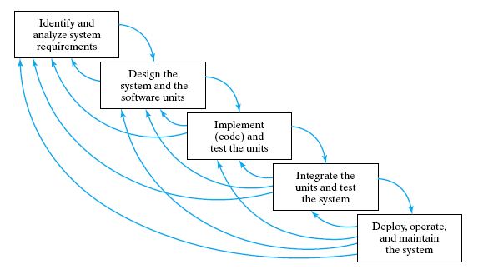
5 Phases of Software Life Cycle
Realistic Waterfall Model – why software development is so costly!

Slide 5
Coding
Verify integration
  combining program units into a complete software system.
Insure quality
  programs must be correct, readable, and understandable
  well-structured, documented, formatted for readability

Slide 6
Validation vs Verification
Validation:
"Are we building the right product?"
  check that documents, program modules, etc. match the customer's requirements.
Verification:
"Are we building the product right?"
  check that products are correct,
  complete,
  consistent with each other and with those of the preceding phases.
6

Slide 7
Different kinds of tests
Unit tests:
  Each individual program unit works?
  Program components tested in isolation
Integration tests :
  Units combined correctly?
  Component interface and information flow tested
System tests:
  Overall system works correctly?
7

Slide 8
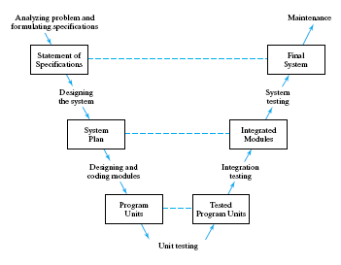
The "V" Life Cycle Model

Slide 9
Types of Errors
Syntax errors
  errors in the grammar of the programming language (easy to correct)
Run-time errors
  happen during program execution (hard to find)
Logic errors
  errors in algorithm design (hardest to track down)

Slide 10
Black Box or Functional Tests
Outputs produced for various inputs
  Checked for correctness
  Do not consider structure of program component itself.
Program unit is viewed as a black box
  Accepts inputs and produces outputs,
  Inner workings of the box are not visible.
/*-------------------------------------------------------
Pre: Elements of a are in ascending order; item has the same type as the array elements
Post: return position of item if found, -1 otherwise
-----------------------------------------------------------*/
int Search (ArrayType a, int first, int last, ElementType item)
How would you test this search unit as a black box?
10

Slide 11
White Box or Structural Test
Performance is tested
  examine code’s internal structure.
Test data is carefully selected
  So that specific parts of the program unit are exercised.
11

Slide 12
Search code for White Box Tests – a recursive Binary Search Algorithm. Let’s try to write the code!
/*------------------------------------------------------
Pre: Elements of a are in ascending order; item has the same type as the array elements
Post: if search is successful return position of item; otherwise return -1
-----------------------------------------------------------*/
int search (ArrayType a, int first, int last, ElementType item)
{ if (first > last) return -1; // anchor 1 -- empty sublist
mid = (first + last) / 2;
if( item == a[mid] return mid; // anchor 2 – found item at mid
// inductive case
if (item < a[mid]) // the first half
return search( a, first, mid-1);
if (item > a[mid]) // the second half
return search (a, mid + 1, last);
}

Slide 13
Things to Test
Random cases
Boundary cases
Positive tests – things that should work
Negative tests – things that should not work
For previous “search” function give examples of each?

Slide 14
Maintenance
Large % of
  Company budgets
  Programmer's time
  Software development cost
Because …
  Includes modifications and enhancements
  Poor structure, poor documentation, poor style
    Bug finding and fixing is tougher
    Impedes implementation of enhancements
    “Poorly” designed testing strategies
14

