Slide 1
Scientific Computing
CS 100
Fall Semester, 2021

Slide 2
TOPIC: RECURSION
OUTLINE
Definition of recursion
Parts of a recursive algorithm
Why use recursion?
Writing Recursive Programs
Recursive square – nested boxes
Recursive count of items in a list
Factorial Function
Palindrome
Drawing recursive tree
Drawing a Sierpinski triangle

Slide 3
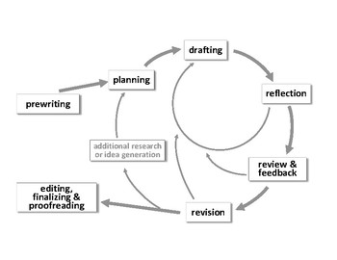
Definition of recursion
Recursion is the process of defining a problem (or the solution to a problem) in terms of (a simpler version of) itself.
Generally speaking, recursion is the concept of well-defined self-reference. It is the determination of a succession of elements by operating on one or more preceding elements according to a rule or a formula involving a finite number of steps.
Example of recursive process: -Writing
Humans indulges in recursive process during writing
The steps involve in the recursive process.

Slide 4
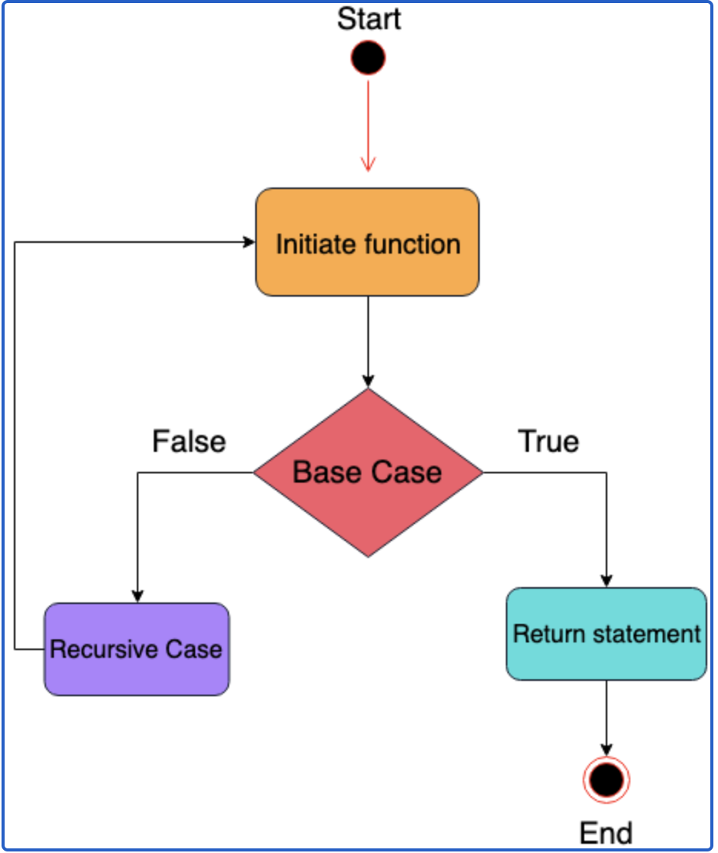
Parts of a recursive algorithm
All recursive algorithms must have the following:
Base Case (i.e., when to stop)
Work toward Base Cases
Recursive Call (i.e., call self)
Erroneous Recursive algorithm
A recursive algorithm that has no terminating condition(Base Case) is very dangerous and viewed to be ill-constructed or erroneous. And, such a situation leads to a program crash.
What is wrong the program code below?
Other problems with recursive algorithm.
def hell(): print(“Hello Word”) hello()
Stack Overflow
Memory Error
Fig 1.: Flow diagram of a recursive
algorithm.

Slide 5
Why Use Recursion?
Recursion is preferred when the problem can be broken down into smaller, repetitive tasks. These are the advantages of using recursion:
Complex tasks can be broken down into simpler problems.
Code using recursion is usually shorter and more elegant.
Sequence generation is cleaner with recursion than with iteration.

Slide 6
Writing Recursive Programs
At this stage and subsequently, we will illustrate how to write a recursive program that will solve the following tasks outlined below.
Drawing nested boxes
Count of items in a list
Factorial Function
Palindrome
Drawing recursive tree
Drawing a Sierpinski triangle

Slide 7
Drawing nested boxes
The objective of this task is to draw a series of squares using a recursive function. Figure 2 is a sample of what the output is ought to be.
Output
Hands-on Code
Additional Exercise
1
2
3
4
5
6
7
8
9
10
11
12
import turtle as aTurtle
def drawSquare(aTurtle, side):
for i in range(4):
aTurtle.forward(side)
aTurtle.right(90)
def nestedBox(aTurtle, side):
if side>=1:
drawSquare(aTurtle, side)
nestedBox(aTurtle, side-5)
nestedBox(aTurtle,150)
What statement is the base case?
Modify the hands-on code by reversing lines 8 and 10. Can you explain the different behavior?
Rewrite or modify the code to draw nested boxes, where each box is centered at the same point.
Fig. 2: Expected output

Slide 8
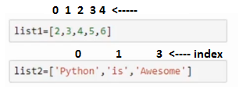
Count of items in a list
The objective of this task is to compute the number of elements in a list using a recursive call approach. Figure 3 is a diagram depicting the conceptual representation of a list.
Hands-on Code
Additional Exercise
def countList(aList):
if aList==[]: #base case, empty list
return 0
else:
return 1+ countList(aList[1:])
aList=[2,3,4,5,6]
print('No of items in the list is:', countList(aList))
Write a recursive function to compute the sum of all the numbers in a list
Write a recursive function to find the minimum number in a list
Write a recursive function to find the maximum number in a list.
Write a recursive function to reverse the characters in a string
Fig. 3: Items in a list
Output

Slide 9
Factorial Function
A factorial function is defined as:
Our task is to implement this function a recursive call approach.
$$fact\left(n\right)=\left\{\begin{aligned} n∗fact\left(n−1\right) n>0 \\ 1 otherwise \end{aligned}\right.$$
Hands-on Code
Output
1
2
# Factorial of a number using recursion
def recur_factorial(n):
if n == 1:
return n
else:
return n*recur_factorial(n-1)
num = int(input("Enter a number>"))
# check if the number is negative
if num < 0:
print("Sorry, factorial does not exist for negative numbers")
elif num == 0:
print("The factorial of 0 is 1")
else:
print("The factorial of", num, "is", recur_factorial(num))

Slide 10
Palindrome Function
A palindrome is a word or a phrase that is the same whether you read it backward or forward, for example, the word: refer, madam,
Hands-on Code
Output
1
2
import string
def is_palindrome(phrase):
# base case
if len(phrase) < 2:
return True
# divide into easier calculation
# and recursive operation
return phrase[0] == phrase[-1] and \
is_palindrome(phrase[1:len(phrase) - 1])
text="civic"
text_is_a_palindrome = is_palindrome(text)
if text_is_a_palindrome:
print ("'{}' is a palindrome.".format(text))
else:
print( "'{}' is not a palindrome.".format(text))

Slide 11
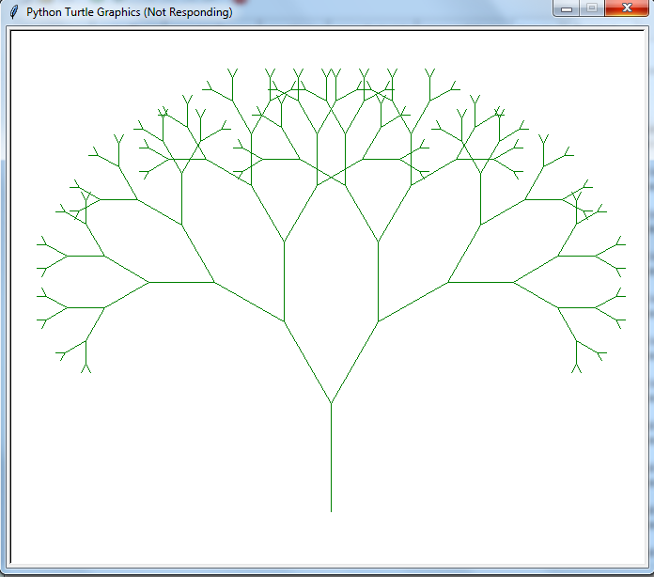
Drawing recursive tree
This tree is drawn using a simple recursive instructions as below:
Steps:
Draw a trunk of n units long
Turn to the right 30 deg., and draw another tree with a trunk n-15 units long
Turn to the left 60 deg., and draw another tree with a trunk n-15 units long
Below is the program code that implements our recursive instructions(steps 1-3)
Hands-on Code
import turtle
t = turtle.Turtle()
def tree(t, trunkLength):
if trunkLength < 5: # check for base case
return
else:
t.forward(trunkLength)
t.right(30)
tree(t, trunkLength-15)
t.left(60)
tree(t, trunkLength-15)
t.right(30)
t.backward(trunkLength)
t.up()
t.goto(0, -225)
t.down()
t.color("green", "green")
t.left(90) # face up
tree(t, 115)
t.hideturtle()
Additional Exercise
Output
Rewrite the tree function using the conditional truckLength >= 5 to check for the base case
Swap the rules for the trees so that it draws the left side of the tree before the right side
Randomize the turning angle to be between 15 and 45 degree. See hint on randomization at https://pynative.com/python-random-randrange/
Instead of always subtracting by 15, try subtracting a random amount between 5 and 25
Make the large branches brown and the small branches green(Hint: choose a threshold value for the length of the trunk and set the color accordingly.

Slide 12
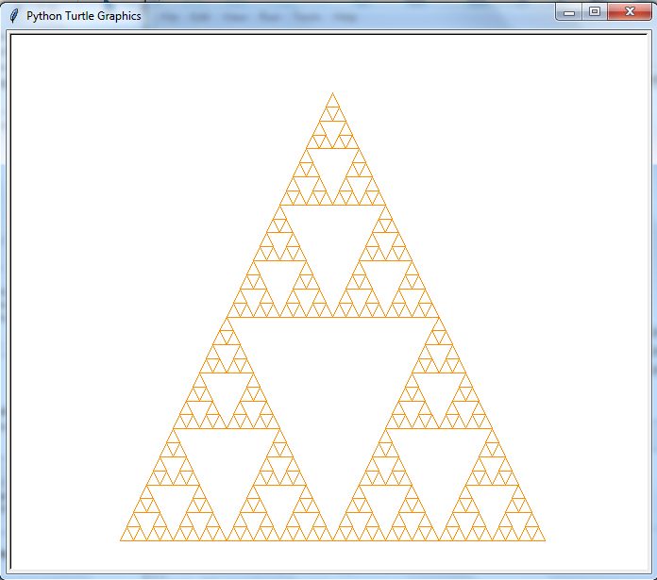
Drawing a Sierpinski triangle
The Sierpinski triangle is a self-similar fractal. It consists of an equilateral triangle, with smaller equilateral triangles recursively drawn on its remaining area. See figure 3 as example of Sierpinski triangle.
Our task is to implement a recursive Sierpinski function that we accept 3 points as parameter to draw a triangle and subdivide the triangle using the following rules:
Output
For each of the corners of the larger triangle, create a small triangle using the corner and the point halfway between the given corner and the other two corners.
Specify the variable "depth" to indicate the number of times the original triangle will be sub-divided. The depth is reduced by one(1) whenever a triangle undergoes recursive division.
We calculate the mid-point of a line using the equations:
${m }_{x }= \frac{X_{1 }+ X_{2}}{2}$and ${m }_{y }= \frac{Y_{1 }+ Y_{2}}{2}$
Hands-on Code
1
import turtle
def drawTriangle(t, p1, p2, p3):
t.up()
t.goto(p1)
t.down()
t.goto(p2)
t.goto(p3)
t.goto(p1)
def midPoint(p1, p2):
return ((p1[0] +p2[0])/2.0, (p1[1]+p2[1])/2.0)
def sierpinski(t, p1, p2, p3, depth):
if depth>0:
sierpinski(t, p1, midPoint(p1, p2), midPoint(p1, p3), depth-1)
Fig. 3: A Sierpinski triangle
2
sierpinski(t, p2, midPoint(p2, p3), midPoint(p2, p1), depth-1)
sierpinski(t, p3, midPoint(p3, p1), midPoint(p3, p2), depth-1)
else: # base case
drawTriangle(t, p1, p2, p3)
t=turtle.Turtle()
t.color('darkorange')
sierpinski(t, [-225, -250], [225, -250], [0, 225] , 5)
t.hideturtle()

Slide 13
References
Python Programming in Context, 3rd edition, B. Miller, D. Ranum, & J. Anderson
Recursion: https://www.cs.utah.edu/~germain/PPS/Topics/recursion.html
Understanding Recursion With Examples: https://betterprogramming.pub/understanding-recursion-with-examples-f74606fd6be0

Slide 14
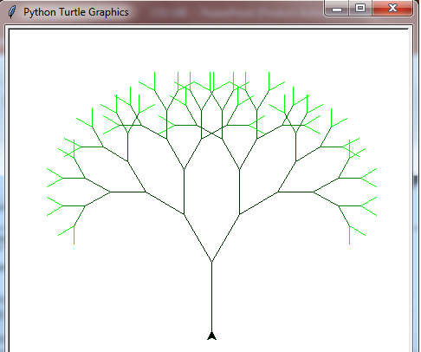
Extra Example on Drawing Fractal Tree
Code
Output
1
2
from turtle import *
speed('fastest')
# turning the turtle to face upwards
rt(-90)
# the acute angle between
# the base and branch of the Y
angle = 30
# function to plot a Y
def y(sz, level):
if level > 0:
colormode(255)
# splitting the rgb range for green
# into equal intervals for each level
# setting the colour according
# to the current level
pencolor(0, 255//level, 0)
# drawing the base
fd(sz)
rt(angle)
# recursive call for
# the right subtree
y(0.8 * sz, level-1)
pencolor(0, 255//level, 0)
lt( 2 * angle )
# recursive call for
# the left subtree
y(0.8 * sz, level-1)
pencolor(0, 255//level, 0)
rt(angle)
fd(-sz)
# tree of size 80 and level 7
y(80, 7)
Output from the execution the code
The code used the turtle library to implement the drawing of the tree and for more information about its usage, visit the link below:
https://docs.python.org/3/library/turtle.html

