Slide 1
Navigation Bloopers: Know where are you going and what you are getting GUI Blooper Chapter 3 Minh Nguyen Sep 5th, 2022

Slide 2
What is navigation bloopers?
Flaws that hinder, divert, and block software users from finding the content they seek.
There are two types of navigation bloopers:
+ Not having accurate cues, hindering users’ ability to see where they are and whether they are on track to their goal.
+ Fail to lead users to the goal or even lead them away from it.
In addition, we will examine how search function, if not used strategically, could confuse users when they navigate toward their goals.

Slide 3
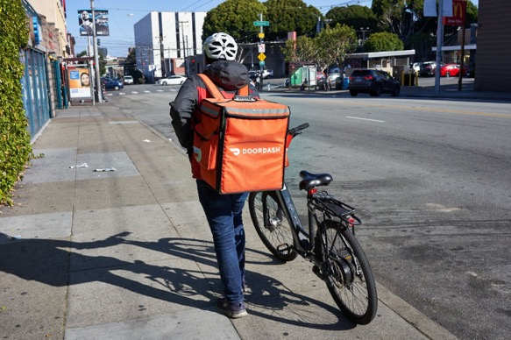
Where are you?
Imagine a scenario where you want to describe your current location to a Dasher. They are not familiar with the building names. How can you lead them to where you are and get your foods?

Slide 4
Direction 101
Can you Google it?
I am at Holden which next to Lowry Student Center
I can meet you at Lowry Student Center aka the Campus Center

Slide 5
We use signs to describe where we are In the context of software, signs could be window title, title of a web,…etc.

Slide 6
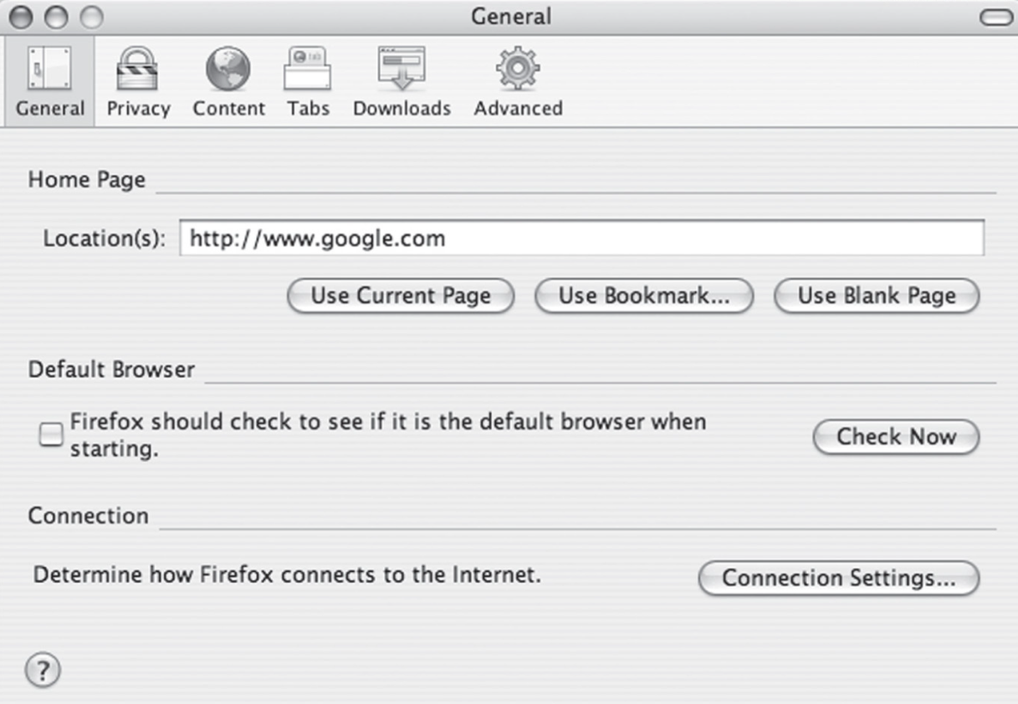
Some applications or Web sites fail to provide any sign of where the user is.
+ Window or page not identified
+ Same title on different window
+ Window title does not match command or
link

Slide 7
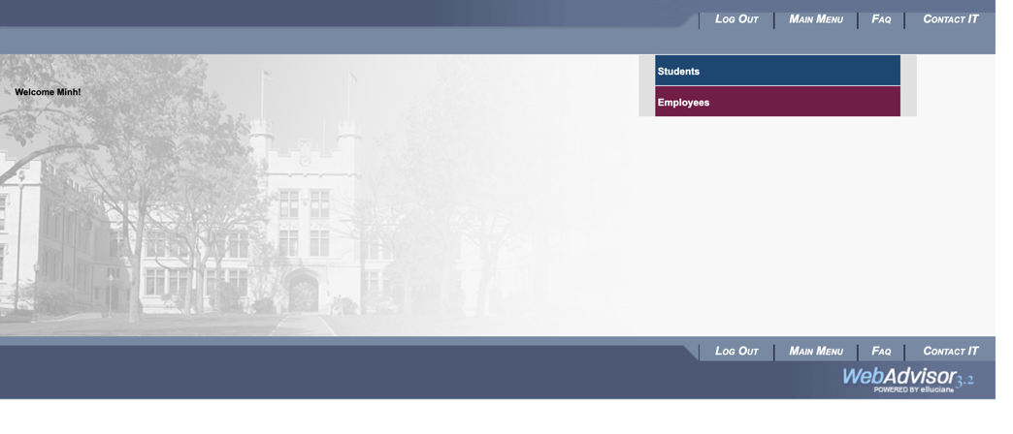
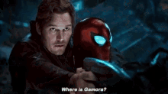
Web software can indicate the current page in two ways. Well-designed sites use one or both of these on every page.
■ Navigation bar: marking the current page’s item in the site’s navigation bar
■ Page title: placing a page title prominently, near the top of the page content

Slide 8
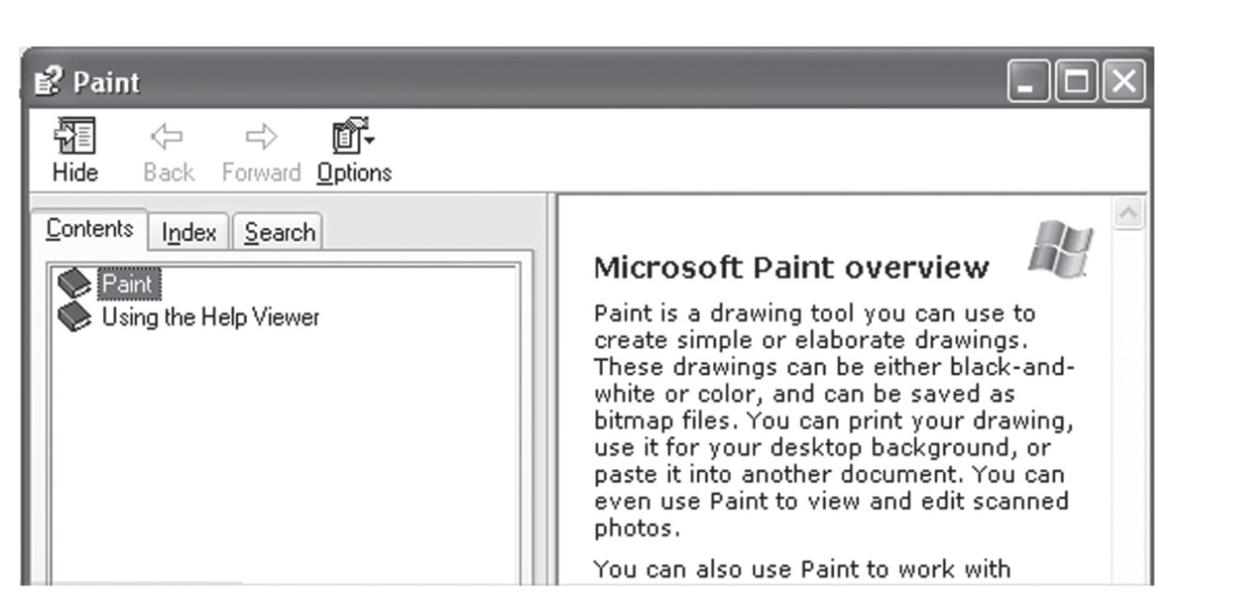
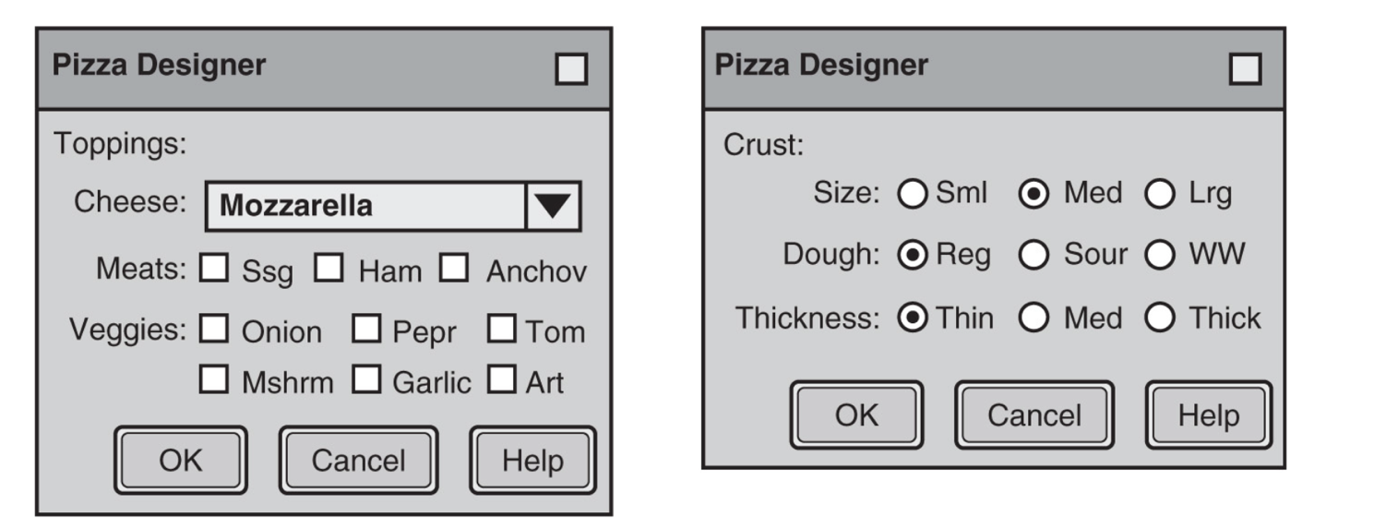
Same Same But Different
Same title on different windows
Sometimes different windows or Web pages have the exact same title. This can mislead users about where they are

Slide 9
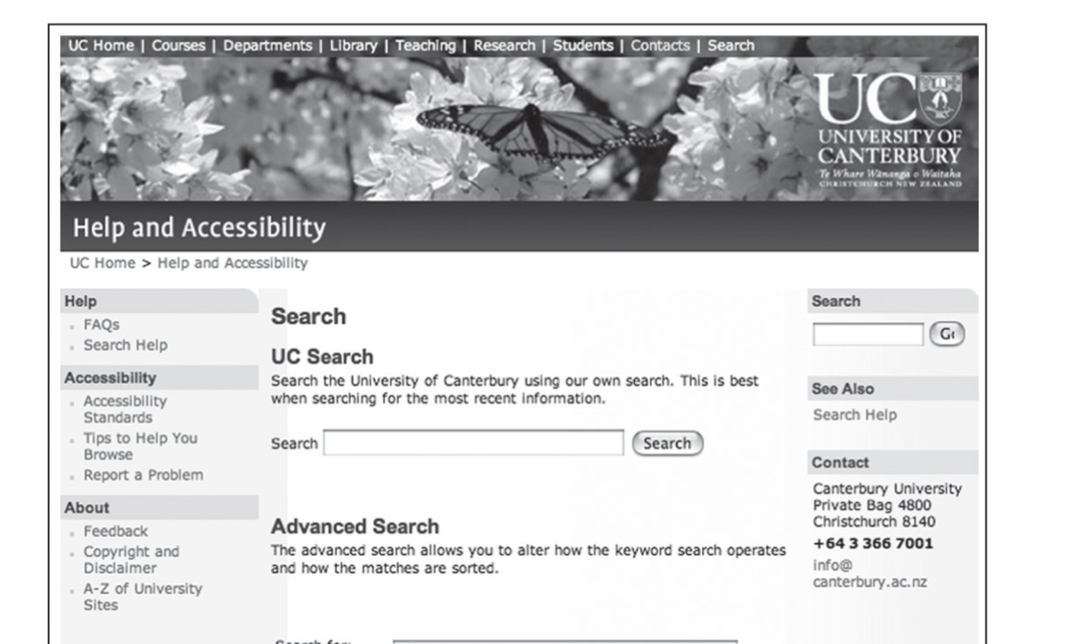
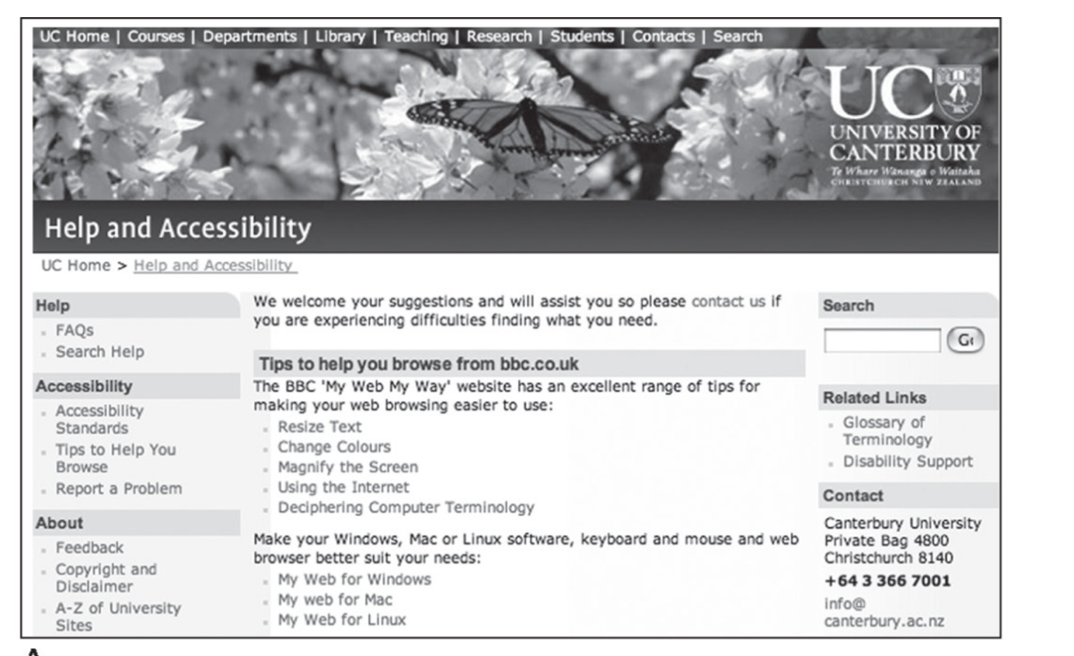
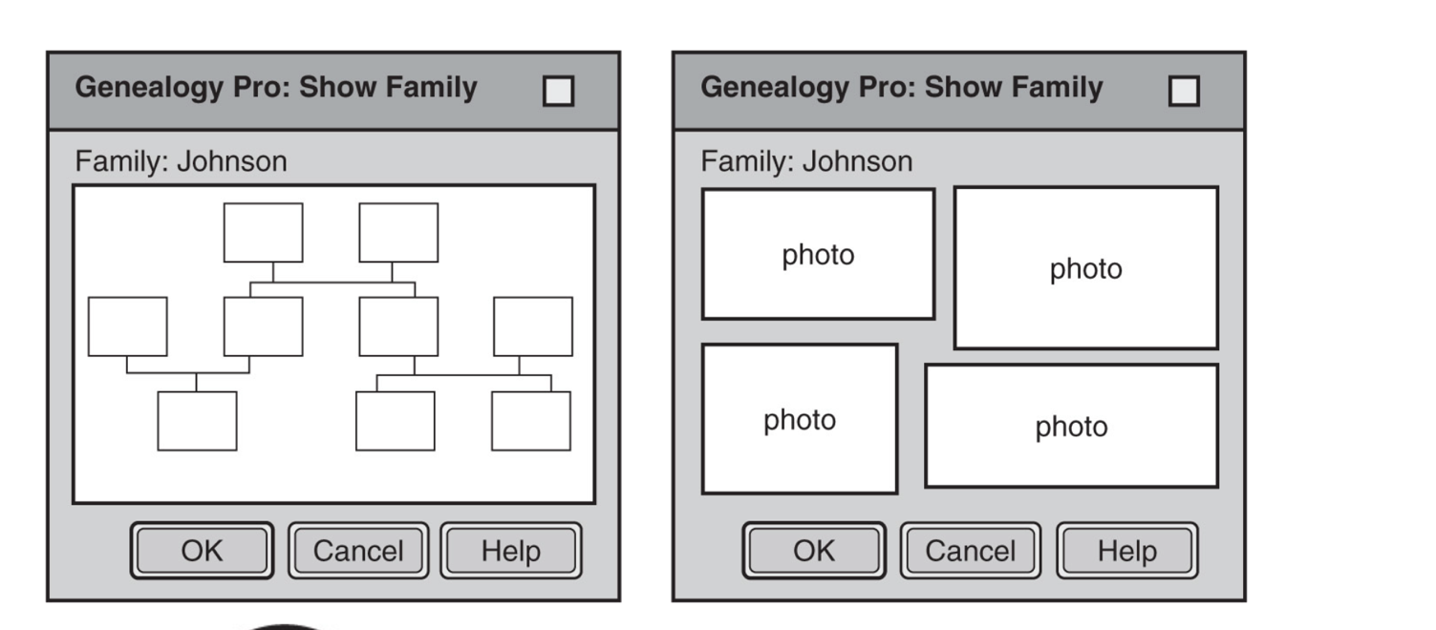

Slide 10
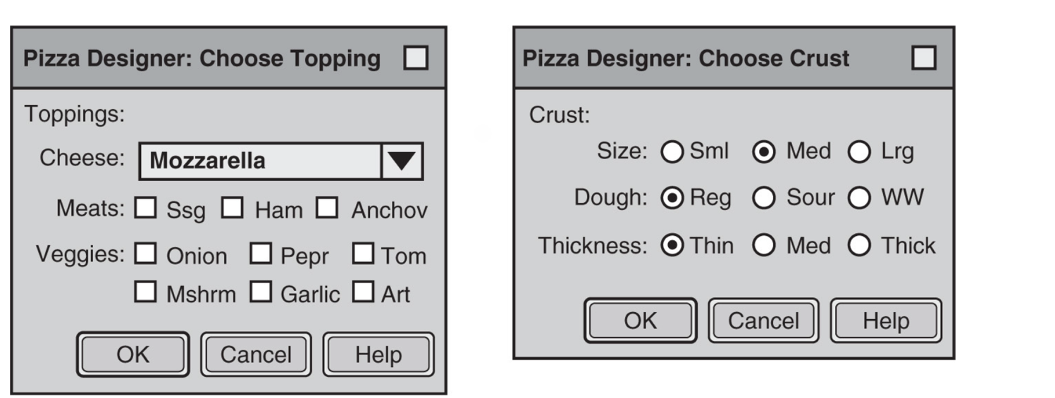
Every window or Web page should have a unique title
Special Cases:
+ Multiple windows represent same function applied to different data
+ Multiple windows represent same function or data with different user options.

Slide 11
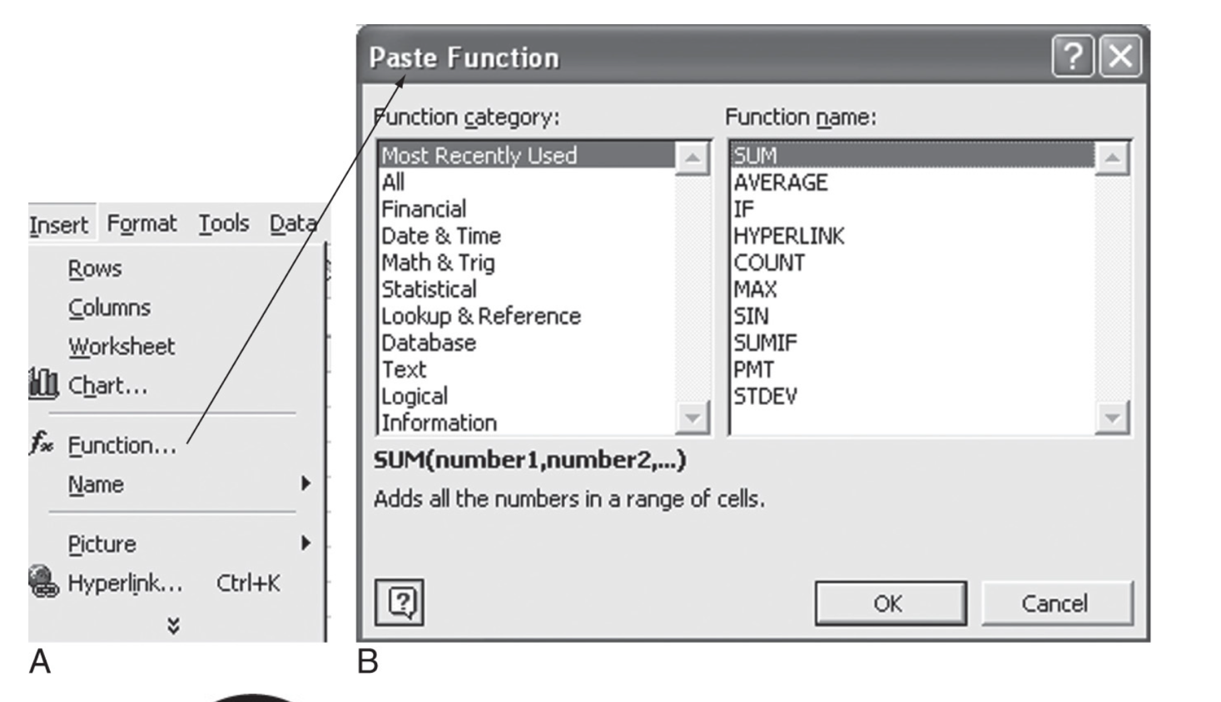
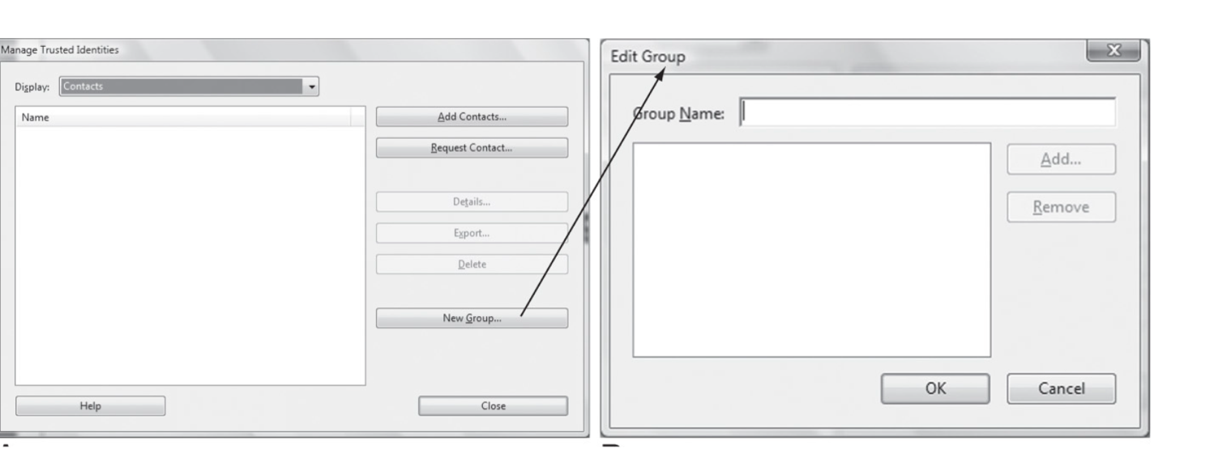
You think you are there? Check again.
Window title doesn’t match command or link

Slide 12
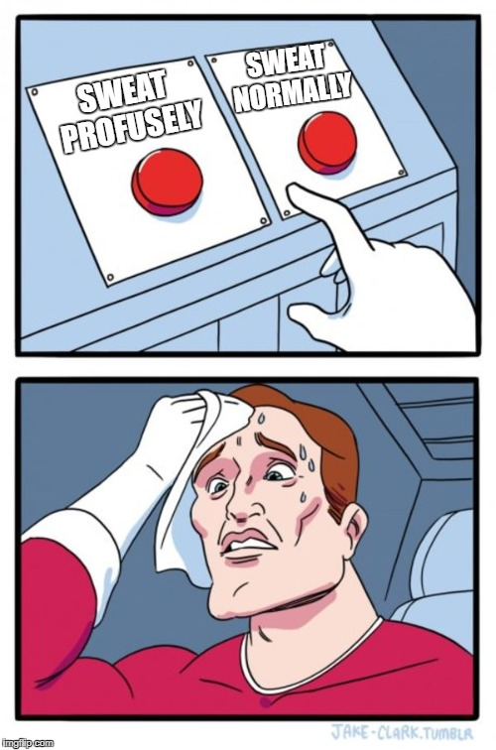
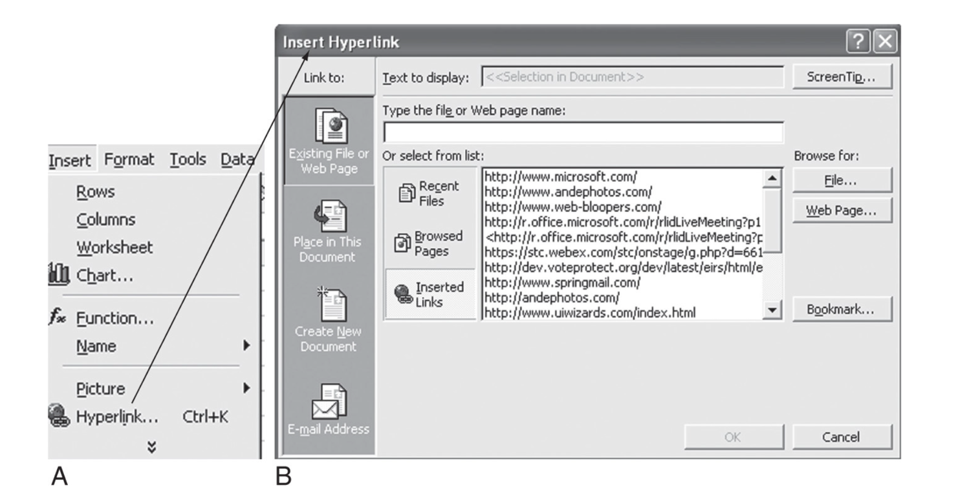
The title of a window or Web page should reflect the command that displayed it. This shows users that they hit the button or menu item they meant to hit.
Inexact matches are OK if they work for users

Slide 13
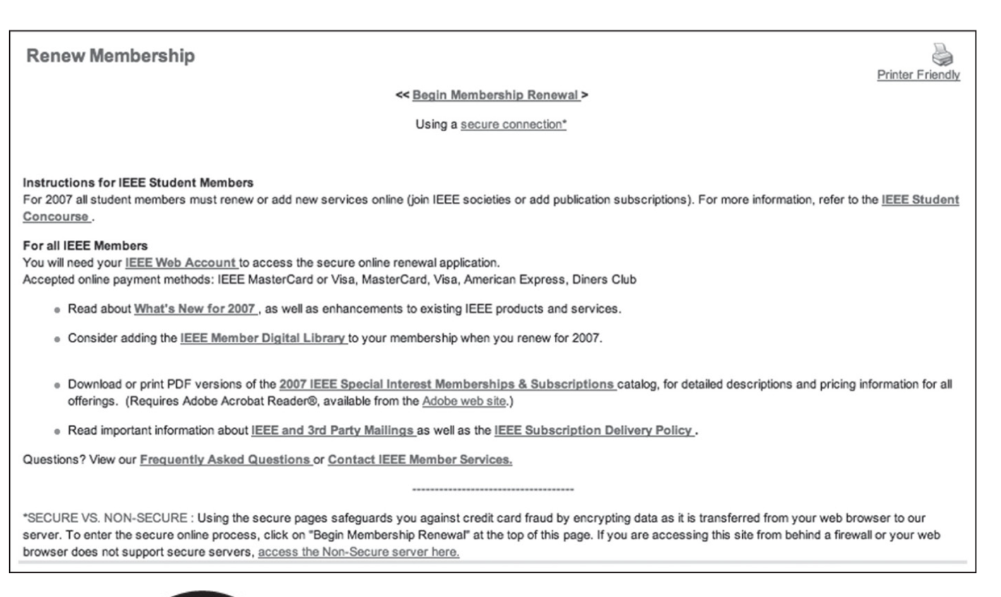
Lure them off the track
A software application or Web site is designed to support certain user goals. The software’s user interface should guide users toward those goals.
Unfortunately, many applications and Web sites throw up distractions that divert users from accomplishing their goals.
Links that explain details, terms, and conditions should appear in separate windows so they don’t cause users to lose where they are

Slide 14
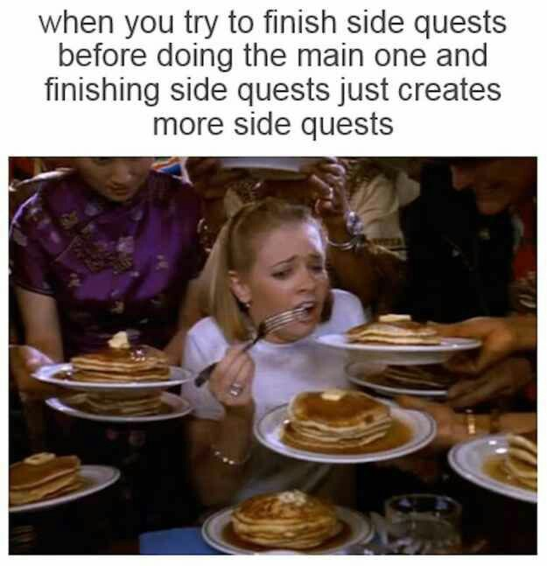
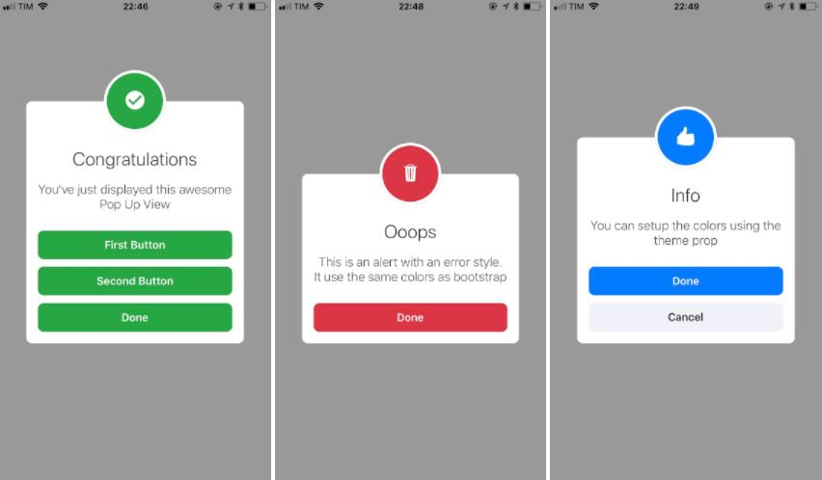
Too many levels of dialog boxes
Developers often are so focused on designing windows or Web pages that they don’t step back to look at the larger picture. How many windows or pages are there, and how easy is it for users to find their way around?
The general rule is: Avoid more than two levels of dialog boxes. A dialog box can bring up another one, but beyond that, users may lose their way.

Slide 15
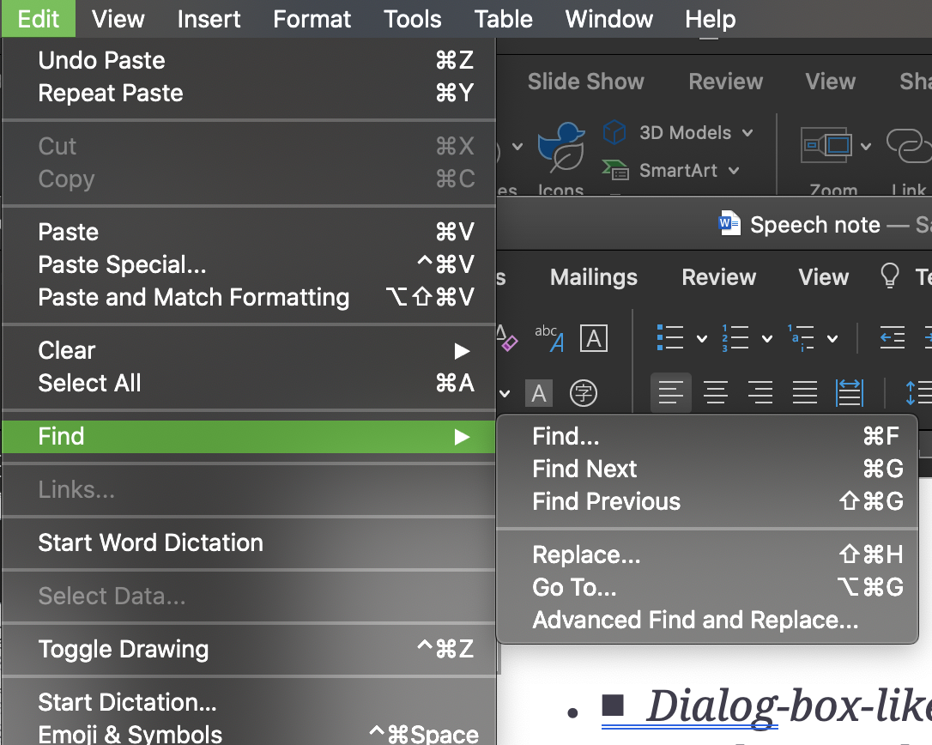
The Art To Cut The Excessive Level
+ Some GUIs use additional windows to provide progressive disclosure—hide details until users ask to see them. In that case, you can use a “Details” panel instead of a separate window.
+ Some dialog boxes provide options on commands.

Slide 16
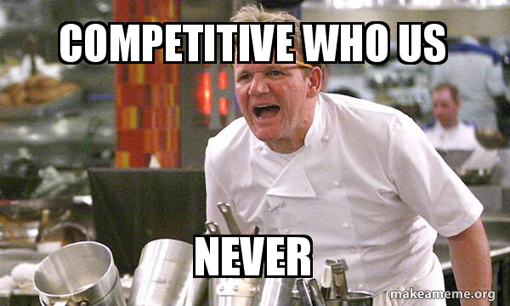
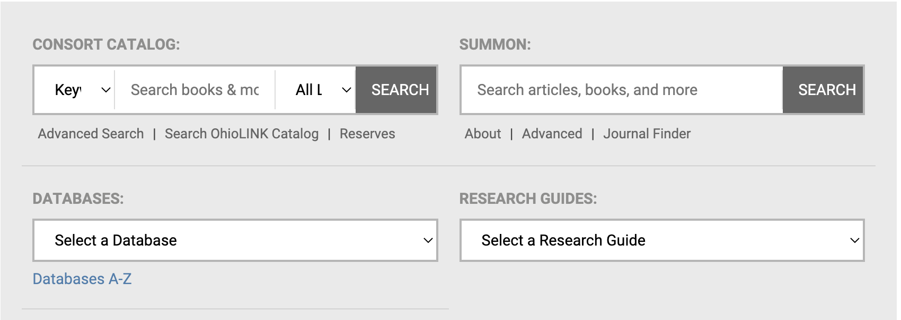
Competing search boxes
+ Wrong search bar
+ Two identical search boxes
+ Provide too many options
For Search functions, as for user interfaces in general, less is more. In fact, for search boxes on a page, the best number is 1. More than one causes confusion, delay, and error.

Slide 17
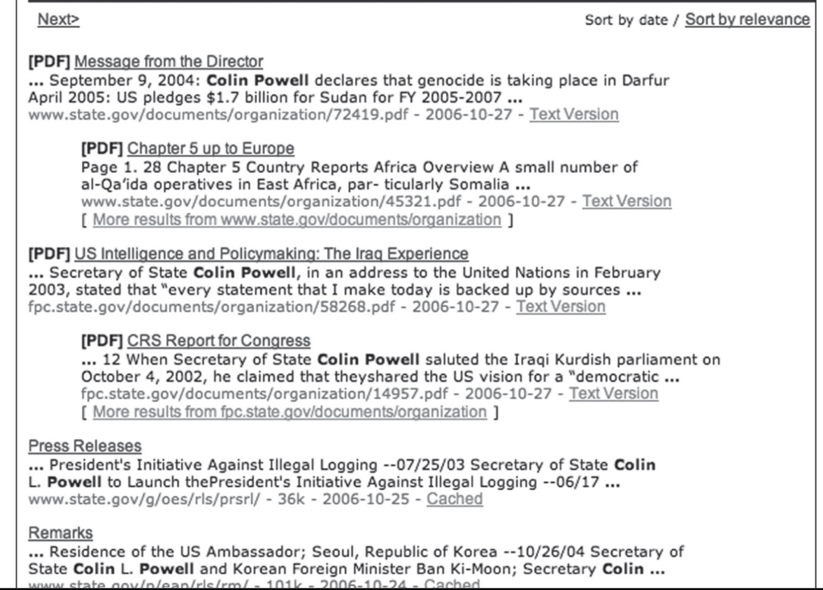
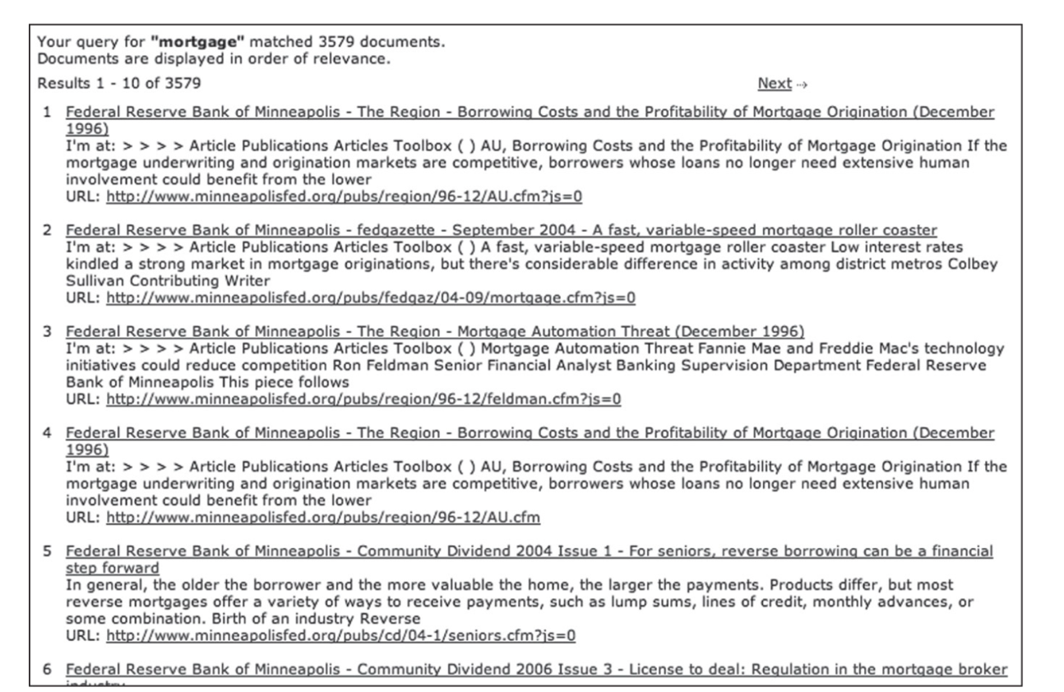
Noisy Search Result
Even if search results allow users to navigate through pages of hits, there is still the issue of how easy it is to spot the truly relevant hits amid all the others
+ Show and stress important data
+ Minimize the need to click.

Slide 18
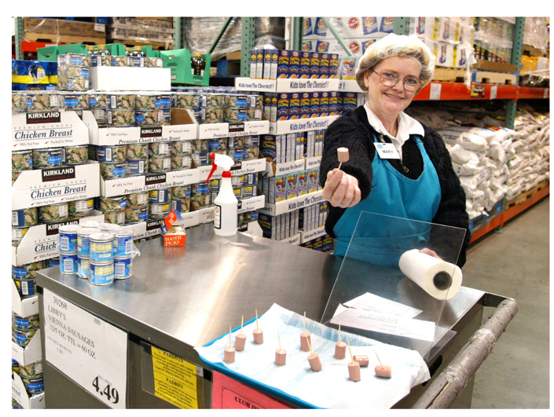
Take-Away(s)
+Design with a outside-in not inside-out mindset
+Adopt progressive closure philosophy
+Less is more
+The best way is the simple way

Slide 19
Thank you!

